Slide 1
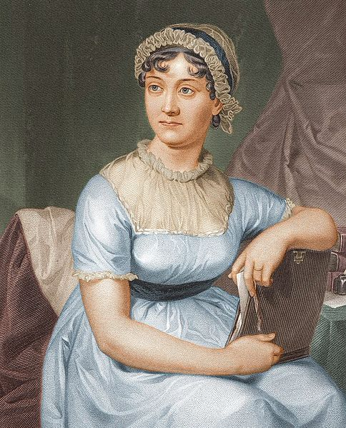
Jane Austen (1775-1817)
Creator of ‘woman novel’ in English literature
The creativity of the author as the standard of high art, which is opposed to mass violence literature
A novel Pride and Prejudice

Slide 2
Biography
Jane Austen was born December 16, 1775 at Hampshire, England. She was brought up in an intelligent but restricted environment.
In 1783 Jane and her older sister attended Abbey Boarding School. While at school they both caught a fever and Jane nearly died.
Even as a child Jane Austen loved writing and she wrote a lot of short stories called the Juvenillia. About 1795 she wrote a novel she called Elinor and Marianne. In the years 1796-97 Jane Austen wrote another novel she called First Impressions. It was later published as Pride and Prejudice. Then in 1798-99 Jane wrote a novel named Susan. It was published posthumously as Northanger Abbey in 1817.
In 1801 Jane Austen moved with her sister and parents to Bath. Jane Austen was a tall, slim woman. In 1802 she received a proposal of marriage from a man named Harris Bigg-Wither. At first Jane accepted but she quickly changed her mind. Jane Austen never married. Her father George Austen died in 1805.
In 1807 Jane Austen moved to Southampton.
Then in 1811 Sense and Sensibility was published. Pride and Prejudice was published in 1813. Mansfield Park was published in 1814. Another book called Emma followed in 1816. Meanwhile Jane Austen wrote Persuasion but she died before it could be published. It was published posthumously in 1817.
Jane Austen died on 18 July 1817. Jane was only 41 years old. She was buried in Winchester Cathedral.

Slide 3
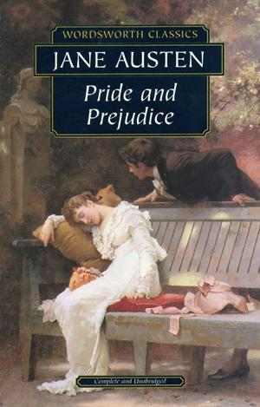
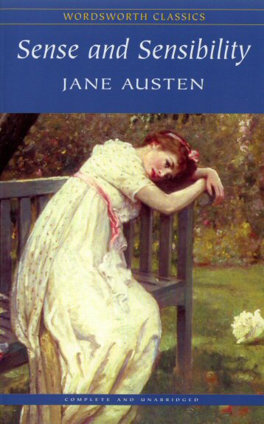
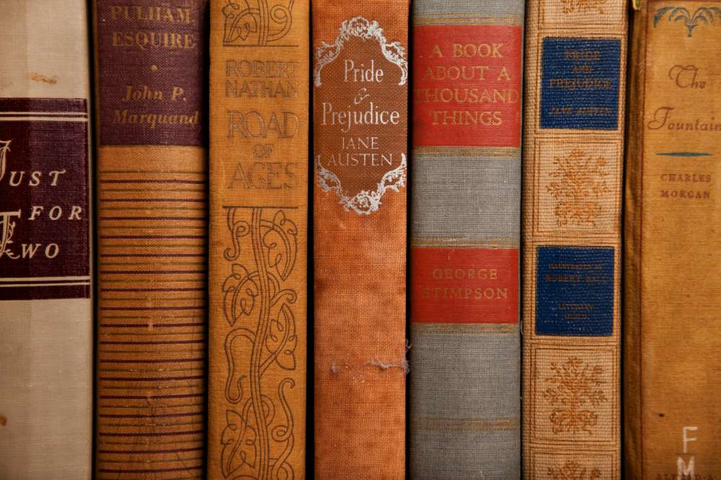
Austen’s Literary Works
Sense and Sensibility (1811)
Pride and Prejudice (1813)
Northanger Abbey (1818)
Mansfield Park (1813)
Emma (1815)
Persuasion (1818)

Slide 4
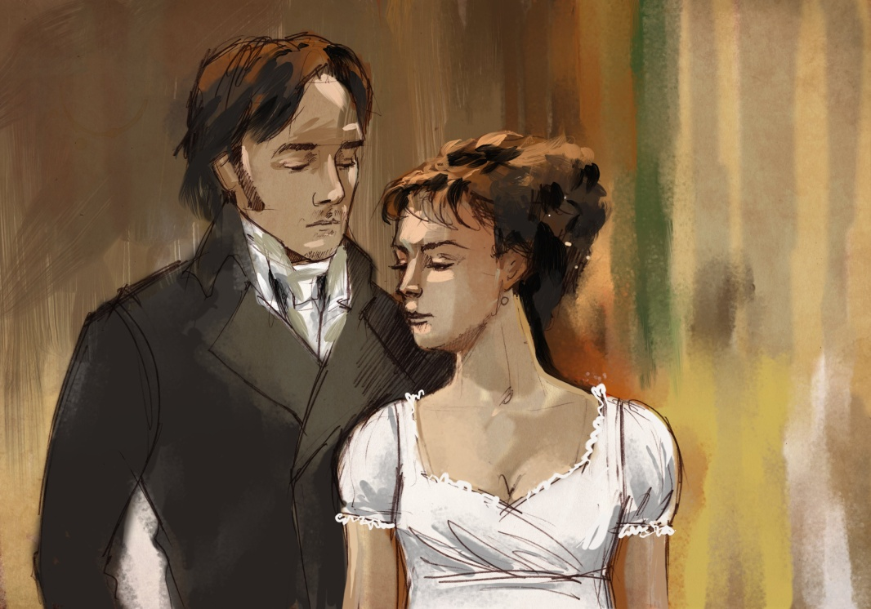
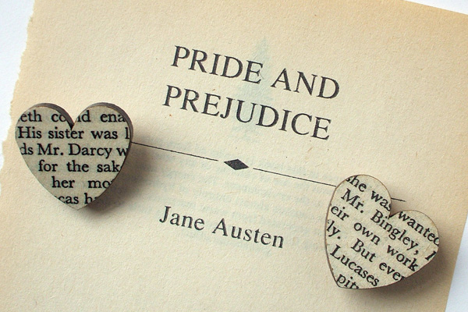
Austen’s Main Ideas
Austen’s main literary concern is about human beings in their personal relationships. Austen shows a human being not at moments of crisis, but in the most trivial incidents of everyday life.
Austen is particularly preoccupied with the relationship between men and women in love. Stories of love and marriage provide the major themes in all her novels.
As in many of Austen’s other novels, irony is employed in Pride and Prejudice as the lens through which society and human nature are viewed. Through the novel, Austen studies social relationships in the limited society of a country neighbourhood and investigates them in detail with an often ironic and humorous eye.

Slide 5
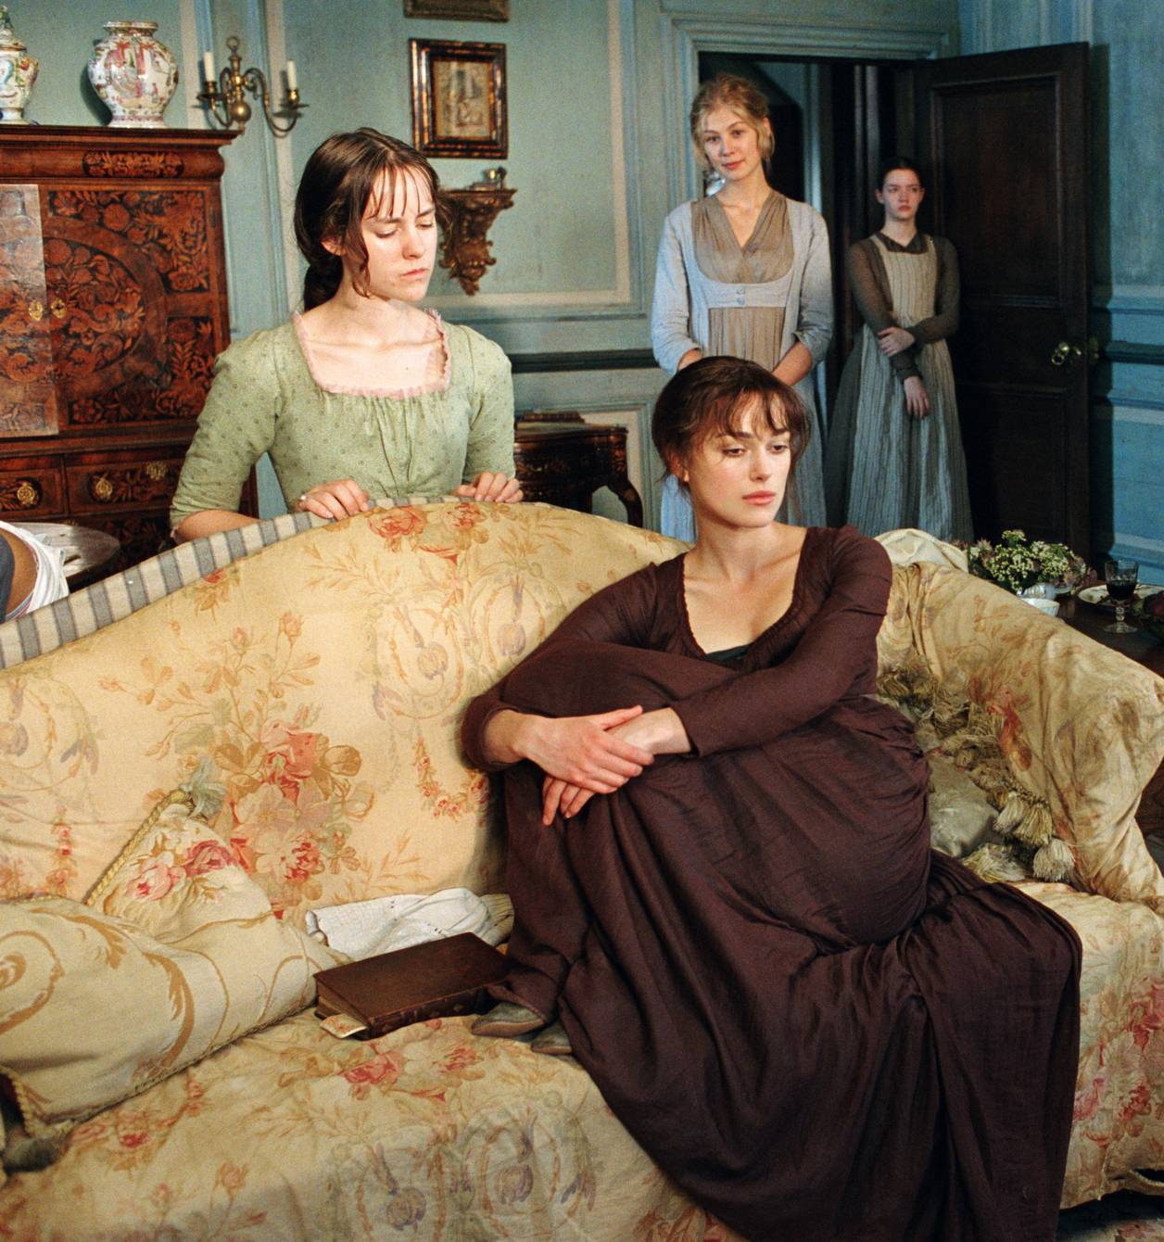
Plot
Pride and Prejudice is a humorous story of love and life among English gentility during the Georgian era.
Mr Bennet is an English gentleman living in Hartfordshire with his overbearing wife. The Bennets 5 daughters; the beautiful Jane, the clever Elizabeth, the bookish Mary, the immature Kitty and the wild Lydia.
Unfortunately for the Bennets, if Mr Bennet dies their house will be inherited by a distant cousin whom they have never met, so the family's future happiness and security is dependent on the daughters making good marriages.
Life is uneventful until the arrival in the neighbourhood of the rich gentleman Mr Bingley, who rents a large house so he can spend the summer in the country. Mr Bingley brings with him his sister and the dashing (and richer) but proud Mr Darcy. Love is soon in the air for one of the Bennet sisters, while another may have jumped to a hasty prejudgment.
For the Bennet sisters many trials and tribulations stand between them and their happiness, including class, gossip and scandal.

Slide 6
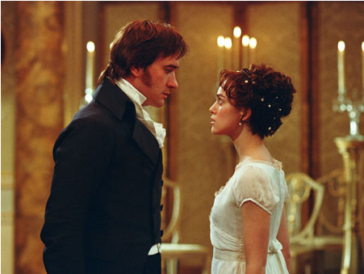
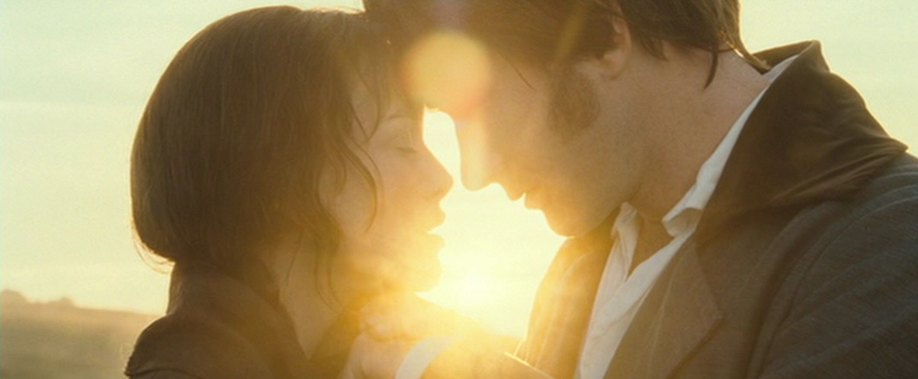
Themes of the novel
Marriage serves many purposes and needs.
Appearances can be deceiving and first impressions are often wrong.
Pride makes one arrogant and insensitive.
The relationship between the individual and society.
The conflict between the individual’s desires and the individual’s responsibility to society.
The use that the individual makes of freedom and its consequences.
The contrast between imagination and reason.
Love, courtship, and marriage.

