Slide 1
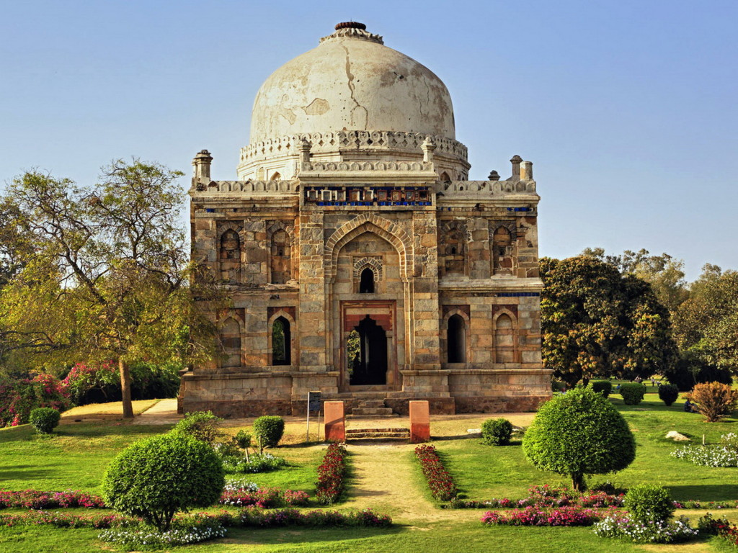
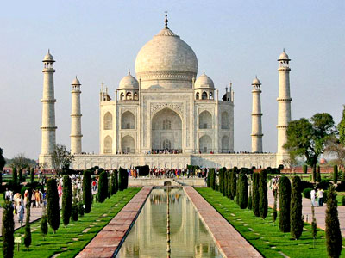
India

Slide 2
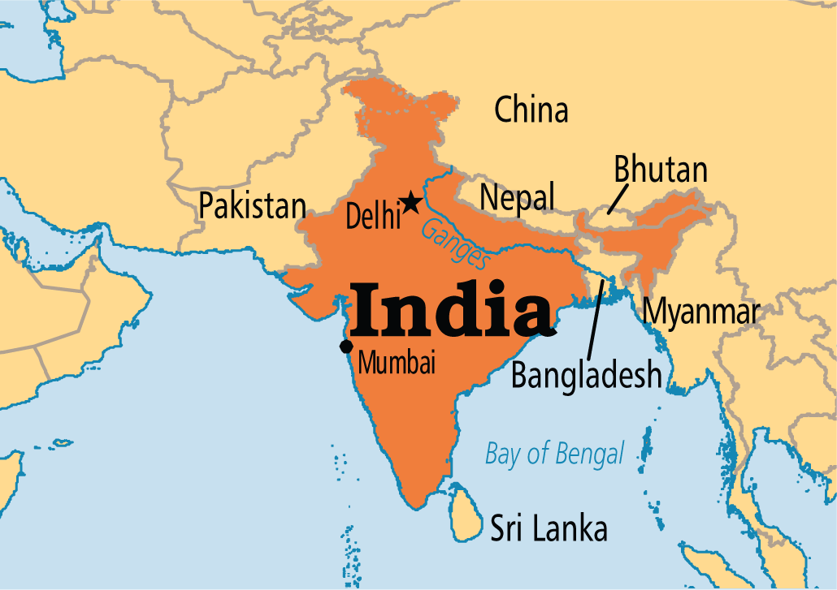
India
Republic of India ,
country in South Asia.
seventh-largest country by area,
the second-most populous country with over 1.2 billion people,
and the most populous democracy in the world.

Slide 3
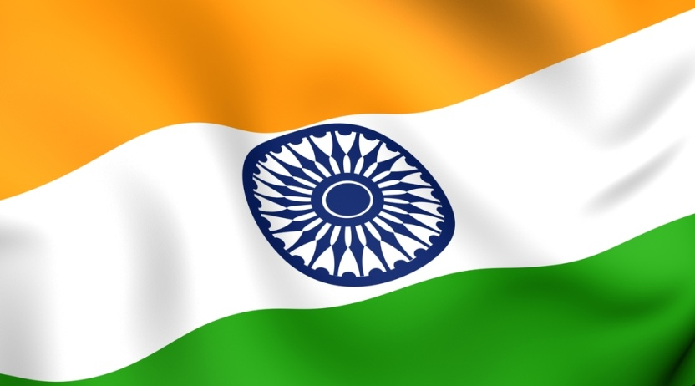
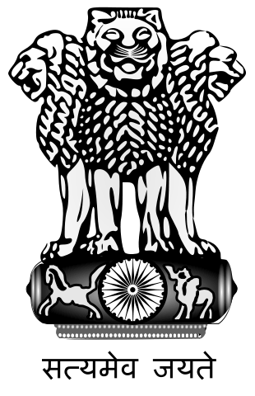
India
Іndia Flag
Capital: New Delhi
Population: 1.237 billion
Currency: Indian Rupee
Official languages: Hindi, English
Area: 3,3 millions square kilometers
Emblem of India

Slide 4
Languages
हिंदी भारत की राजभाषा है. अंग्रेजी व्यापक रूप से व्यापार और सरकार में प्रयोग किया जाता है, विशेष रूप से उच्च शिक्षा के बीच शिक्षा के क्षेत्र में इस्तेमाल किया "राजभाषा", का दर्जा प्राप्त है. इसके अलावा, हर राज्य और केंद्र शासित प्रदेश को भारतीय संविधान में एक अधिकारी भी अक्सर भारतीय समाज में प्रयोग किया जाता है और वे आधिकारिक दर्जा दिया जाता है, जो एक और 21 भाषा,
Hindi is the official language of India.
English is widely used in business and government.
1652 dialects
It should be noted that researchers broadcasters in India Earn many dialects, their number reaches 1652

Slide 5
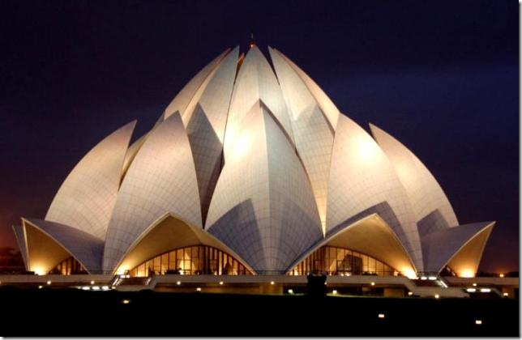
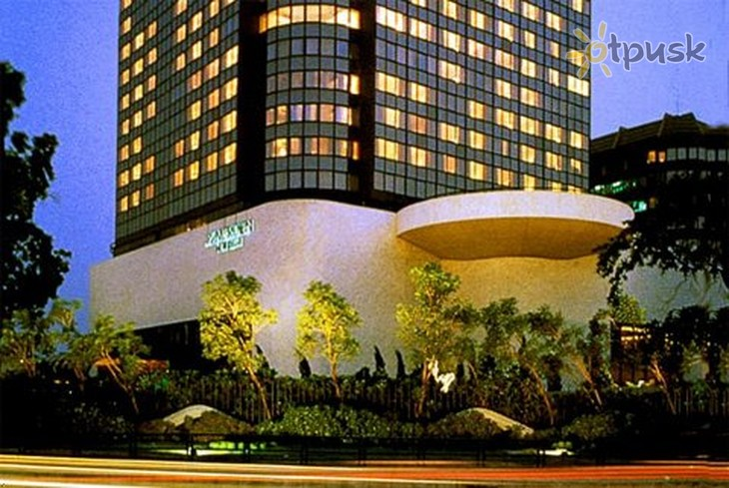
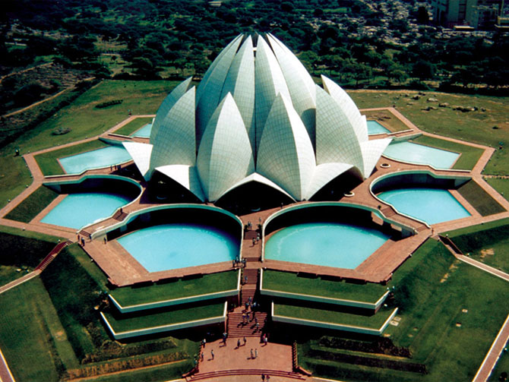
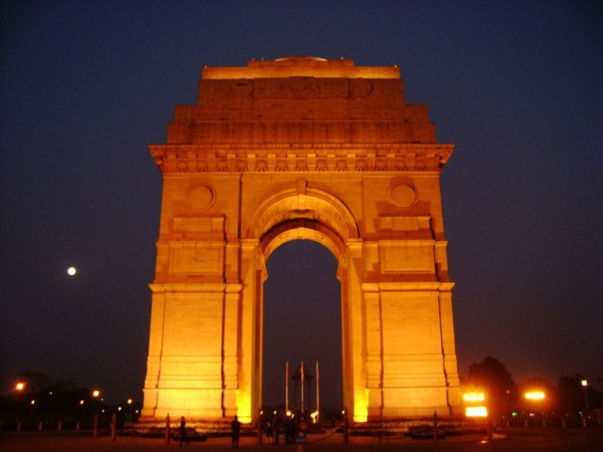
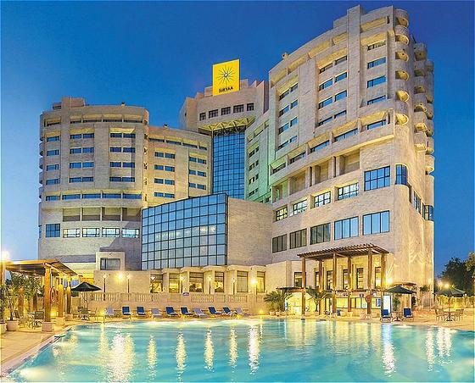
Capital: New Delhi
built by the British in 1911-1931 years.
the administrative center for India
the residence of the president

Slide 6
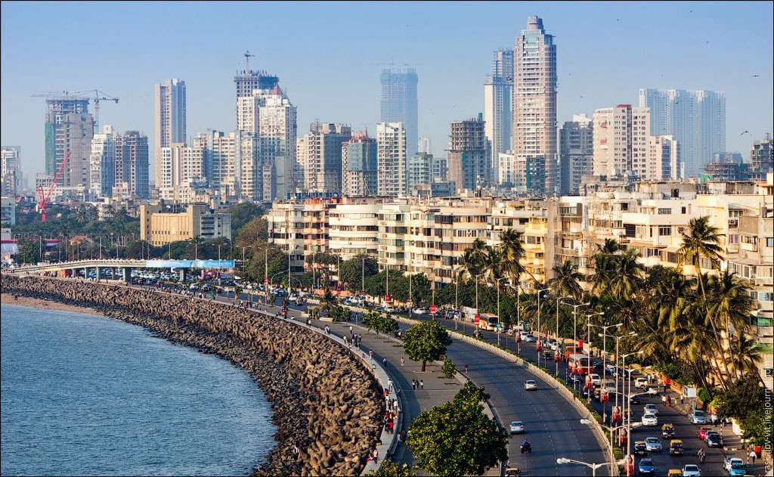
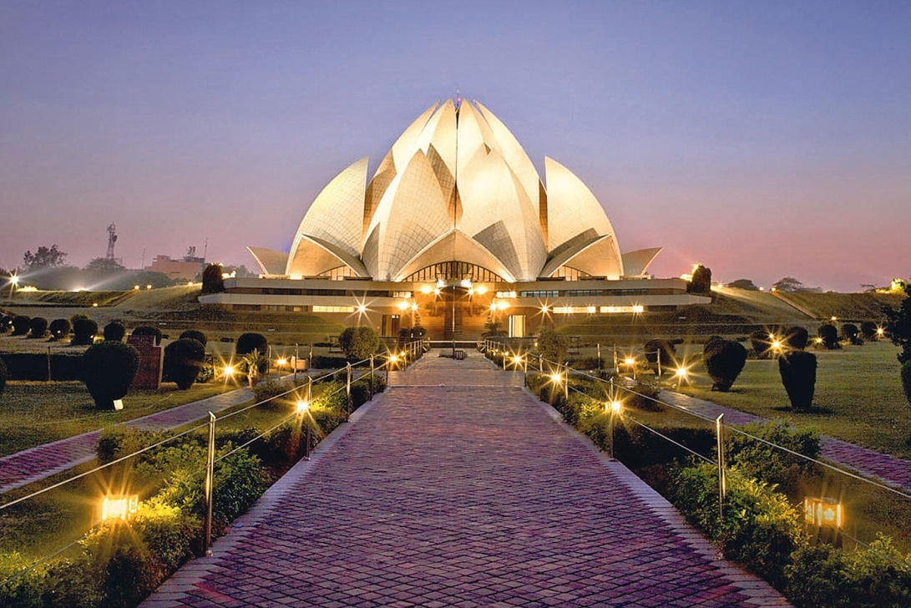
Major cities of India
Mumbai (Bombay)
Delhi ter. Delhi
Kolkata (Calcutta)
Bangalore
Chennai (Madras)

Slide 7
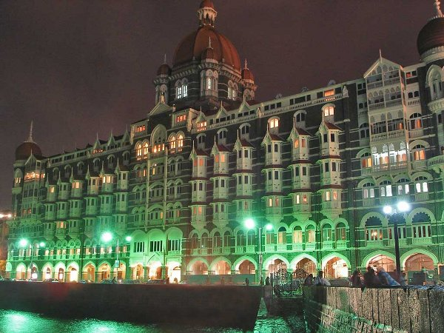
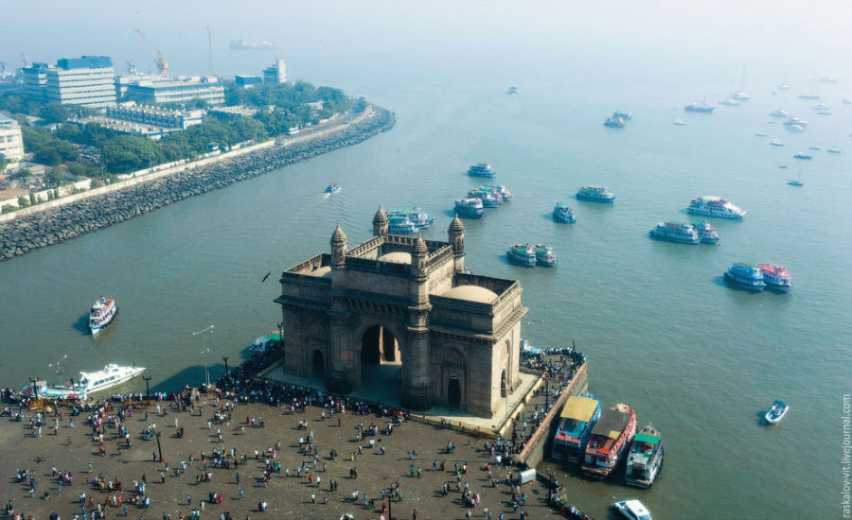
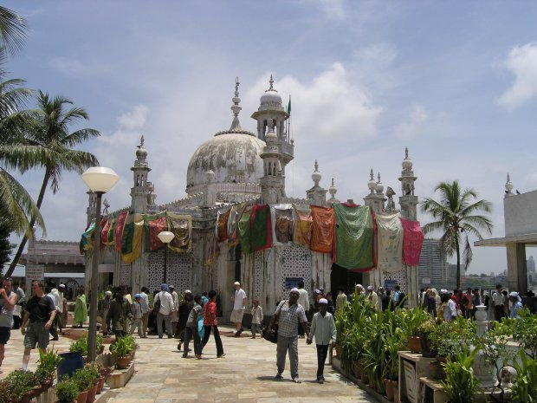
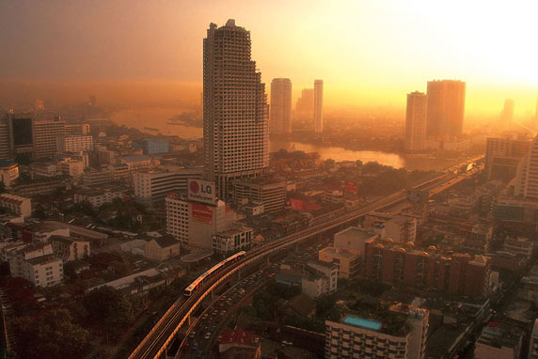
Mumbai (Bombay)

Slide 8
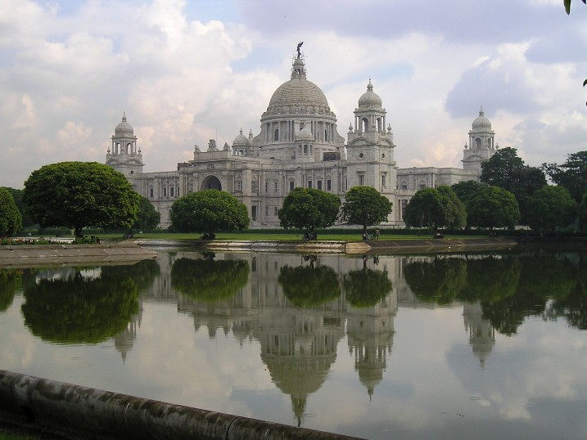
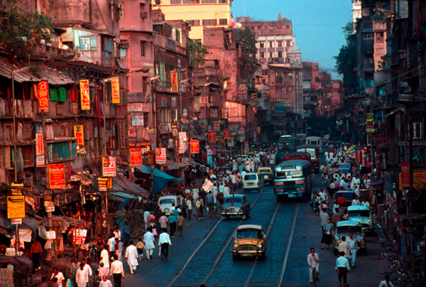
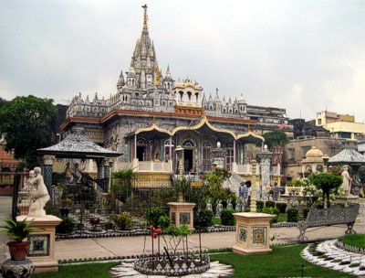
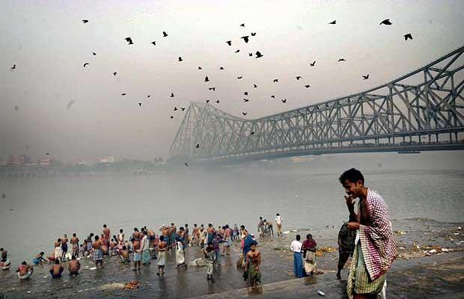
b
Kolkata (Calcutta)

Slide 9
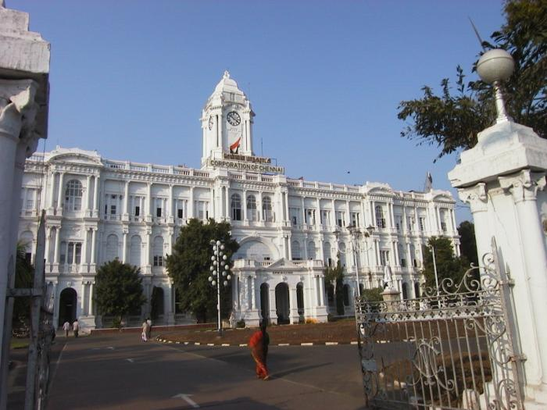
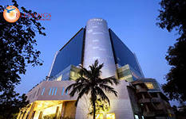
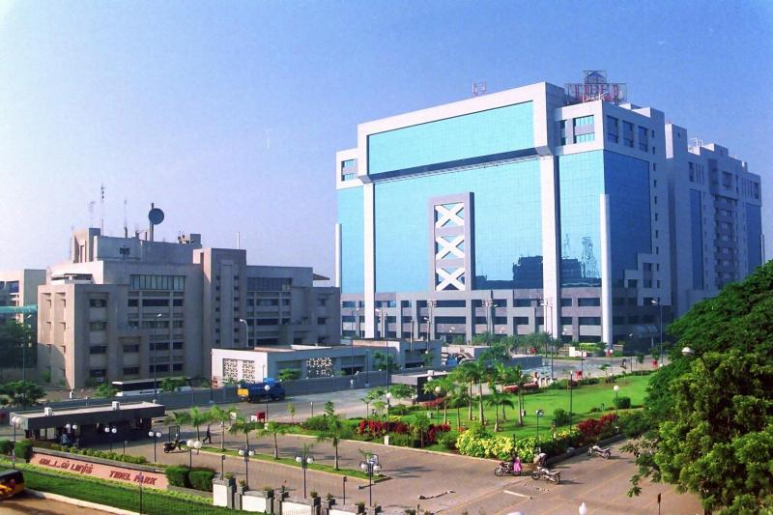
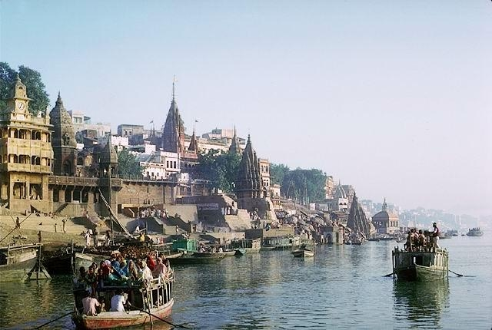
Chennai (Madras)

Slide 10
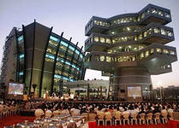
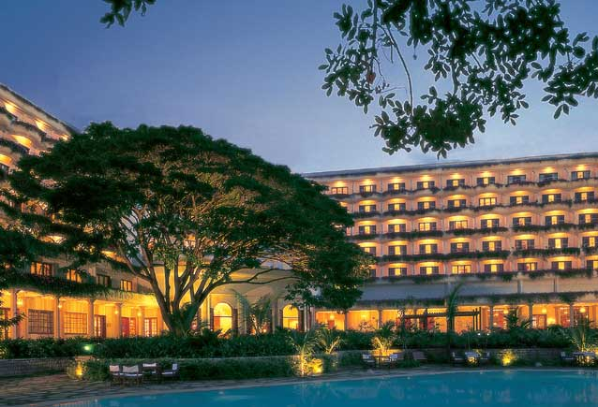
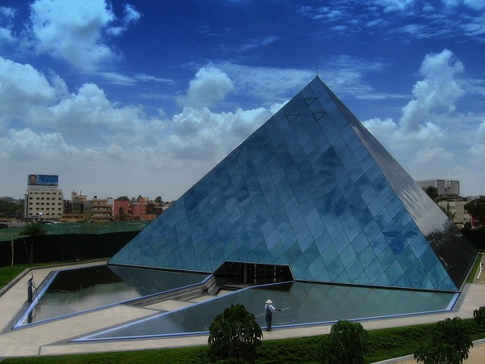
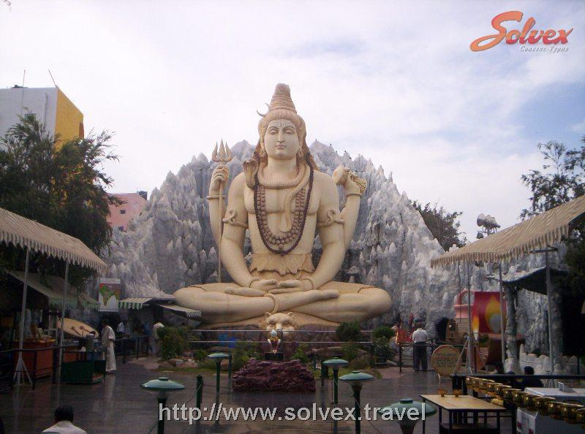
Bangalore

Slide 11
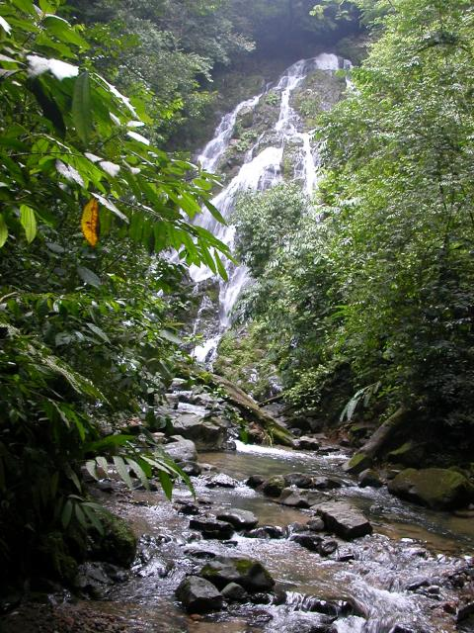
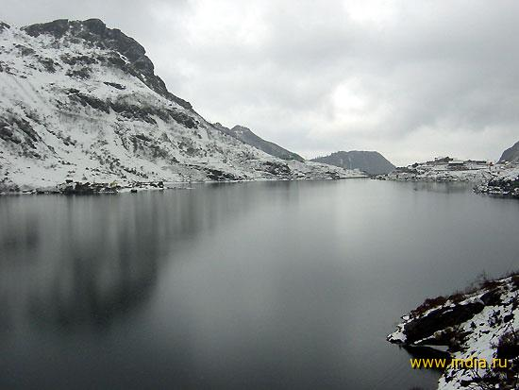
Nature
India is located on the peninsula. It is washed by Indian Ocean.
It is located in a tropical climate zone.
Mountains are in the south of a country.

Slide 12
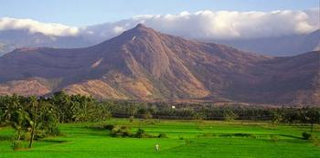
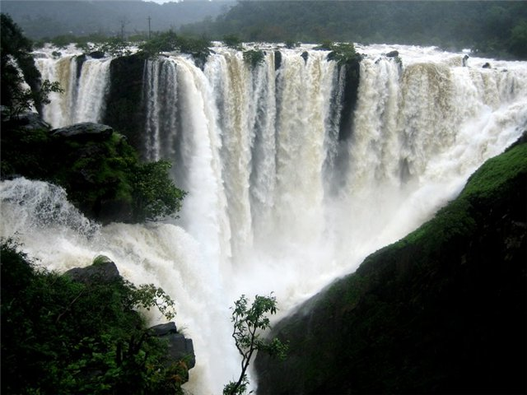
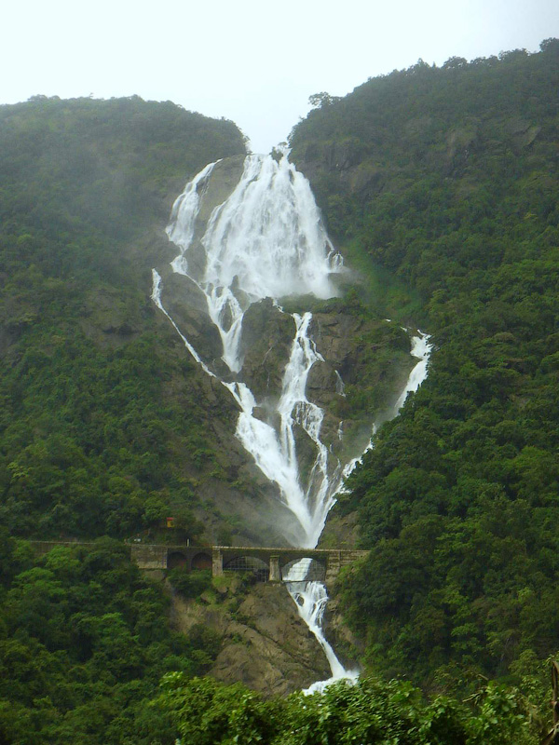

Slide 13
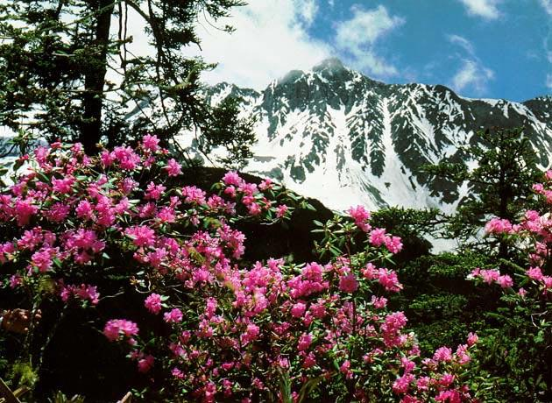
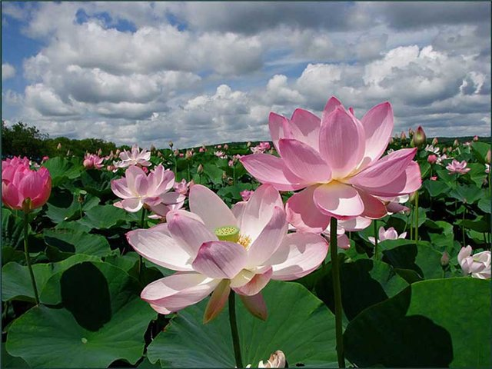
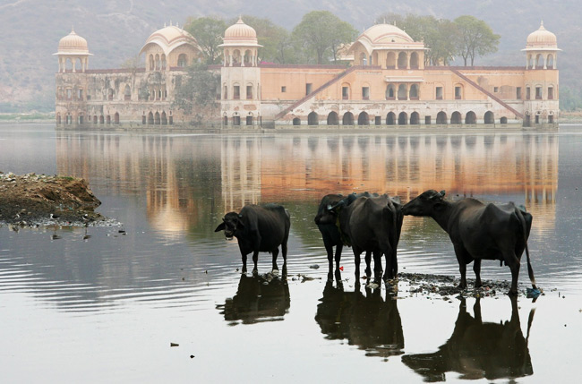
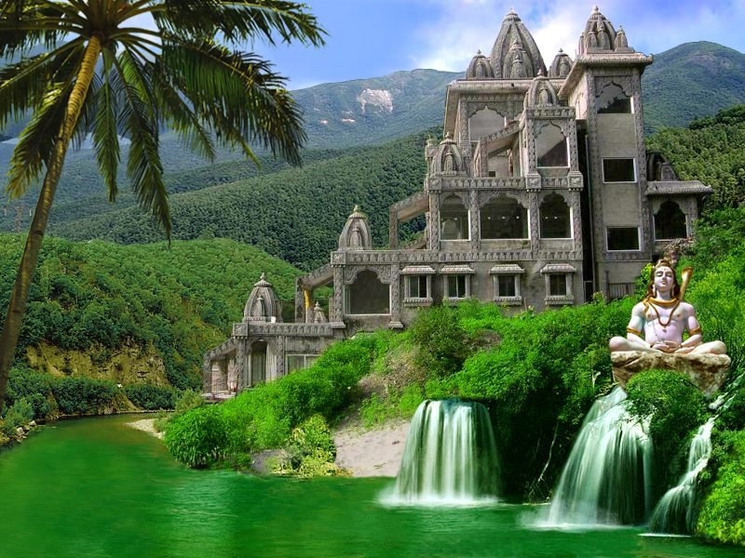

Slide 14
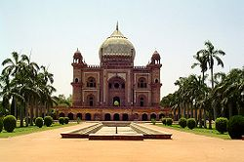
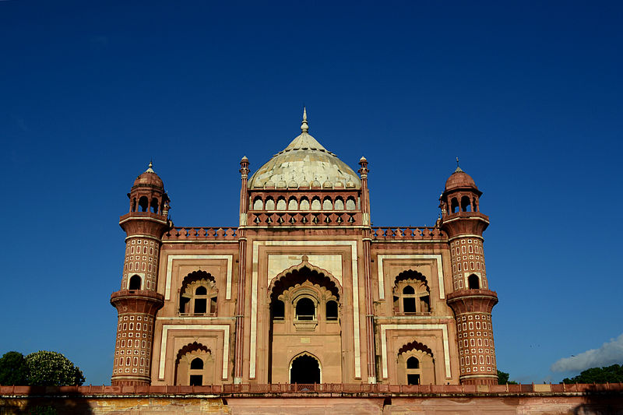
Places of interest
Tomb Safdardzhanha

Slide 15
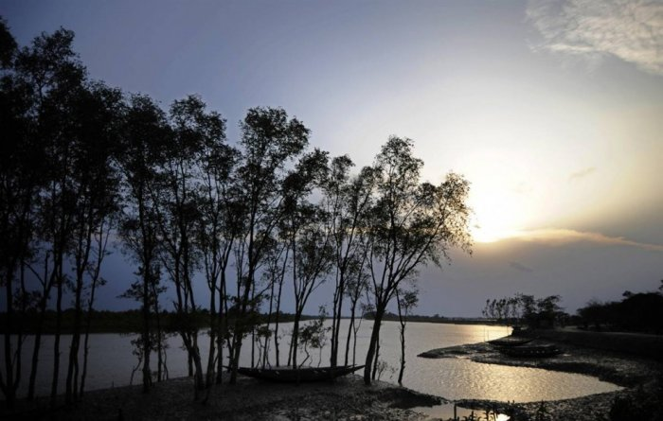
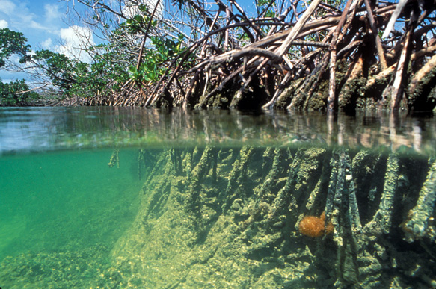
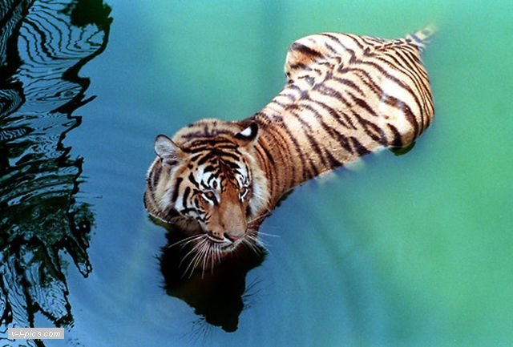
Places of interest
Indian Sunderbans
National Park

Slide 16
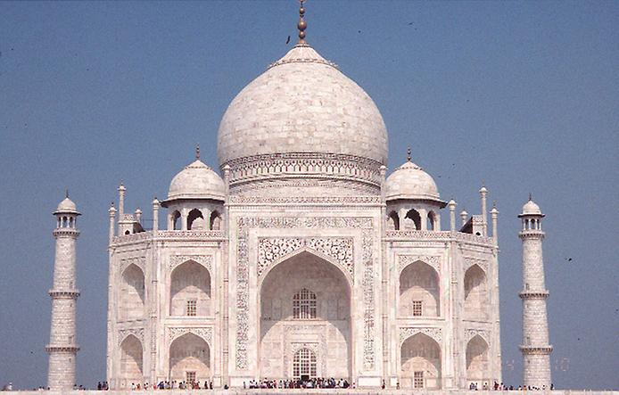
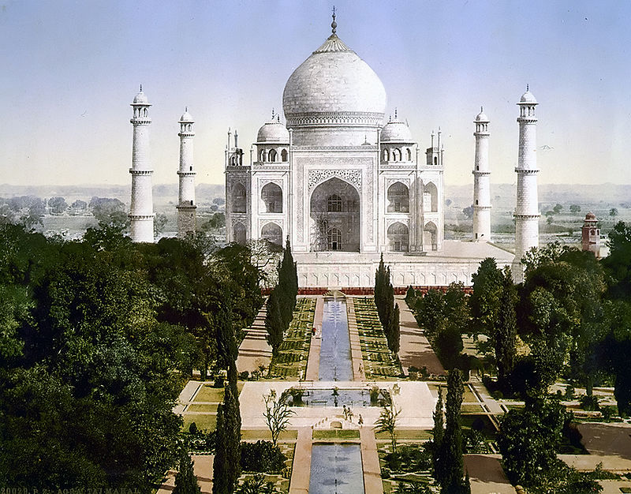
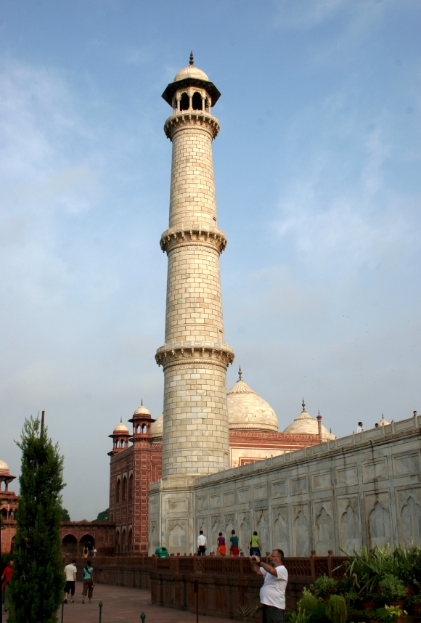
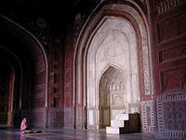
Taj Mahal
Places of interest

Slide 17
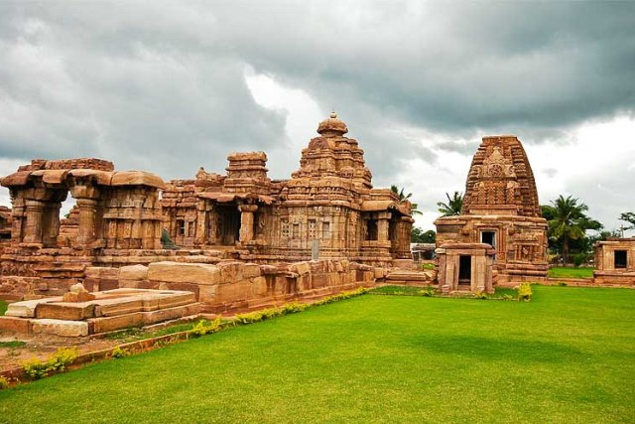
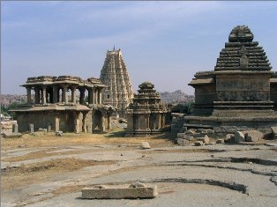
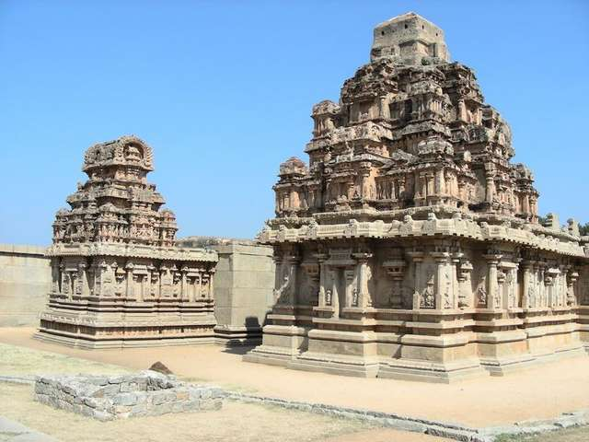
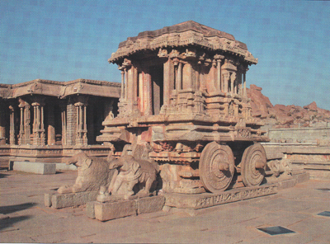
Abandoned city –
Vijayanagar
Places of interest

Slide 18



Khajuraho
Places of interest

Slide 19


Kharmandir Sakhib
Places of interest

Slide 20



Places of interest

Slide 21


Interesting facts
developing country
of the largest countries in the world
first learned to grow rice and cotton, sugar cane, raising poultry
Chess and decimal number system
colony of Great Britain

Slide 22


The Indians opened the first university in the city of Takshashila (700 BC).
India in 1974 became the eighth country that has nuclear weapons.
The Indian film industry, called Bollywood, overtaken Hollywood to produce films.

Slide 23



How charmer makes deaf to the sounds of pipes snake dance?
Cobra cobras of the genus is deaf to the
sounds of pipes.

Slide 24




Holi?!
Holi - the traditional Indian celebration, symbolizing the coming of spring.

Slide 25


Cows freely walk around the streets of Indian cities.

Slide 26




Symbolics
The national animal - the tiger.
National Flower - Lotus
National Fruit - Mango.
National Bird - Peacock

