Slide 1

4-H
Petrova Darina
11 B

Slide 2
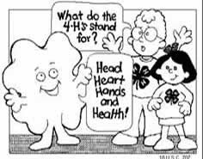
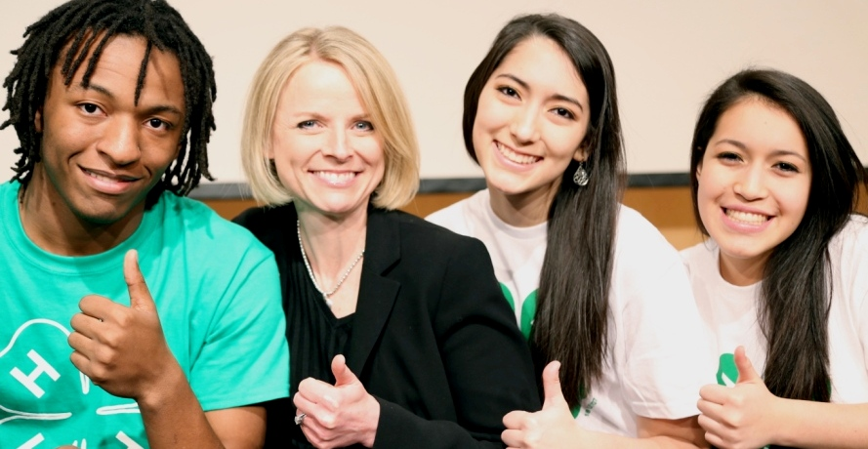
4-H in the United States is a youth organization. It has over 6.5 million members from ages 5 to 21.

Slide 3
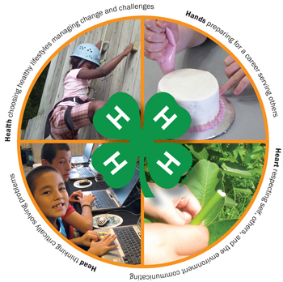
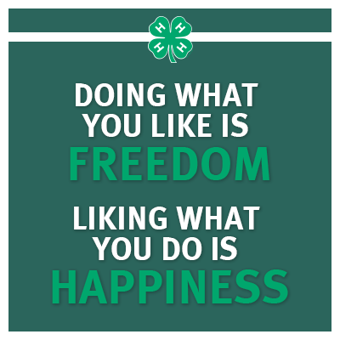
The goal of 4-H is to develop citizenship, leadership, responsibility and life skills of youth through experiential learning programs and a positive youth development approach.

Slide 4
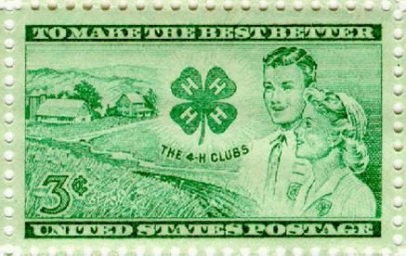

To make the best better
Learn by doing

Slide 5
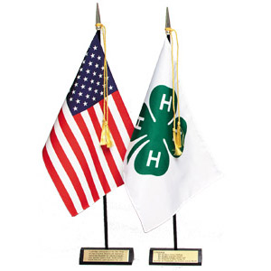

The 4-H pledge is:
I pledge my head to clearer thinking,
My heart to greater loyalty,
My hands to larger service, and my health to better living, for my club, my community, my country, and my world.

Slide 6

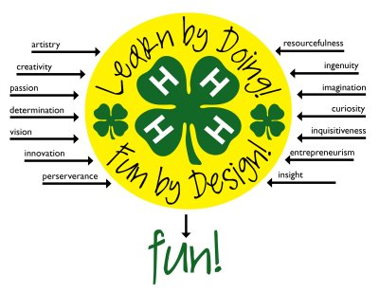
The official 4-H emblem is a green four-leaf clover with a white H on each leaf standing for Head, Heart, Hands, and Health

Slide 7
