Slide 1
Презентація на тему:
«Polka children’s theatre»
Підготувала
учениця 6 класу
Чортківської гімназії
Імені Маркіяна Шашкевича
Гулька Марія

Slide 2
History
The Wimbledon-based Polka Children's Theatre is one of the few venues in the UK which produces and directs work solely for kids. Opened in 1979, the Polka has two theatre spaces and is aimed at children aged 0 to 13. Everything from dramas and comedies are shown here, as well as adaptations of popular stories like We're Going on a Bear Hunt. Some of the works are aimed at children as young as 9 months old. If your baby does start challenging the actors for the audience's attention during the performance, you can simply take them out of the auditorium where you can continue to watch the show on the monitor provided. The Polka offers plenty of family programs and as well as out-of-school clubs and summer schools. Parents will appreciate the child-friendly cafe and a playground complete with a Wendy House and giant cat.

Slide 3

Polka Theatre is one of the few venues in the UK which is dedicated to producing and presenting work for young audiences. Since the doors opened in 1979, this unique venue has been entertaining children with resonant, engaging and exciting theatre.
Over 100,000 children a year come to Polka and are inspired, stimulated and engaged by theatre, often for the first time. Polka strives to stir the emotions, spark the imagination and, most of all, entertain. Its two theatre spaces, the Main Theatre and the Adventure Theatre are designed especially for children so that their first taste of theatre is welcoming and relevant.
At Polka children aged 0 to 13 enjoy a wide-range of experiences designed to make theatre a natural part of their lives: from the powerful drama Stamping, Shouting and Singing Home; to hilarious family shows like Flat Stanley; fantastic world-premieres of new plays for children like Cloud Pictures; and adaptations of well-loved stories like We’re Going on a Bear Hunt.

Slide 4

Polka Theatre for the very young is a vital part of Polka’s artistic programming. Over the past few years Polka has developed its Early Years work and established itself as a centre for innovation in this field. Children as young as 9 months and their families are brought into a colorful and stimulating environment where simple stories are told in a sensory and visual way. Early Years shows also visit Polka from across Europe encouraging the telling of a diverse range of stories in a varied and exciting way.
Creative programming keeps Polka’s work fresh and relevant. Audiences can expect imaginative new writers, dynamic performers, inventive adaptations of popular stories and resonant subjects. Everything we do is focused on providing children with thrilling world-class theatre.

Slide 5
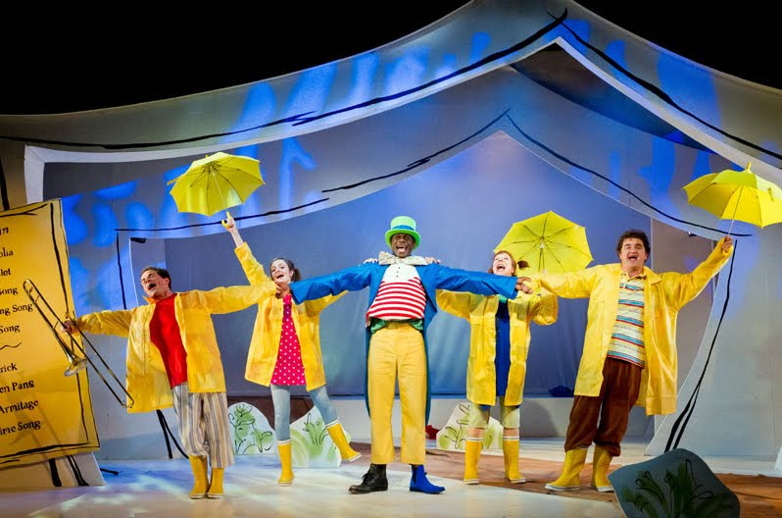
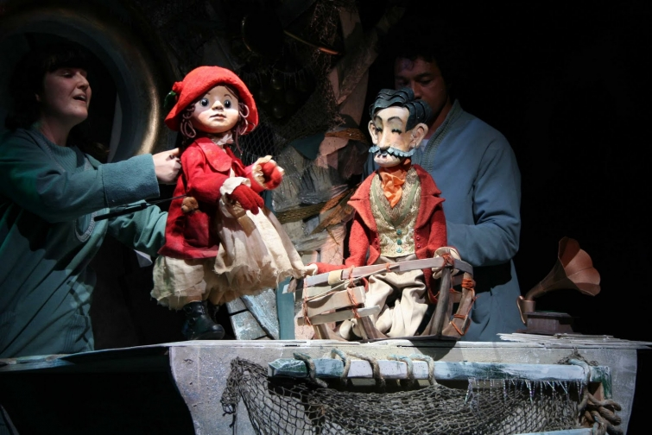
At the heart of Polka’s work is a program of learning that encourages children to explore and develop creatively. Every Polka show is supported by a learning program. Schools visiting the theatre can benefit from online free resource packs and rehearsal diaries, show-related workshops and after-show talks. Polka embraces family learning and encourages it through exciting family days, after-show events and show-related activities packs. It also runs a regular program of out-of-school clubs and summer schools giving children the freedom to explore their creativity and learn a wide-range of performance skills from storytelling to puppetry. Polka is first and foremost a local theatre, loved by the people of Wimbledon and the wider London community, but enjoys an international reputation, known the world over as a pioneer of theatre for children, consistently setting the standard and raising audience’s expectations.

Slide 6
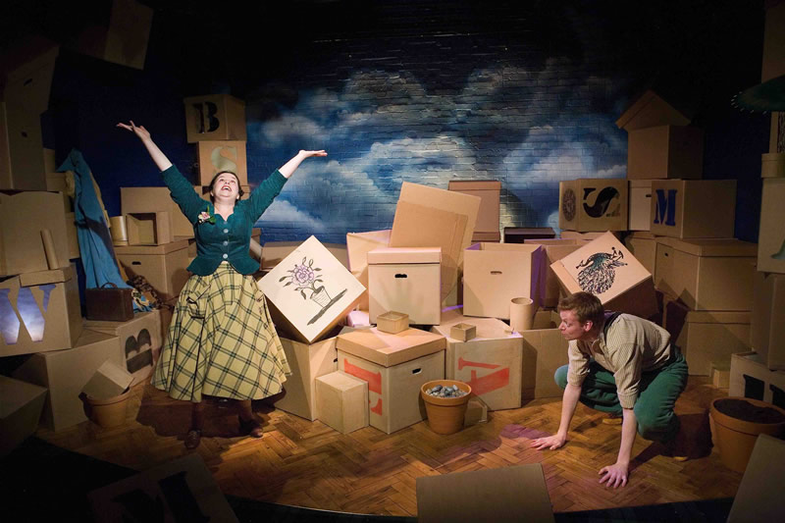
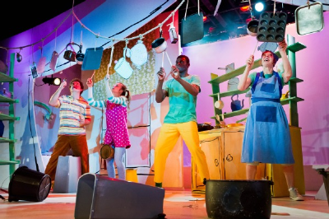
When you come and see a show at Polka you won’t just enjoy the theatre. Polka’s welcoming building is a resource for local people with its friendly café, worry-free foyer with big toys and a book corner, a charming garden and a playground complete with a Wendy House and giant cat! It is playful, fun and interactive - Polka stimulates even the biggest child’s imagination and is a magical place where you can share a special moment with your children.
Polka is a registered charity - without subsidy and the generosity of our donors, our average ticket price would increase from £9 to £25! Up to 800 children visit Polka every day and Polka introduces thousands of children from disadvantaged backgrounds to theatre for the first time each year

Slide 7


