Slide 1
New York City

Slide 2
Who founded New York City
The Dutch founded New York City as “New Amsterdam” in 1614/ The colony existed of what is now Manhattan. The Duke of York’s brothers, King Charles the second, sent warship to attack the Dutch in 1664 and renamed it New York City. Today there 5 boroughs: The Bronx, Brooklyn, Manhattan, Queens and State Island. Today there are 19.000.000 people living here.

Slide 3
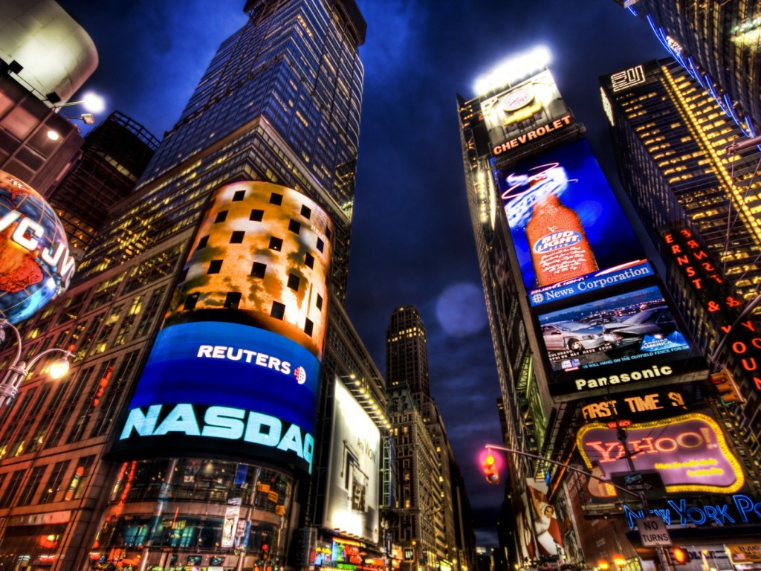
Time square
Times Square is a major commercial intersection in Manhattan. Formerly named Longace Square, Times square was renamed in April 1904. Times Square is nicknamed “The Crossroads of the World”. Times Square is a national landmark

Slide 4
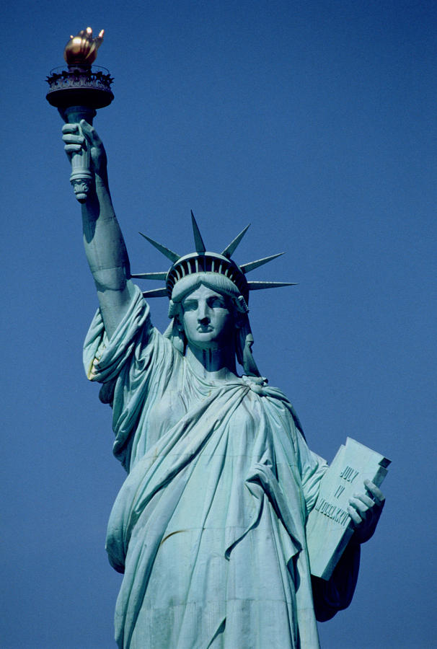
Statue Of Liberty
Statue of Liberty was designed by Frederic Berthold and dedicated on October 28, 1886. It’s a female figure representing the roman goddess of freedom, with torch and a tablet with date of the American Declaration of Independence. A broken chain lies at her feet, this statue is a symbol of freedom

Slide 5
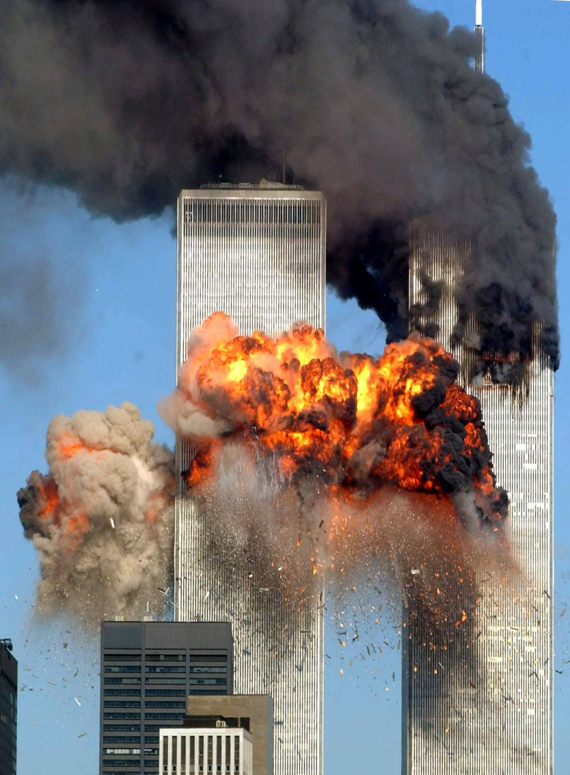
Twin towers
The twin towers are the tallest building in Manhattan at that time. They destroyed after attack on September 11, 2001.

Slide 6
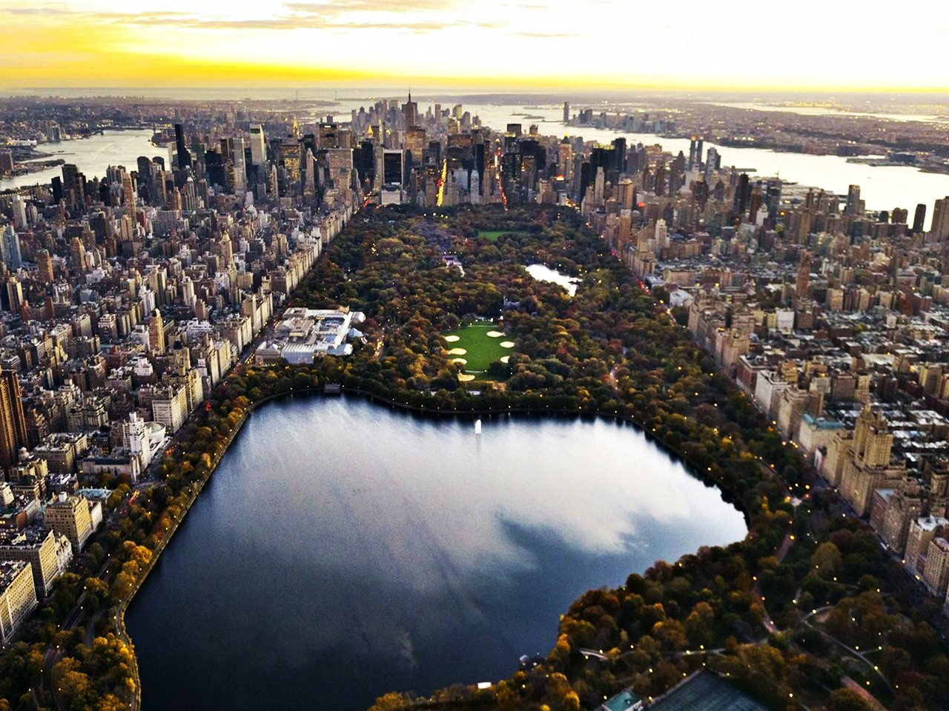
Central Park
Central Park is a public park in the centre of Manhattan. The park initially opened in 1857, on 843 acres of land.

Slide 7
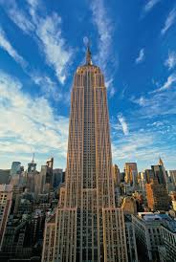
Empire State Building
Empire State Building is a 102-story landmark. It’s feet long. The tallest building in New York City.

