Slide 1
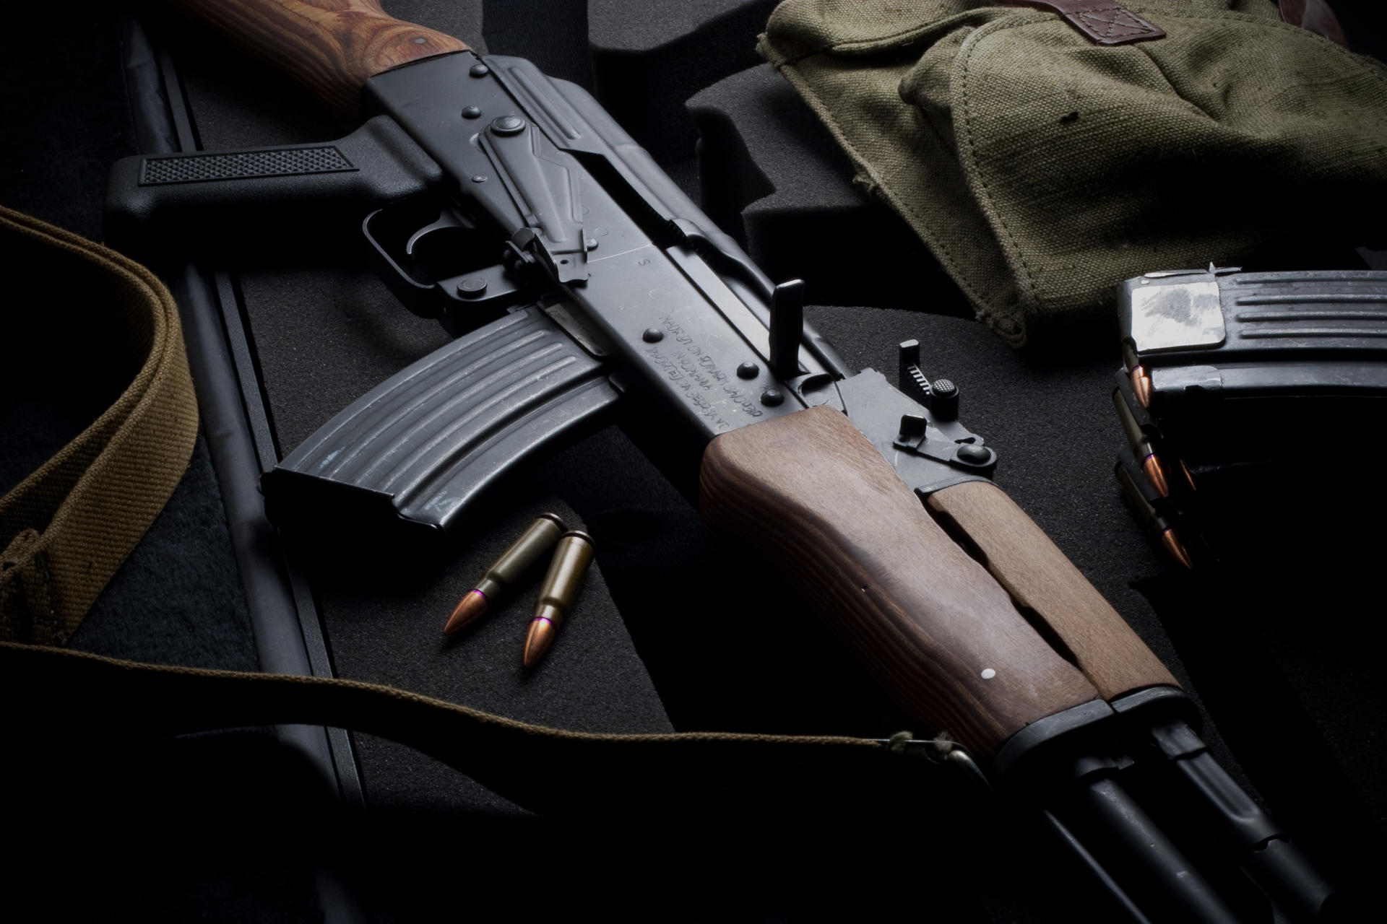
Automatic Kalashnikov
AK-47

Slide 2
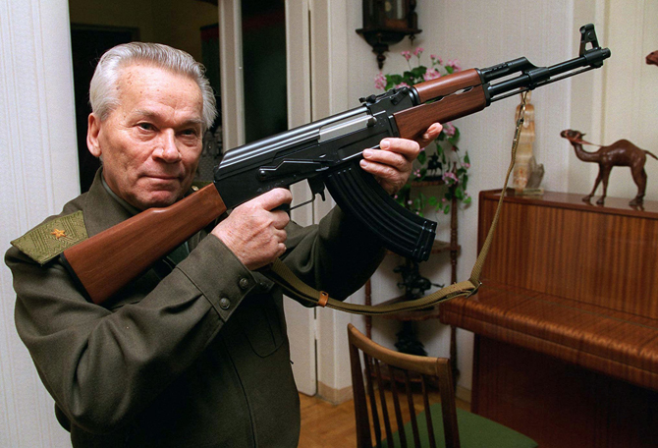
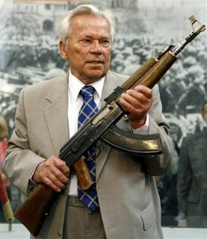
Mikhail Kalashnikov began his career as a weapon designer while in a hospital after he was shot in the shoulder during the Battle of Bryansk
The original AK-47 was one of the first assault rifles of 2nd generation, after the German StG 44. Even after six decades the model and its variants remain the most widely used and popular assault rifles in the world because of their durability, low production cost, availability, and ease of use.. The AK-47 was the basis for developing many other types of individual and crew-served firearms. More AK-type rifles have been produced than all other assault rifles combined

Slide 3
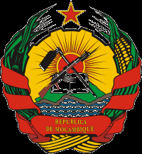
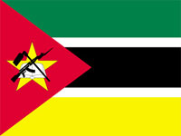
Interesting Facts
Kalashnikov rifle and state symbols of some countries:
- On the arms and the flag of Mozambique

Slide 4

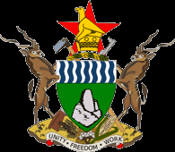
- The emblem of Zimbabwe
Burkina Faso in the emblem of the Kalashnikov assault rifle attended from 1984 to 1997.

Slide 5
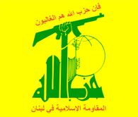
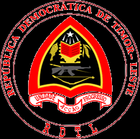
2007 is used in the coat of arms of East Timor.
Kalashnikov rifle depicted in the emblem group "Hezbollah".

Slide 6
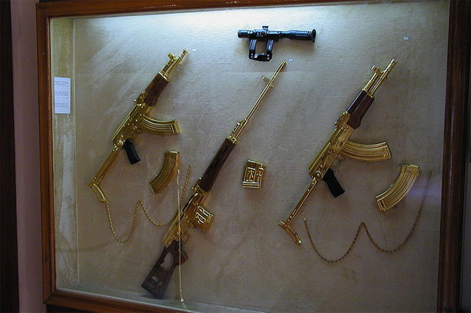
Saddam Hussein had a few gold-plated Kalashnikovs. Dictator awarded their closest associates for their outstanding achievements. When in April 2003, American troops entered Baghdad, soldiers found about two dozen gold-plated firearms. In an abandoned palace of Uday Hussein's eldest son was found plated AK with the inscription: "A gift from President Saddam Hussein."

Slide 7
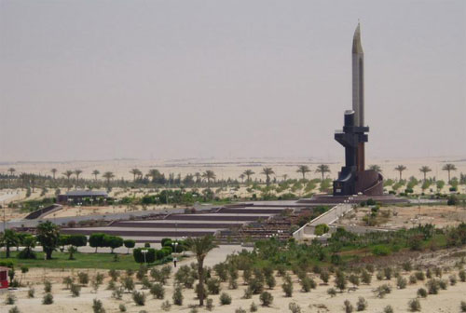
Monument machine in Egypt
In Egypt, on the coast of the Sinai Peninsula monument Kalashnikov - the main weapons to stop the Israeli aggression.

Slide 8
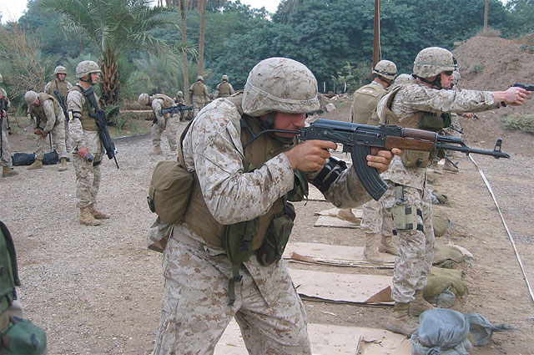
In some African countries, children are given the name of Kalash - in honor of the famous machine.

Slide 9
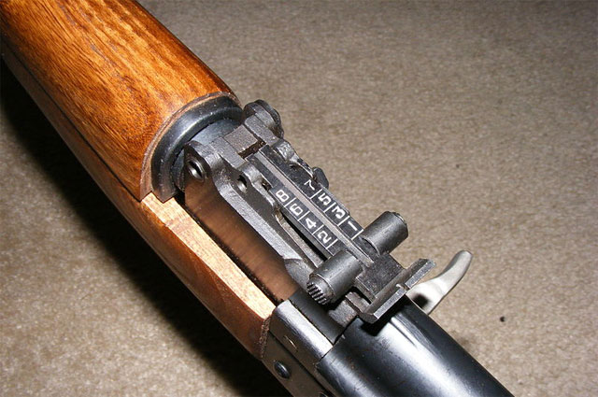
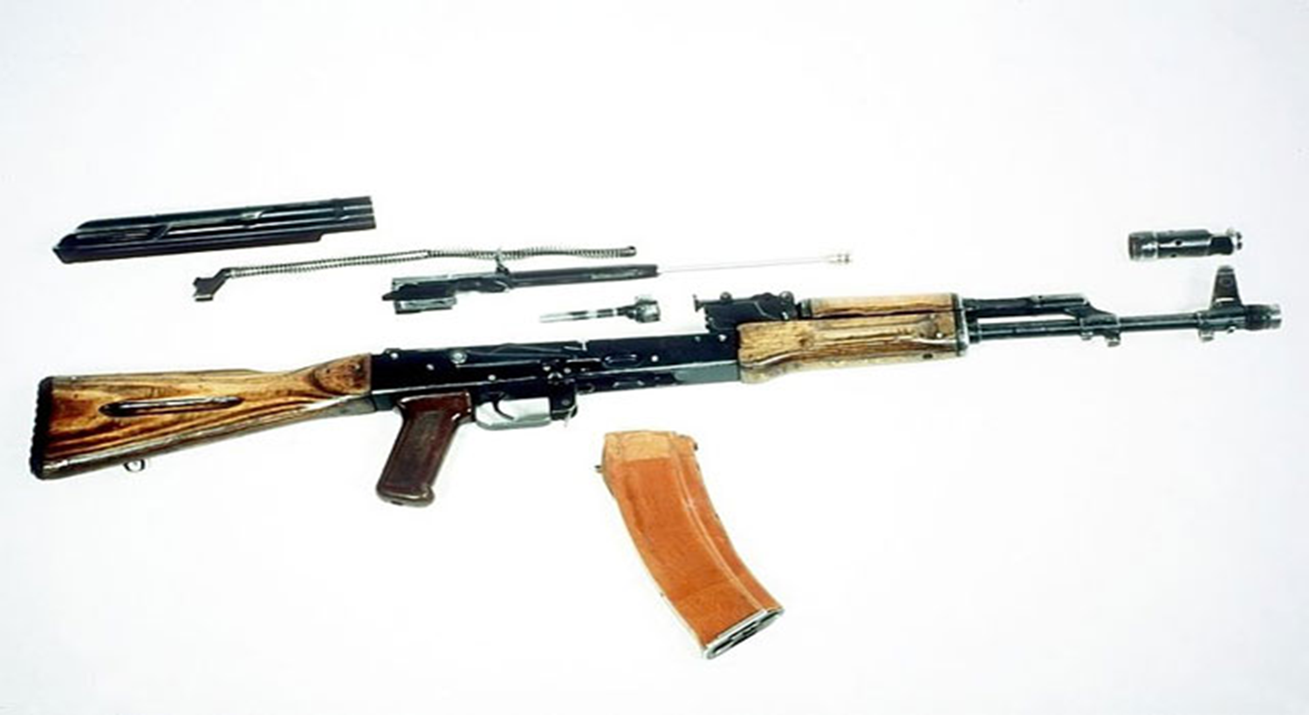
In Soviet times, each student was able to assemble and disassemble an AK-47, it was taught the lessons of basic military training. To get five, courier had to assemble and disassemble for 18-30 seconds. Today in school lessons OBZH Russian schoolchildren are taught again to assemble and disassemble Kalashnikovs.
Assembly machine was mandatory lessons CWP

Slide 10
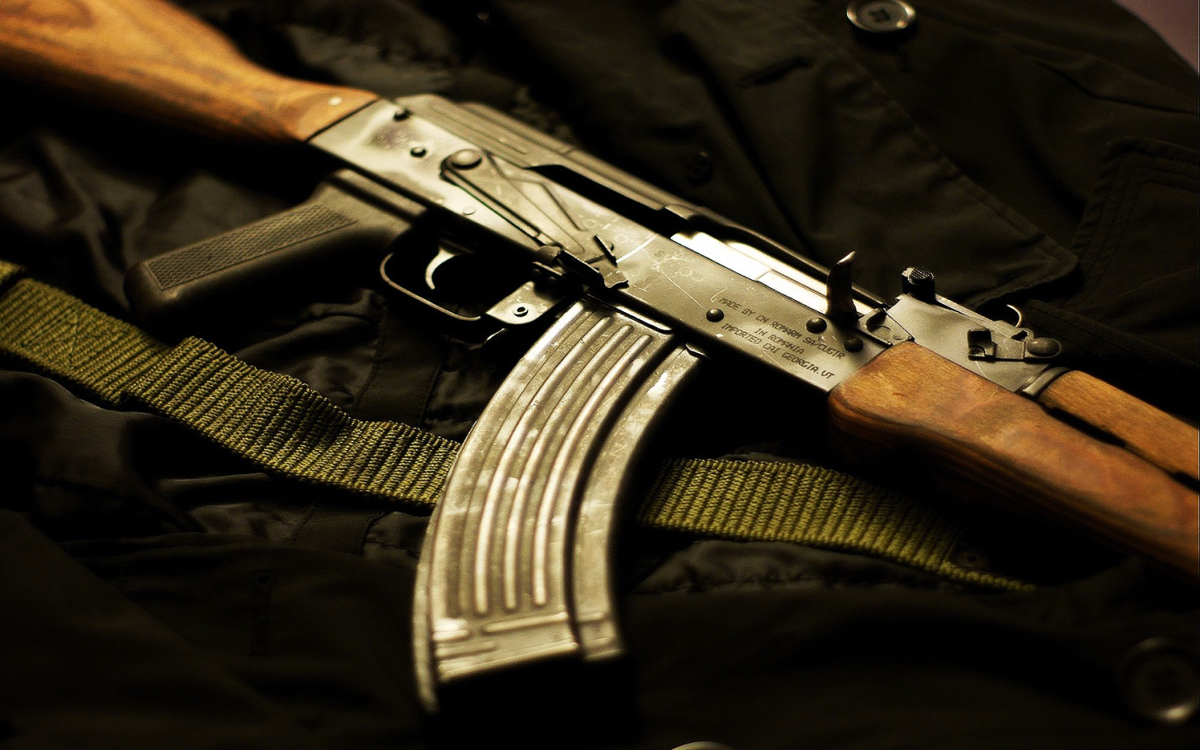
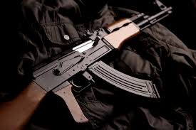
Machine can be purchased on the black market for $ 10
According to the magazine Foreign Policy, the price of the automaton on the "black market" range from $ 10 to 3 in Afghanistan, eight thousand dollars in India. In the U.S., a Kalashnikov rifle can be bought for 70-350 dollars. Military experts say that the price of one of Izhevsk AK-74 (export price - about $ 100) it is possible to buy two, and even three Asian production machine.

Slide 11
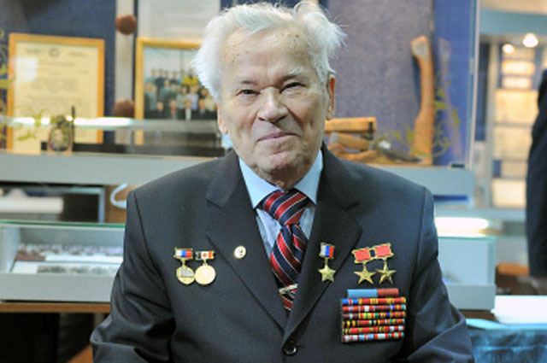
Mikhail Kalashnikov never patented his invention, and therefore is not a rich man. For the invention of the machine in 1947, Mikhail Kalashnikov received the Stalin Prize and first degree Order of the Red Star. The prize was 150 thousand rubles. With that money you could buy almost ten "Wins" (then this car cost 16 thousand rubles).

Slide 12
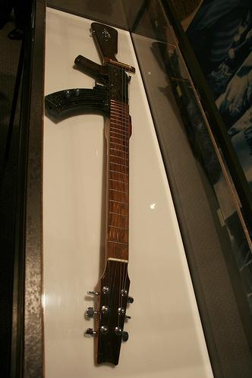
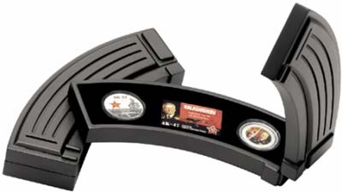
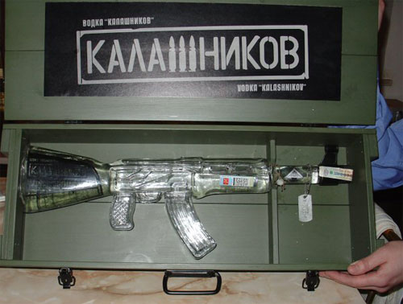

Slide 13


