Slide 1
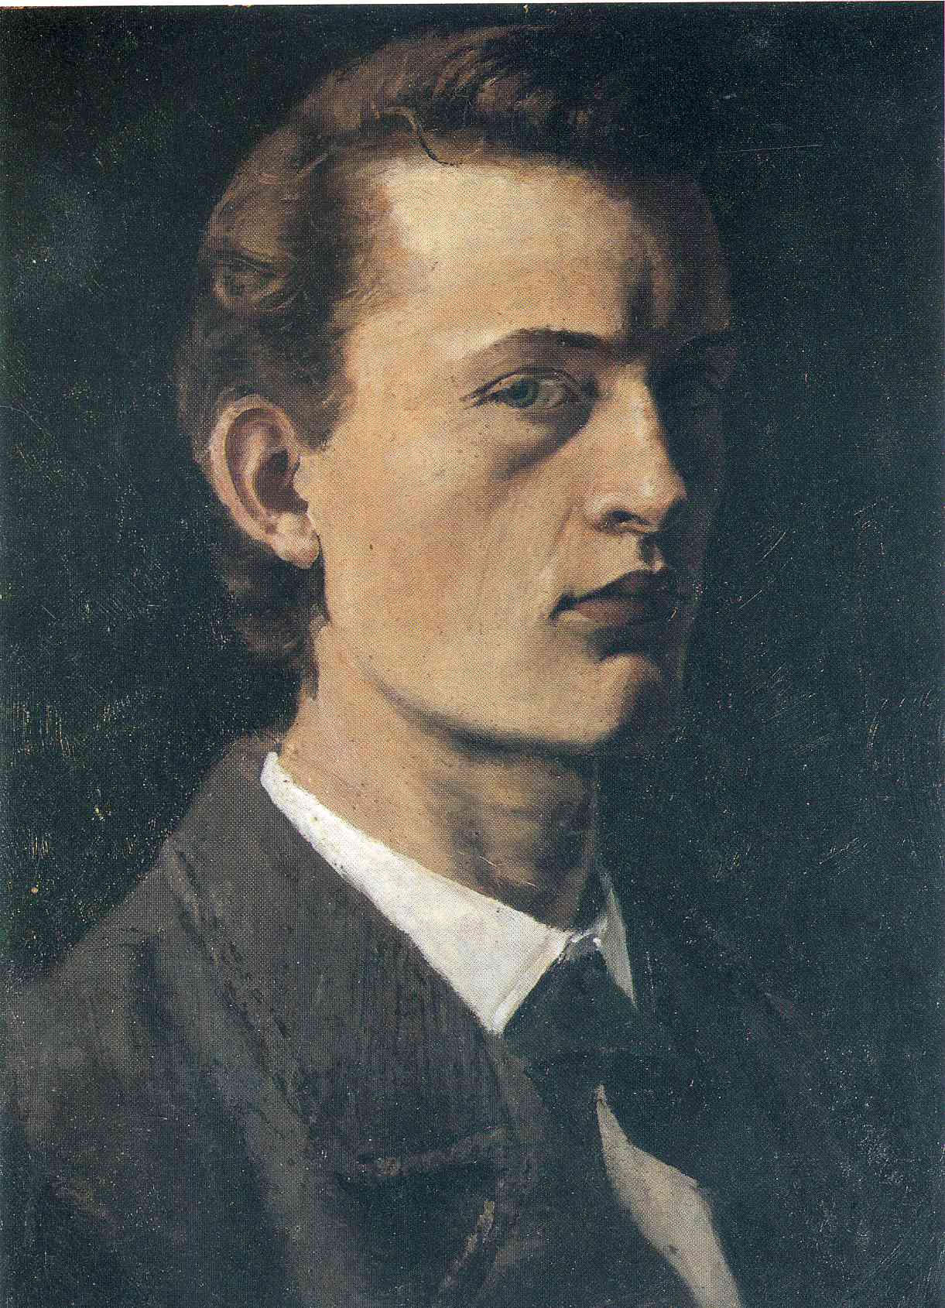
150 years ago was born a wonderful Norwegian artist Edvard Munch, whose works, oddly enough, often better known of the author.

Slide 2
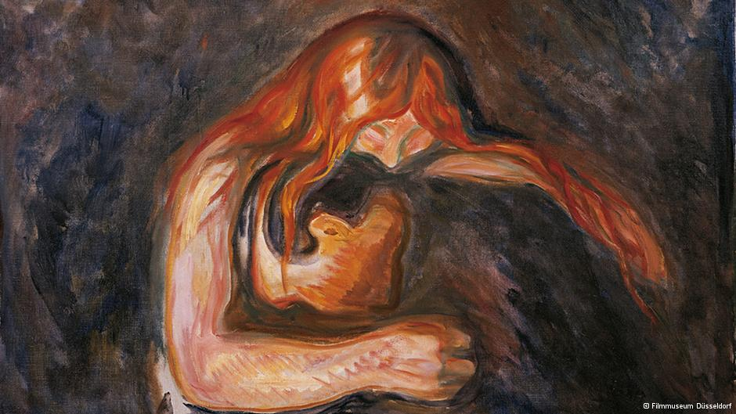
He allowed himself something to him that few dare: show not what you see on the outside, and what you see inside. He was not afraid of allegations sketchy and did not like "beautiful" pictures. He portrayed the people depicted in paintings not their appearance as their inner world.

Slide 3
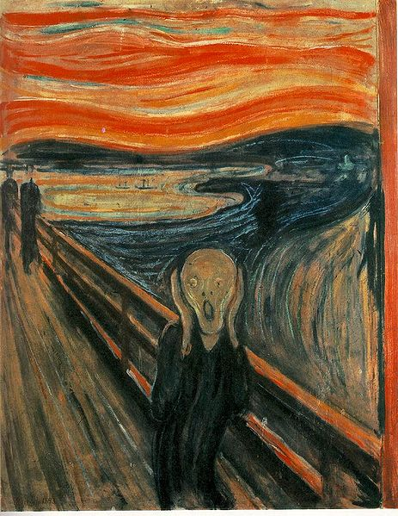
"The Scream"
The first version of the picture was painted by Munch in 1893. And this time many theorists and practitioners of art tend to believe the first milestone in the history of modern painting. Asexual creature bent on the background of the western landscape in blood- red colors became a symbol of expressionism. There is no faces, no person. There are only emotion , passed a couple of strokes. This painting in the world has ever had.

Slide 4
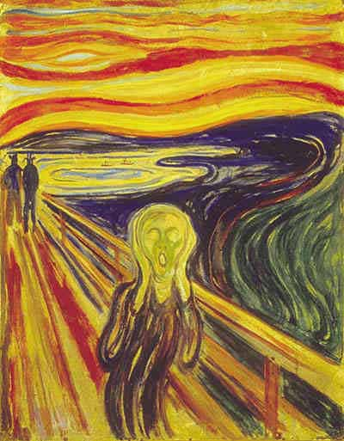
The degree of popularity motive " Scream" can only be compared with the " Mona Lisa ," da Vinci. It depicted on T-shirts , key chains and comics . There are even chips in a screaming head , and even quotes every now and then pop up in horror movies do not count. Image of " sold " and " bought " so far.

Slide 5
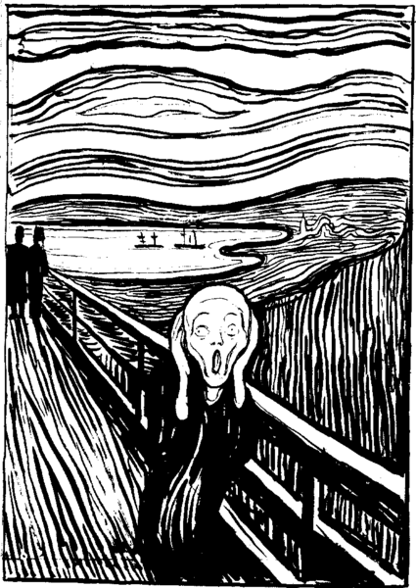
Crowds of fans willing to spend hours waiting in line to defend the showroom to see once "Scream " live . The 2012 version of the picture , painted in 1895, was sold at auction for nearly $ 120 million " Scream" entered the top ten most expensive paintings of all time.

