Slide 1

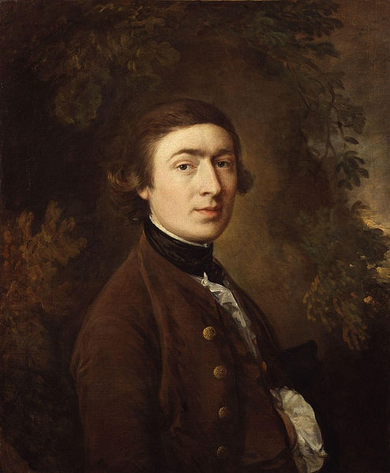
Thomas
Gainsborough
(14 May 1727 – 2 August 1788)

Slide 2

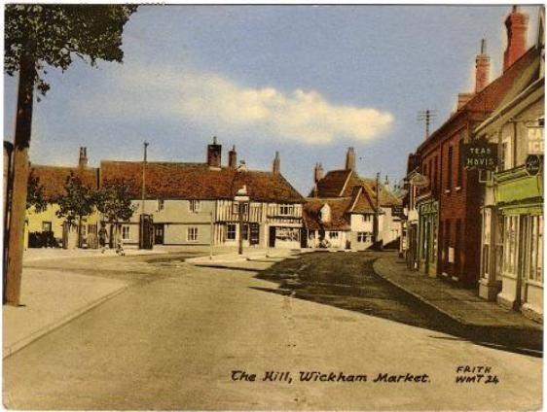
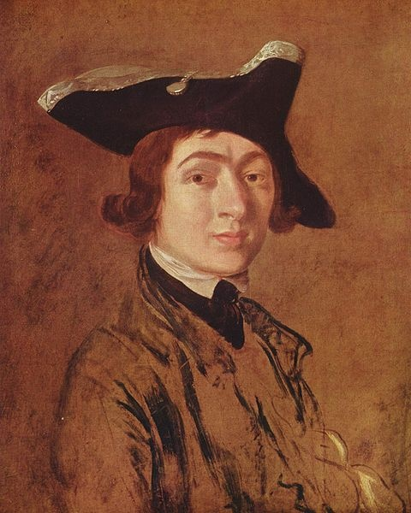
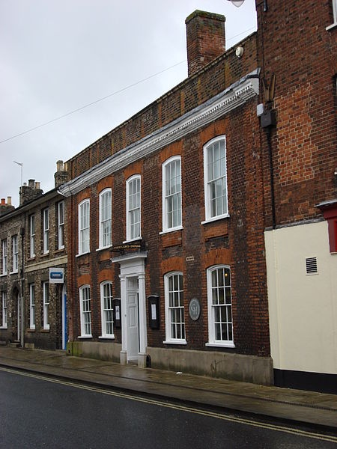
Thomas Gainsborough was an English portrait and landscape painter. He was born the youngest son of John Gainsborough, a weaver in Suffolk.
Thomas Gainsborough's house

Slide 3

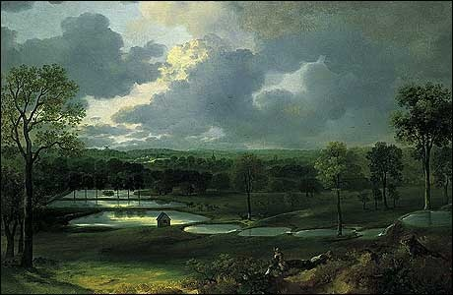
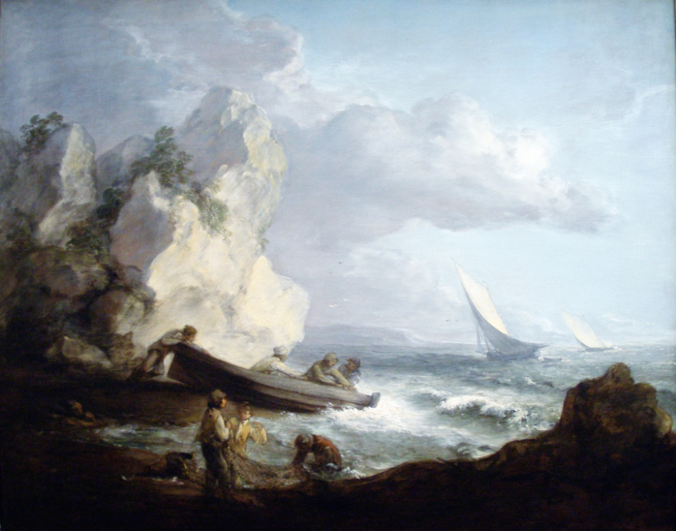
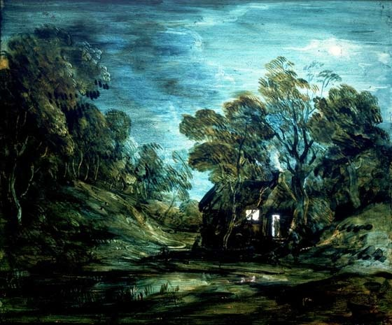
He painted quickly and his pictures are characterized by a light palette and easy strokes. He preferred landscapes to portraits.

Slide 4
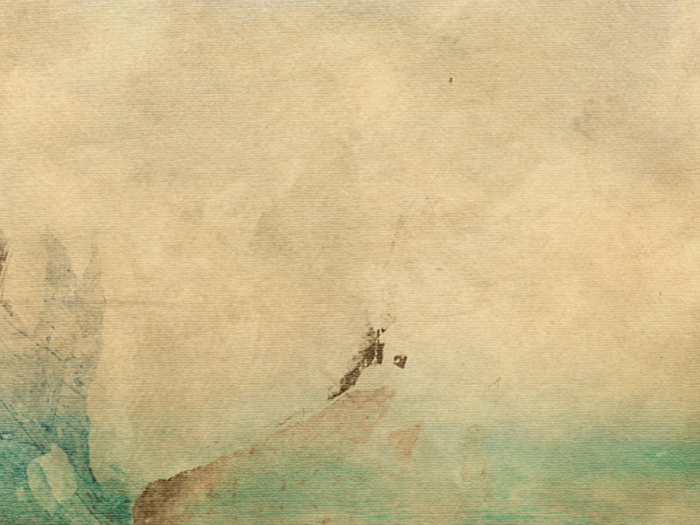
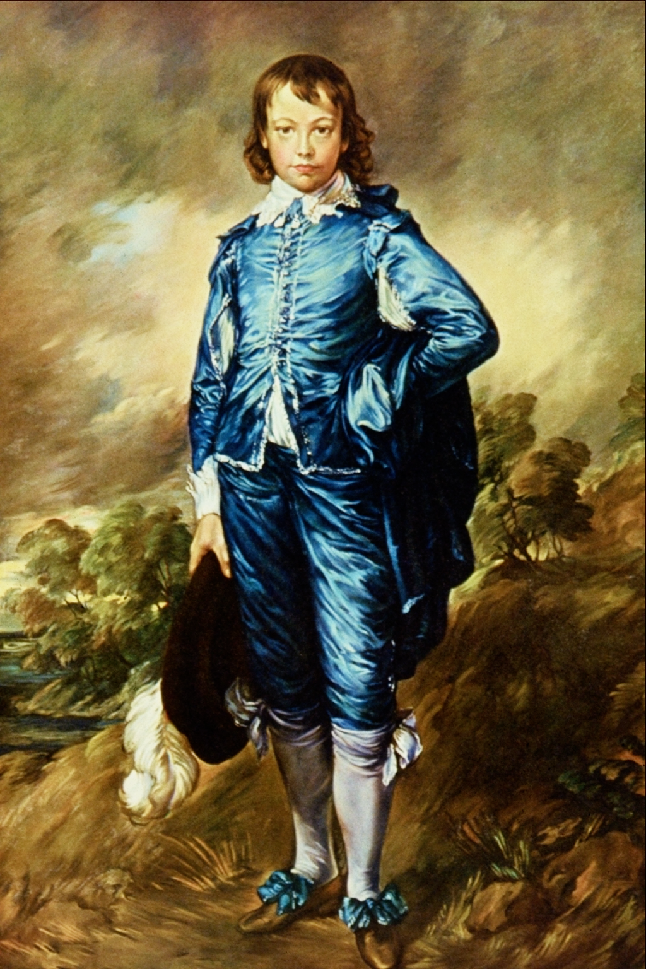
Perhaps the best known to-day of all Gainsborough’s portraits is the famous “Blue Boy”.

Slide 5

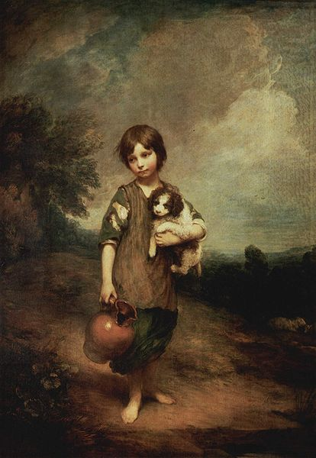
His picture “The Cottage Girl with Dog and Pitcher” attracted general attention

Slide 6

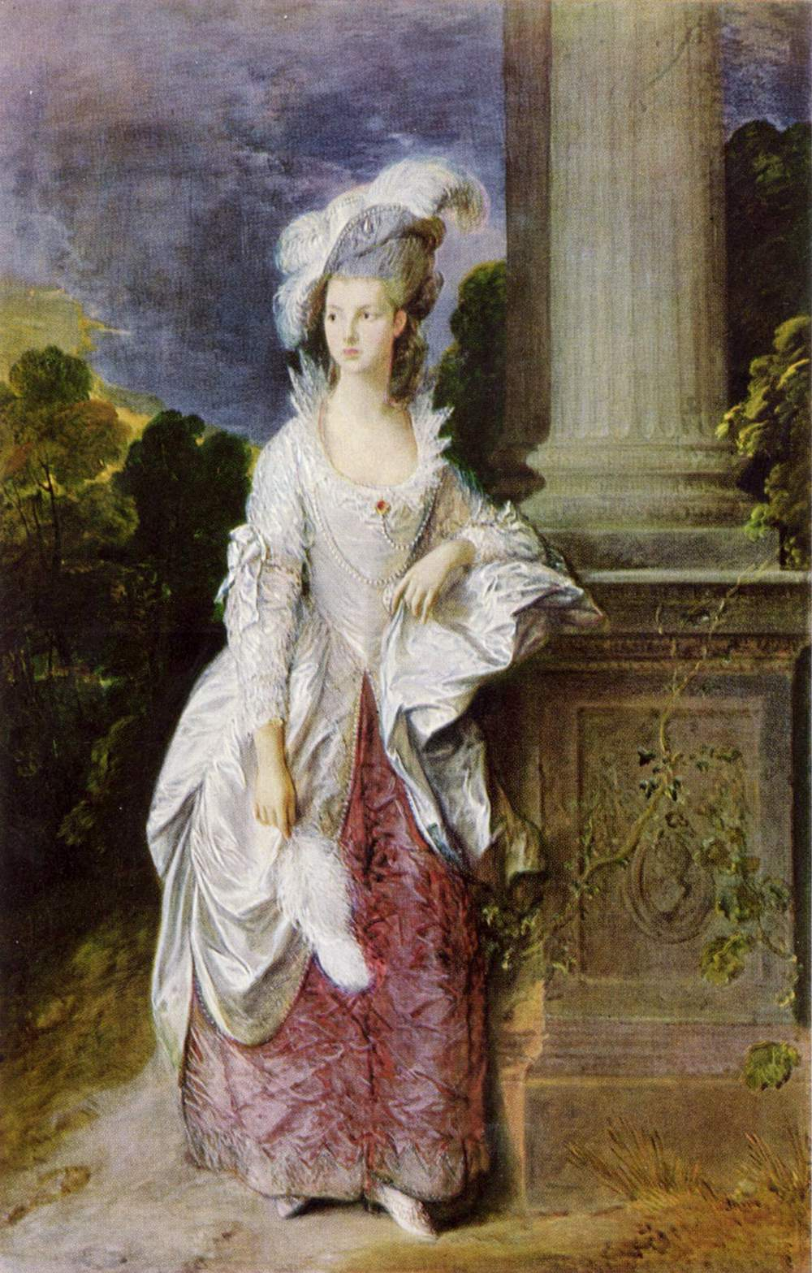
“Mrs. Graham”

Slide 7

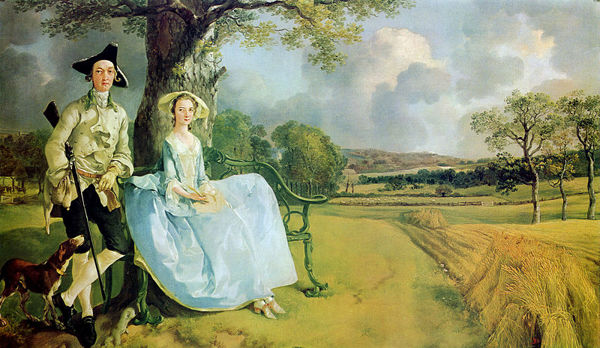
“Mr and Mrs Andrews”

Slide 8
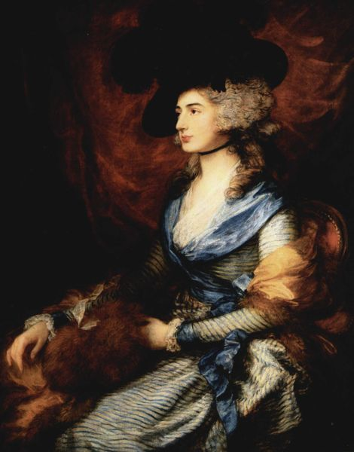
“Mrs. Sarah Siddons”

Slide 9

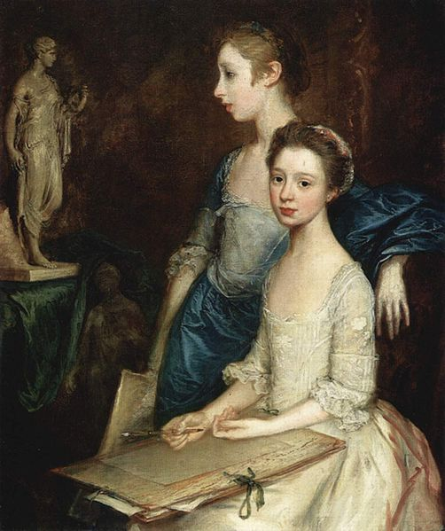
“The Artist`s Daughters,
Molly and Peggy”

Slide 10

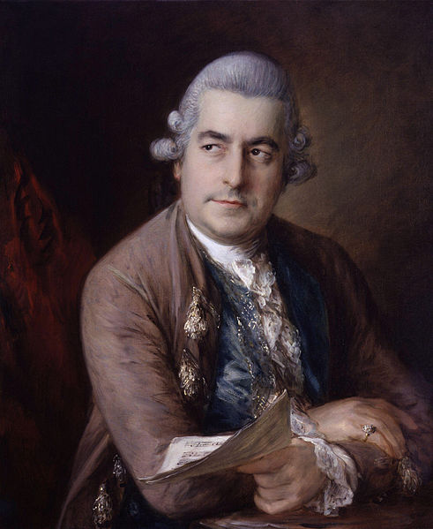
“Johann
Christian Bach”

Slide 11

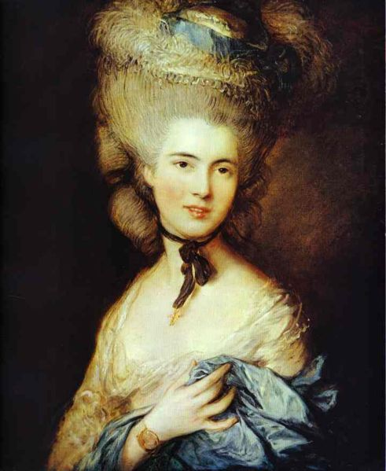
“Lady in Blue”
This portrait, one of Gainsborough's most successful paintings, is the artist's only work in the Hermitage.

Slide 12

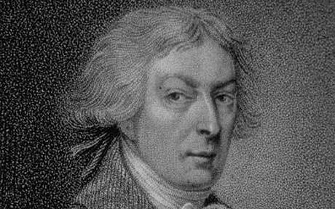
He was in advance of his time. His art became a forerunner of the Romantic Movement.

