Slide 1

My hobbie

Slide 2
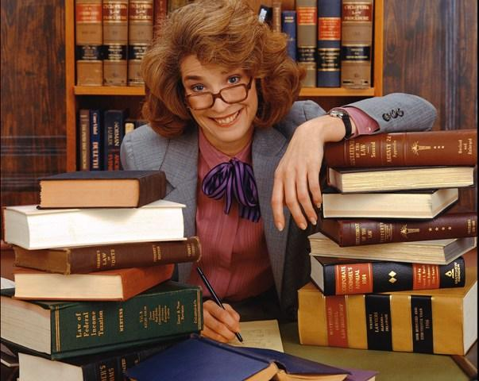
My hobby is reading.

Slide 3
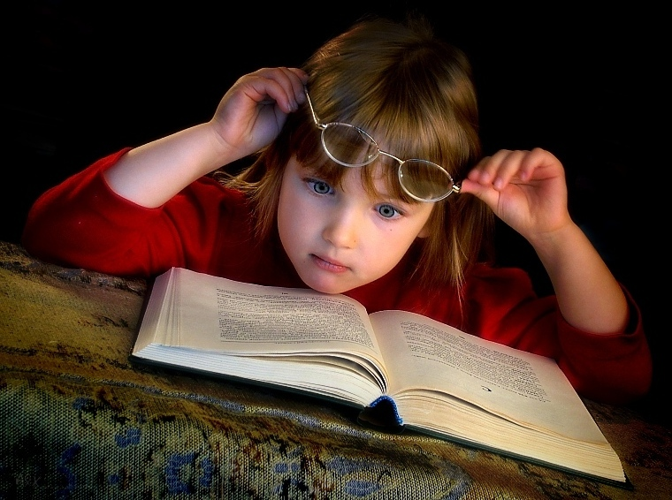
Reading is one of the best hobbies for me.

Slide 4

Reading is a way for me to relax and to use imagination.

Slide 5

Books have influenced all my life.

Slide 6

The books are brilliant!

Slide 7
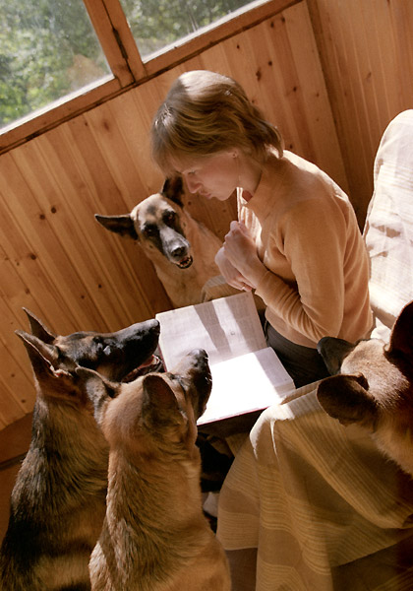
I am mad about books.

Slide 8

I like reading story about real life.

Slide 9
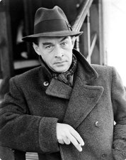
My favorite author is Remark

Slide 10

My favorite his book is «Three friends».

