Slide 1
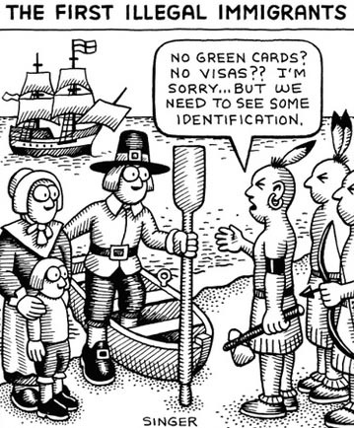
Illegal migration

Slide 2
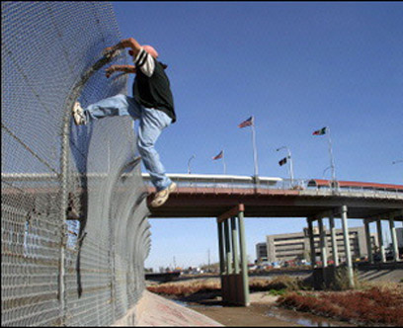
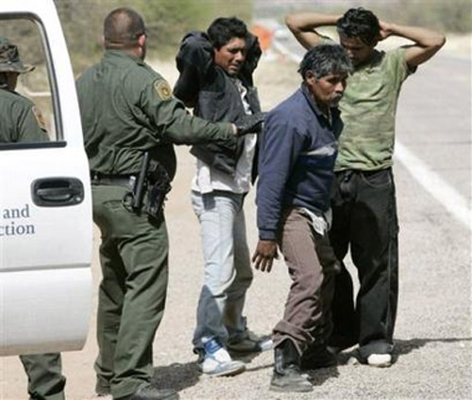
Migration

Slide 3
Illegal immigrant population in the USA

Slide 4
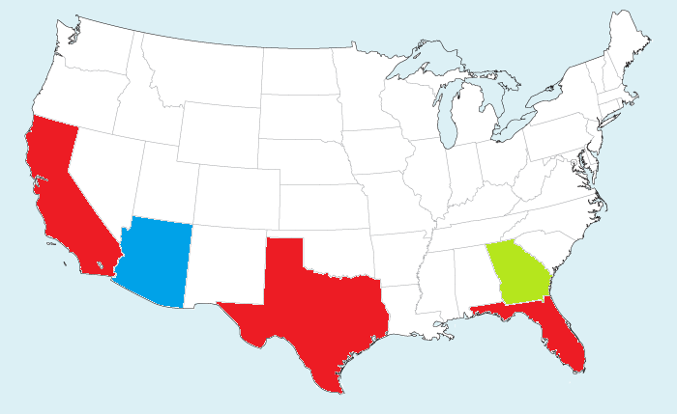
Illegal immigrant population in the USA

Slide 5
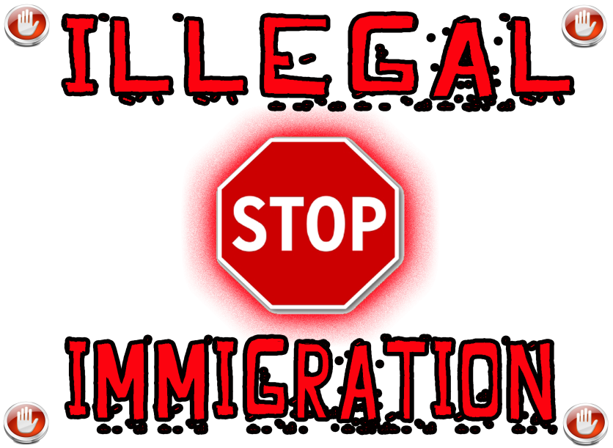
Pros and cons
- Burden on tax-based resources.
- Disparity between immigrants who follow the rules and those who don't.
- They risk death when traveling the desert to reach the borders.
- Continued growth of the demand for cheap labor and low wages.
+ It helps keep the economy moving by filling low-wage jobs.
+ It provides a better life to individuals and families who enter the country illegally.
+ It creates a pool of consumers for a variety of goods and services.

Slide 6
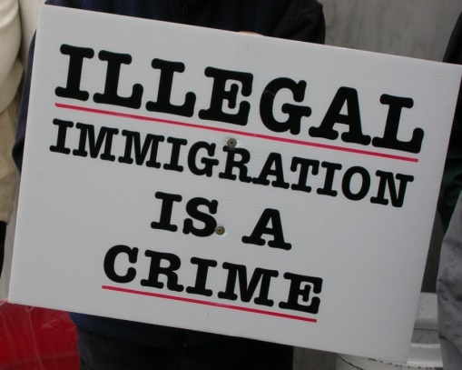
Pros and cons
+ Farmers are able to plant and harvest less expensively.
+ Illegal immigrants pay sales taxes.
+ Illegal residents, who are property owners, also pay real estate taxes.
- Potential negative effects on working and middle-class citizens.
- Millions of U.S. dollars sent outside the country.
- Unbalanced ethnic diversity.

Slide 7


Economic benefits

Slide 8
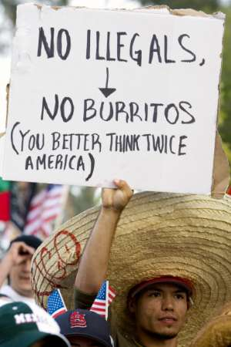
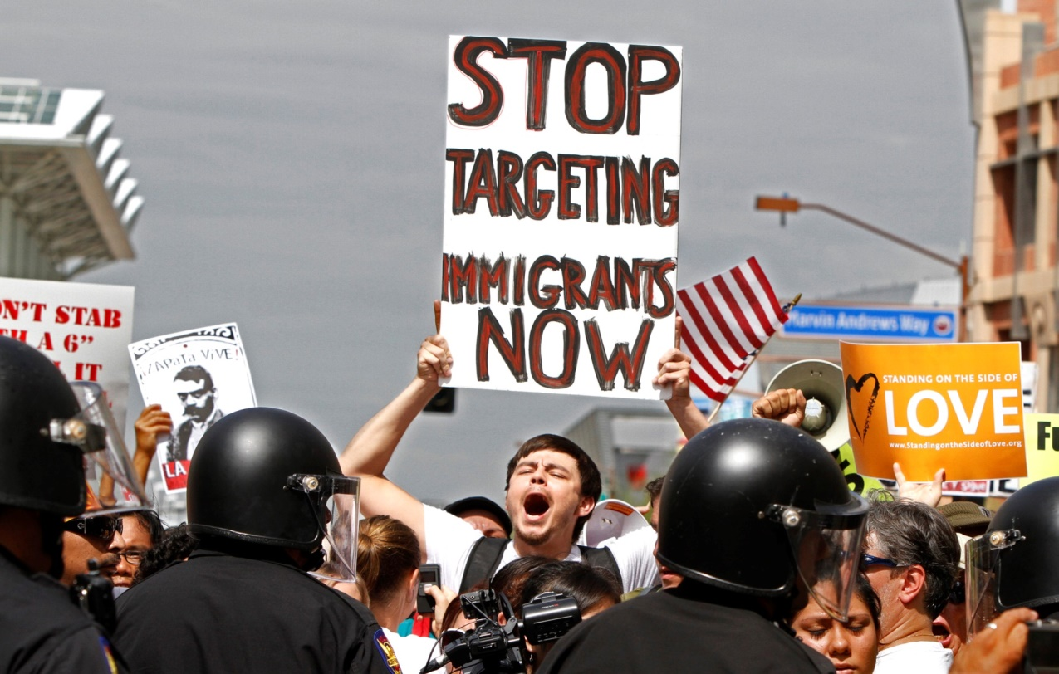
Deportation and human rights

Slide 9


Orphans
About 88.000 orphans left in the USA because of the deportation of their parents

Slide 10


Violence at home
1 of 4 women in the USA suffer from husband’s violence

Slide 11


New opportunities for migrants

Slide 12
Thank you for your attention!

