Slide 1
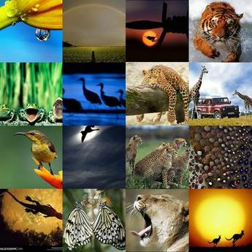
FAUNA

Slide 2
Fauna of Africa
Fauna of Africa, in its broader sense, is all the animals living on the African continent and its surrounding seas and islands. The more characteristic African fauna is found in the Afrotropical ecoregion - formerly called Ethiopian (the Sub-Saharan Africa).Lying almost entirely within the tropics, and equally to north and south of the equator creates favourable conditions for rich wildlife.

Slide 3


Slide 4
Fauna of Asia
Fauna of Asia is all the animals living in Asia and its surrounding seas and islands. Asia shows a notable diversity of habitats, with significant variations in rainfall, altitude, topography, temperature and geological history, which is reflected in its richness of animal life.

Slide 6
Fauna of Europe
Fauna of Europe is all the animals living in Europe and its surrounding seas and islands.The wildlife is not as rich as in warmer regions, but nevertheless diverse due to the variety of habitats and the faunal richness of the Eurasia as a whole.
Before the arrival of humans European fauna was more diverse and widespread than today. The European megafauna of today is much reduced from its former splendour. Many of these species still exist in smaller number, while others thrive in developed continent free from natural predators. Many other species went extinct all together.

Slide 8
Fauna of South America
The fauna of South America consists of a huge variety of unique animals some of which evolved in relative isolation. The isolation of South America had an abrupt end some few million years ago when the Isthmus of Panama was formed allowing small scale migration of animals that would result in the Great American Interchange.

Slide 10
Fauna of north Аmerica
The North American continent is covered by extensive pine forests. This is the habitat of animals that are similar to Asian species. Even before the middle of the XIX century to the vast expanses of the local dry prairies in the center of the North American continent peacefully grazing herds of bison and wolves roamed.

