Slide 1
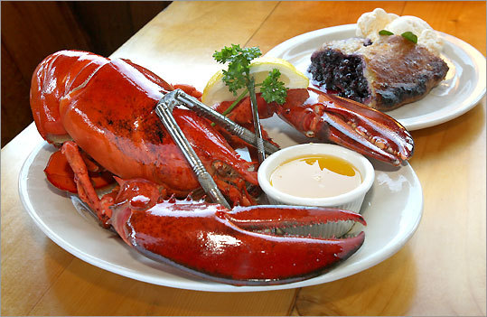
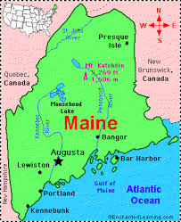
Welcome to Maine!!!

Slide 2
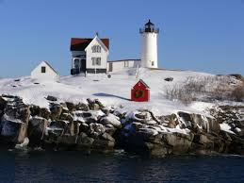
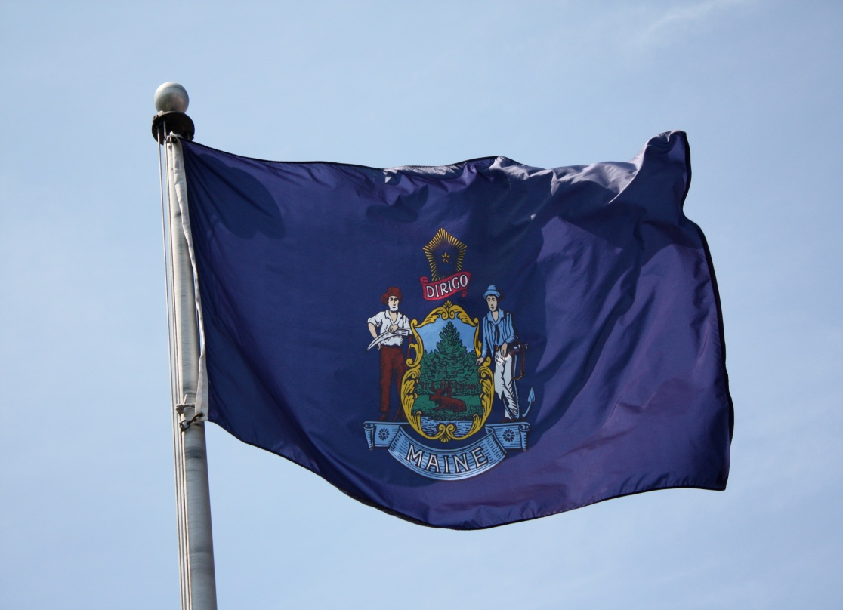
Geography
Maine is a state in the New England region of the northeastern United States, bordered by the Atlantic Ocean. The population of Maine is 1 million 3 hundreds thousands. The capital of the state is Augusta. The biggest cities are Portland, Lewiston. The flag was adopted in February 23, 1909.

Slide 3
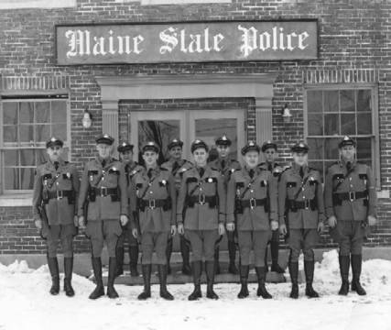

History
John Cabot and his son, are believed to have visited the Maine coast in 1498. However, the first permanent English settlements were established, in 1623. . Long governed by Massachusetts, Maine became the 23rd state as part of the Missouri Compromise in 1820.

Slide 4
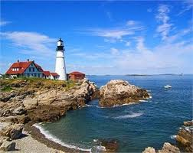
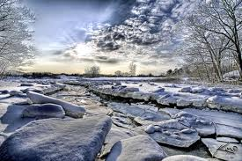
Climate
Maine has a humid continental climate with warm humid summers. Winters are cold and snowy throughout the state, and are especially severe in the northern parts of Maine..

Slide 5
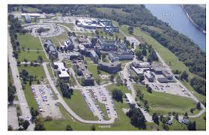
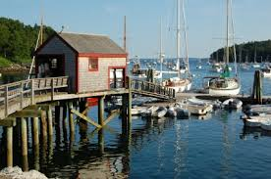
Places of interest
Maine is full of different tourist attractions. In spite of the fact that it is not very big it is a calm peaceful place which attracts tourists all over the world.

Slide 6
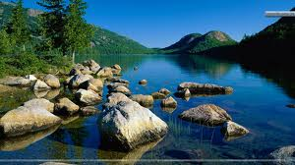
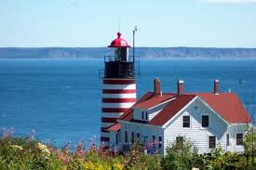
Greater Portland & Casco Bay
Situated on the southern coast of Maine, the Greater Portland area is a hub of arts, entertainment and dining. Natural deepwater in Casco Bay which doesn’t freeze in winter looks extremely beautiful.

Slide 7
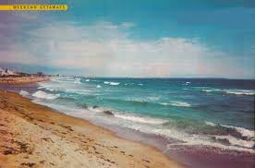
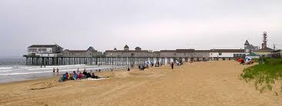
Beaches in Maine
At Maine's southern tip, The Maine Beaches region contains 30 miles of white sand beaches. Every year, the sandy beaches in Maine are a primary tourist attraction.

Slide 8
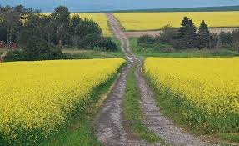
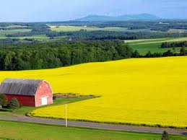
Aroostook County
Aroostook County is Maine's northernmost region and the largest county in the state. It is an extremely relaxing and peaceful place. So if you are tired of noisy city life that will be the best place for you.

Slide 9


Penobscot Marine Museum
The Penobscot Marine Museum is Maine's oldest maritime museum and is designed to educate people. It was founded in 1936. Designed as a unique 19th century seafaring village, the museum has thirteen historic and modern buildings.

Slide 10
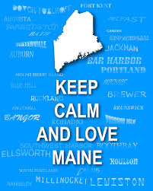
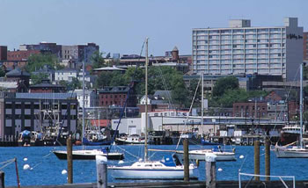
Thank you for your attention!!☺

