Slide 1
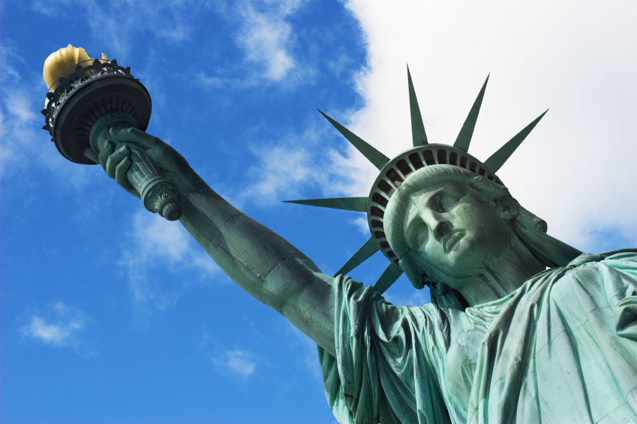
Statue of Liberty
Liberty Enlightening the World

Slide 2
Create statue was entrusted to the French sculptor Frédéric Auguste Bartholdi. Conceived it as a gift to the centennial of the Declaration of Independence in 1876. According to one version, Bartholdi has a French model: beautiful, recently widowed Isabella Boyer, the wife of Isaac Singer, the creator and entrepreneur in the field of sewing machines. "She was released from the awkward presence of her husband, who left her with only the most preferred attributes in society: the state ... and children. From the beginning of his career in Paris, she was well-known personality. Being beautiful French widow of an American entrepreneur, she was a suitable model for the Statue of Liberty Bartholdi. "
By mutual agreement, America would build the pedestal, and France - create the statue and install it in the US. However, the lack of money was felt on both sides of the Atlantic. In France, charitable donations, along with a variety of entertainment events and lottery allowed to collect 2.25 million francs. In the United States to raise funds it was performed theatrical performances, art exhibitions, auctions and boxing bouts.

Slide 3
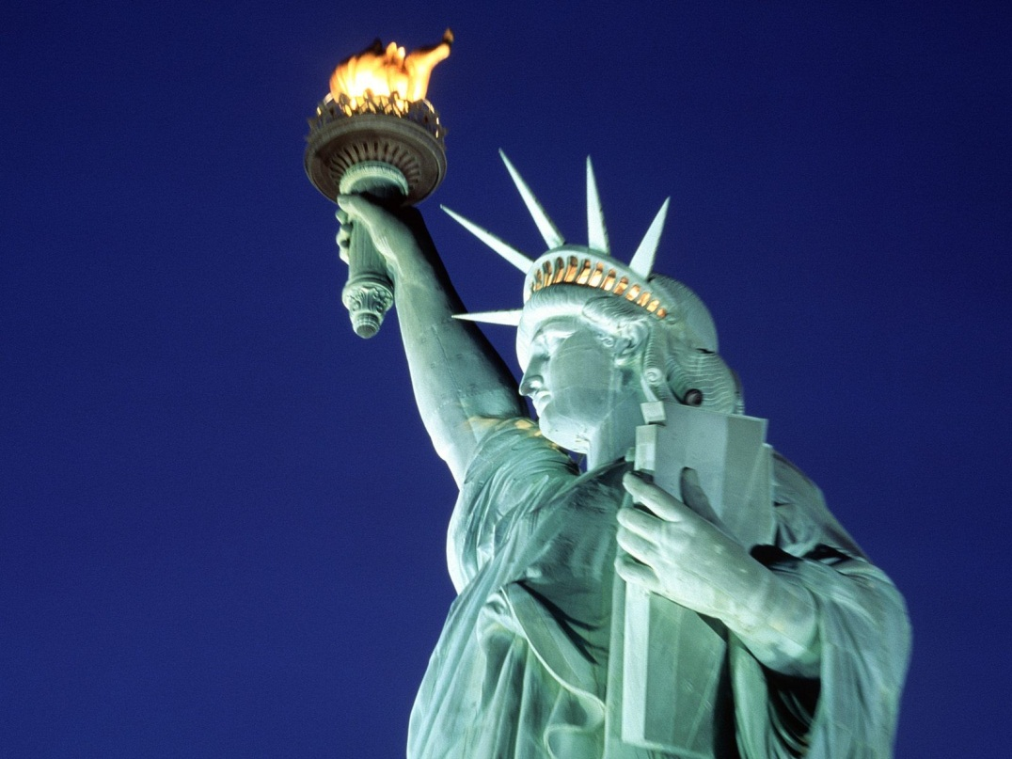
Since its opening, the statue served as a navigational landmark and was used as a lighthouse. Three superintendent for 16 years in turn keeps the fire in her torch.

Slide 4
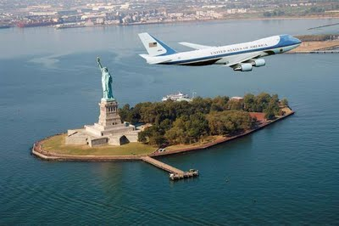
Island
Меню

Slide 5
History of the Statue of Liberty and the island on which it stands, - a history of changes. The statue was placed on a granite pedestal inside Fort Wood that was built in the 1812 war, the walls of which are laid out in the shape of a star. Service of lighthouses in US is responsible for maintaining the statue until 1901. And after 1901, this mission was assigned to the War Department. Presidential Decree from October 15, 1924 Fort Wood (and the statue on its territory) was declared a national monument whose boundaries coincide with the boundaries of the fort.
October 28, 1936, on the 50th anniversary of the opening of the statue, US President Franklin Roosevelt said, "Freedom and peace – is the living things. That they continue to exist, each generation must protect them and invest in them a new life. "

Slide 6
The statue and the island were closed from September 11, 2001 to August 3, 2004 due to the terrorist attacks on the World Trade Center. August 4, 2004 the monument was opened, but the statue itself, including the crown remained closed. On the inner frame of the statue could look through the glass ceiling of the pedestal. And there, on the observation deck at the podium could only get organized excursion. Access to the island itself was accompanied by new restrictions and checks for security purposes. Statue and her crown were again open for tours from July 4, 2009. Stairs to the torch is still closed (since 1916). Visitors on Liberty Island and the Statue are still subject to restrictions, including personal searches similar to the security check at airports.
Меню

Slide 7
The height from the bottom to the top of the torch 46.05 m. The height from the ground to the tip of the torch 92.99 m. Height of the statue 33.86 m. The length of the hand of 5.00 m. The length of the index finger, 2.44 m. From head to head chin 5.26 m. The width of the face 3.05 m. Length of eyes 0.76 m. The length of the nose of 1.37 m. The length of the right hand 12.80 m. The thickness of the right hand of 3.66 m. The thickness of the waist 10.67 m. The width of the mouth of 0.91 m. The height of the plate 7.19 m. The width of the plates of 4.14 m. The thickness of the plate of 0.61 m. The height from the ground to the top of the pedestal of 46.94 m.

