Slide 1
Project
Spanish artists
By Olga Draganchuk

Slide 2
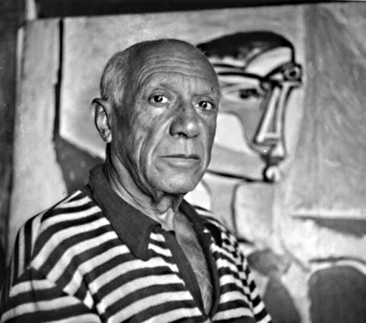
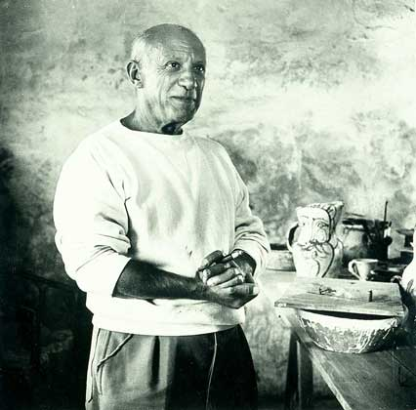
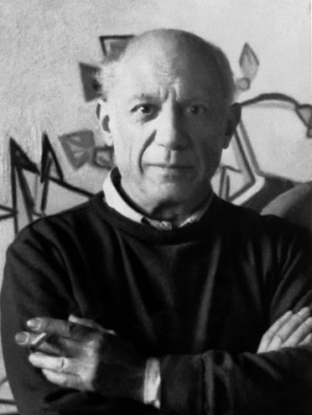
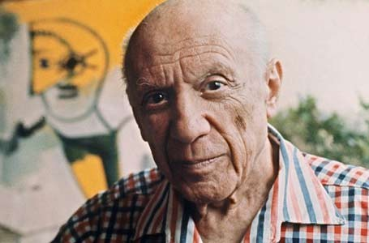
Pablo Picasso
Pablo Picasso, Spanish and French painter, one of the greatest artists of the XX century.

Slide 3
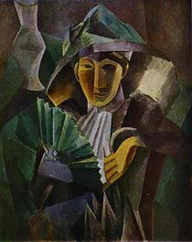
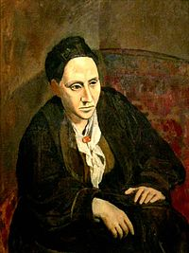
He was the founder of cubism, the mid 1910's created works in the neoclassical style, from the beginning of the 1920s became the leader of surrealism.
Portrait of Gertrude Stein
"Woman with a Fan"

Slide 4
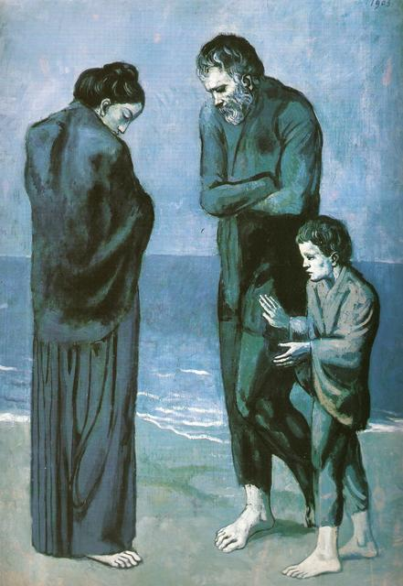
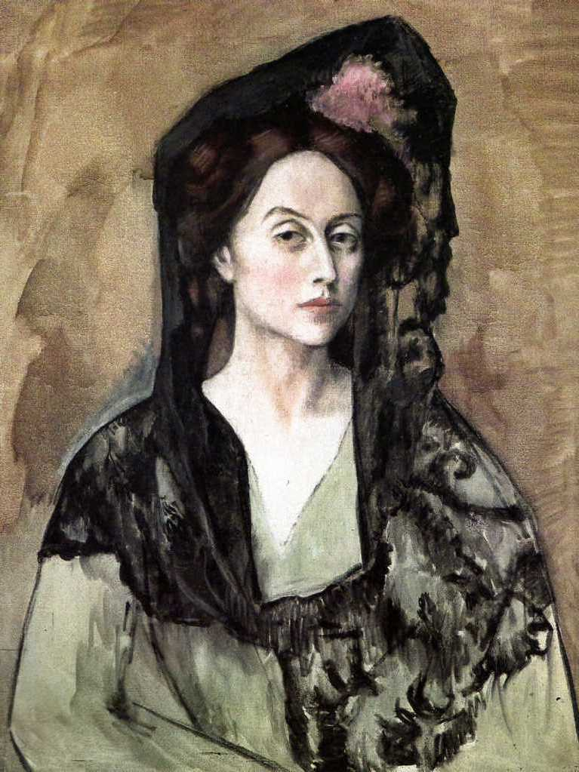
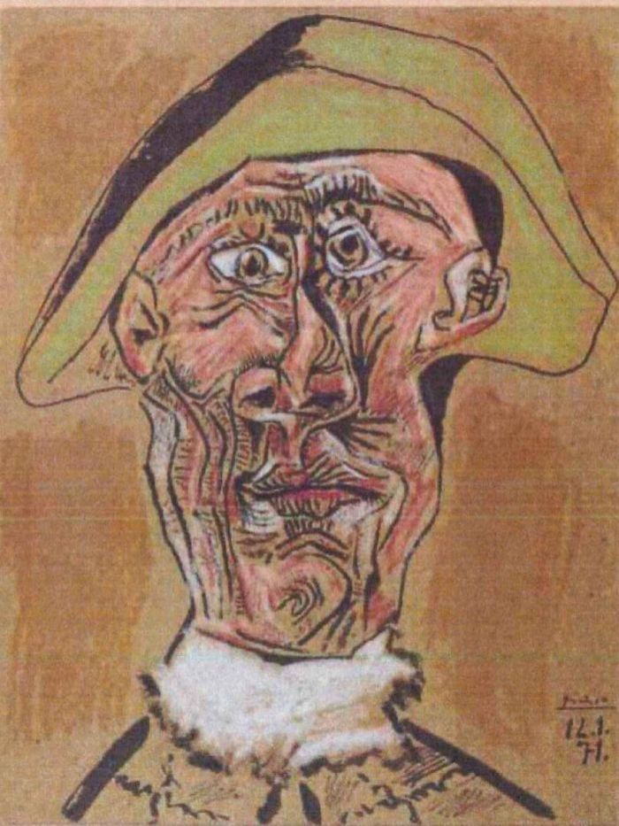
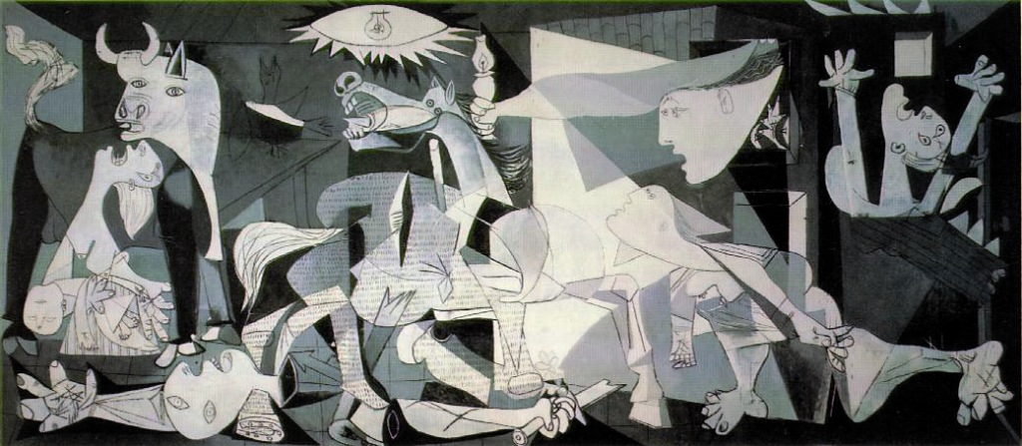
Retrato de
Benedetta Canals
Tête d'Arlequin
La Tragedia
Guernica

Slide 5
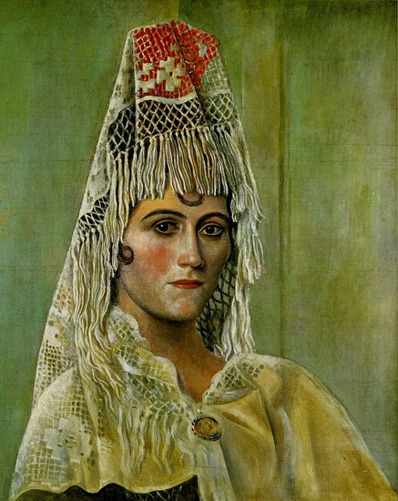
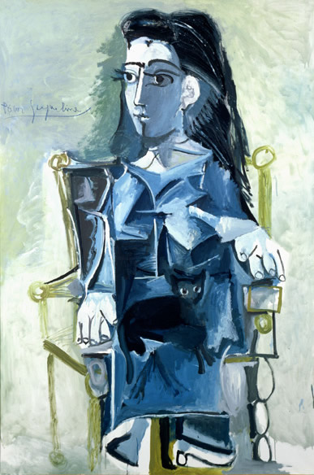
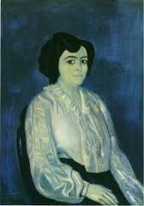
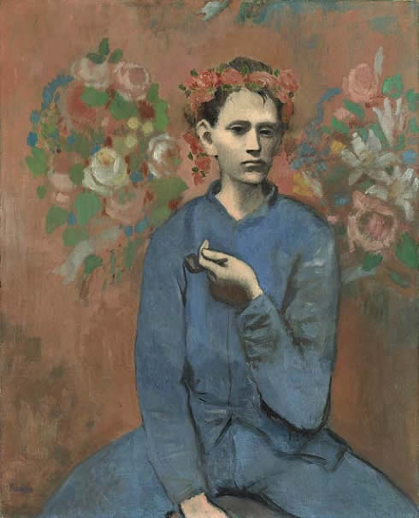
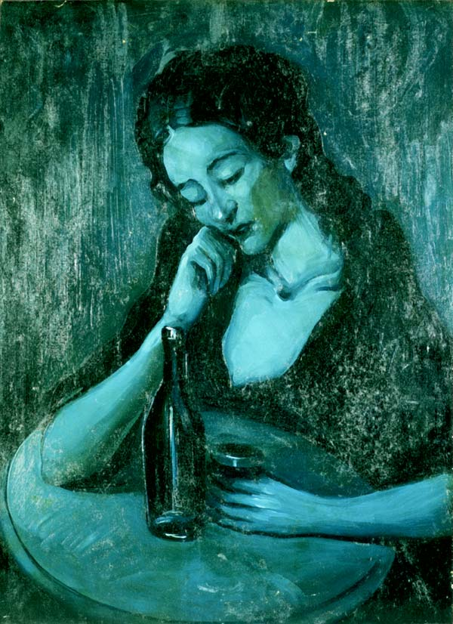
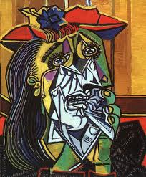
Olga Kokhlova
à la mantille
Jacqueline
assise
la Sra. Soler
La femme qui
pleure
Dama en Eden Concert
Chico con pipa

Slide 6
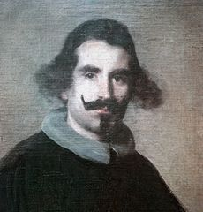
Diego Velazquez
Diego Velazquez - Spanish artist.
By genre paintings and portraits.
He was born in Seville in 1599, the poor aristocratic family of immigrants from Portugal. He studied painting in his hometown of Francisco Herrera the Elder and Francisco Pacheco.

Slide 7
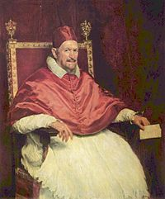
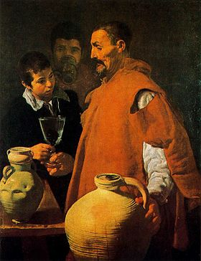
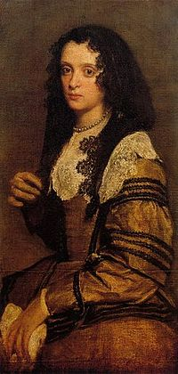
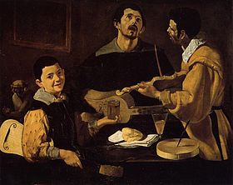
Portrait of Pope
Innocent X
"Waterman"
"Three music"
Unknown

Slide 8
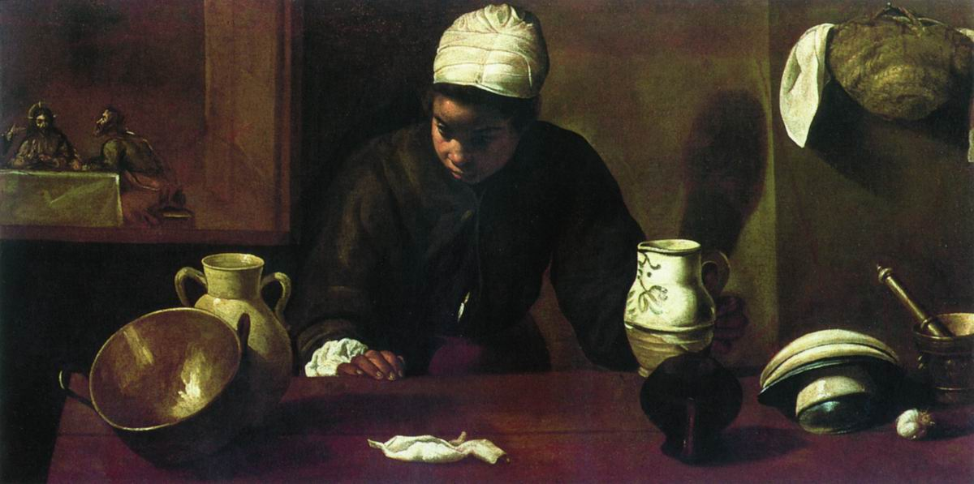
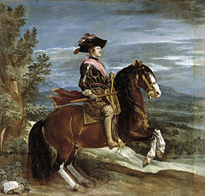
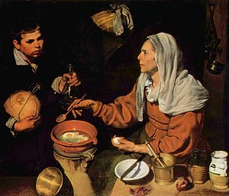
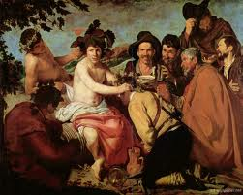
"Mulatto"
Philip IV on horseback
Wallpapers
"A woman prepares eggs"

Slide 9
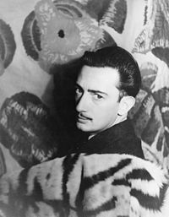
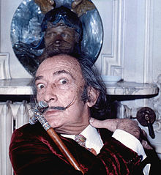
Salvador Dali
Salvador Dali, Spanish painter, one of the greatest surrealists of the twentieth century.
Interesting Facts:
- Collaborated with Walt Disney
He loved sweet and so in exchange for the
logo "Chupa Chups" he was given a box of candy every day.
- The giant anteater was his favorite pet.

Slide 10
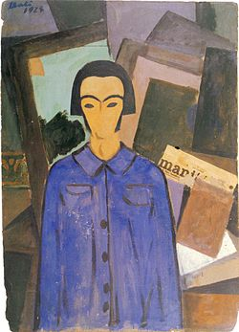
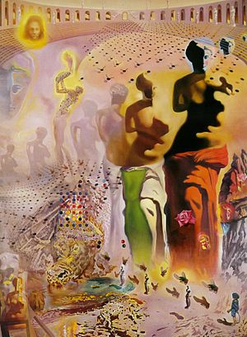
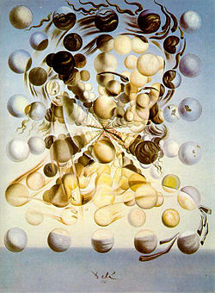
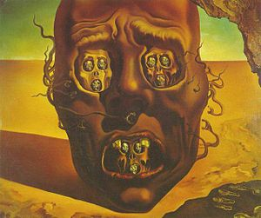
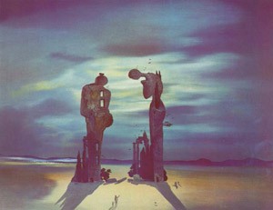
hallucinogenic toreador
"Cubist portrait"
"Galatea of the spheres"
"Archaeological echo"
Anzhelyusa "Mille"
Faces of war

