Slide 1
Homelessness

Slide 2
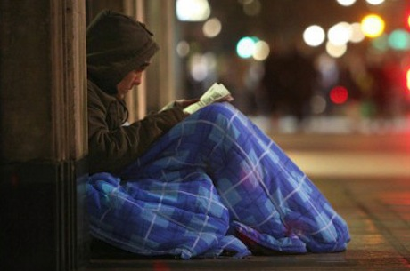
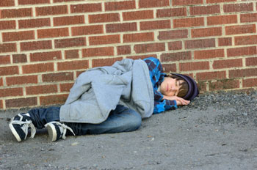
Homelessness
the condition of people without a regular, safe, secure and adequate dwelling

Slide 3
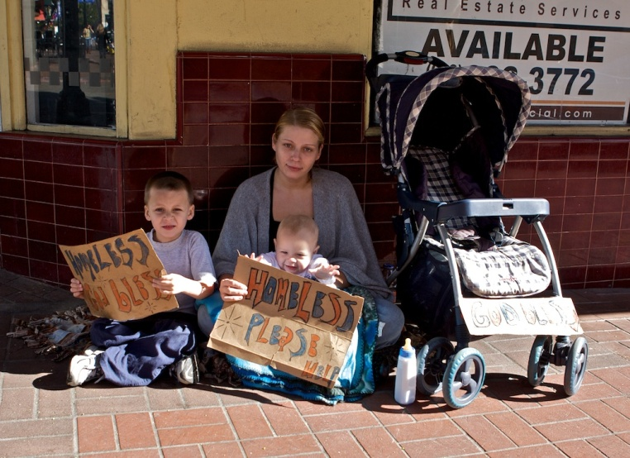
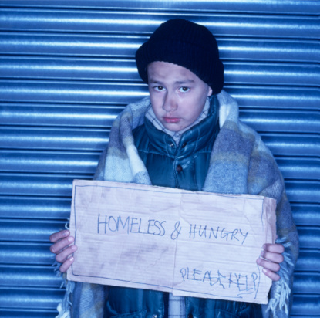
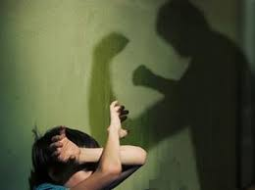
Who are homeless today?
35% - families with children
21% - have domestic violence
19% - children under the age of 18

Slide 4
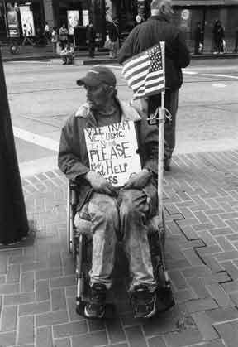
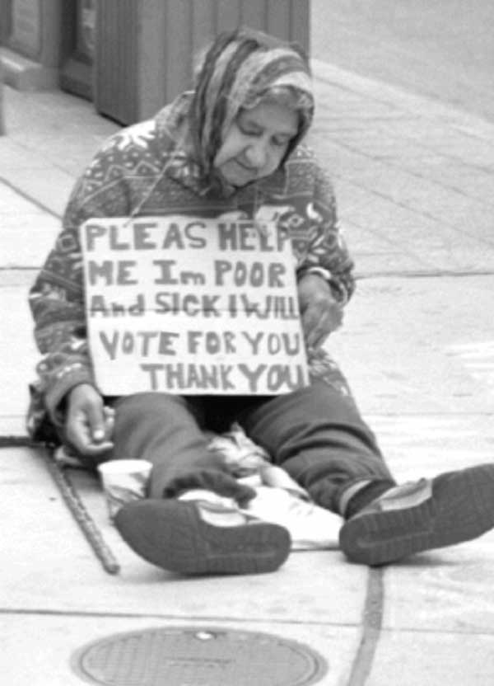
Who are homeless today?
15% - US military veterans
10% - suffer from mental illnesses

Slide 5
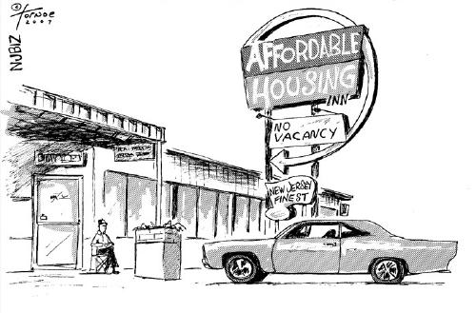
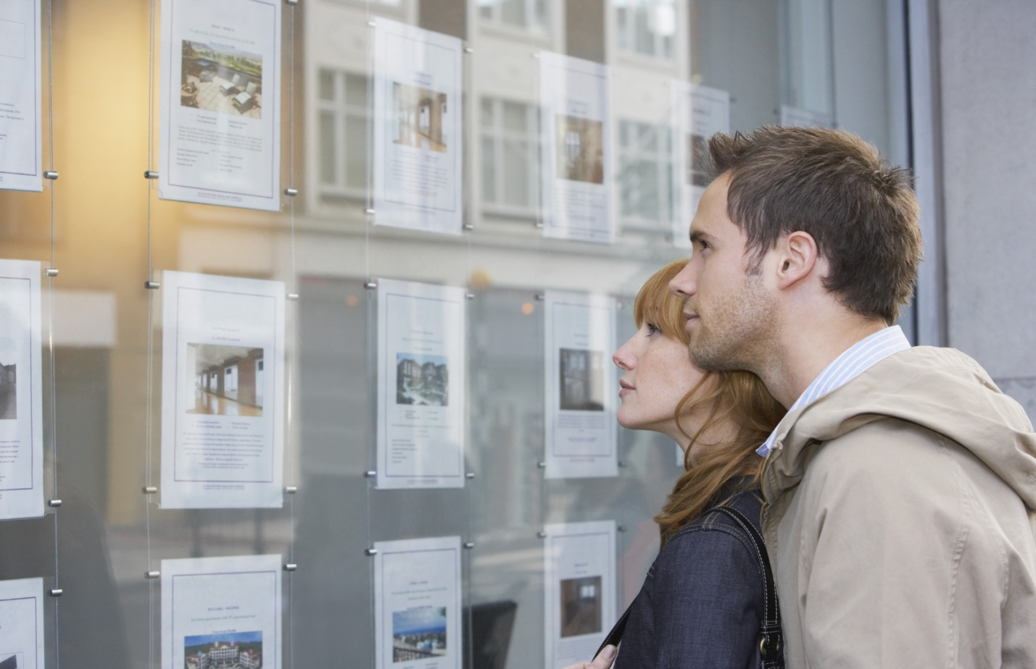
Reasons of the problem
There is a lack of affordable housing.

Slide 6
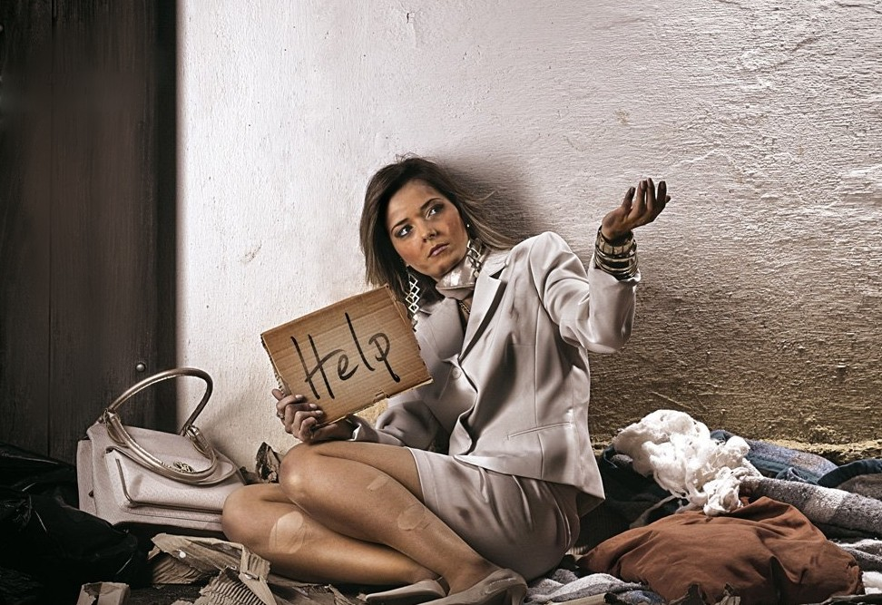
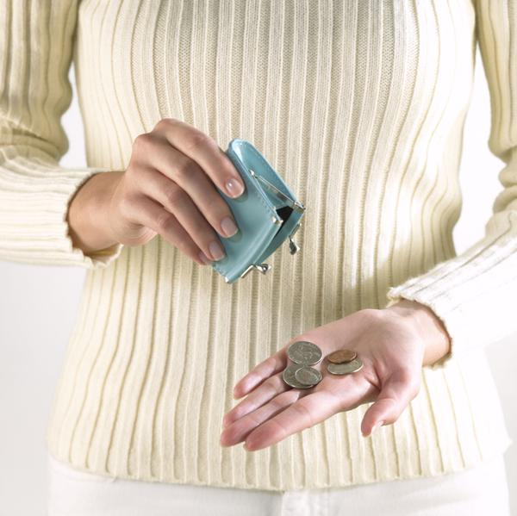
Reasons of the problem
Minimum incomes is too low.

Slide 7
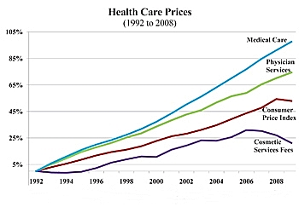

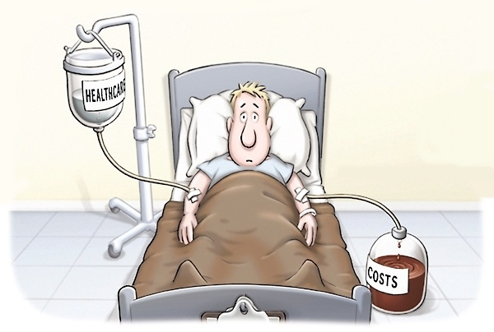
Reasons of the problem
The cost of health care has risen dramatically.

Slide 8
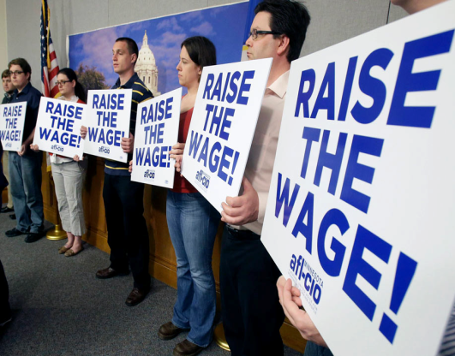


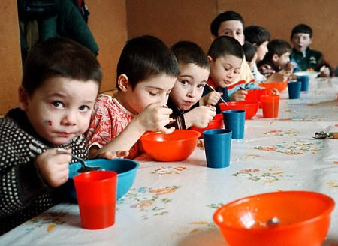

Solutions
Reconstruct the economy.
Provide new places for work.
Increase pensions for veterans.
Free health care.
Provide better conditions in shelters.
Pay more attention to housing and social programs.

Slide 9
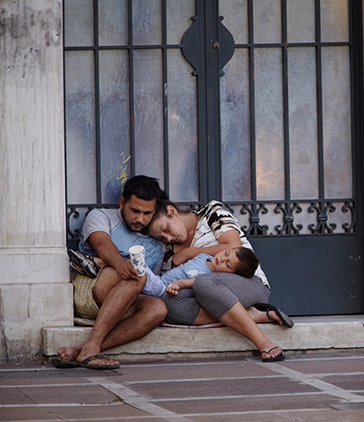

It’s impossible to solve the problem of homelessness quickly, but let’s turn
into

Slide 10
THANK YOU FOR YOUR ATTENTION!

