Slide 1

MY FAVOURITE ACRTESS
Jennifer Lawrence

Slide 2

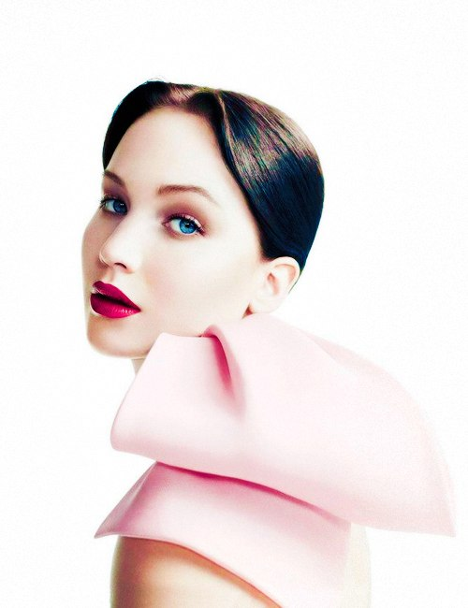
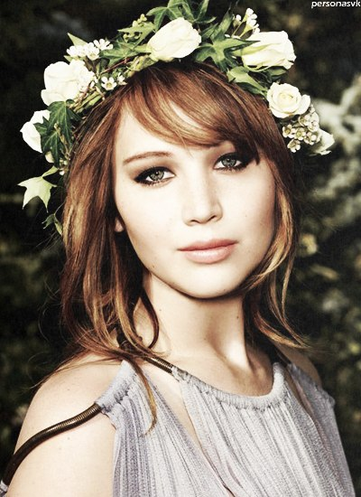

Slide 3

The girl who has lost the husband and "moved down from coils", looking for an exit from a depression in dance. The movie “Silver Linings Playbook” became Oscar-winning for young actress Jennifer Lawrence. Also her the best and known films were become “X-Men: First Class” and "Hunger games".

Slide 4

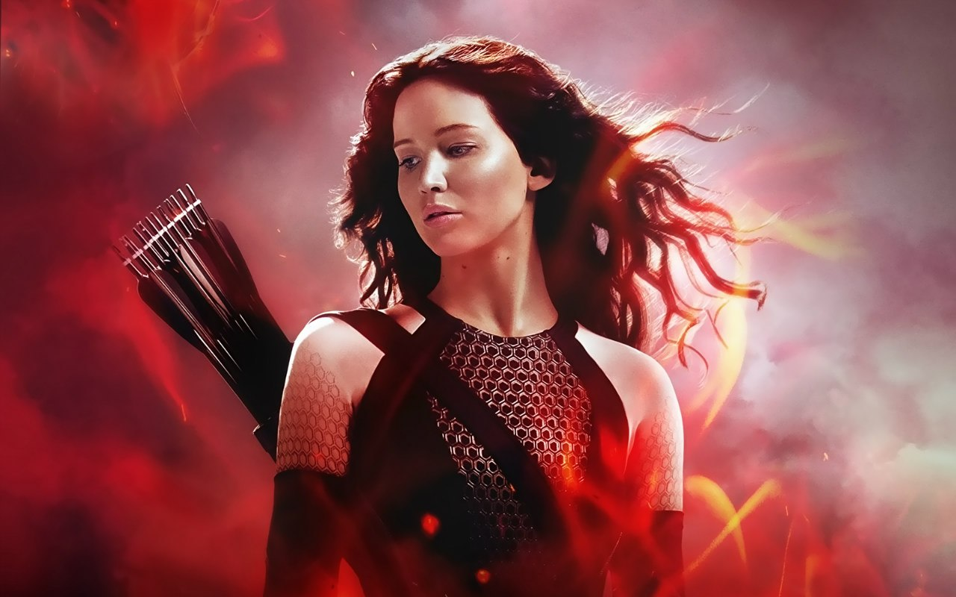


Slide 5
At 20-year age it was nominated on "Oscar" and "The gold globe", but both figurines were lost by Natali Portman.

Slide 6

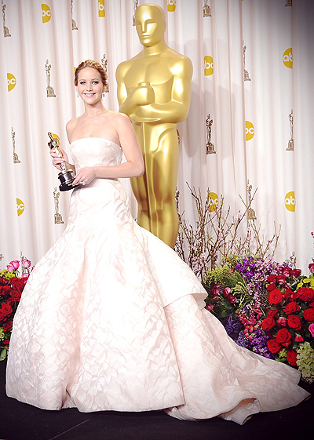
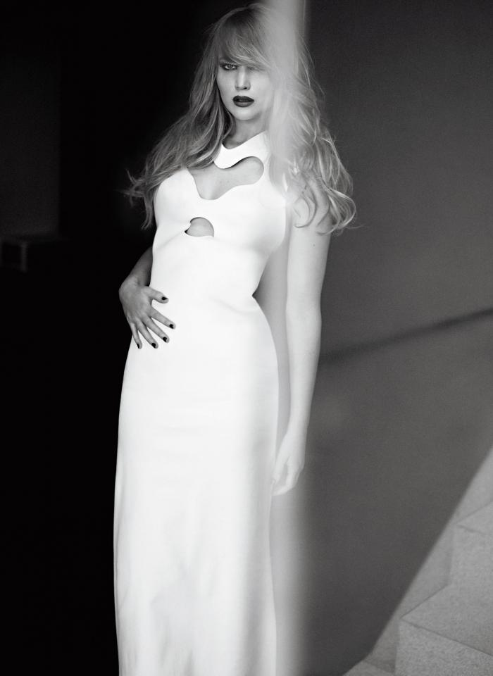

Slide 7
Jennifer was born on 15 of August, in 1990 in Louisville, the USA. In 14 years she resolved to become the actress, parents brought her to New York where agents highly appreciated her actor's skills. She graduated from school external for 2 years earlier to start acting in actively at film.

Slide 8
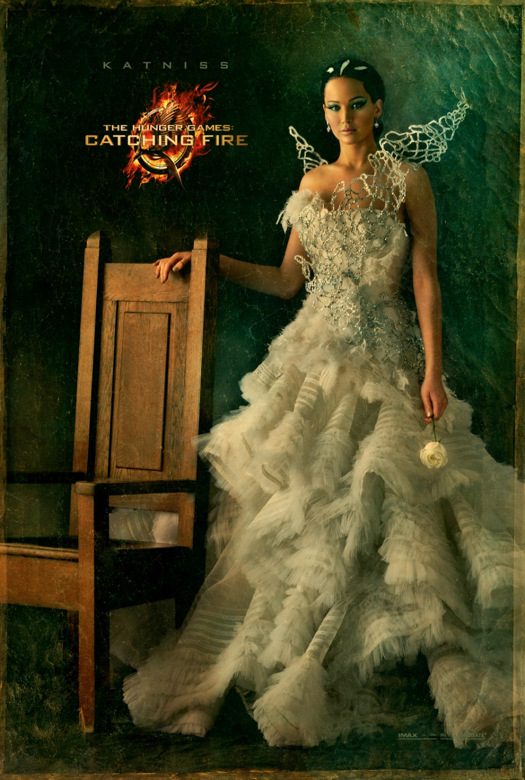
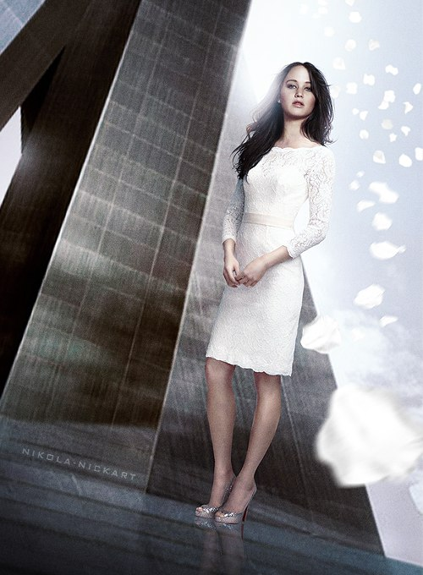

Slide 9
Jennifer — the girl, whose delightful sense of humour and a step, excellent actor's game and remarkable external data, refinement and an emotionality, appreciates and loves everyone who is familiar with her creativity.

Slide 10
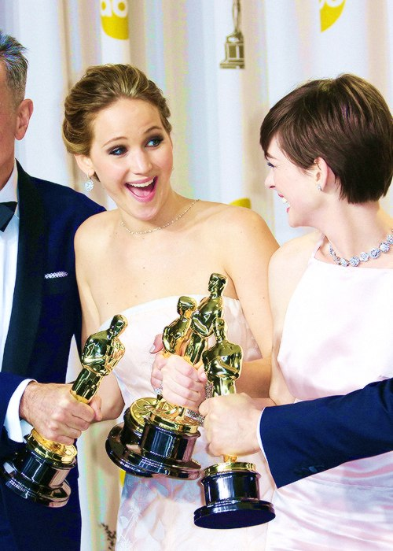
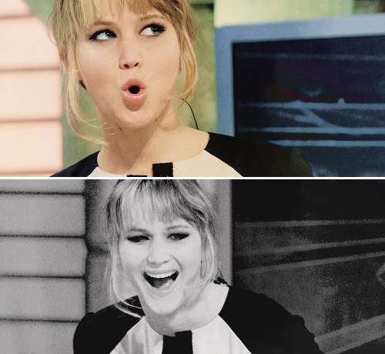

Slide 11
Jenn – well put girl of average height with hair of wheaten color and blue eyes. It fantastically looks both in design clothes, and in daily.

Slide 12
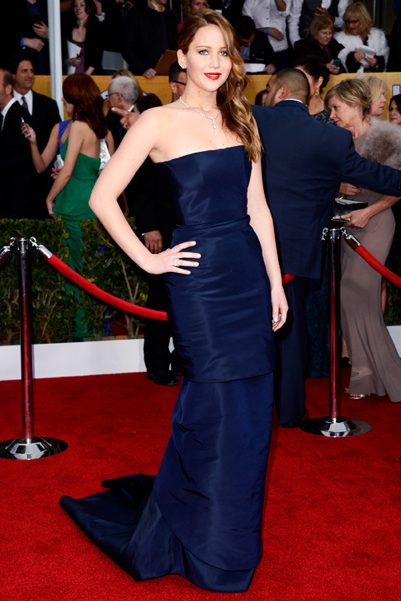
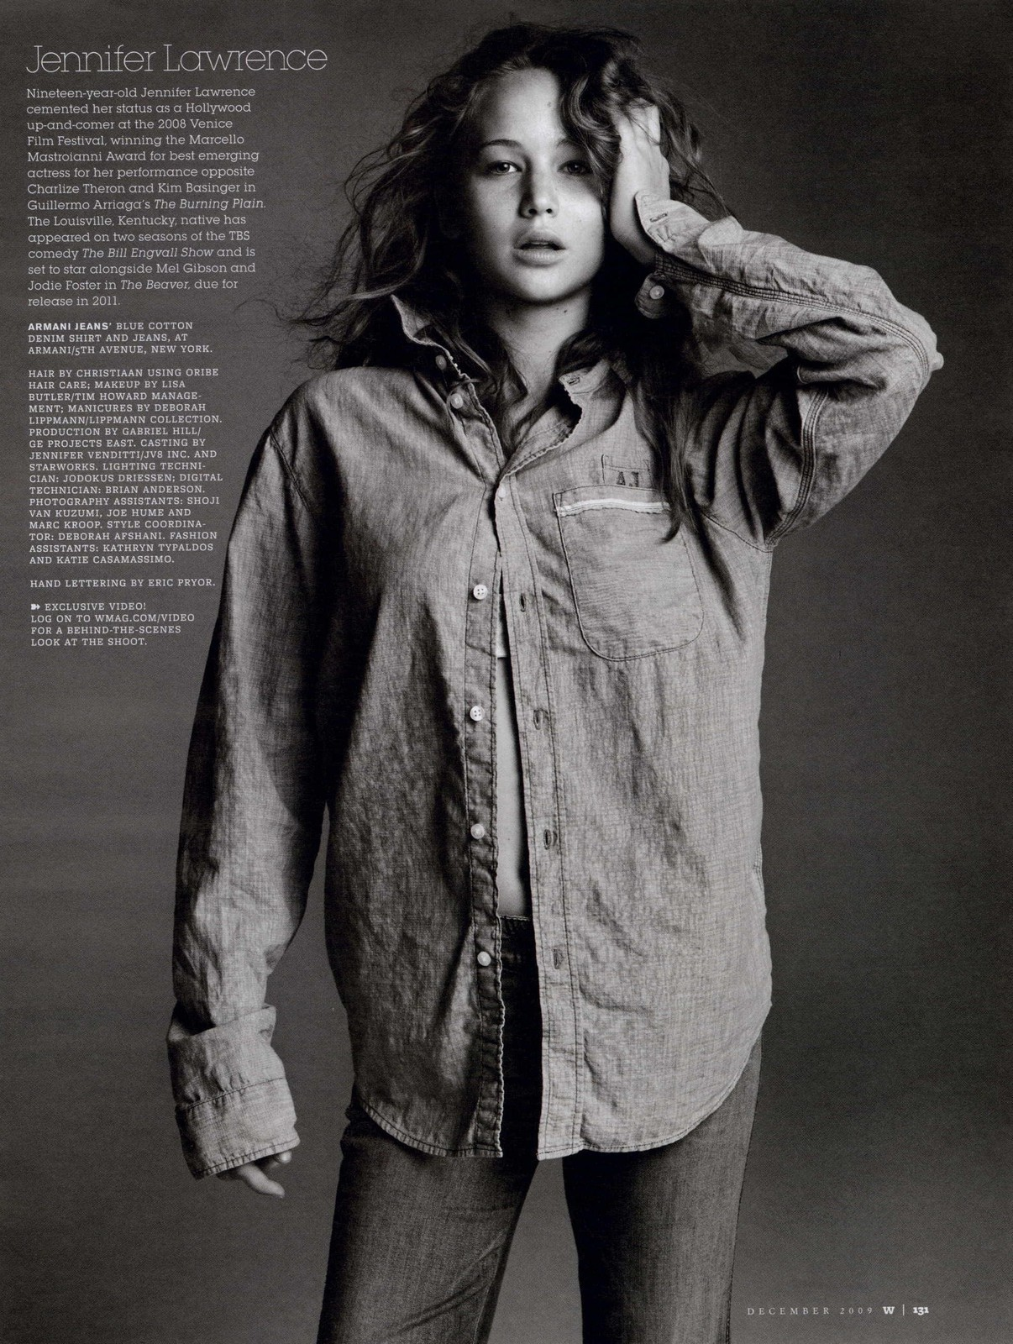

Slide 13
Ms. Lawrence enough constitution though at teenage age her agents forced to grow thin that she could receive a desirable role. Now Jennifer is ready to kill any who will say the word "diet" near her. The young actress one of the few who doesn't put a lot of effort to play a certain role, and it is grateful for it to the talent given by nature. Jenn often appears on public, but in 7 years, says that "despite the fact that, how many earns by the favourite business, it is difficult not to regret about it when the rack of paparazzi pursues you". Lawrence the kind and sympathetic person, it isn't ill star fever and on a scene (during interview) behaves simply and sincerely.

Slide 14
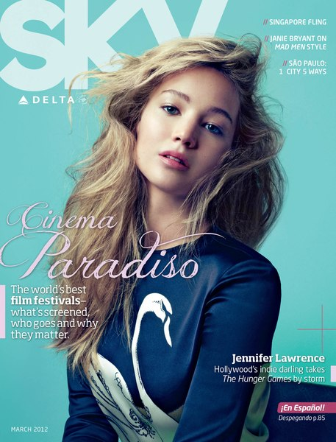
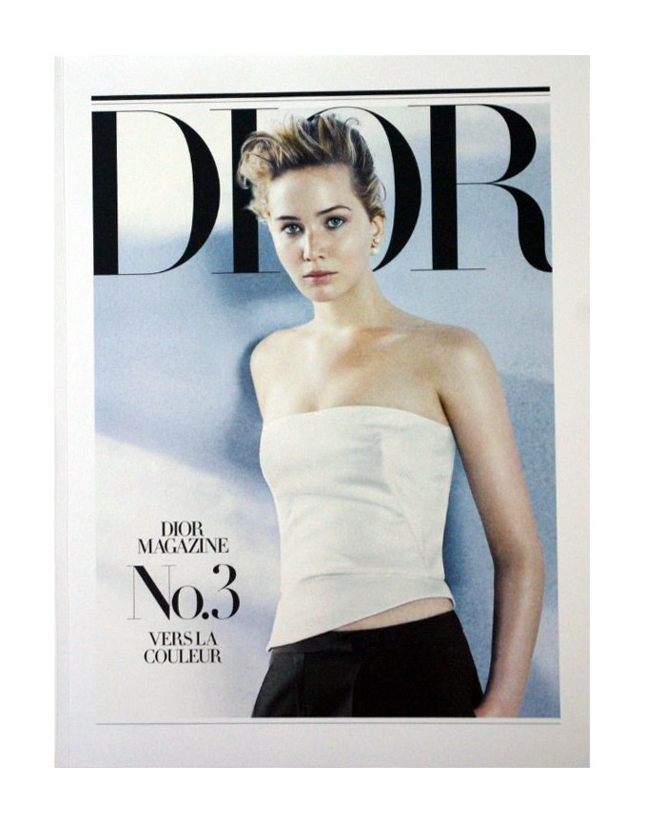

Slide 15
"Its counter — it to be shocking, a little near and simple-minded, and it is remarkable, the talent" is for this purpose necessary — Josh Hatcherson, her colleague according to the movie "Hungry Games" speaks.

Slide 16
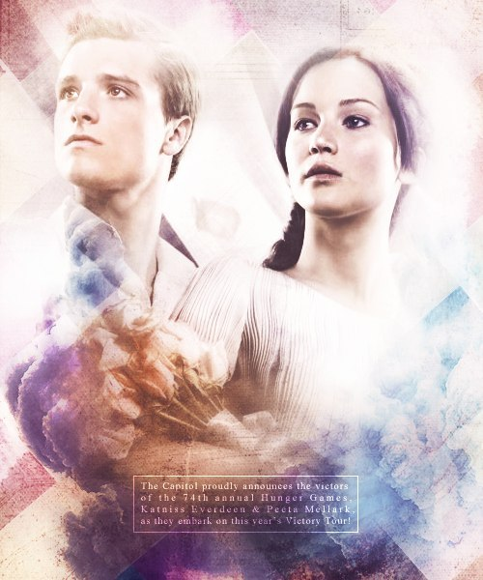
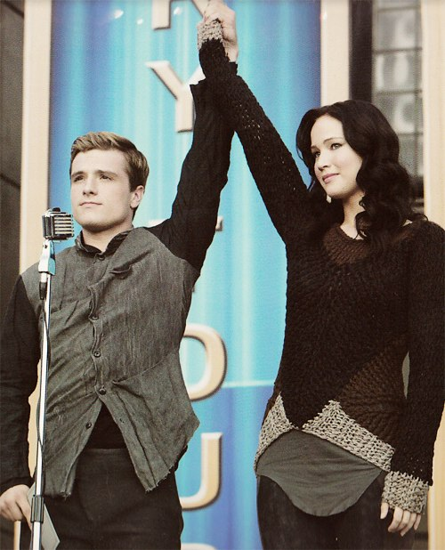

Slide 17
In free from work the actress draws time, knits sweaters, is engaged in surfing and plays a guitar. Also Ms. Lawrence says that in free time likes to spend time with friends and to look "Desperate Housewives".

Slide 18
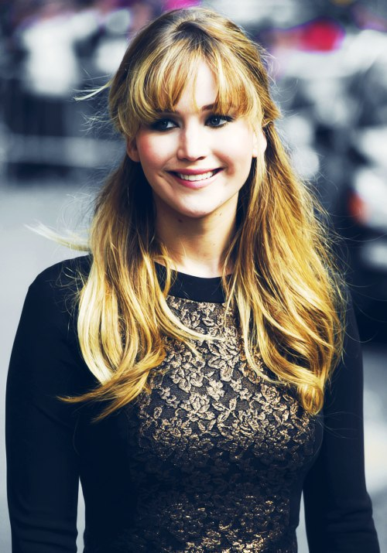
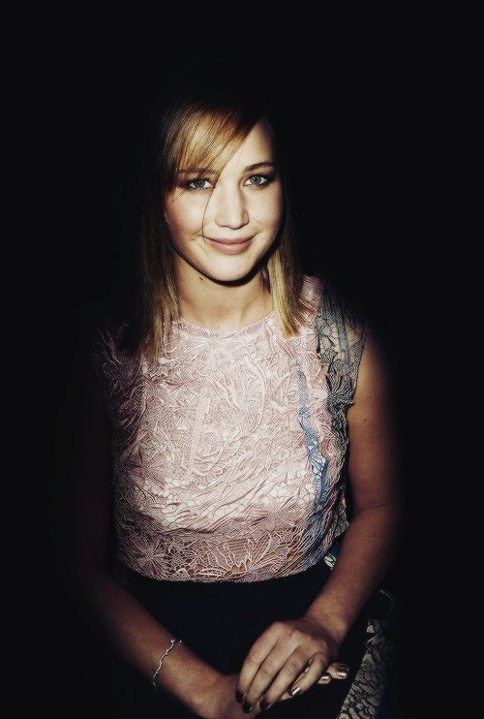

Slide 19
About itself - to stay-at-home Jennifer speaks so: "If I appear at a party, after eleven evenings I start thinking of the sofa. And that I pass a new series of reality show about Kardashyan's family, for me it is a stress".

Slide 20
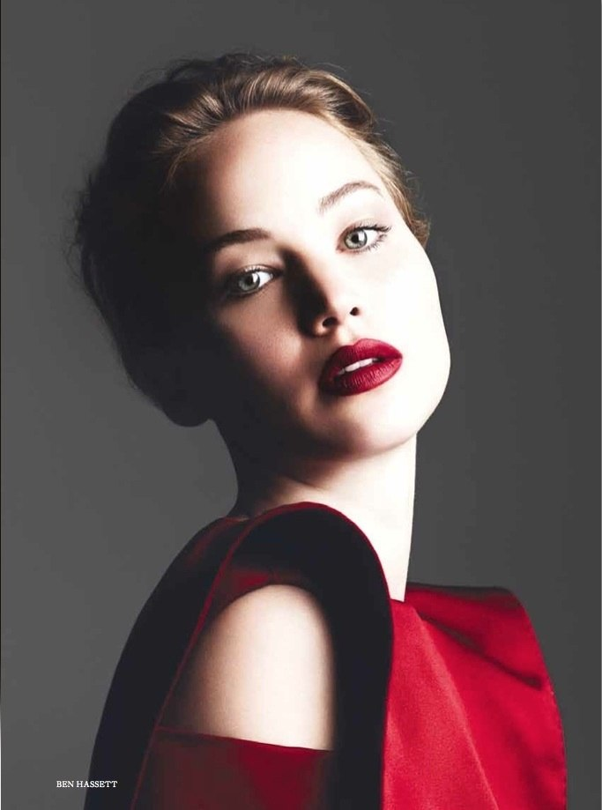
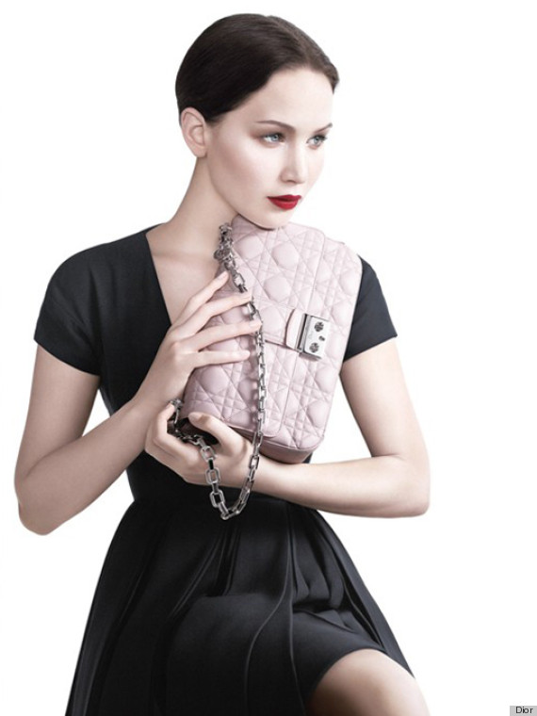

Slide 21
In one of Jenn's interview she told about the opinion on an actor's profession: "Perhaps it will sound roughly, but it seems to me, an aktor- such nonsense. When me ask as I manage not to think no mall of oneself, I answer: "And than me to be proud? I after all don't rescue people from death". There are doctors who save lives, firefighters who enter into burning buildings. And I only play at cinema. It is silly".

Slide 22
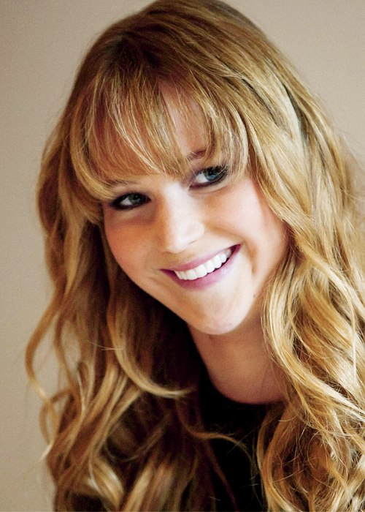
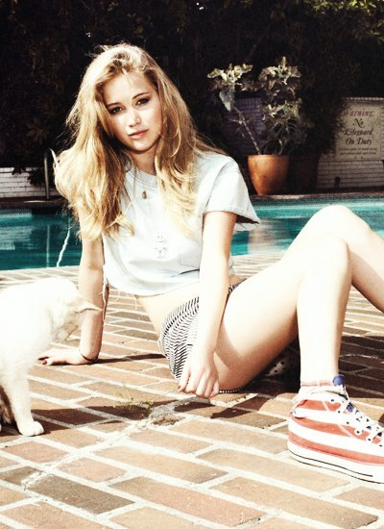

Slide 23
I love Jennifer Lawrence as idol that it even being the popular actress, remains the ordinary person without any star whims. She is a very good man with excellent sense of humour andtender heart.

Slide 24
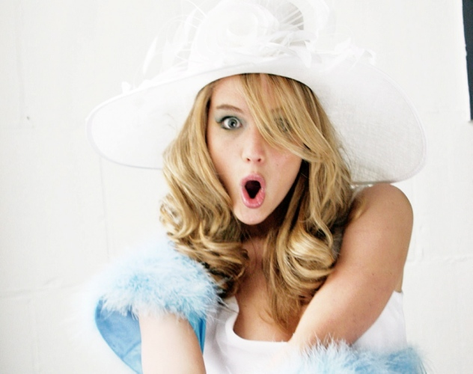
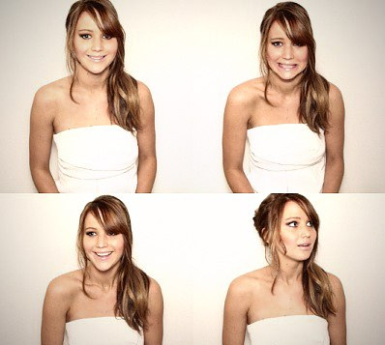

Slide 25
Thank you for a revision!

Slide 26
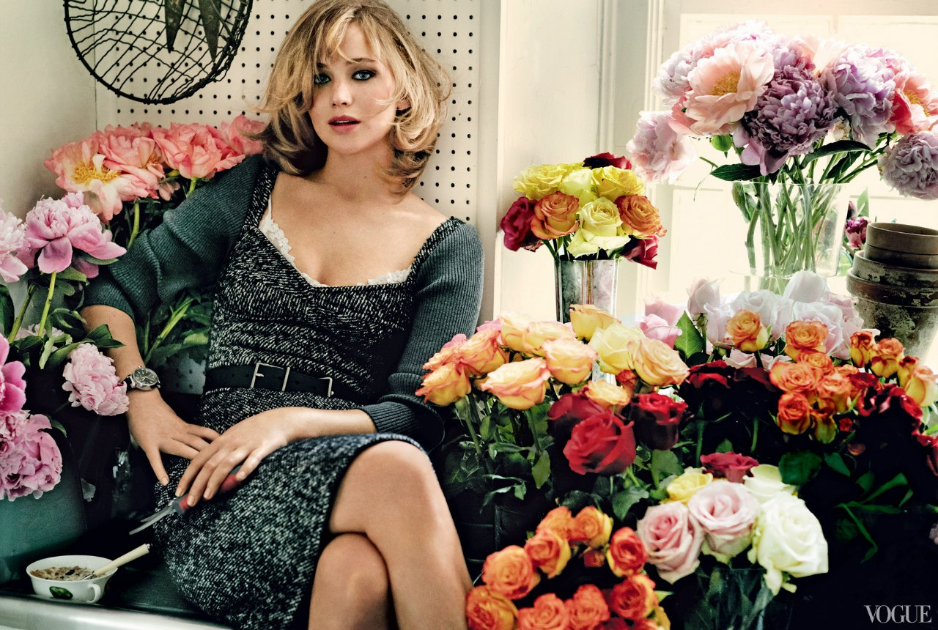

Slide 27
Presentation on a theme
"My favourite actress" from English students are 9-2 groups
Financial and Economic lyceum
Dnipropetrovsk
Zajvoi Ksenii
2013

