Slide 1

Italian national cuisine

Slide 2
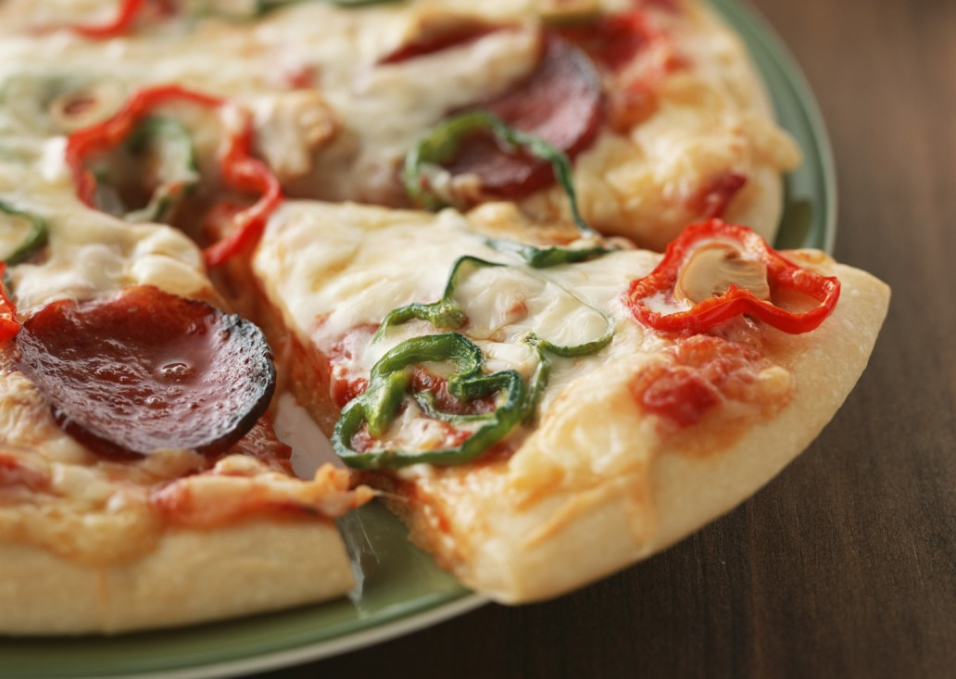
Enormous popularity of pizza, but, strangely enough, most of the tourists. Famous throughout the world was once a pizza dish poor - bread with tomatoes and spices, sometimes with cheap cheese. Over time, however, the chefs have learned to give it a spicy, sometimes refined taste, using in recipes, mushrooms, a variety of seafood, artichokes and even pineapples.

Slide 3
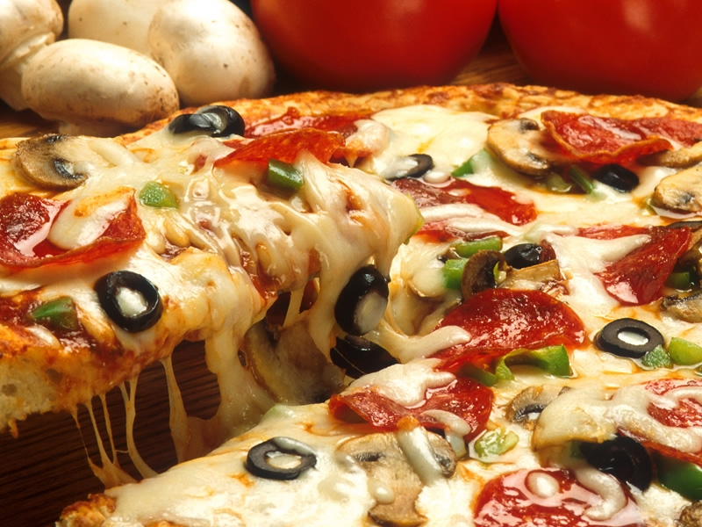
The weakness of the Italians - olives. They are served to any dish, including preparing sauces, added to soups and stews, baked with meat and various vegetables.

Slide 4
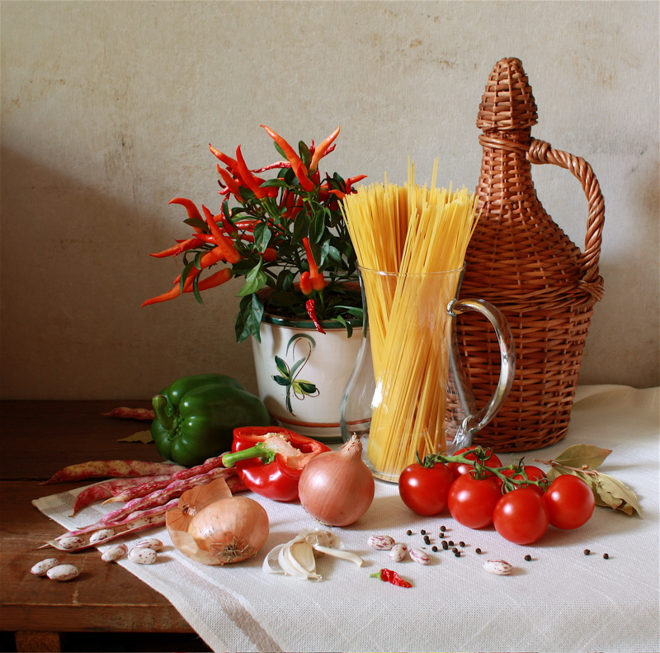

Slide 5
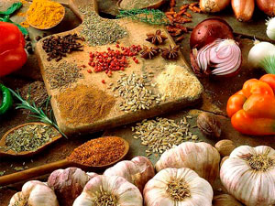
A characteristic feature of Italian food is the love of herbs. In Italian recipes basil and saffron is more often than any other recipes in the world.

Slide 6
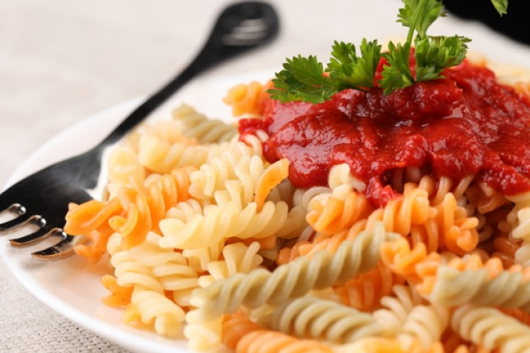
Italian cuisine, recipes which conquered the world, came to us later than others, but fell in love at first sight, to be exact, from the first bite.

Slide 7
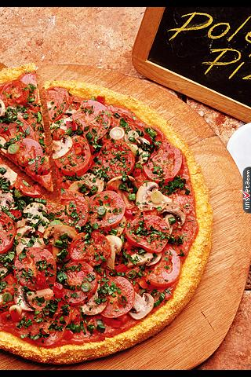
Play «Guess the food»
a) lasagna
b) pizza
c) salad

Slide 8
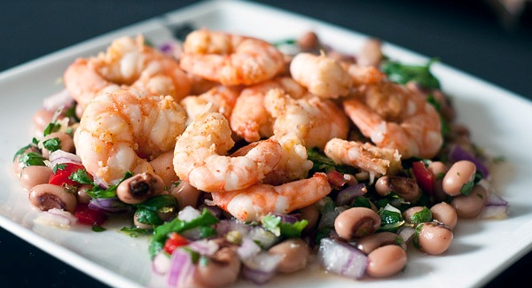
a)salad
b)crab sticks
c)shrimp

Slide 9
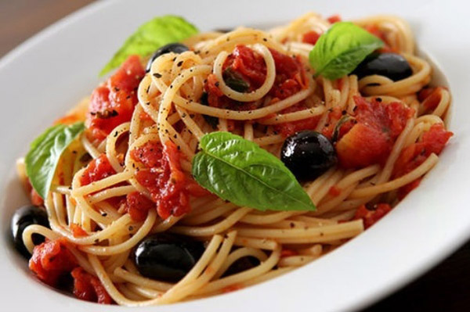
a) pasta
c) olives
b) salad

Slide 10
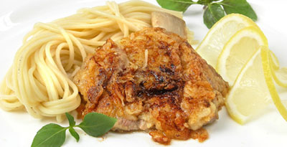
a) rissole
b) fish
c) chicken

