Slide 1
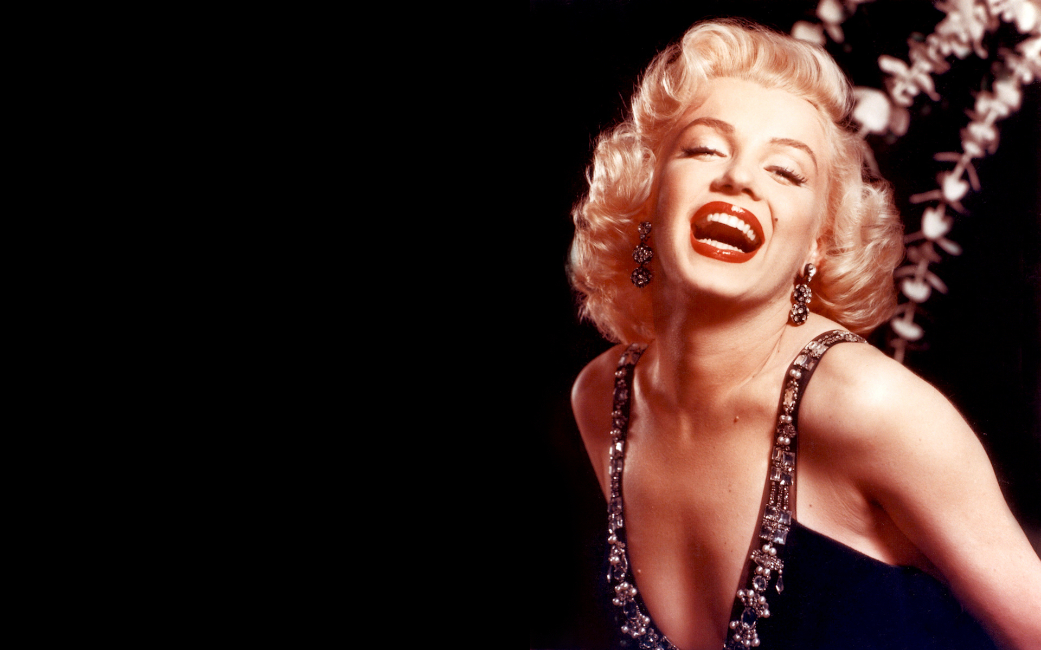
Marilyn
Monroe

Slide 2
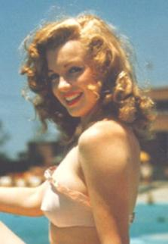
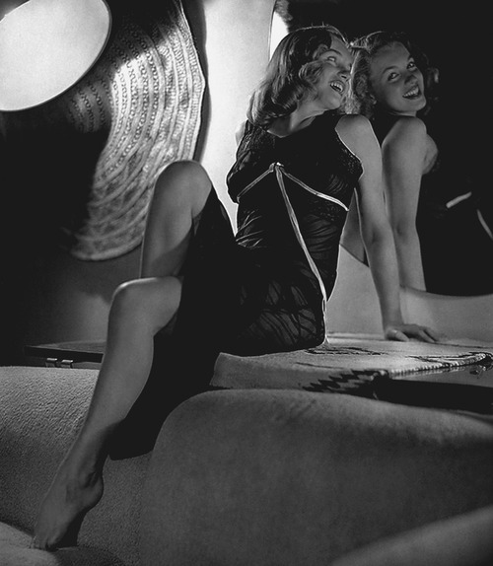
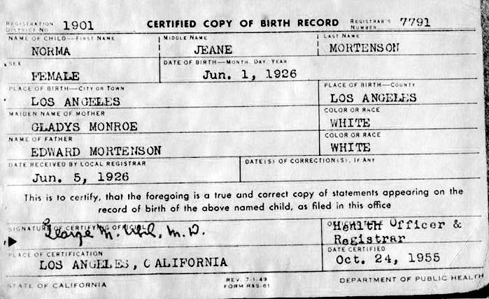
Marilyn Monroe Baker had a disturbing childhood. She was raised under the care of foster parents as her mother was mentally unstable.
Having spent most of her years under foster care, young Marilyn was often subjected to sexual abuse, which had an impact on her life and behaviour.

Slide 3
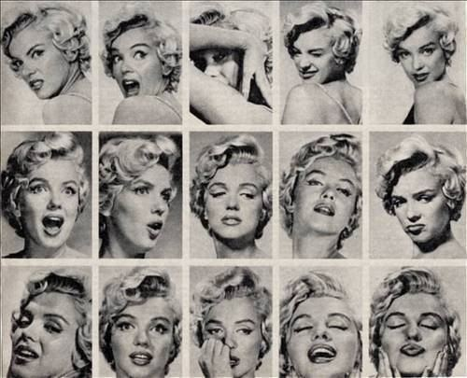
It was her mom's friend and guardian Grace McKee who first told Monroe that someday she would become a movie star. She used to make Norma Jeane wear makeup and got her hair curled like her movie star Jean Harlow.

Slide 4
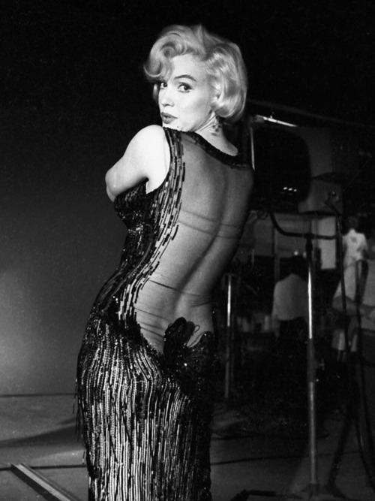
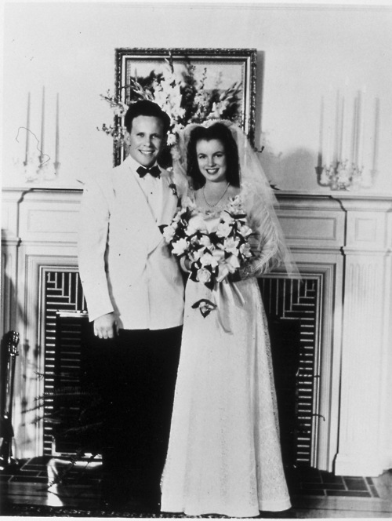
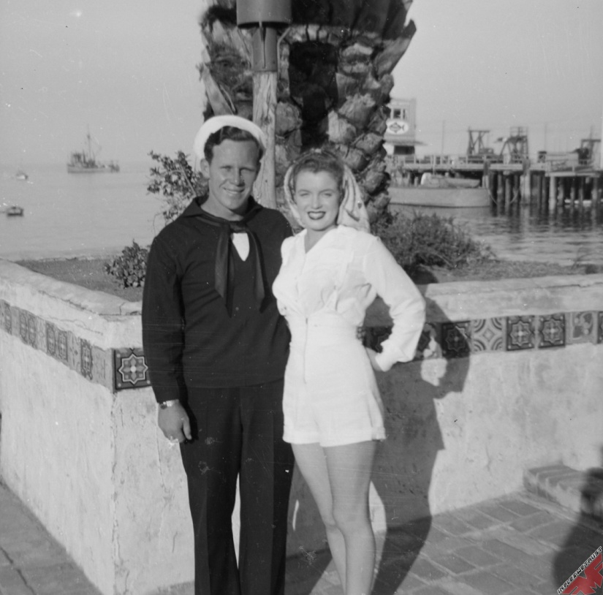
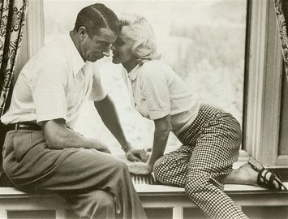
She married her first love James Dougherty, but they had to split eventually as Dougherty didn't approve her becoming a model. Marilyn was reluctant to give up her successful modelling career for the sake of family and thus decided to divorce Dougherty.

Slide 5
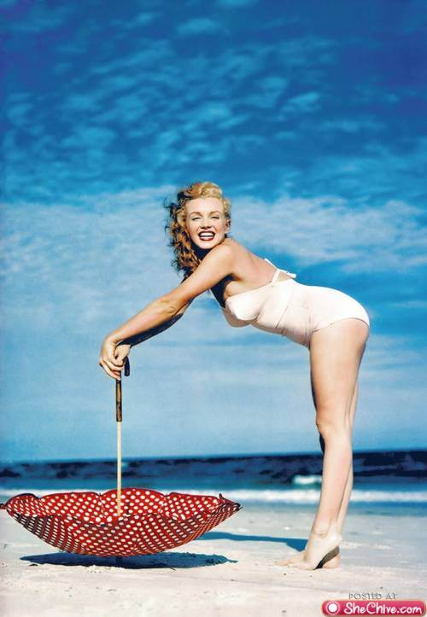
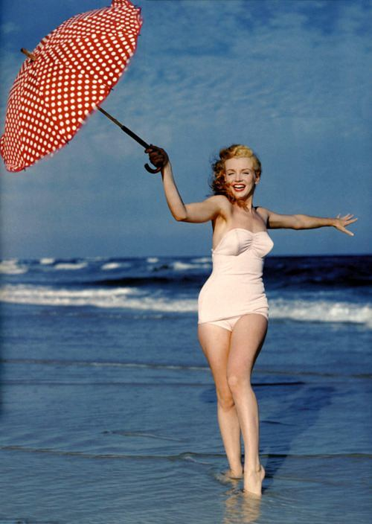
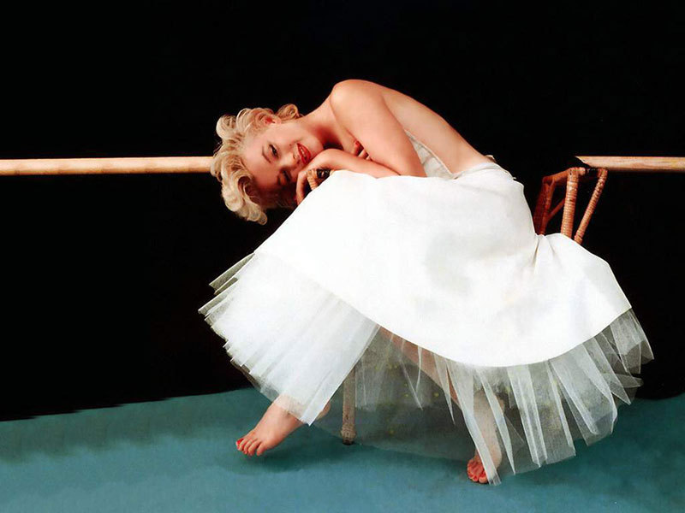
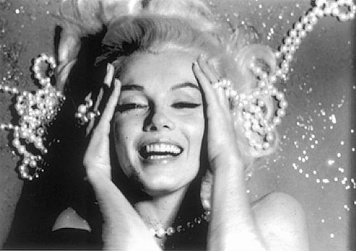
20th Century Fox executive Ben Lyon who 'discovered' Marilyn through her photographs. It was Lyon and his wife who changed her name from Norma Jean Baker to Marilyn Monroe.

Slide 6
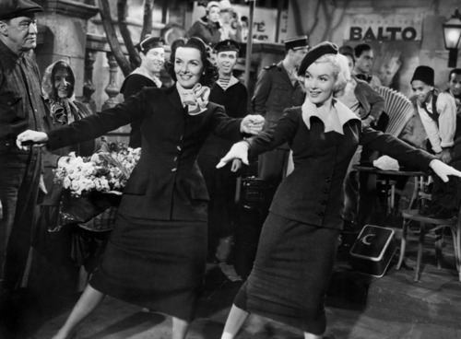
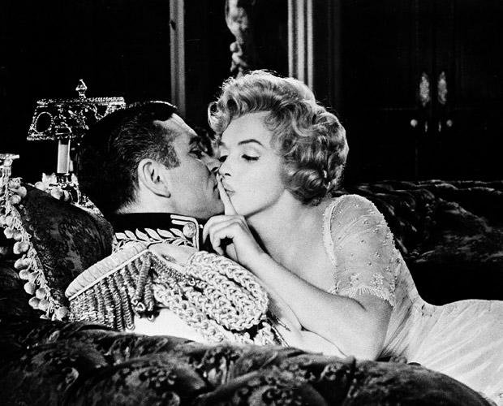
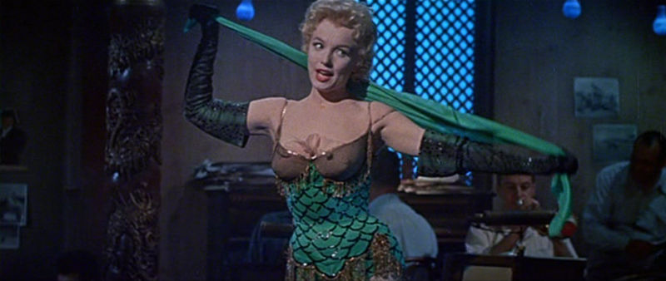
More than a decade Monroe sharmed audiences through a multitude of comedic and dramatic roles. Audiences loved her breathy, blonde bombshell appeal combined with her light comedic approach in How To Marry A Millionaire, Gentlemen Prefer Blondes, The Seven-Year Itch and Some Like It Hot.

Slide 7
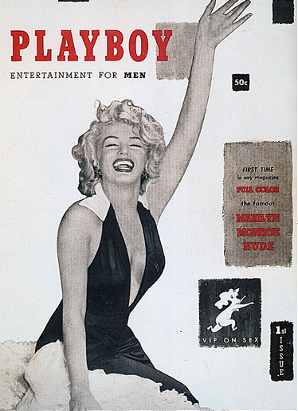
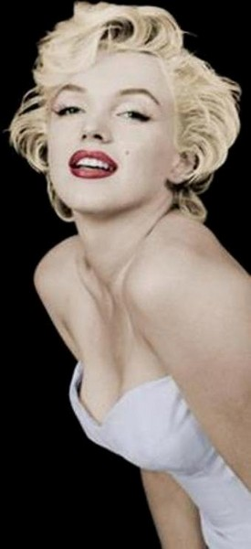
All great started out small. 59 years ago - December 1, 1953 - in Chicago was published the first issue of the journal «Playboy». The first issue of the popular men's magazine came out with Marilyn Monroe on the cover. One of the sexiest women in the history was the first blonde on the cover of Playboy.

Slide 8
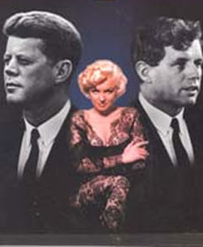
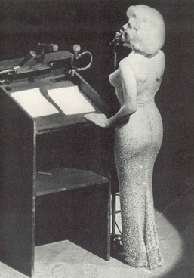
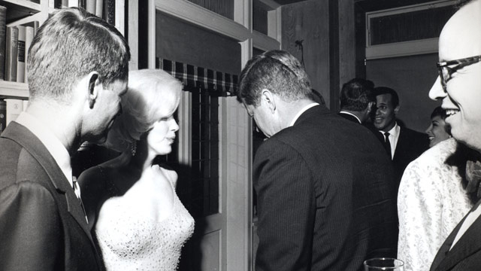
According to some reports Monroe and Kennedy met in 1951, and in 1954 Marilyn and John became close. Their interest was mutual, both were crazy about each other. Their relations lasted until 1960.
Robert Kennedy (President's younger brother). They were almost never seen together. Nevertheless, people believe that he also had an affair with Marilyn.

Slide 9
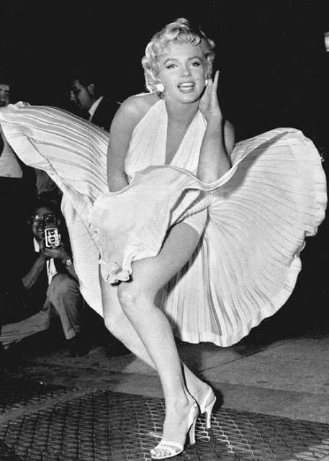
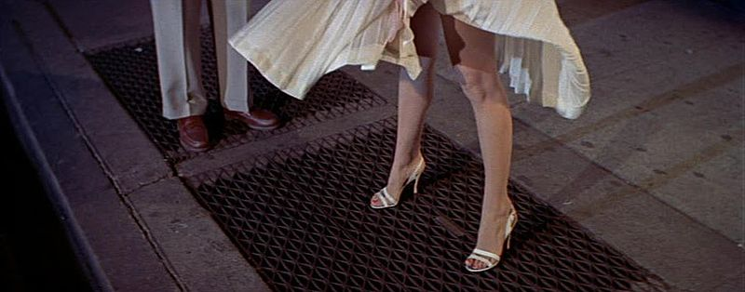
I'm selfish, impatient and a little insecure. I make mistakes, I am out of control and at times hard to handle. But if you can't handle me at my worst, then you sure as hell don't deserve me at my best.
Quotes of Marilyn Monroe
If I'd observed all the rules, I'd never have got anywhere.
A wise girl kisses but doesn't love, listens but doesn't believe, and leaves before she is left.
I am good, but not an angel. I do sin, but I am not the devil. I am just a small girl in a big world trying to find someone to love.
Give a girl the right shoes, and she can conquer the world.

Slide 10
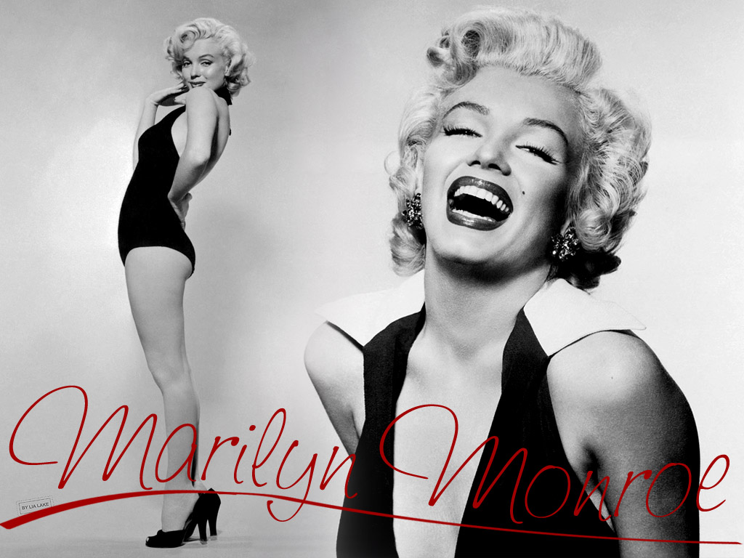
Monroe was found dead at her California home on August 5, 1962 at the age of 36. Doctors declared barbiturate poisoning as cause of her death. Though they said it was a suicide, mystery still shrouds the untimely death of the Hollywood icon.

Slide 11
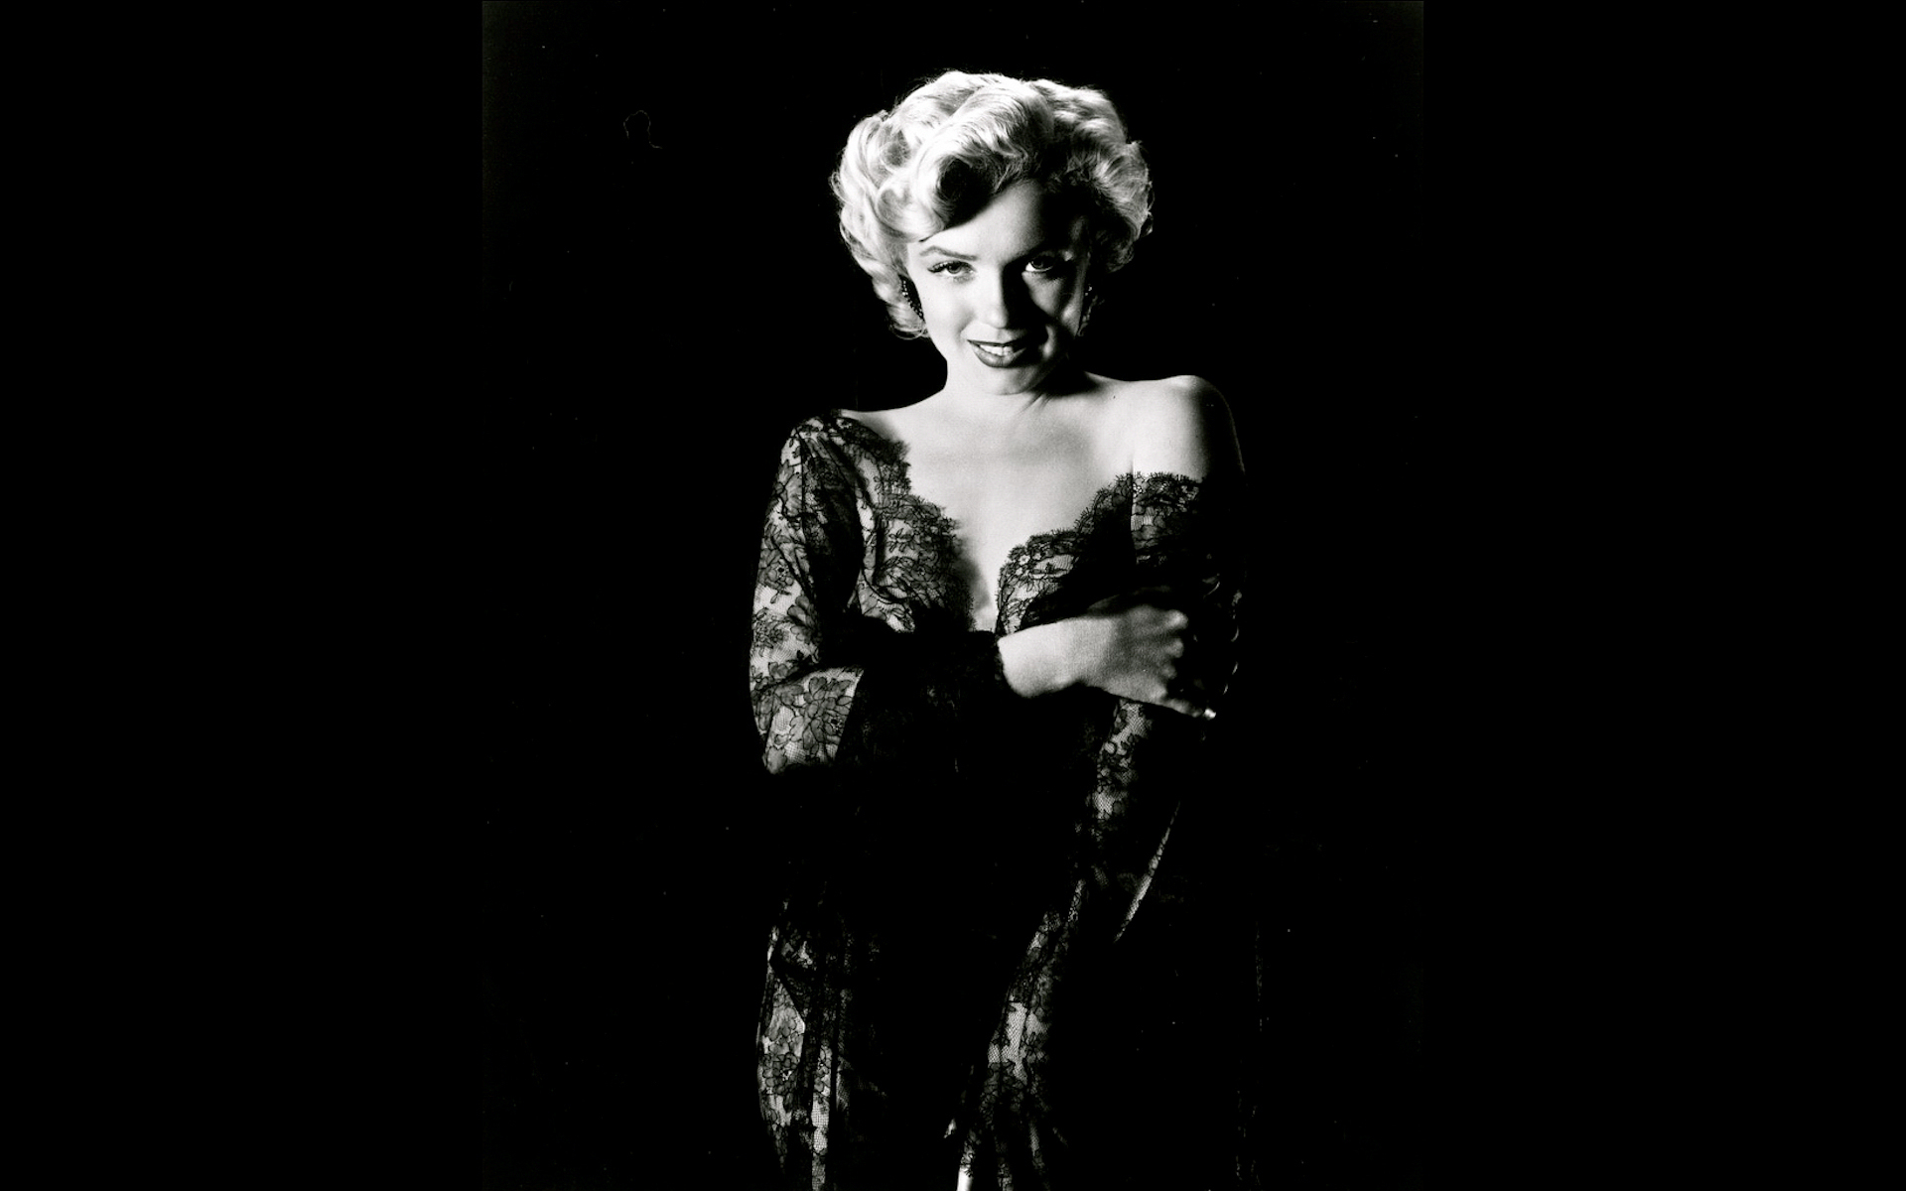
Thank you for attention!

