Slide 1
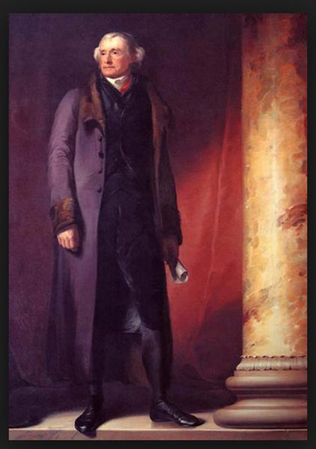
Thomas Jefferson
by Kucherenko K.

Slide 2
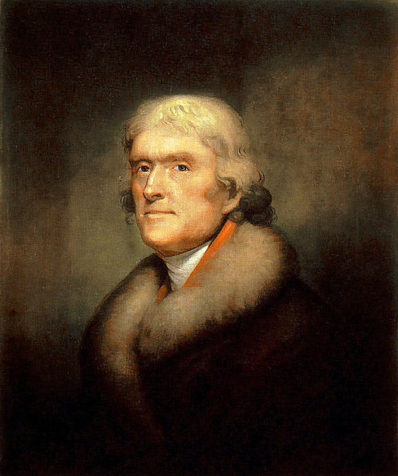
Thomas Jefferson
(April, 13 1743 - July 4, 1826)
American Founding Father
The principal author of the Declaration of Independence (1776)
The third President of the US (1801-1809)

Slide 3
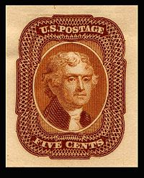
Early life and career
The third of ten children;
- Jeffersons relocated to Tuckahoe (1745);
- Thomas inherited approximately 5,000 acres of land ( including Monticello and between 20 and 40 slaves) after father’s death;
- He took control of the property after he came of age at 21.

Slide 4
Education
Jefferson began his childhood education under the direction of tutors at Tuckahoe along with the Randolph children.
began studying Latin, Greek, and French; he learned to ride horses, and began to appreciate the study of nature
At age 16, Jefferson entered the Collage of William & Mary in Williamsburg.
Jefferson read law while working as a law clerk for Wythe
he also read a wide variety of English classics and political works
He collected and accumulated thousands of books for his library at Monticello.

Slide 5
Marriage and family
Jefferson married the 23-year-old widow Martha Wayles Skelton
Jefferson played the violin and Martha was an accomplished piano player
Martha bore six children
. A few months after the birth of her last child, Martha died. Jefferson was was distraught after her death
Jefferson never remarried

Slide 6
Declaration of Independence
Jefferson served as a delegate to the Second Continental Congress beginning in June 1775.
Jefferson and Adams established a friendship that would last the rest of their lives; it led to the drafting of Jefferson to write the declaration of independence.
After voting in favor of the resolution of independence on July 2, Congress turned its attention to the declaration
The Declaration would eventually be considered one of Jefferson's major achievements; his preamble has been considered an enduring statement of human rights

Slide 7
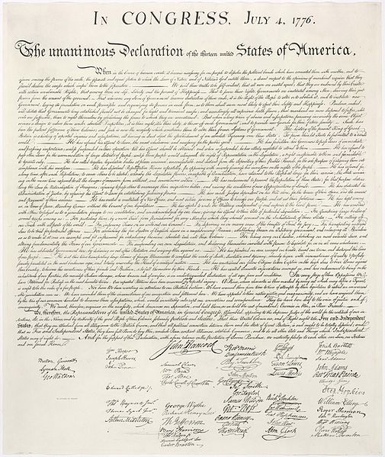

Slide 8
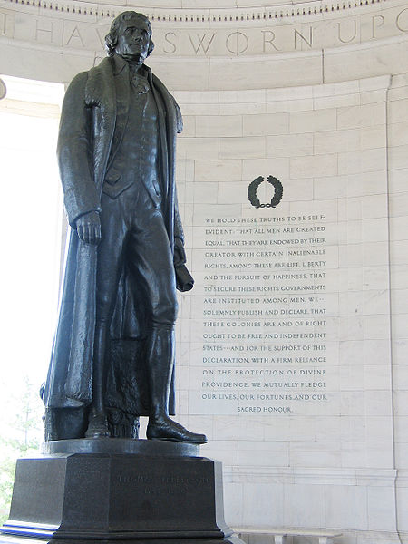
Democracy
Jefferson is often cited as an important figure in early American democracy
Jefferson envisioned democracy as an expression of society as a whole, and that he called for national self-determination, cultural uniformity, and education of all the people
Jefferson believed that public education and a free press were essential to a democratic nation

Slide 9
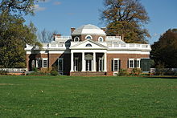
Monticello

