Slide 1

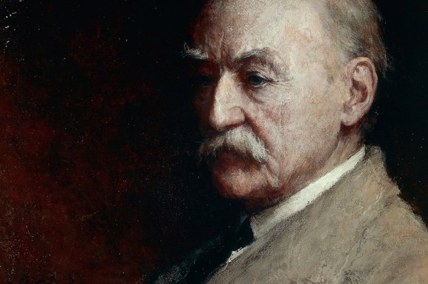
Thomas Hardy
(1840-1928)
«grieving and courageous painter»
A novel Tess of the D’Urbervilles

Slide 2
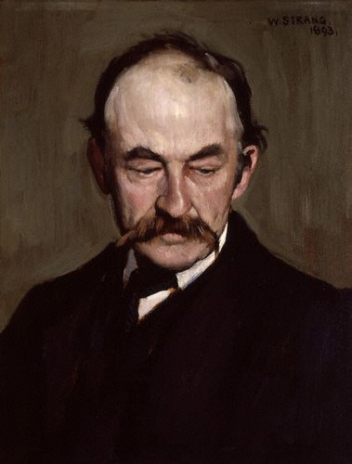
Biography

Slide 3

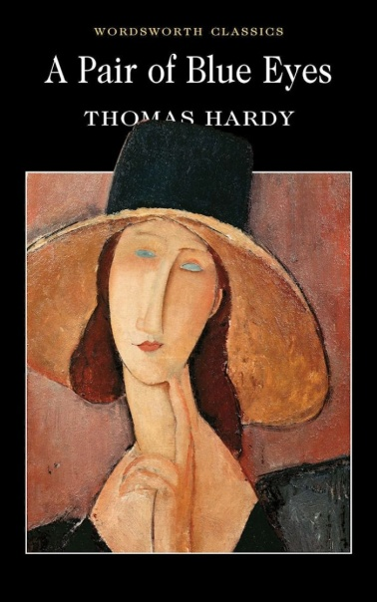



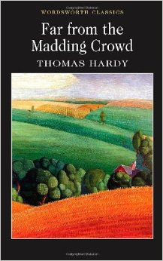

Major novels
Under the Greenwood Tree (1872)
A Pair of Blue Eyes (1873)
Far from the Madding Crowd (1874)
The Return of the Native (1878)
The Mayor of Casterbridge (1886)
Tess of the D’Urbervilles (1891)
Jude the Obscure (1896)

Slide 4


