Slide 1
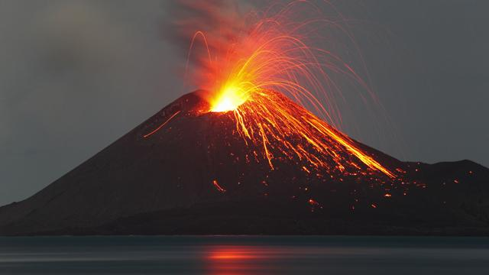
Volcanoes

Slide 2
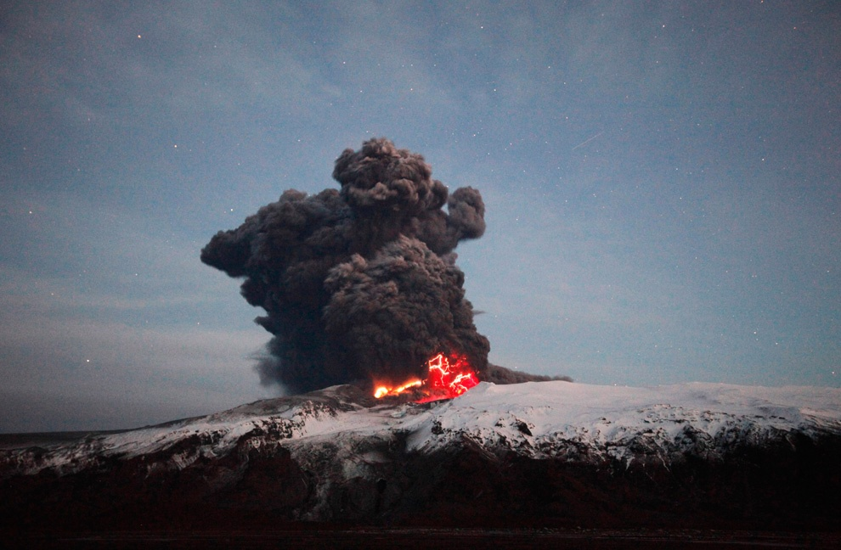
A volcano is an opening, or rupture, in the surface or crust of the Earth or a planetary mass object, which allows hot lava, volcanic ash and gases to escape from the magma chamber below the surface.

Slide 3
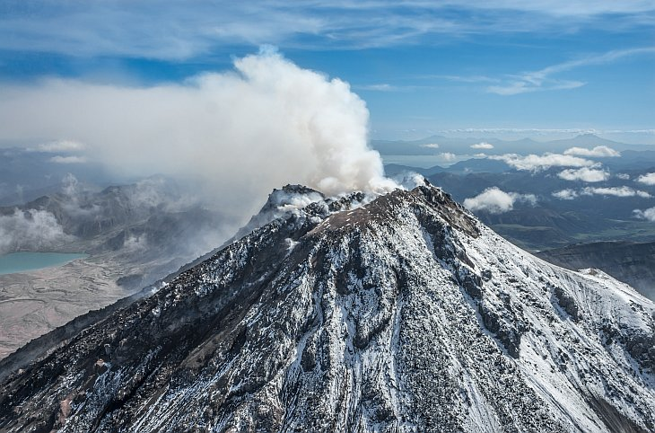
On Earth, volcanoes are generally found where tectonic plates are diverging or converging.

Slide 4
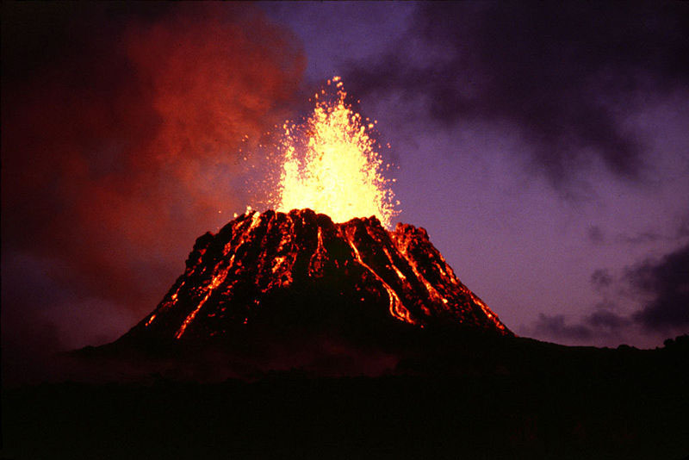
There are three common types of volcano:
composite volcanoes, often the most deadly;
shield volcanoes, which are large but generally less violent;
cinder cones.

Slide 5
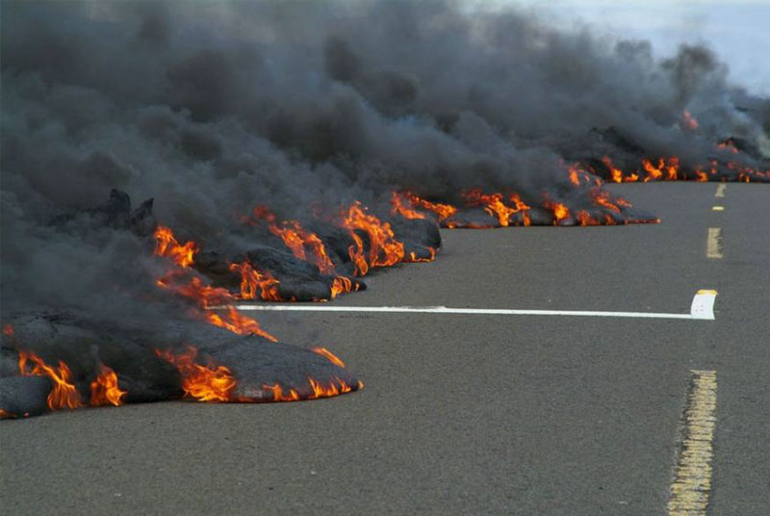
Erupting volcanoes can pose many hazards, not only in the immediate vicinity of the eruption.

Slide 6
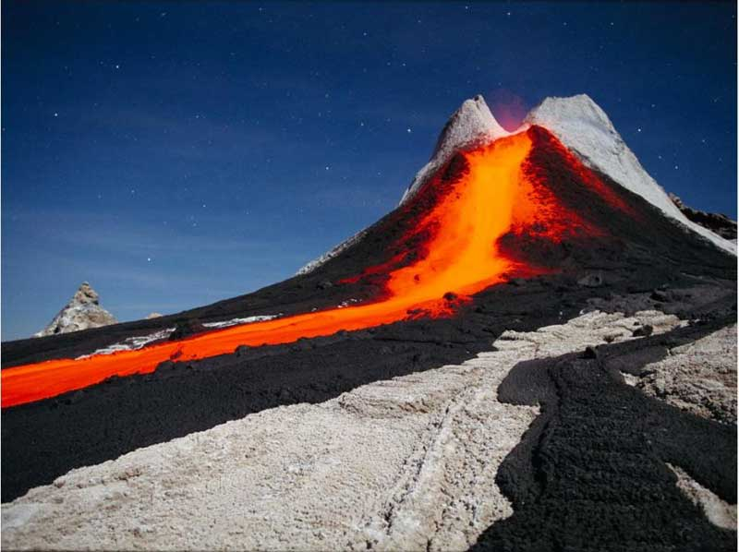
Lava has a temperature of more
than 1200 ° C, the rate of
2 to 40 kilometers

Slide 7
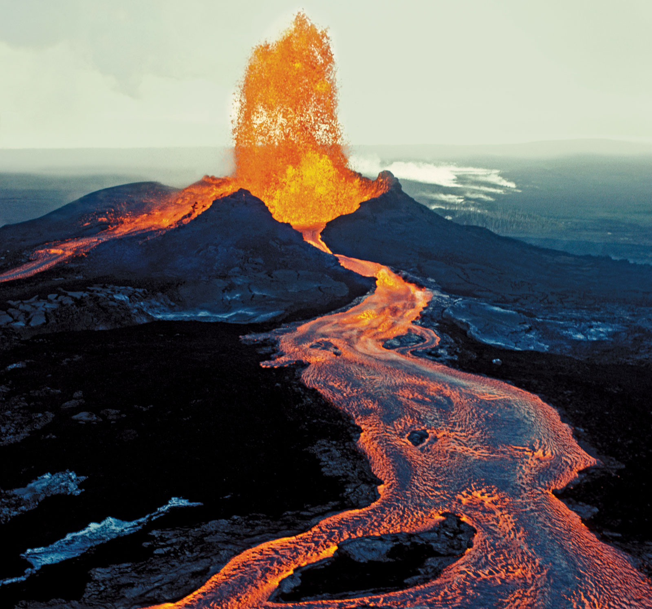
The largest volcano on Earth is Hawaii's
Mauna Loa. It is about 10 km tall from the sea floor to its summit (it rises about 4 km above sea level).

Slide 8
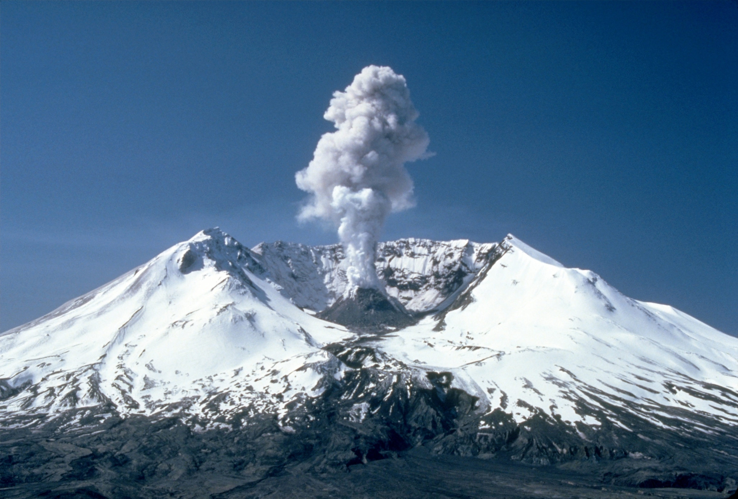
The most active volcano in the continental USA is Mt. St. Helens (located in western Washington state).

Slide 9
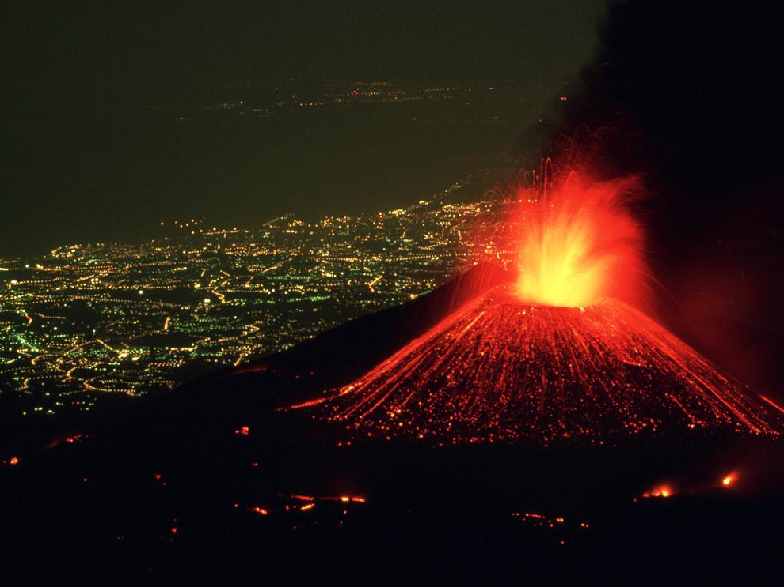
Volcanic eruptions continue posing ever-greater threats to life and property.

Slide 10
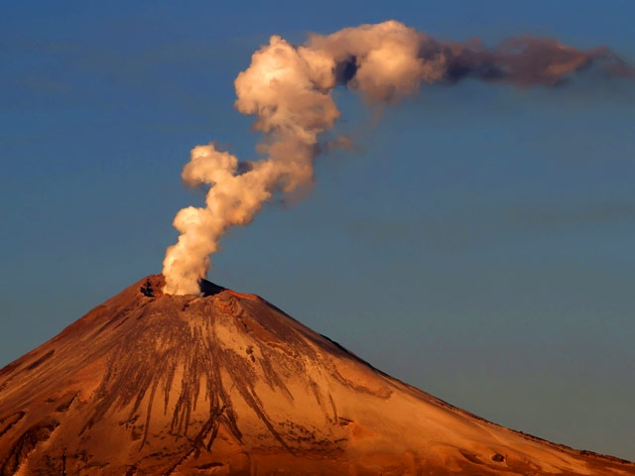
South of Mexico City, Popocat petl has begun to come to life again.

Slide 11
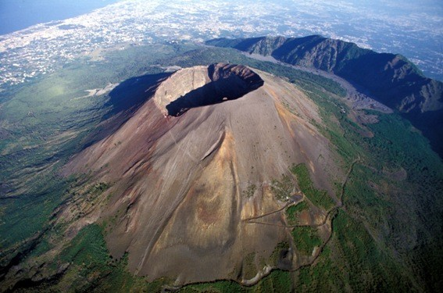
Another million people living
in the Naples area are threatened
by Mt. Vesuvius' continued unrest.

Slide 12
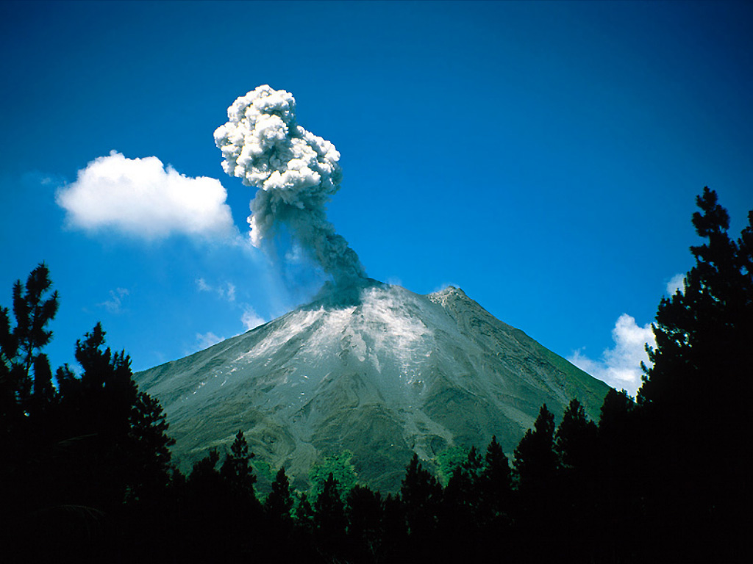
THE END

