Slide 1
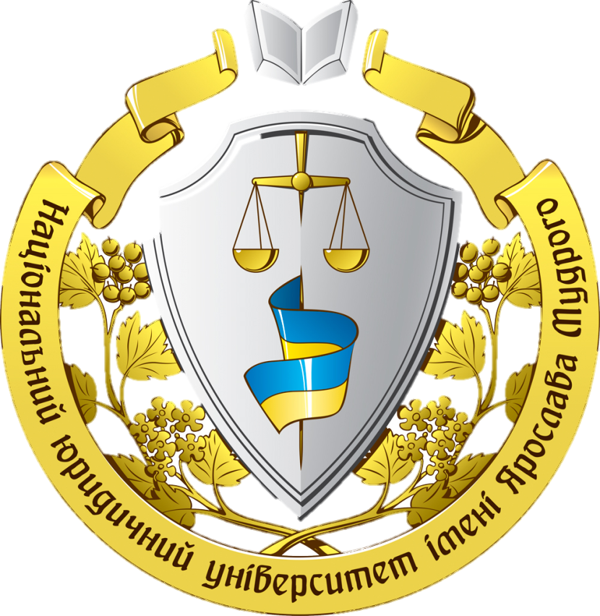
Yaroslav Mudryi
National law university

Slide 2
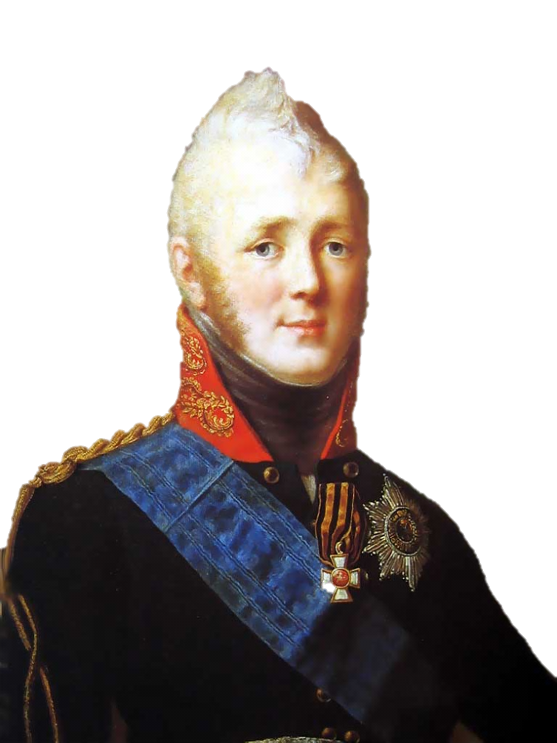
About the University
Yaroslav the Wise National Law University is self-governing (autonomous) state higher law educational establishment of IV level of accreditation.
The history of the University has begun since XIX century, on November 17 1804 the Kharkiv Empire University was established by the order of Alexander I and the ethics and political department was part of it. In 1835 it was officially renamed as the Law department of University. At different times famous lawyers worked here, such as professors M.M. Alekseenko, L.E. Vladimirov, M.A. Hredeskul, V.P. Danevskyi, I.I. Ditiatin, L.N. Zahurskyi, D.I. Kachenovskyi, O.V. Kunitsin, M.O. Kuplevaskyi, O.I. Paliumbetskyi, A.M. Stoianov, M.O. Taube, I.F. Timkovskyi, M.P. Chubinskyi and others.

Slide 3
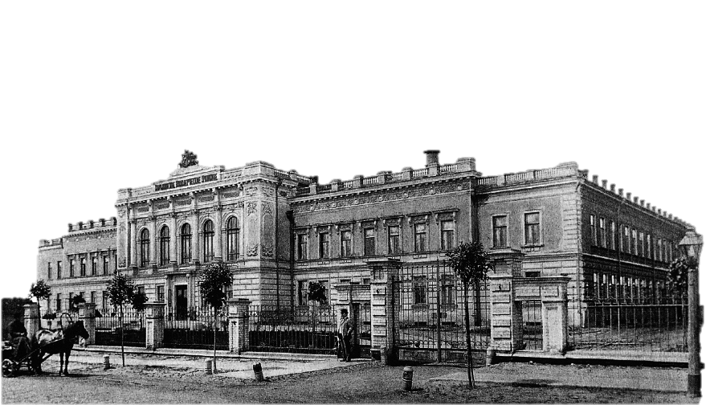
In 1920 by the decision of the government of Ukraine the Institute of National Economy was established on the basis of the Kharkiv University law faculty. It was the basis of the Law Institute which trained lawyers for state and economic bodies. The first lecturers of the law faculty – the founders of the Institute – were famous law professors: V.M. Hordon, V.M. Koretskyi, O.D. Kisilev, V.F. Levitskyi, M.O. Maksimeyko, M.I. Palienko, V.I. Slivitskyi, V.S. Trakhterov and others who worked at the Kharkiv University before. They were holding scientific and teaching positions for many years and made the great contribution in formation and development of law science, education and training lawyers.

Slide 4
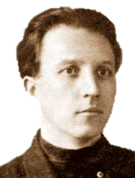
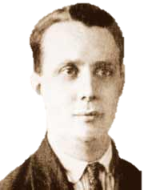
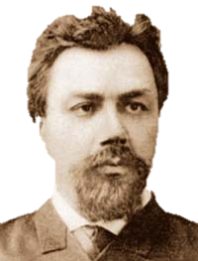
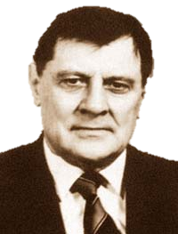
In 1930 The Institute of National Economy got the title as the Institute of Soviet Construction and Law, it was up to the mark of it’s status as higher law educational establishment. On May 1933 the Institute was renamed on the Ukrainian Communist Institute of Soviet Construction and Law. For the purpose of improvement of training lawyers it was rearranged in the Kharkiv Law Institute in 1937. The rectors (directors) of the Institute were P.I. Fomin, Ya.O. Sokolin, L.I. Levikov, E.O. Kustolian, K.K. Brandt, M.M. Eminnik, F.M. Tsaregradskyi, S.M. Kanarskyi, V.O. Barachtian, S.I. Vilnianskyi, O.A. Nebotov, V.P. Maslov; pro-rectors – V.M. Koretskyi, K.K. Brandt, V.V. Krivitskyi, E.O. Kustolian, G.V. Sodin, G.V. Eminnik, D.K. Piatak, M.I. Levikov, S.L. Fuks, S.I. Vilnianskyi, M.V. Hordon, A.l. Rogozhin, I.M. Danshin.

Slide 5
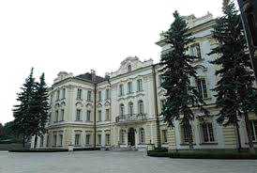
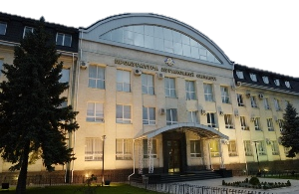
In the pre-war period the famous law scholars, experienced scientists and pedagogues were in the professorial and teaching staff of the Institute. Some of them came from the law practical work in the Supreme Court, the Prosecutor’s Office and other law enforcement organs and made the great contribution in the latter development of the Institute. They were professors: R.M. Babun, K.O. Bernovskyi, M.S. Bokarius, G.I. Volkov, S.I. Vilnianskyi, M.V. Hordon, M.M. Hrodzinskyi, M.M. Eminnik, S.M. Kanarskyi, V.L. Kobalevskyi, V.M. Koretskyi, S.N. Landkof, B.V. Popov, N.M. Romaniuk, S.E. Sabinin, A.S. Semenova, Ya.O. Sokolin, O.I. Stroev, S.L. Fuks and others.

Slide 6
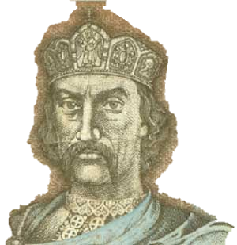
In accordance with the resolution of Rada of Ministers of Ukraine from March 20, 1991 the Kharkiv Law Institute was rearranged in the National Law Academy of Ukraine. Under the president’s decree from March 30, 1995 No. 267 the Academy got the status of the national self-governed (autonomous) state higher educational establishment and by decree from November 4, 1995 the name of Yaroslav the Wise was given. In accordance with the decree of the president of Ukraine No. 457 from May 21, 2001 «The question of Yaroslav the Wise National Law Academy of Ukraine», recognizing its considerable role in training specialists for bodies of state authorities, law enforcement organs, various fields of law practice, considering the necessity of keeping and further development of generated scientific schools in the University , it was given additional rights with the approval of statute by Cabinet of Ministers of Ukraine. In accordance with the decree of the president of Ukraine No. 485 from May 25, 2009 and the resolution of Cabinet of Ministers No. 796 from July 29, 2009, «The question of Yaroslav the Wise National Law Academy of Ukraine» the University was given the status of self-governed (autonomous) scientific national higher educational establishment, which carried out their activity in accordance with its statute with the right to:
- to set up a research institute of legal science;
- to make the final decision on awarding of scientific degrees and titles;

Slide 7
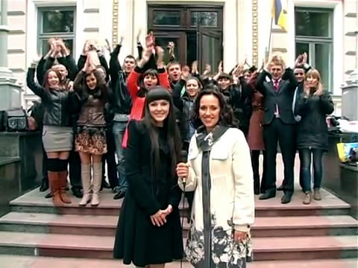
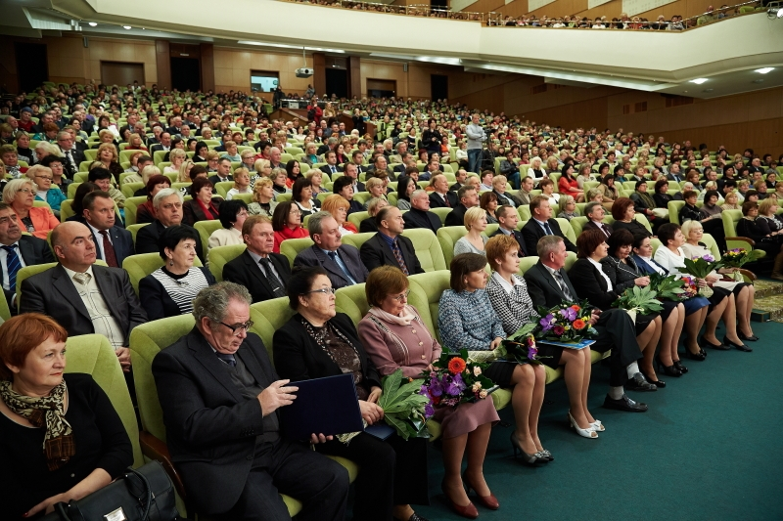
The University has significant research and educational potential. Teaching, research and tutorial work are realized by 44 chairs where about 800 lecturers work. Among them 100 doctors of laws, professors, about 600 candidates of science, associate professors; 1 Hero of Ukraine; 1 Member of the National Academy of Science of Ukraine; 15 Members of the National Academy of Law Sciences of Ukraine; 18 Corresponding Members of the National Academy of Law Sciences of Ukraine; 18 Honoured Science and Technology Workers; 2 Honoured Art Workers of Ukraine; 1 Honoured Higher School Worker; 15 Honoured Public Education Workers of Ukraine; 15 Honoured Lawyers of Ukraine; 1 Honoured Lawyer of Russia; 1 Honoured Builder of Ukraine; 7 Honoured Professors – Fathers of the The Yaroslav the Wise National Law University; 2 Honoured Culture Workers of Ukraine; 3 Honoured Artists of Ukraine; 14 the State prize winners.

Slide 8
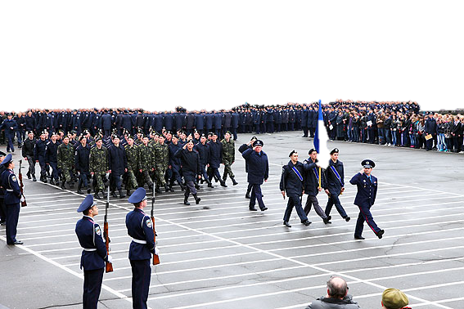
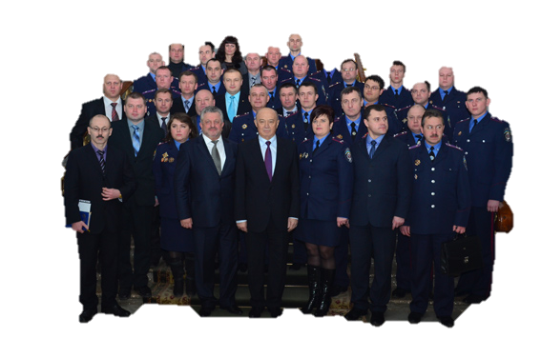
At present time about 23 thousand students study at the University. There are such educational structural departments as: The Institute of training workers for Prosecutor’s Office of Ukraine, the Institute of training legal personnel for Security Service of Ukraine, Personnel Training Institute for the Bodies of Justice of Ukraine, the Institute of raising the level of professional skills, 6 day-time faculties, 2 correspondence departments, evening faculty and separated structural subdivisions: The Crimea Law Institute (Simferopol), the Poltava’s department. At the University the research work concerning fundamental and applied problems of jurisprudence is fulfilled, 17 objective complex programmes on four scientific directions are being developed, famous scientific schools which are known in Ukraine and abroad have been formed.

Slide 9
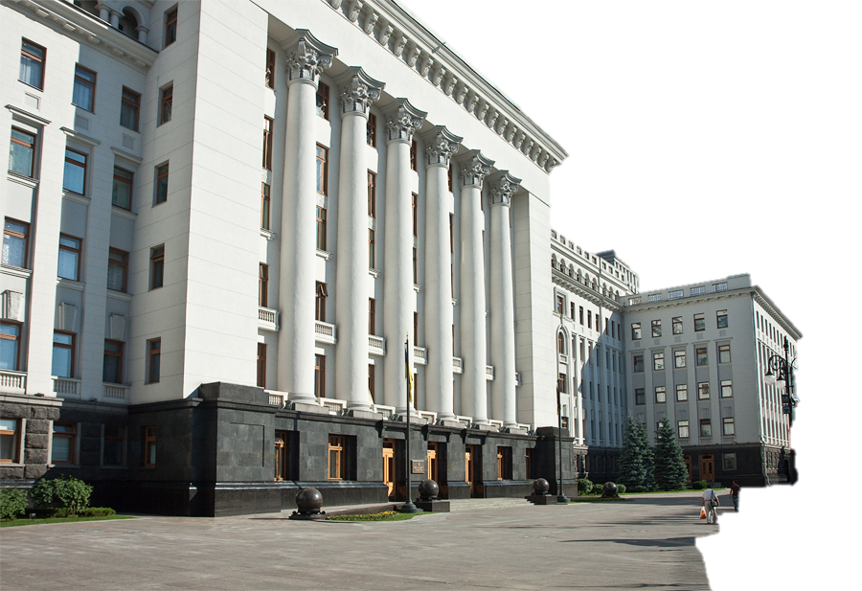
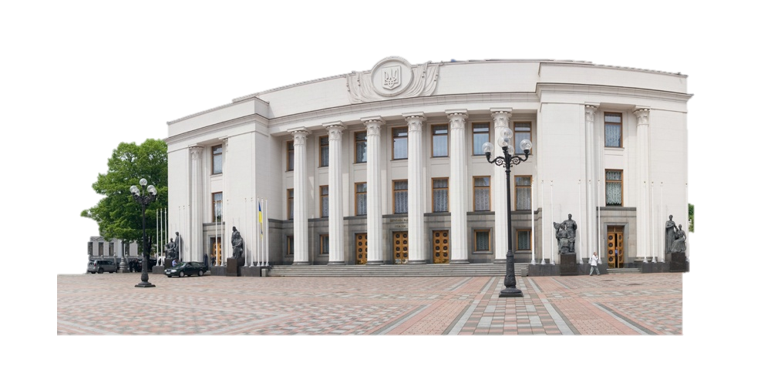
The University makes the major contribution to formation of legal country, updating of law making and law enforcement processes. The scholars took direct participation in making of valid Constitution of Ukraine and others rules and regulations. In the field of law making process the cooperation with the Verkhovna Rada of Ukraine, Secretariat of the President, Cabinet of Ministers of Ukraine, ministers and departments, bodies of local government is uphold. The scholars of the Academy actively impact on practice of using legislation. Many of them are consultants, members of consultative councils of the Supreme Court, Higher Economic Court, General Prosecutor’s Office, Ministry of Interior, Central Electoral Commission of Ukraine and others.

Slide 10
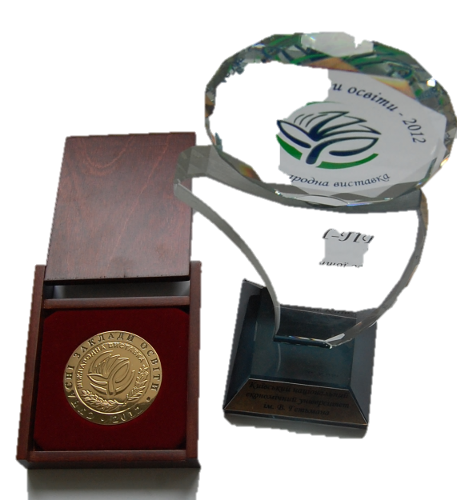
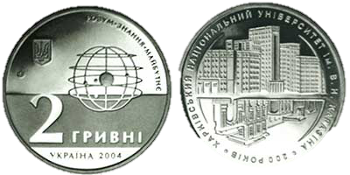

The University takes the leading position in legal education. It is confirmed by the results of Ukrainian rating of higher educational establishments «Compass», which taking into account the rating of employers and graduates, according to which, the University is the leader among legal educational establishments of Ukraine. The University has been awarded by the Gold Medal of XIII International Exhibition of educational establishments «Modern Education in Ukraine 2010» in the nomination «Innovations in using IT technologies in the educational process» for the innovative project «Modern architecture of informative educational environmental» (foresight-project); has taken the first prize and awarded by Diploma in the nomination of «Innovation in higher education» for the innovative project «Semantic informative educational portal of Yaroslav the Wise National Law University in the international exhibition-presentation «Innovation in the education of Ukraine»; has taken the Grand Prize «The Leader of the higher education of Ukraine» in the international exhibition «Modern educational establishments 2012».

Slide 11
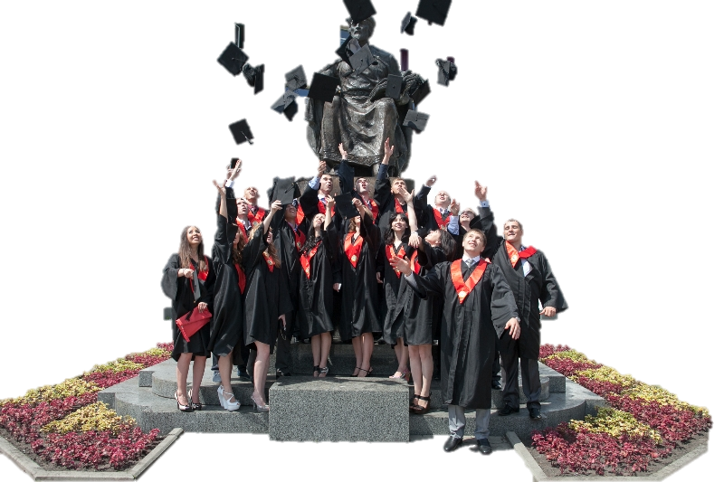
The University has wide international connections. It enters into cooperation and signs agreements with educational establishments of Great Britain, Vietnam, Spain, Germany, Poland, Russia, USA, Uzbekistan, France and other countries. It is a participant of joint European projects in the network of programme «Tempus-Tasis» and many other international projects.

