Slide 1
British influence in the global development of science

Slide 2
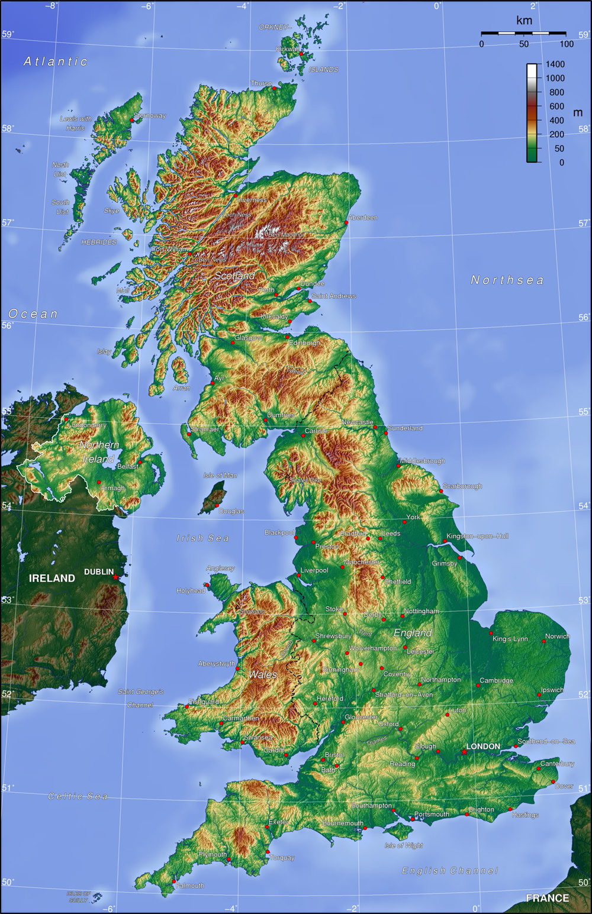

Slide 3
to poke out – виглядати, висовуватись;
virtually [ˈvɜːtʃʊəlɪ] – фактично, практично;
human endeavor [ɪnˈdɛvə] – людська діяльність;
motion – рух;
gravity [ˈɡrævɪtɪ] – сила тяжіння;
DNA – ДНК;
application [plɪˈkeɪʃ(ə)n] – програми;
persued by people – проведені людьми, «переслідувані» людьми;
controversial [kɒntrəˈvːɜʃ(ə)l] – спірний, дискусійний;
regard to – щодо, відноситись до;
to lay the foundation - закладати фундамент;
force – сила;
the forces acting upon[əˈpɒn] - сили, що діють на ;
influential [ɪnflʊˈɛnʃ(ə)l] – впливовий;
in response to – у відповідь ;
polymath [ˈpɒlɪmæɒ] – ерудит;
via [ˈvaɪə] – через;
immense [ɪˈmɛns] – величезний, колосальний;
cargo [ˈkɑːɡəʊ] – вантаж;
vicinity [vɪˈsɪnɪtɪ] – навколишній район, прилеглий район;
directly [d(a)ɪˈrɛktlɪ] – відразу, негайно;
simultaneously [sɪm(ə)lˈteɪnɪəslɪ] – оддночасно, синхронно;
audible [ˈɔːdɪb(ə)l] – звуковий;
the incandescent light bulb – лампа розжарювання;
relativity [rɛləˈtɪvɪtɪ] - теорія відносності;
equation [ɪˈkweɪʒ(ə)n] – рівняння;
subsequent [ˈsʌbsɪkwənt] – наступний, подальший;
breakthrough [ˈbreɪkθruː] – прорив;
citation [saɪˈteɪʃ(ə)n] – цитування, посилання (на автора);

Slide 4
7 British Inventions

Slide 5
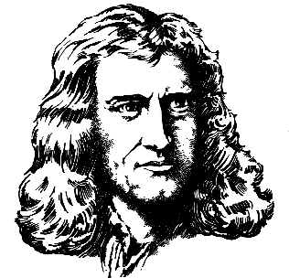
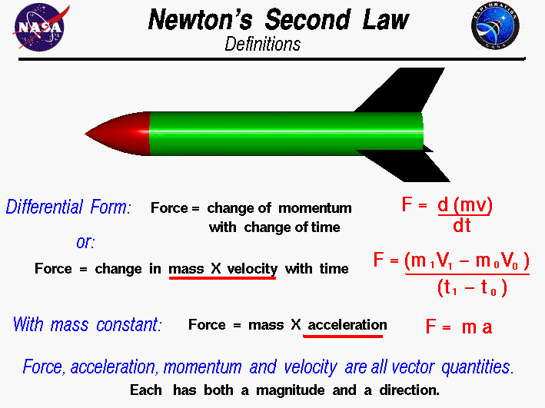
Newton’s Laws

Slide 6
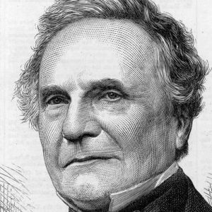
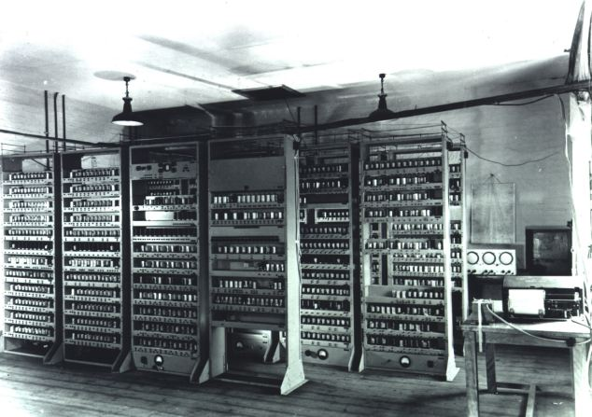
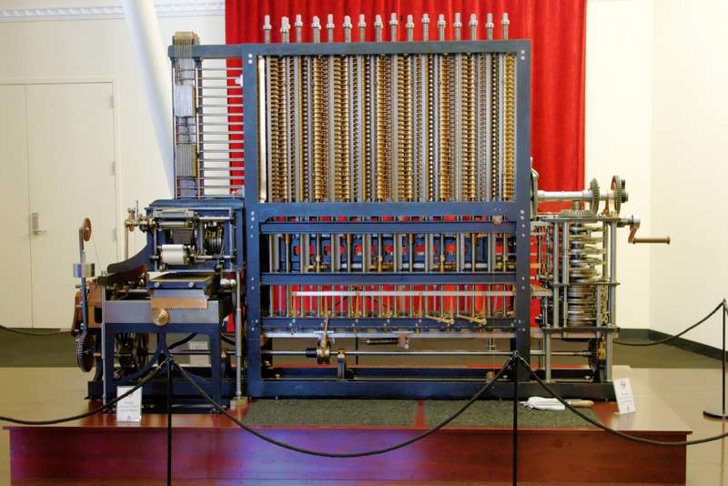
Programmable Computer

Slide 7
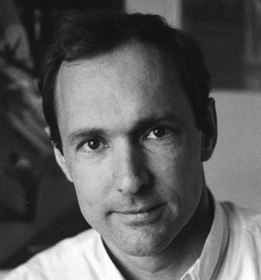
World Wide Web

Slide 8
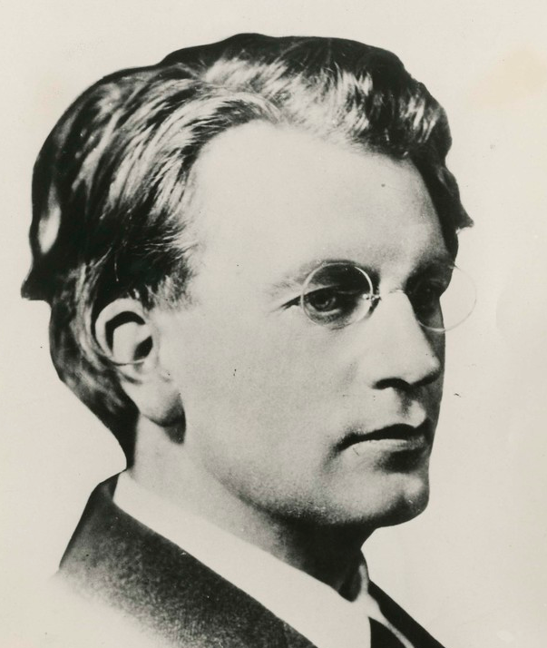
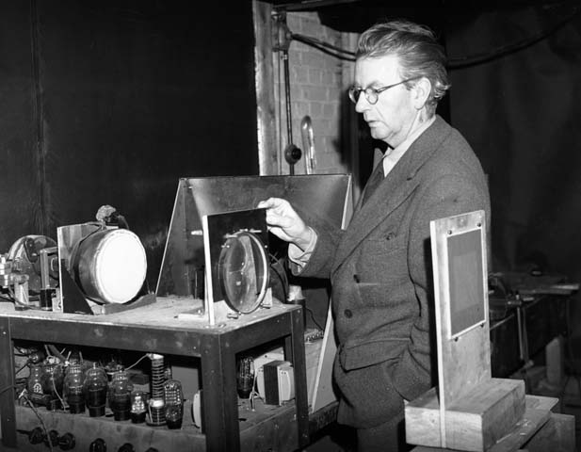
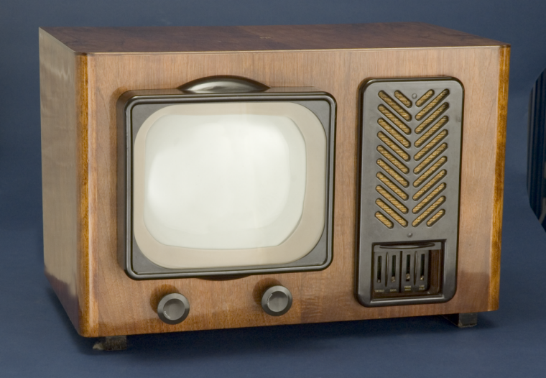
Television

Slide 9
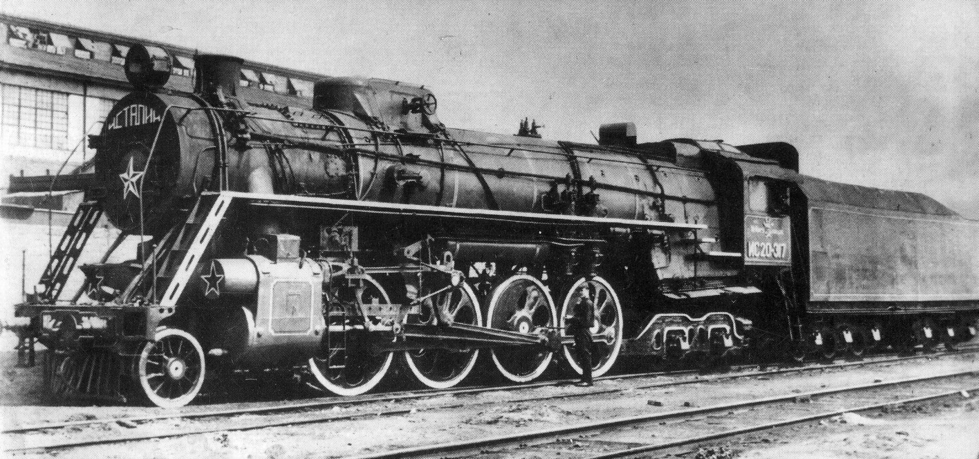
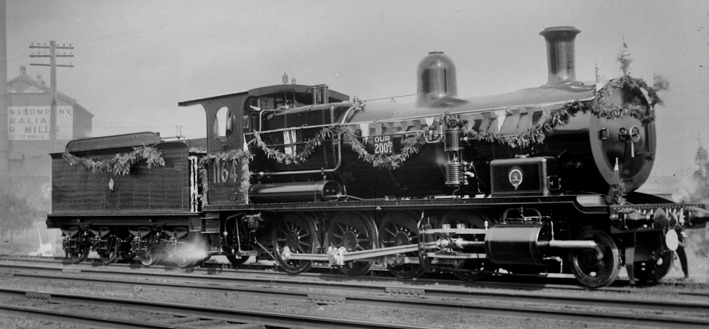
Steam Locomotive

Slide 10
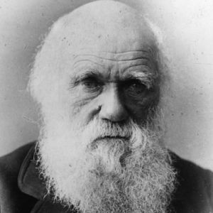
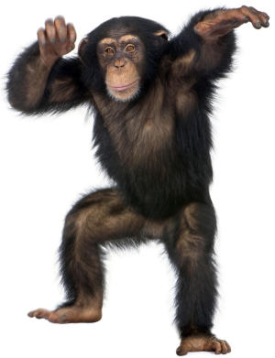
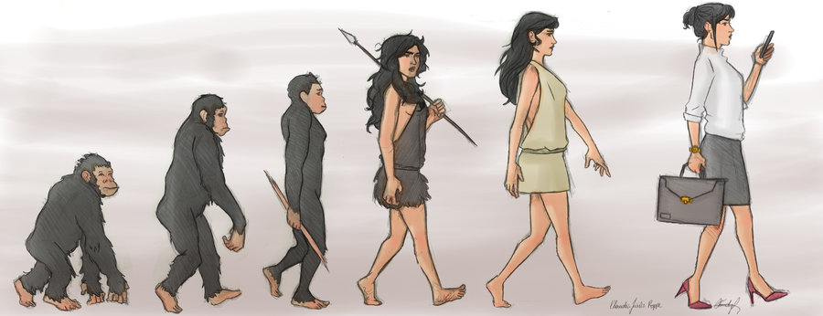
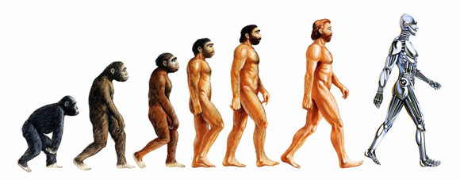
Theory of Evolution

Slide 11
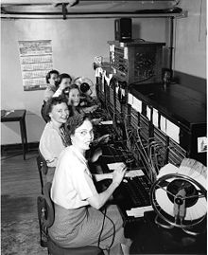
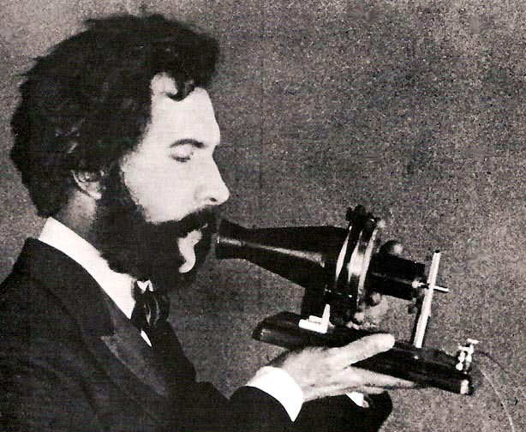
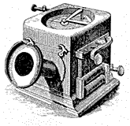
Telephone

Slide 12
Important advances made by people from the UK
There are many others major theories, discoveries and applications advanced by scientists from the Great Britain.

Slide 13
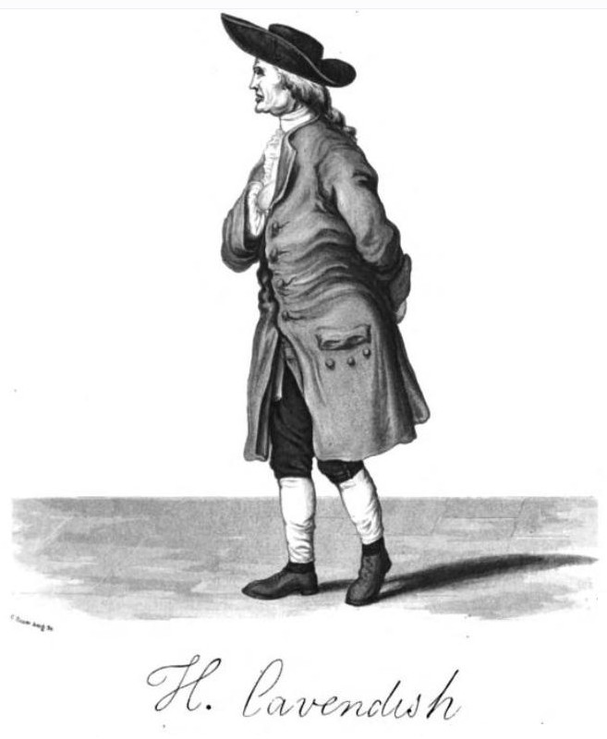
The discovery of hydrogen, by Henry Cavendish (1731–1810).

Slide 14
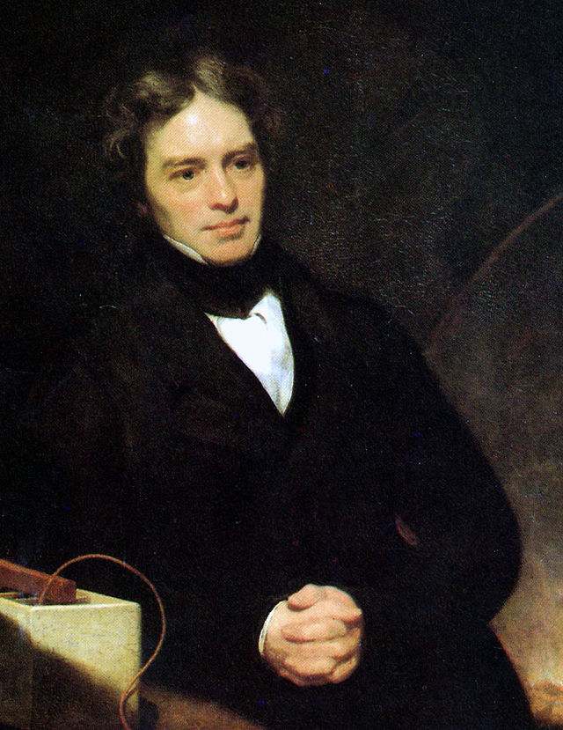
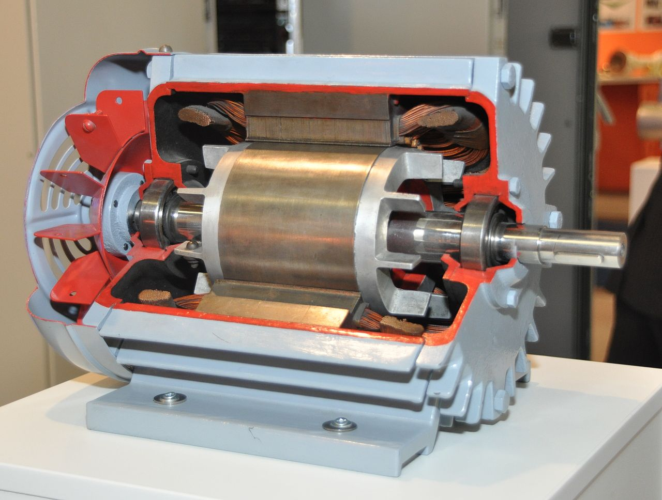
The electric motor, by Michael Faraday (1771–1867), who largely made electricity viable for use in technology.

Slide 15
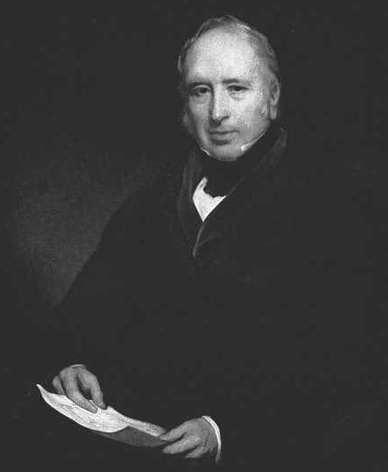
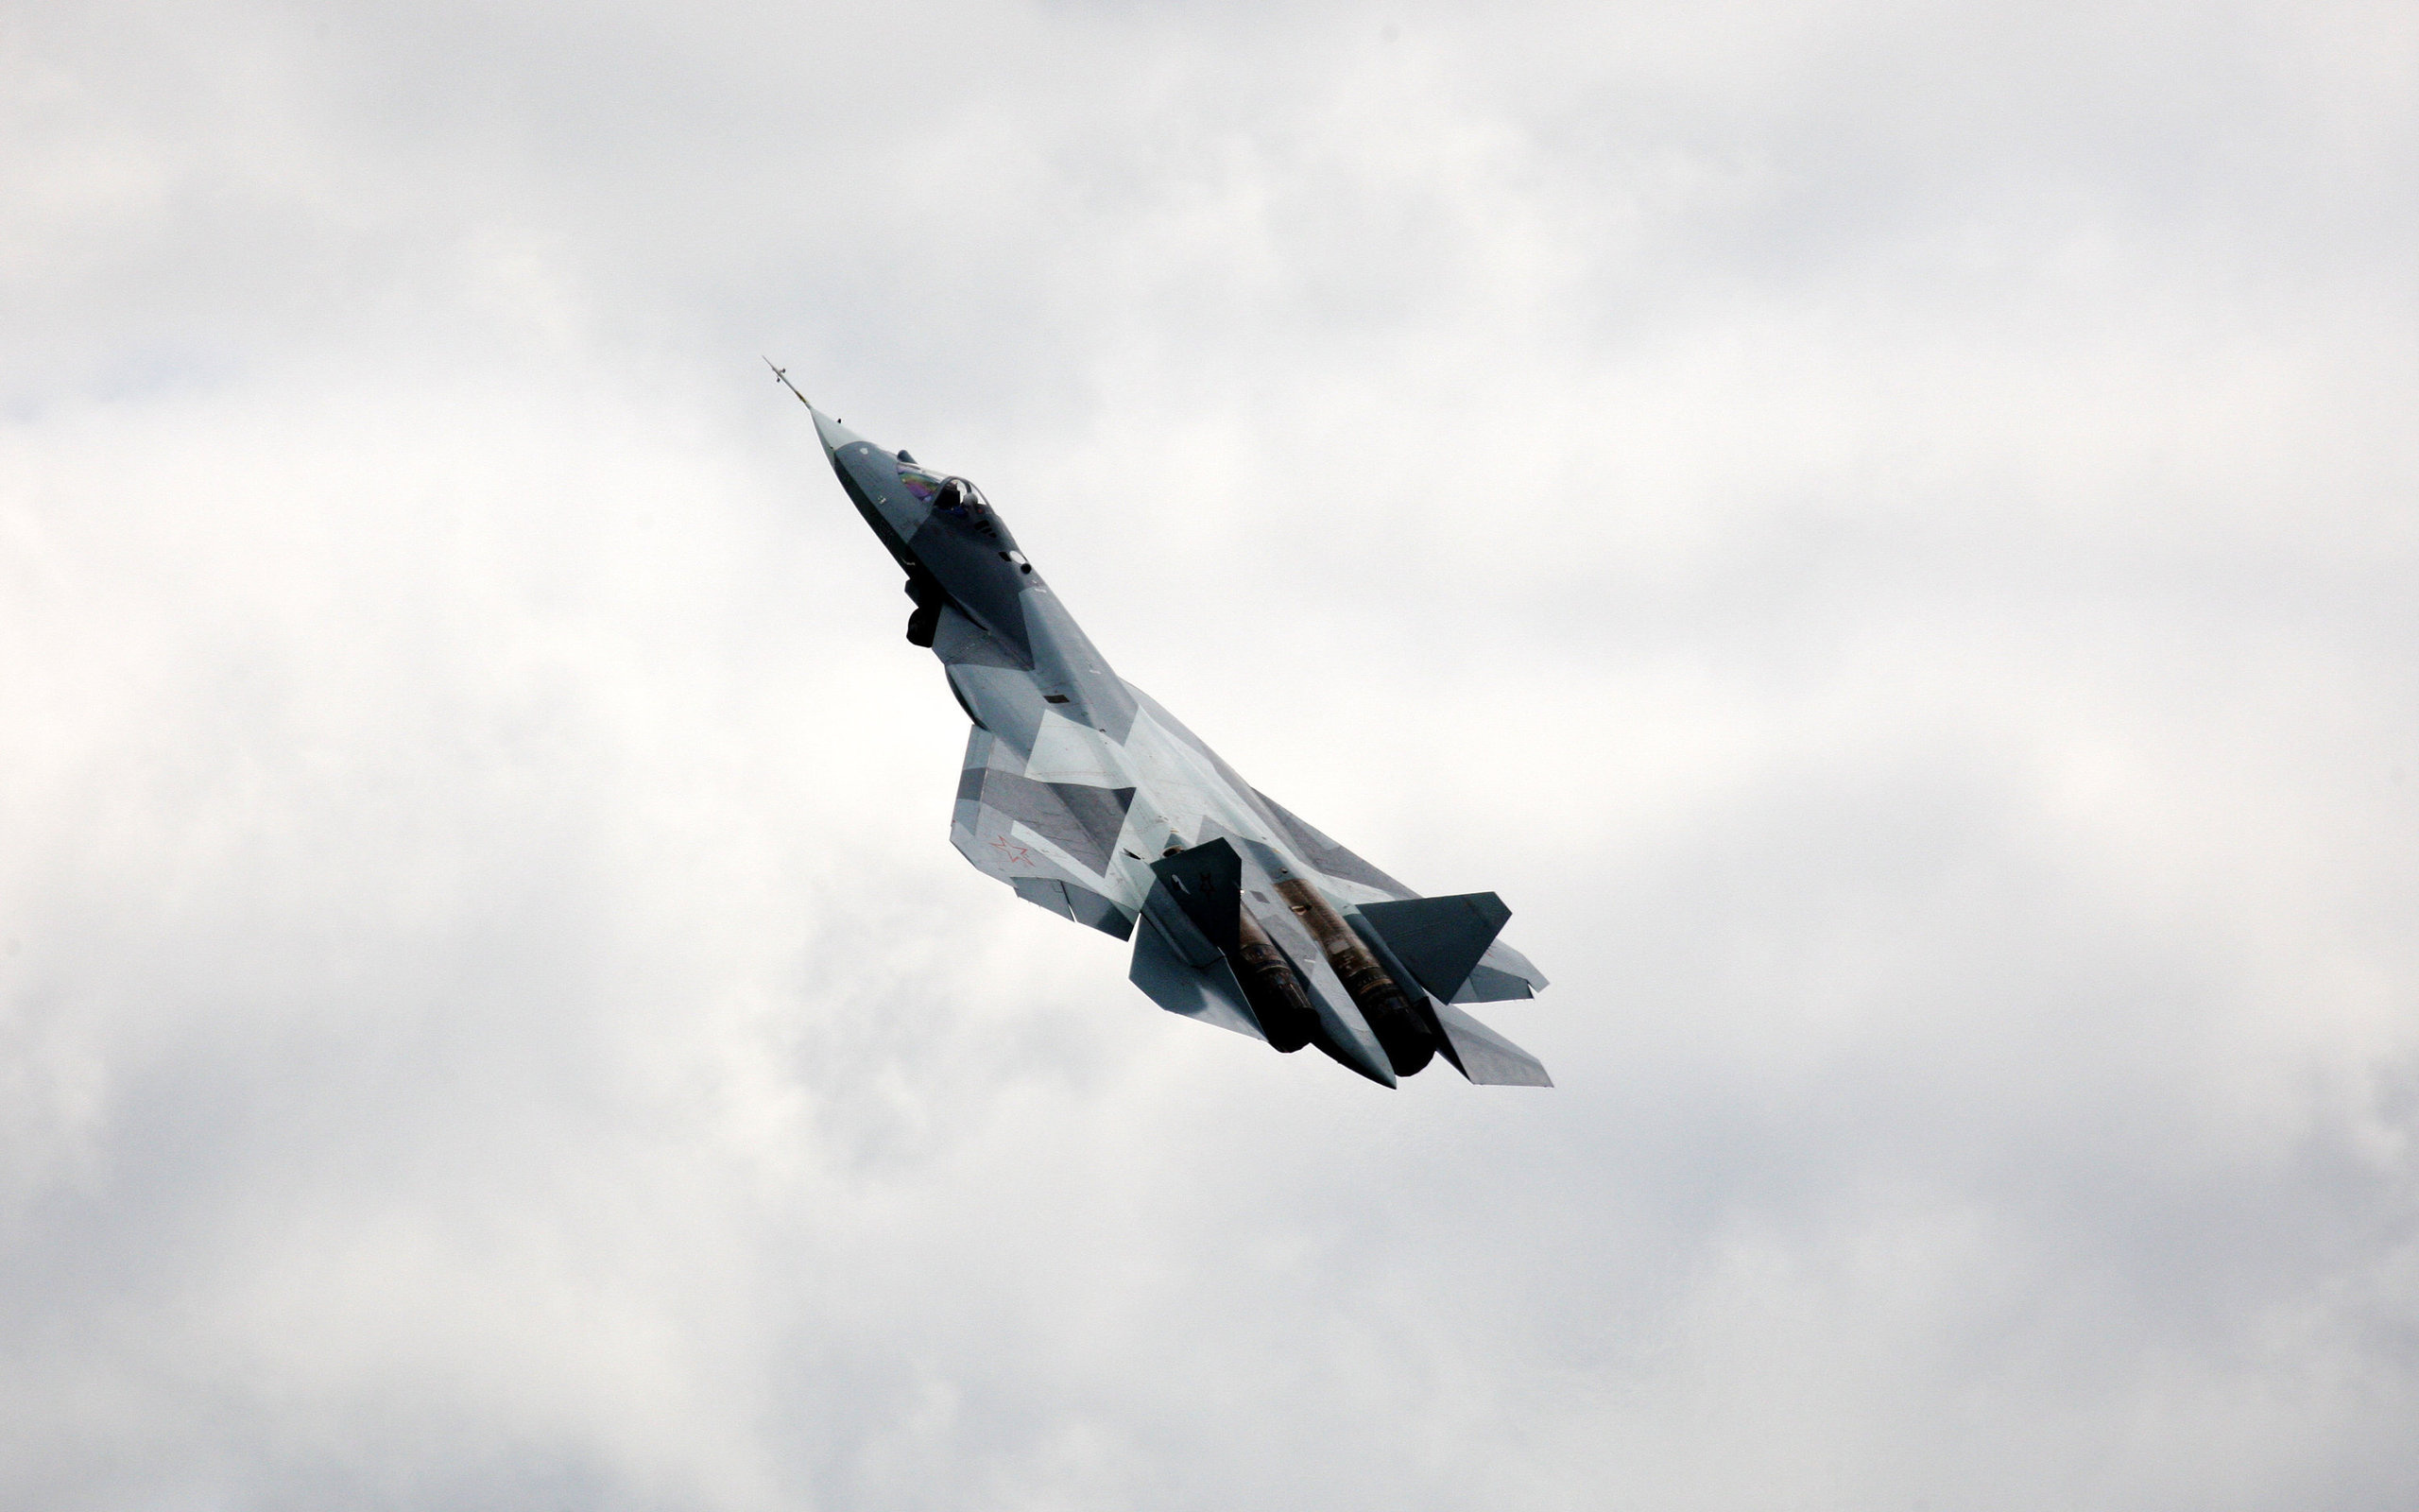
The theory of aerodynamics, by Sir George Cayley (1773–1857).

Slide 16
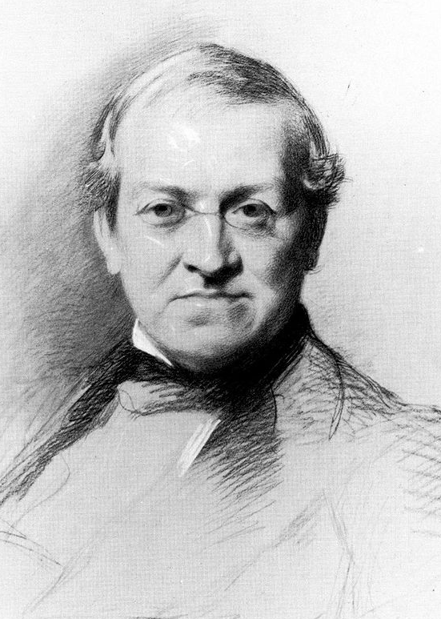
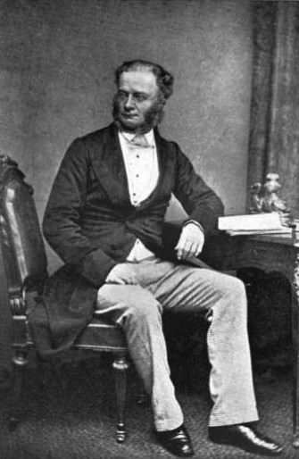
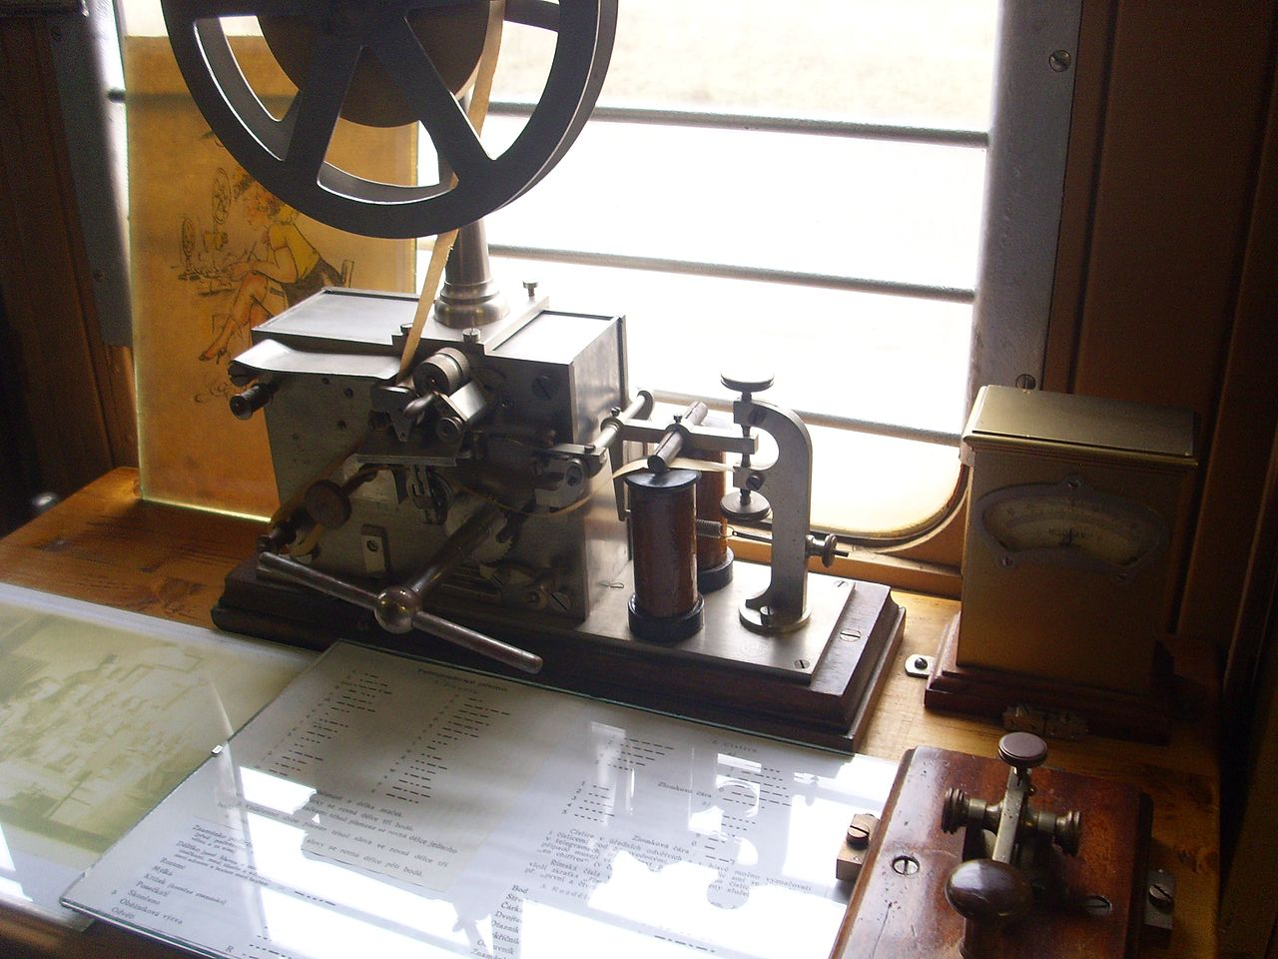
The first commercial electrical telegraph, co-invented by Sir William Fothergill Cooke (1806–79) and Charles Wheatstone (1802–75).

Slide 17
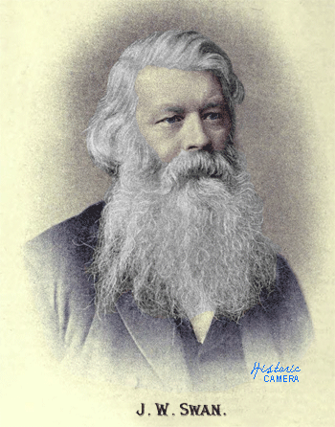
The invention of the incandescent light bulb, by Joseph Swan (1826–1914).

Slide 18
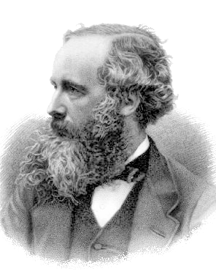
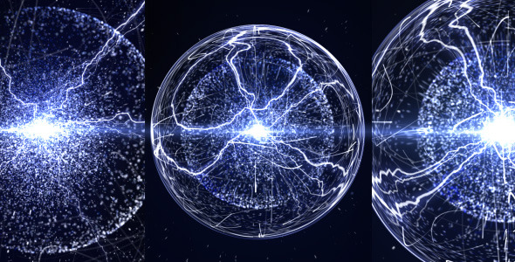
The unification of electromagnetism, by James Clerk Maxwell (1831–79).

Slide 19
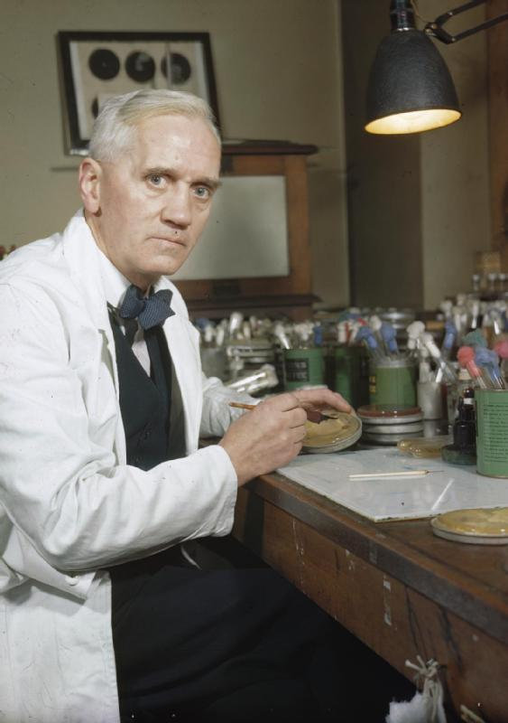
The discovery of penicillin, by biologist and pharmacologist, Sir Alexander Fleming (1881–1955).

Slide 20
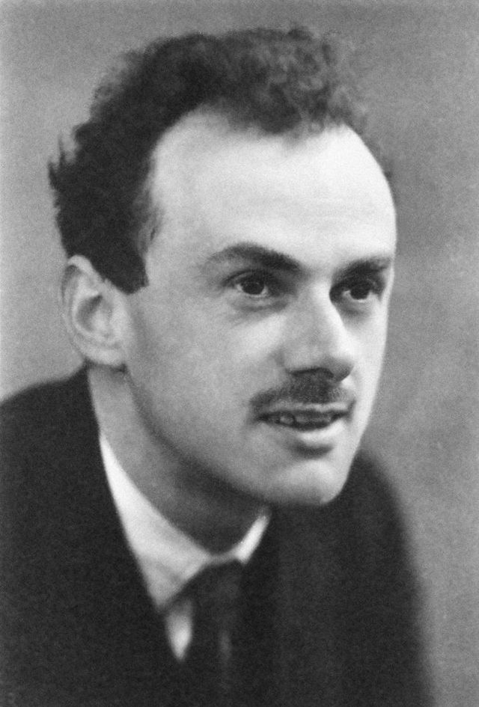
The first meaningful synthesis of quantum mechanics with special relativity by Paul Dirac (1902–84) in the equation named after him, and his subsequent prediction of antimatter.

Slide 21
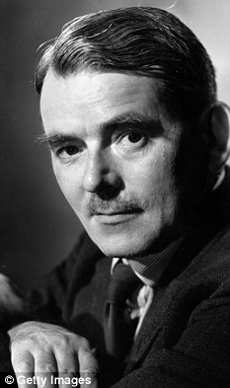
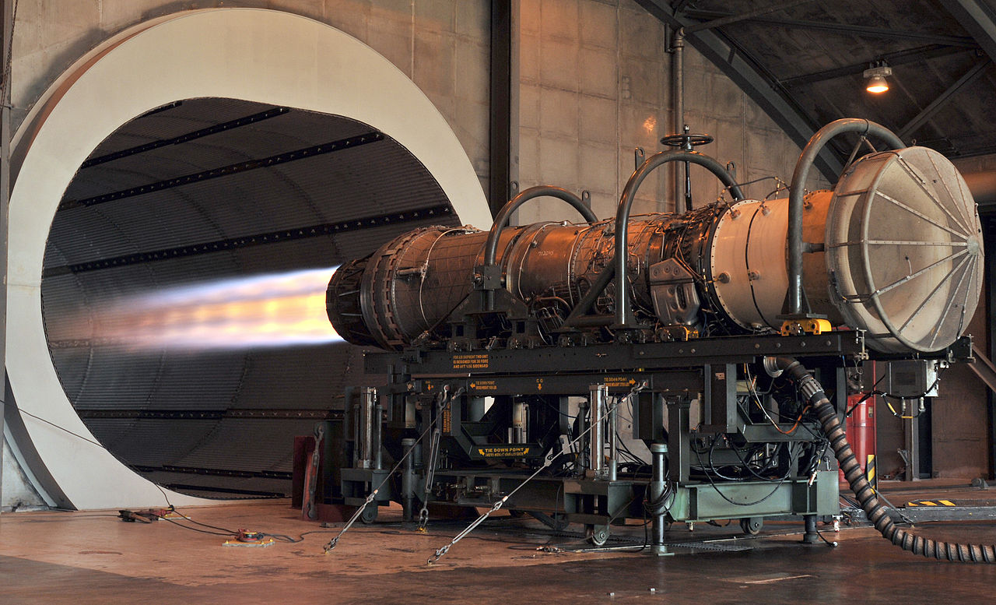
The invention of the jet engine, by Frank Whittle (1907–96).

Slide 22
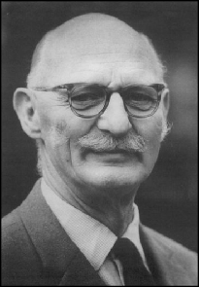
The invention of the hovercraft, by Christopher Cockerell (1910–99).

Slide 23
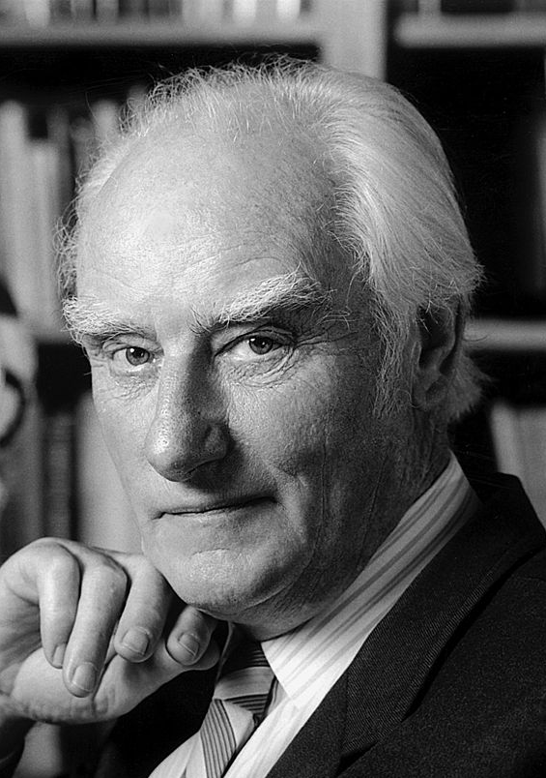
The structure of DNA, by Francis Crick (1916–2004) and others.

Slide 24
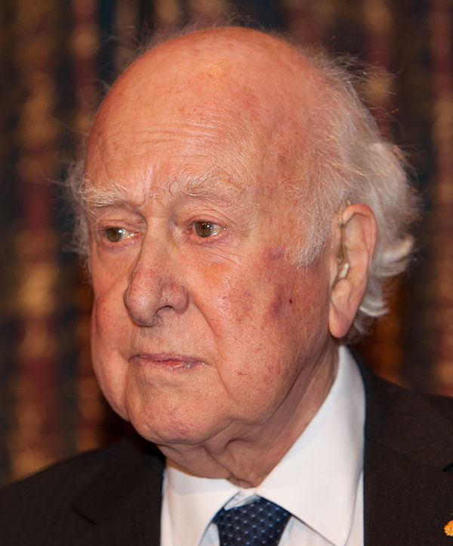
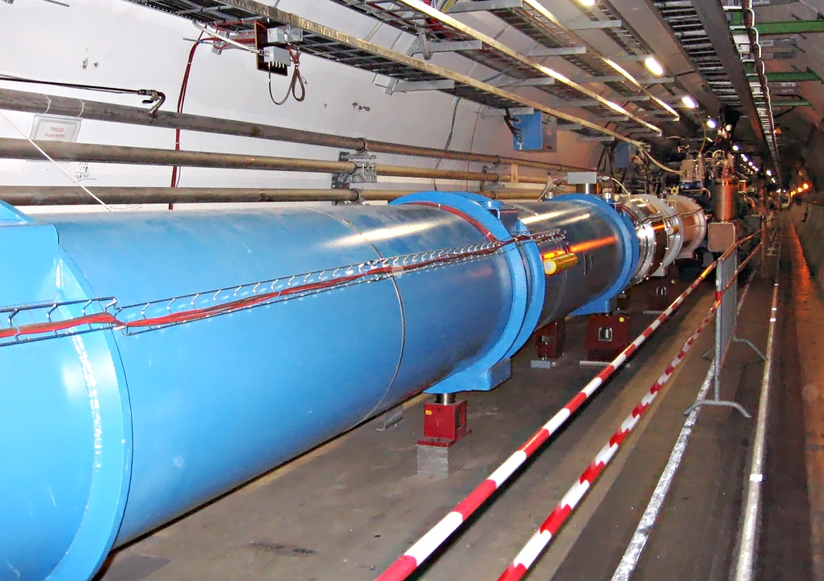
The theoretical breakthrough of the Higgs mechanism to explain electroweak symmetry breaking and why some particles have mass, by Peter Higgs (1929-).

Slide 25
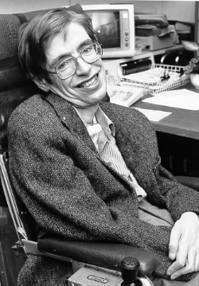
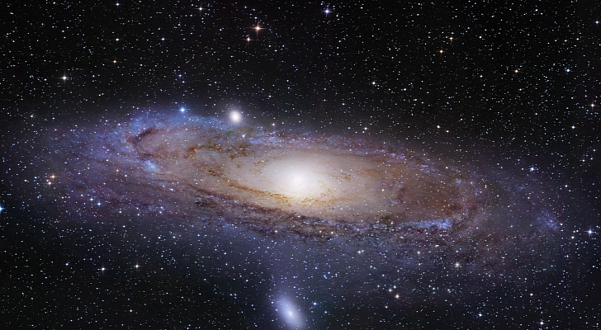
Theories in cosmology, quantum gravity and black holes, by Stephen Hawking (1942–).

Slide 26
To sum-up, nowadays, The UK has the most productive research base amongst the G7 (Group of Seven) and other leading research nations. The UK accounts for 3.2% of global expenditure on research and development and has less than 1% of the world’s population, but produces:
• 6.4% of global journal articles
• 11.6% citations
• 15.8% of the world’s most highly-cited articles.

