Slide 1
superstitions

Slide 2
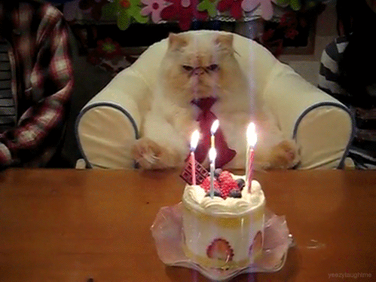
If you blow out all of the candles on your birthday cake with the first breath …
…you will get
whatever you
wish for.

Slide 3
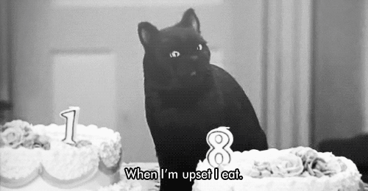
If a black cat crosses your path
you will have bad luck

Slide 4
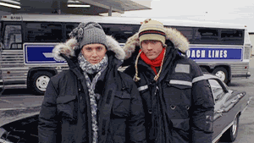
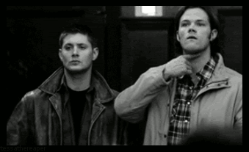
If a friend gives you a knife, you should give him a coin, or
your friendship will
soon be broken.

Slide 5
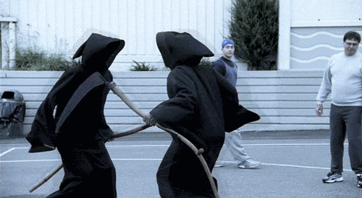
If a clock which has not been working suddenly chimes,
there will be a death in the family.

Slide 6
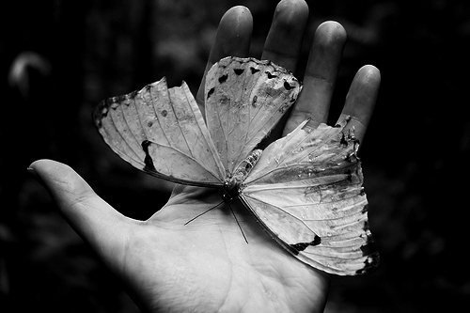
If the first butterfly you see in the year is white,
you will have good luck all year.

Slide 7
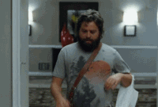
Thank you for your attention!

