Slide 1
overview
In December 1911 - January 1912 South Pole was reached by competing teams of Roald Amundsen and Robert Scott, with a difference of 33 days. Scott Polar team killed in full on the way back, its fate during the XX century has been the subject of extensive debate very professional historians polar and polar expeditions ...

Slide 2
Amundsen and Scott way
The terrain on which routes were similar Amundsen and Scott. From wintering bases both teams were on the Ross Ice Shelf, followed by glacial valleys of the Transantarctic Mountains and then along the plains of the Polar Plateau. Both teams based on the experiences of E. Shackleton Expedition 1908-09, the (not reached the Pole 97 geographical miles or 180 miles) and believed that the major cause difficulty crossing the mountains and climb to the plateau.

Slide 3
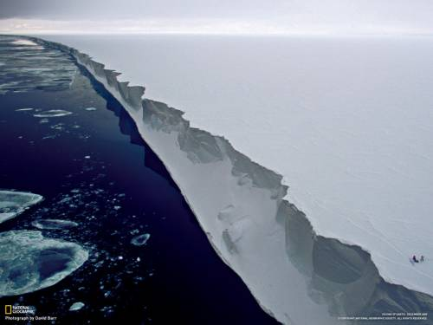
Ross Ice Shelf was the most easy part of the route.

Slide 4
Weather Conditions
Weather conditions accompanying expeditions, consider difficult because of the difference in terms of campaigns. Scott wrote in his diary that at the end of the pole route he encountered unexpectedly low temperatures. However, during the winter on the "Discovery", in March 1903 were recorded temperature below -40 ° C. Amundsen tried whenever possible to reduce the time of being in the field, avoiding the adverse conditions encountered Scott.

Slide 5
Return back
On return to base Amundsen spent one and a half times less time than the way to the pole, so its average speed for the entire distance is 36 km / day. The reasons are obvious: no need for reconnaissance, traces of (partially) were intermediate compositions in each geographical degree of latitude. Team Scott Speed ​​was approximately constant for both the journey.

Slide 6
When Scott's team climbed on the Beardmore Glacier, despite the blizzard 5 - 9 December 1911 and crack zone, its rate increased. This was due to the fact that after shooting horses simplified assembly and folding of the original camp. The surface of the glacier did not create serious obstacles.

Slide 7
In December 1911, Scott's team took an average of 27 km / day at the end of the month the speed dropped to 21 km / day, and in the first week of 1912 - up to 19 km / day. These features are not reflected in the diary Scott

Slide 8
On the way back from the pole pace movement commands Scott rose from 20 to 22 km / day. In January 1912 Amundsen introduced a new schedule: tight schedule transitions to 28 km with a six-hour stay. This pace was maintained until the return to base. Signs of exhaustion dangerous team Scott appeared after three months of transition, apparently, it is a time limit for safe operation in extreme conditions. Since death E. Evans, Scott average transition command does not exceed 5 km / day, and often was below

Slide 9
Amundsen triumph was marred by several deaths: January 9, 1913 committed suicide Hjalmar Johansen, February 11, arrived in New Zealand barque "Terra Nova" with the message that the November 12, 1912 were found the bodies of Scott and his two companions, who died in late March
Amundsen said in an interview:
I would donate all the money and fame, so if I could save by Scott from a horrible death

Slide 10
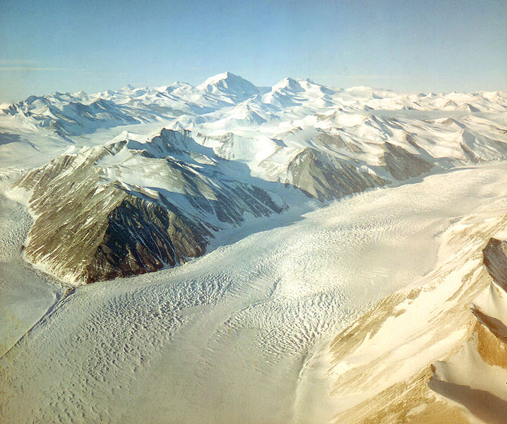

Slide 11
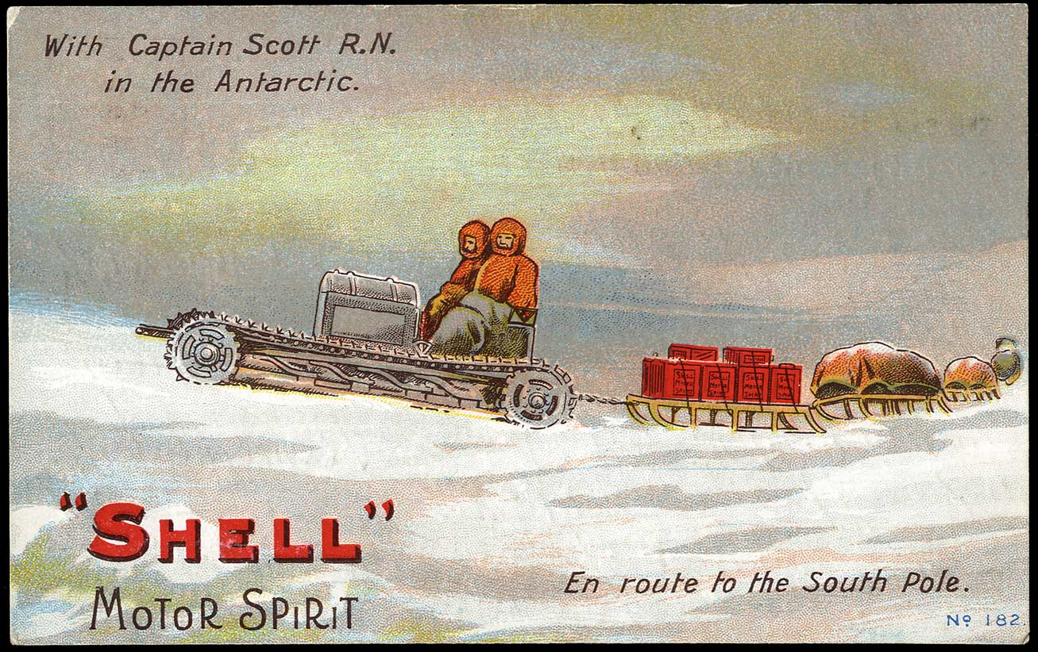

Slide 12
