Slide 1
Water pollution

Slide 2
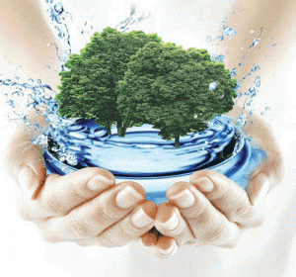
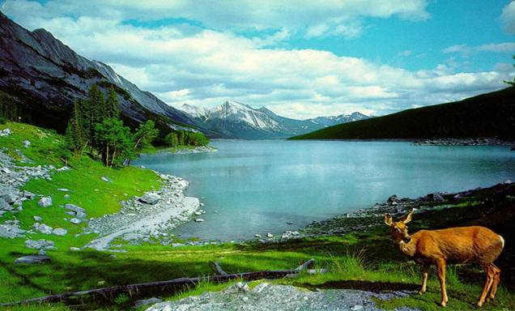
Water pollution is one of the famous and one of the largest problems in our world. Water is the giver and the taker of life. It covers most of the planet and has a huge influence on our lives. We can not live without water and are always dependable on it.

Slide 3
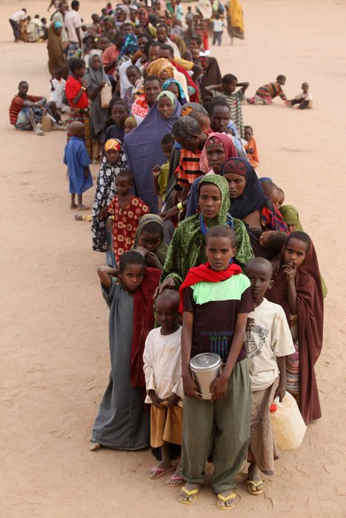
People in Africa cannot drink clean water; their children die because a big part of our water has been polluted. Children in Kenya often have to go many kilometers to collect drinking water. At all over 2 million people don’t have clean water.

Slide 4
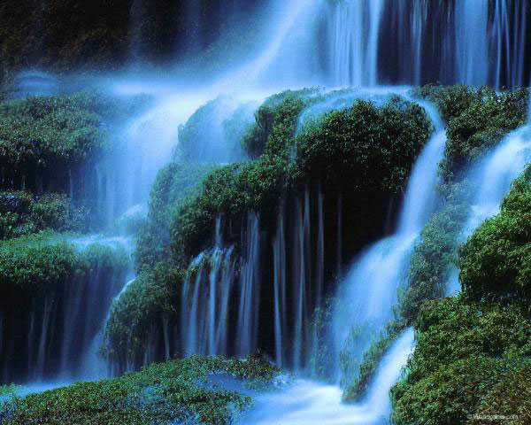
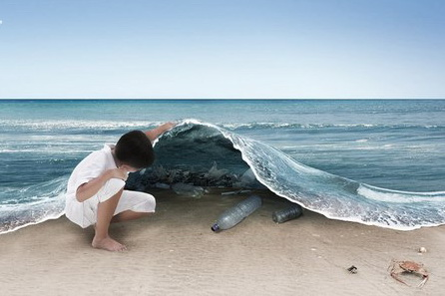
If we drink polluted
water or eat junky food,
we have problems with health.
It is very important to preserve water for the future.

Slide 5
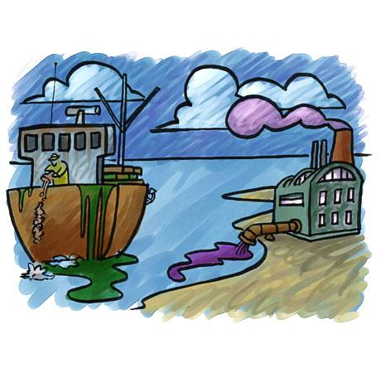
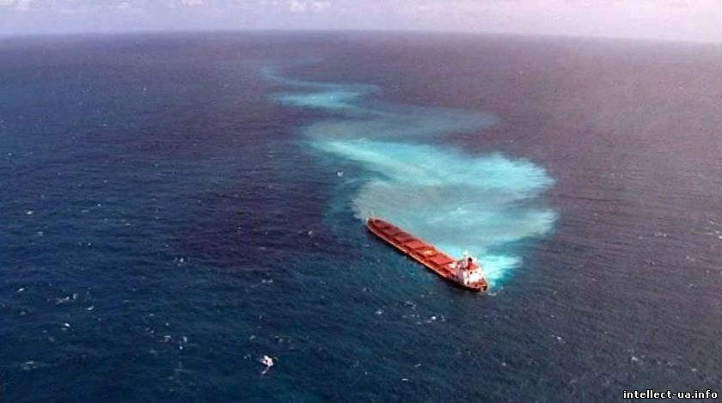
Many ships pour oil and wastes into the seas and rivers. As a result, they are dirty and the fish is poisonous and not good for eating. Many seas are used for dumping industrial and nuclear waste.

Slide 6
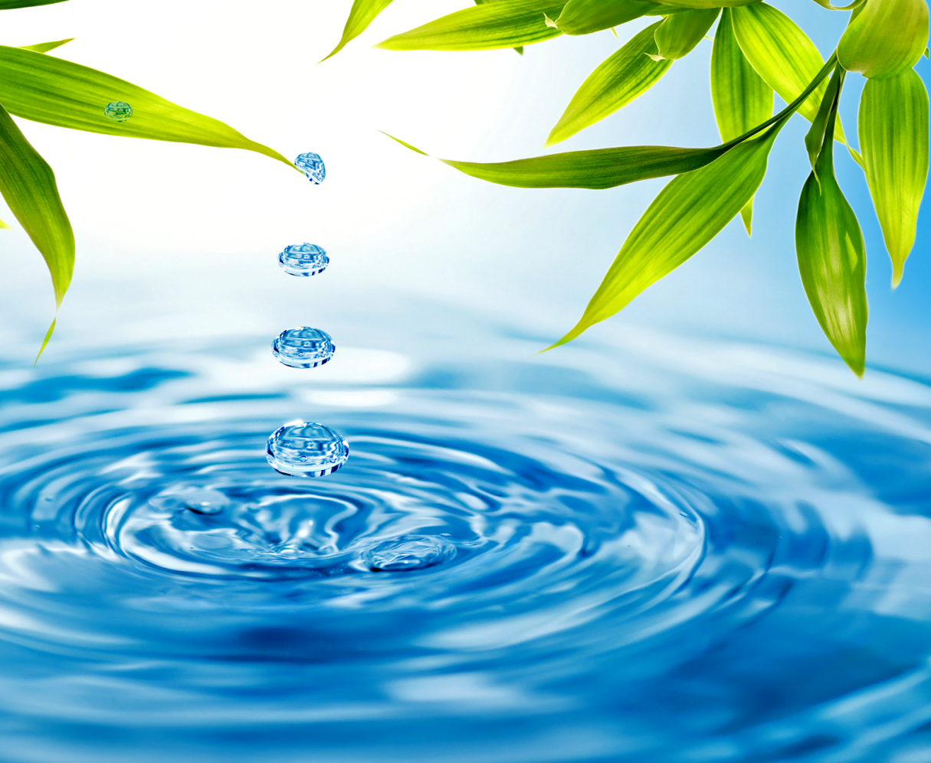
We should avoid wasting water without reason. People must be fined for bad attitude to nature.

Slide 7
Let’s keep our water clean!

