Slide 1
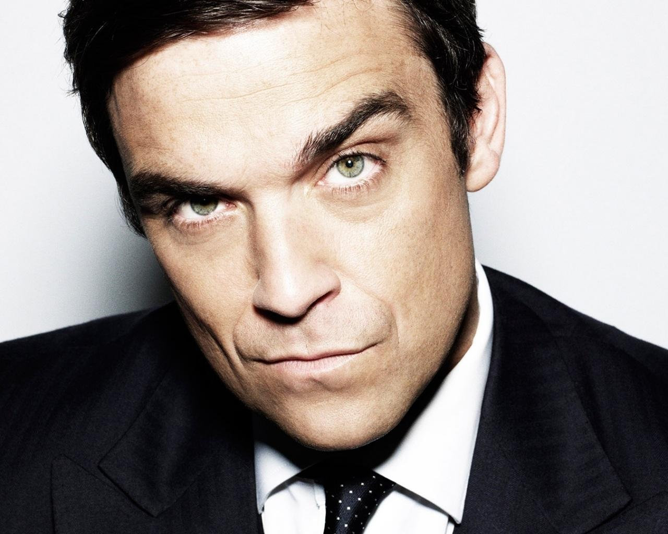
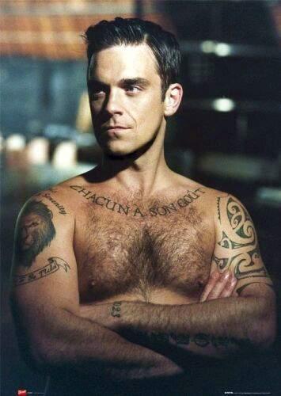
Robbie Williams

Slide 2
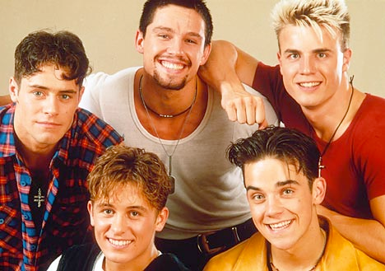
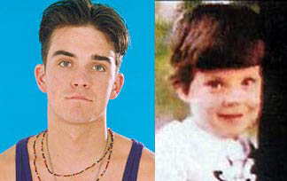
Early Life
Robbie Williams was born Robert Peter Williams on February 13, 1974, in Stoke-on-Trent, England. When he was 3 years old, his mother Janet divorced his father (entertainer Pete Conway). Growing up Williams rarely stayed out of trouble in school. He performed in local plays and spent school holidays with his father. At 16 his mother told him about an audition for a boy band. His song won him a spot alongside Gary Barlow, Mark Owen, Howard Donald and Jason Orange. The band was called Take That.

Slide 3
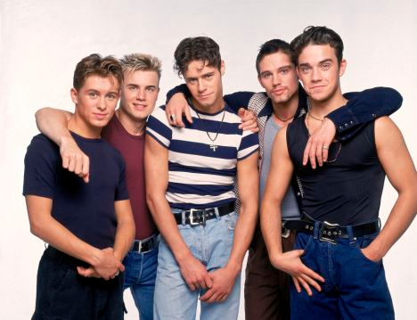
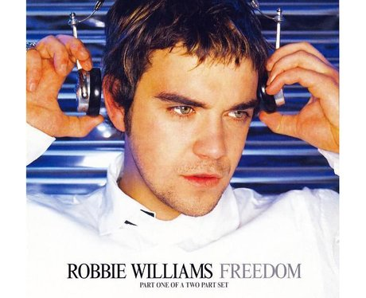
Professional Success
As a member of the boy band, Williams helped earn Take That six No. 1 singles and three No. 1 albums. But five years of living a squeaky-clean image turned out to be enough for the young singer, and at 21 he left the band. He kicked off his solo career by signing a contract with Chrysalis/EMI for over $1 million and singing a hit cover of George Michael's "Freedom."

Slide 4
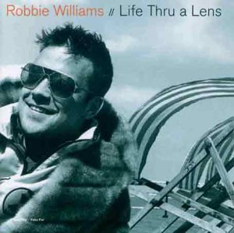
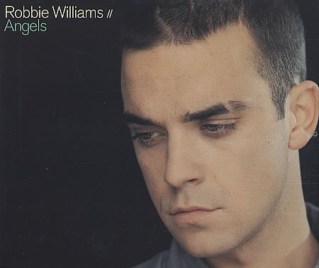
Professional Success
His first solo album, Life Thru a Lens (1997) got a lukewarm reception from critics. But his single from it, "Angels," sold more than 800,000 copies and spent over three months in the top 10. Subsequent albums continued his winning streak: I've Been Expecting You (1998), Sing When You're Winning (2000), Swing When You're Winning (2001), Escapology (2002), Intensive Care (2005), Rudebox (2006), Reality Killed the Video Star (2009) and Take the Crown (2012). In fall 2013, he's expected to release his sequel album Swing When You're Winning II.

Slide 5
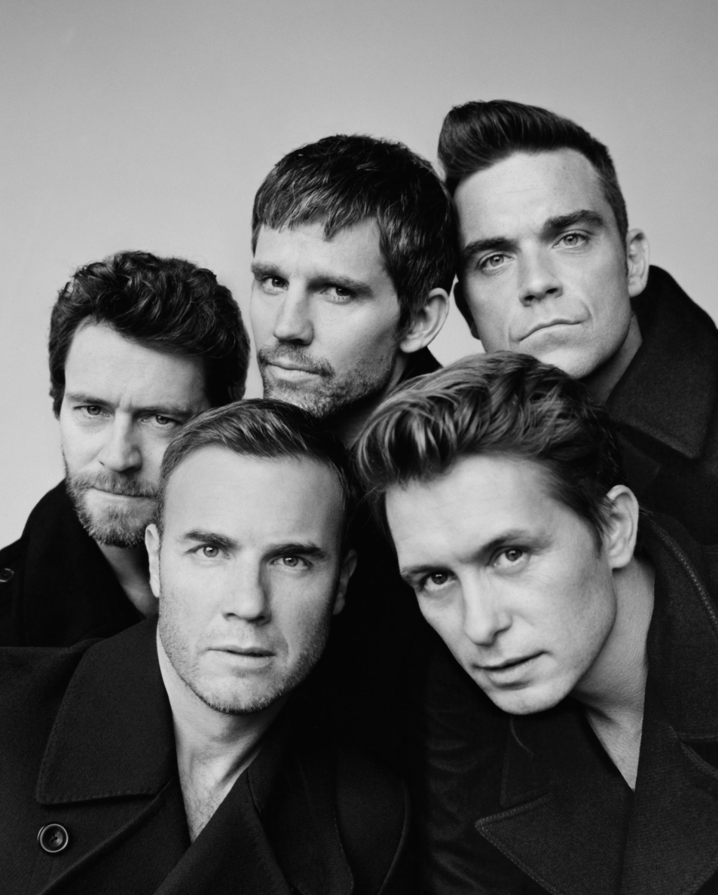
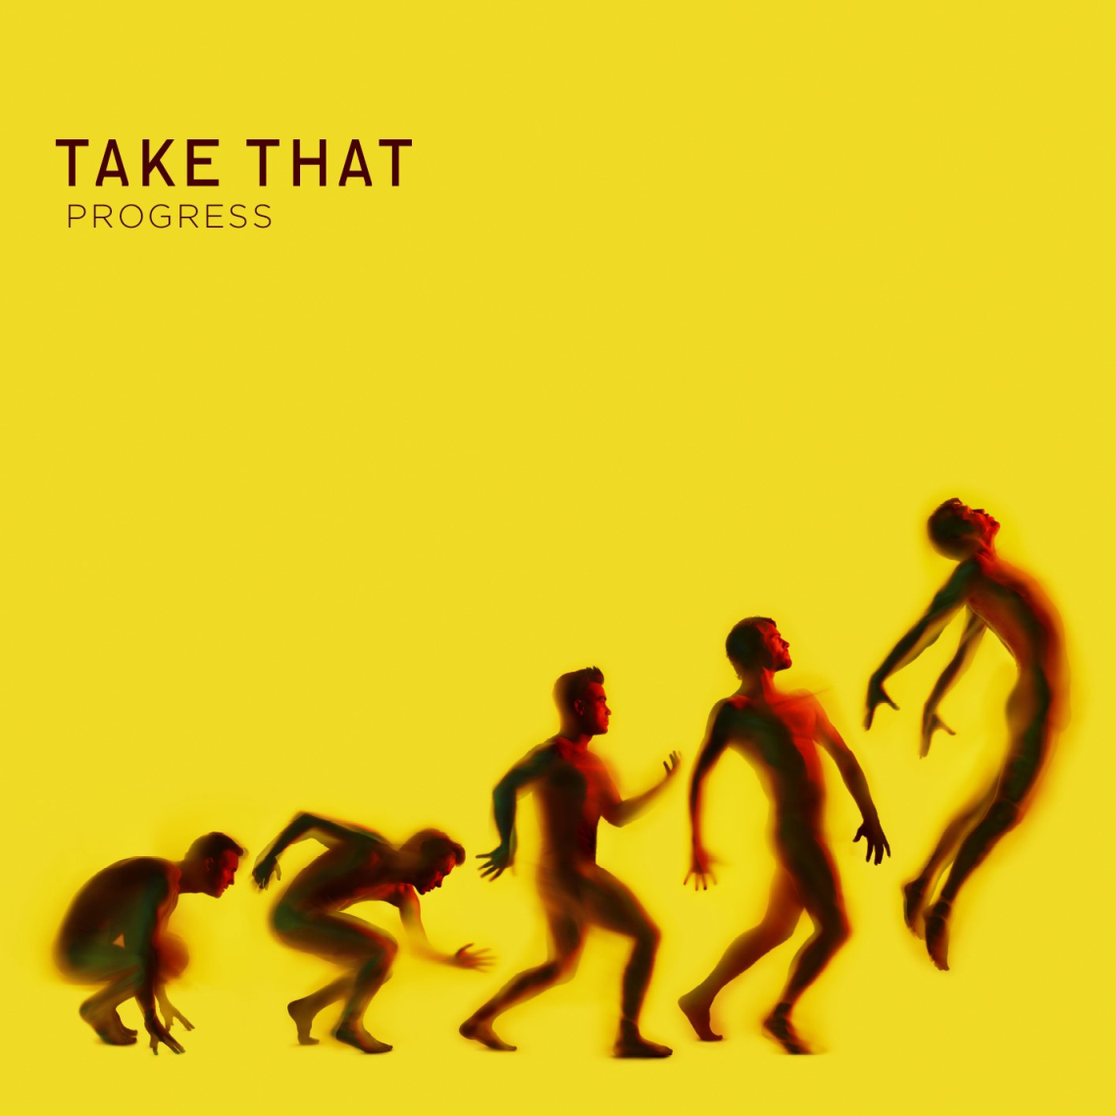
Professional Success
In 2010, Williams reunited with Take That and recorded the highly successful album Progress. But less than a year later, reports emerged that he would be leaving the band again, leaving their concert tour in 2011.

Slide 6
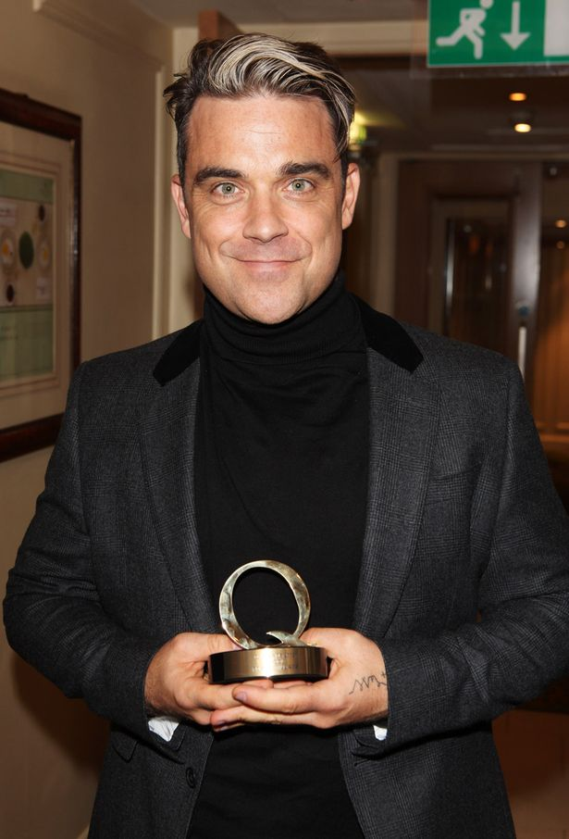
Professional Success
Although the reunion was brief, he has said he'd be open to an official reunion in the future. Wililiams' success has made him the best-selling British solo artist in the United Kingdom, with over 70 million records sold worldwide. In 2004, he was inducted into the UK Music Hall of Fame.

Slide 7
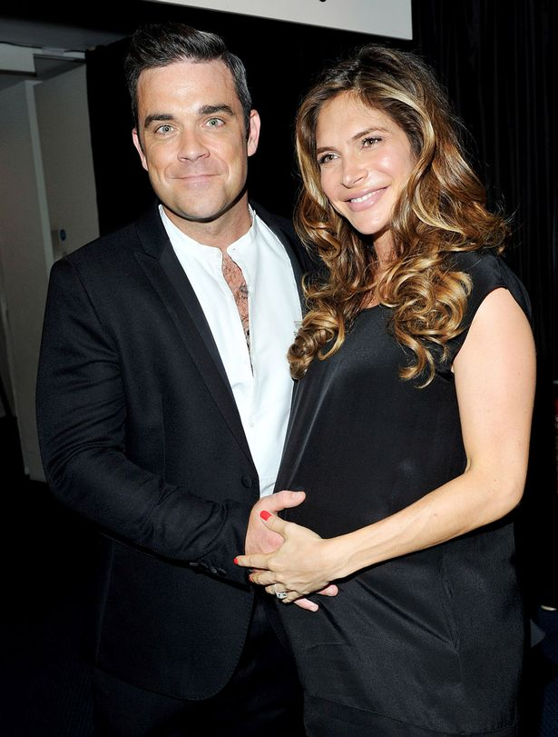
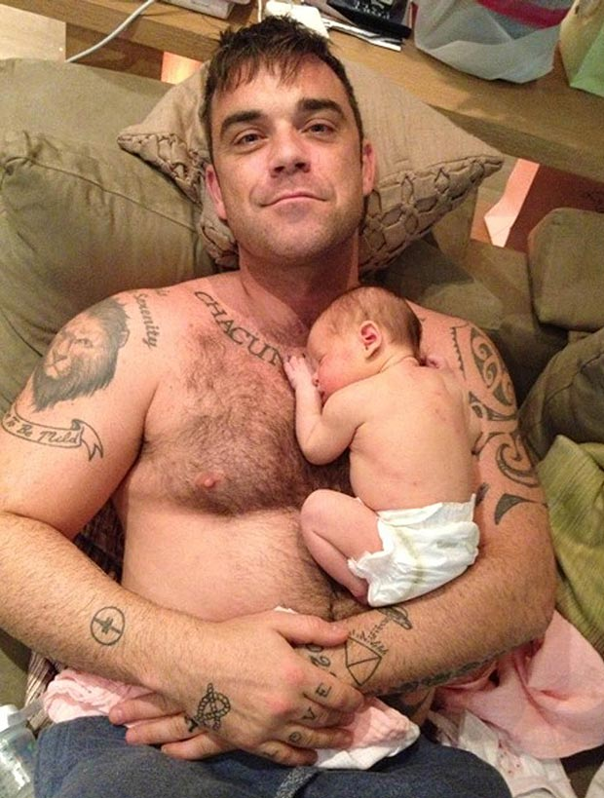
Personal Life
In 2010, Williams married actress Ayda Field. The couple met in 1997. He lives in Beverly Hills with his wife and his daughter, Teddy.

Slide 8
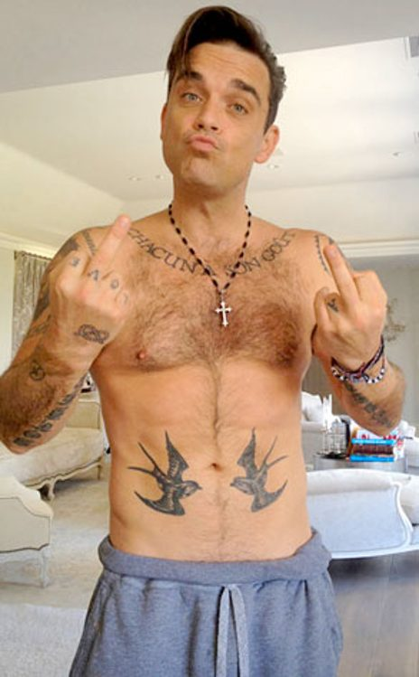
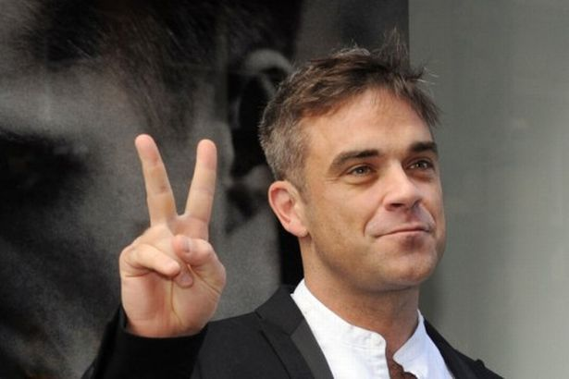
Thanks for your attention!

