Slide 1
Newspaper: First news
Journalist- Bezsmola Oksana

Slide 2
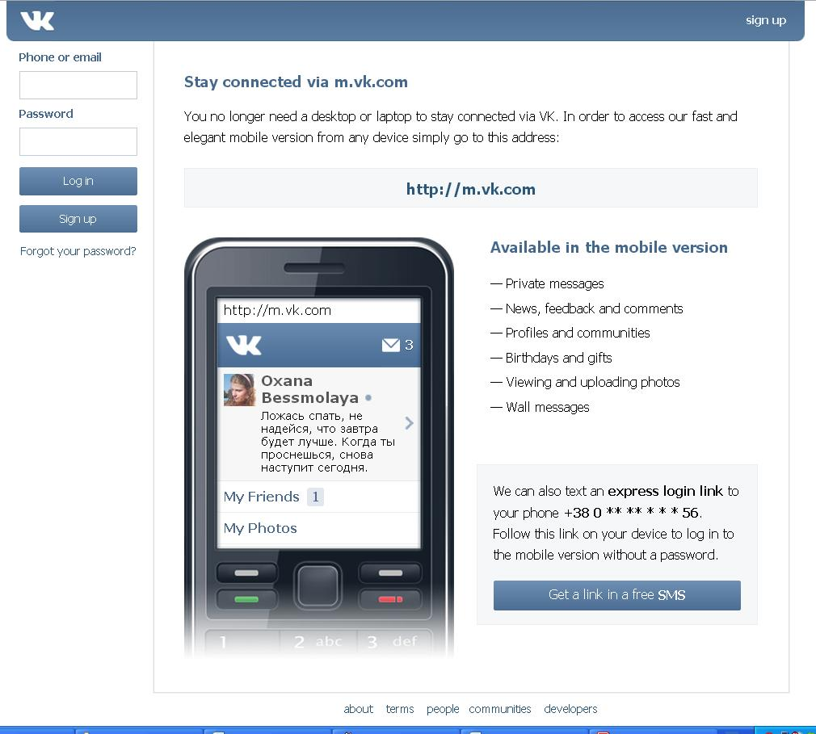
Article about dependence on social networks.
It's no secret that virtually every person registered in any social network. and spends on the Internet most of his life. The most popular is the site Vkotakte. depending on him and we'll talk.

Slide 3
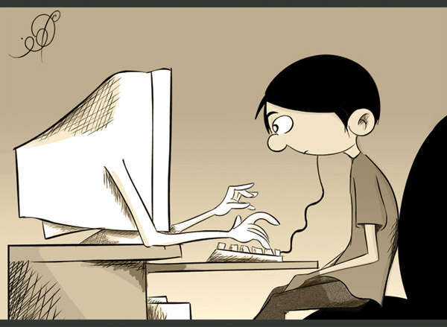
Dependence on social networks : The most important sign of symptoms - overreliance online resource or more . If you feel that the day has passed in vain, if you are not logged on your page, you can be sure that you have an addiction. Very often , it is difficult to be objective and this dependence notice people around you - parents , boyfriend / girlfriend , a loving grandmother . Even pets can at you askance glances . Especially worth considering if you come to rest somewhere and immediately interested in whether there is in this place Wi-Fi.

Slide 4
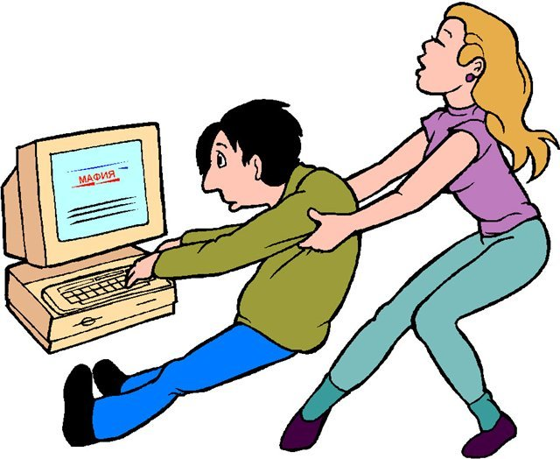
Avid social network users say that it is easier to quit than to delete your page. In China, Internet addiction equated with mental illness and treated in clinics. With a simple test, you can determine whether you are addicted to In Touch.

Slide 7
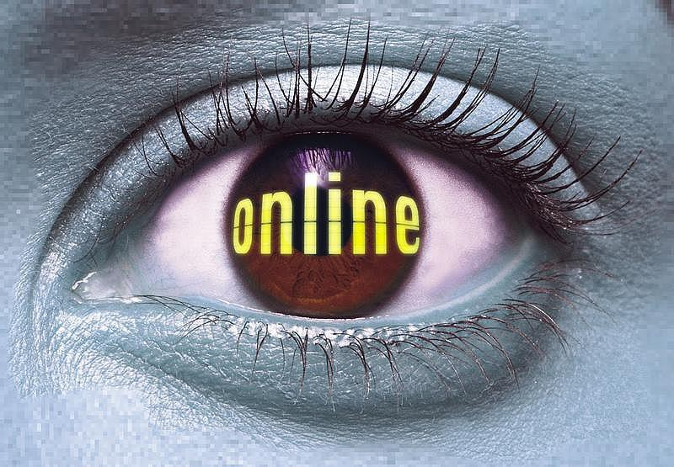
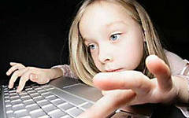
You just need to stop doing it, that is to go vkontakte. It's enough to delete a page, the benefit of such a function there, but I'm sure it's got quite a few.

Slide 8
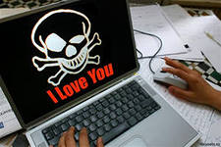
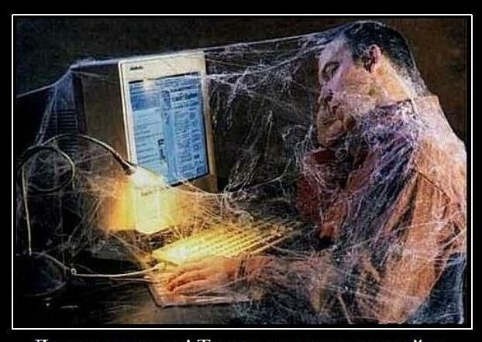
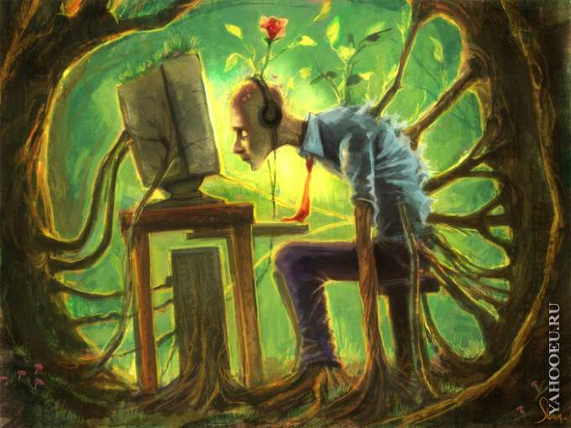
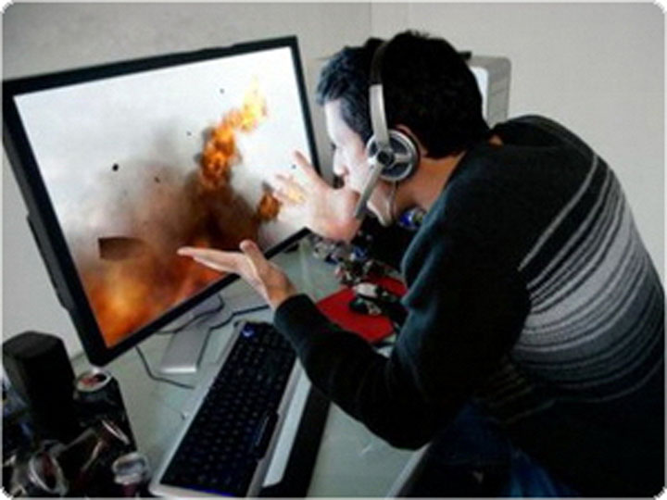
At first contact was just another means of communication, in addition to ICQ, sms, home phone, but now it's - a whole life! Music, pictures, videos, friends, meetings, groups, messages, news, games.

Slide 9
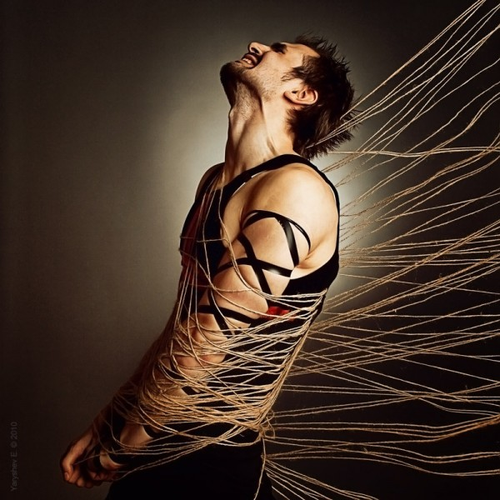
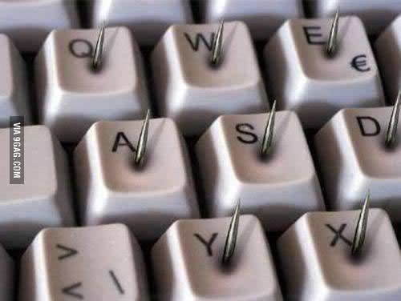

Slide 10
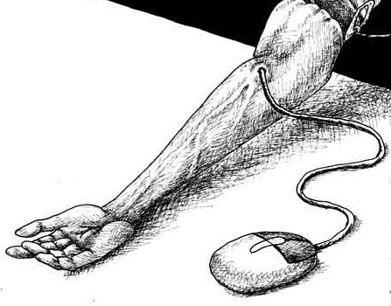
We must do something, so you can spend a lifetime sitting vkontakte, online replacing his real life!

Slide 11
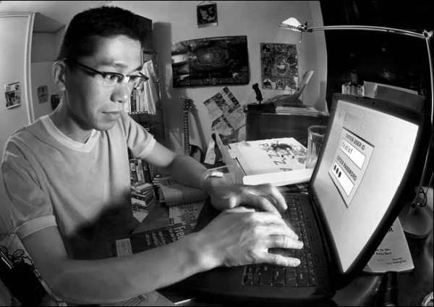
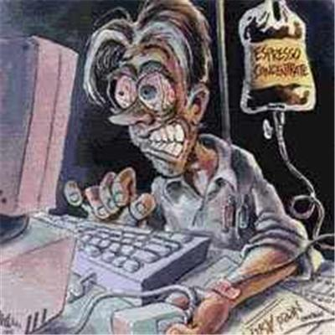
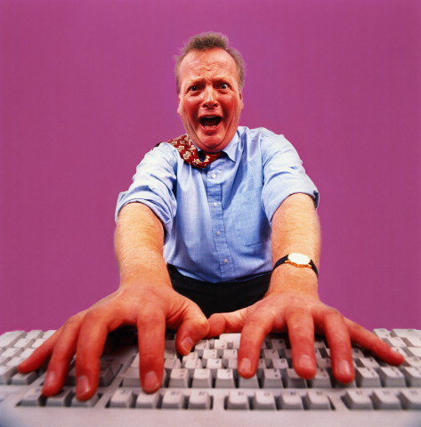
The easiest and most affordable way to resolve dependencies - is the acquisition of other addiction. Maintaining a healthy lifestyle, communication with nature, creative hobby applications, such as drawing, usually derive from human dependence.

Slide 12
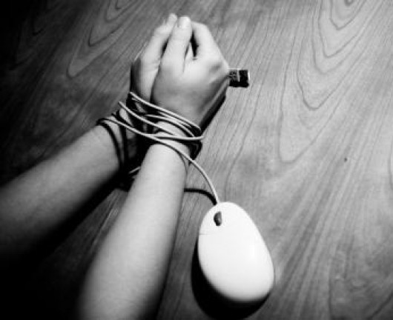
First of all, deteriorating eyesight, posture appears overweight from conducting passive lifestyle. If you analyze, the more time is spent on pointless display of news, photos, "laykane" and useless communication, from which the teacher of Russian language and just educated people are horrified. Not to mention the online games, which in addition to time, make more and give you earn money . Surprisingly, many began to hover in the social sphere because of games that are out there actively advertise.

Slide 13
I wish you all a lot of time to sit on the internet. and understand that social networking is not a life.

