Slide 1
Ustym Karmaliuk
by Liz Prishchepa

Slide 2
Basic information
Ustym Yakymovych Karmаliuk was a Ukrainian peasant outlaw who became a folk hero. He is often referred to as the "Ukrainian Robin Hood" and "the last Haydamak". Karmalyuk was born a serf in the settlement of Holovchyntsi in Lityn uyezd of Podolie Governorate.

Slide 3
Early Age
There is little known about his early life except that he possessed some literacy and was fluent in Russian and Polish, besides his native Ukrainian language. When he was 17, he was taken to serve landlord estate. Karmalyuk was a hard worker, but naughty. As a result in 1812 his owner decided to forcibly send him into Russian military service, in order to remove him from others whom he was inciting to rebellion.

Slide 4
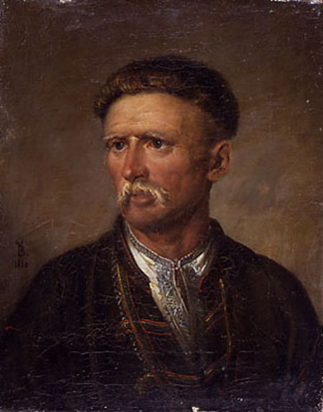
Ustym Karmlyuk by Vasily Tropinin

Slide 5
Established Revolutionary
But in 1813 Ustim Karmalyuk escaped from the location of the 4th Lancers army of the Russian Empire, which was located in Kamenetz-Podolsk, and returned home. Soon he was caught and sentenced to a punishment of 500 lashes, and then sent to a penal battalion in the Crimea. But on the way to the Crimea Ustim Karmelyuk escaped from prison, came back, and in 1914 led a rebellion.

Slide 6
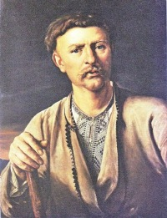
In 1817 - again gendarmes caught Karmalyuk. He was sentenced to death, but at the last moment replaced the 10 years of exile in Siberia and 25 lashes. But he ran away from there. In the end, he was in captivity in Kamenetz-Podolsk fortress, but from there he made for the fourth escape. In 1824, he was caught and was assigned 101 lashes, and then labeled and sent back to the familiar Siberia.

Slide 7
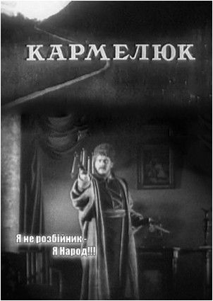
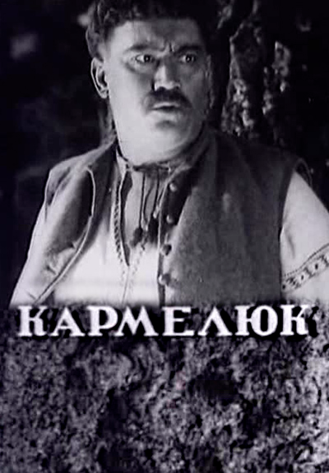
In 1930 he returned to Podolie where organized revolt in which about 20 thousand people took part. For 23 years of persistent fight Karmelyuk's insurgent groups made more than 1 thousand attacks on estates of landowners. The money taken at landowners and property distributed to the country poor.

Slide 8
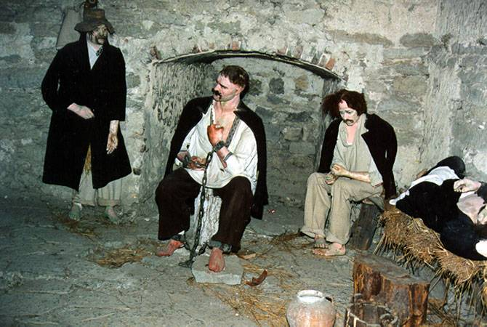
The exhibition "interior" of Karmalyuk’s camera.
The exhibition at the Pontifical tower restores the conditions in which was imprisoned Ustim Karmalyuk. Next to him, his "Colleges" which he organized an escape.

Slide 9
Karmalyuk's death
Ustym Karmelyuk was killed in an ambush gentleman Rutkowski (according to legend, buttons and not a bullet, because then believed that the only way to kill "Kharakternyky" - the so-called witches once Cossacks). The body Karmalyuk long then drove villages, to terrorize the peasants. He was buried in Letichev, at his grave in 1974 on a boulder-pedestal erected a 5-meter-high monument.

Slide 10
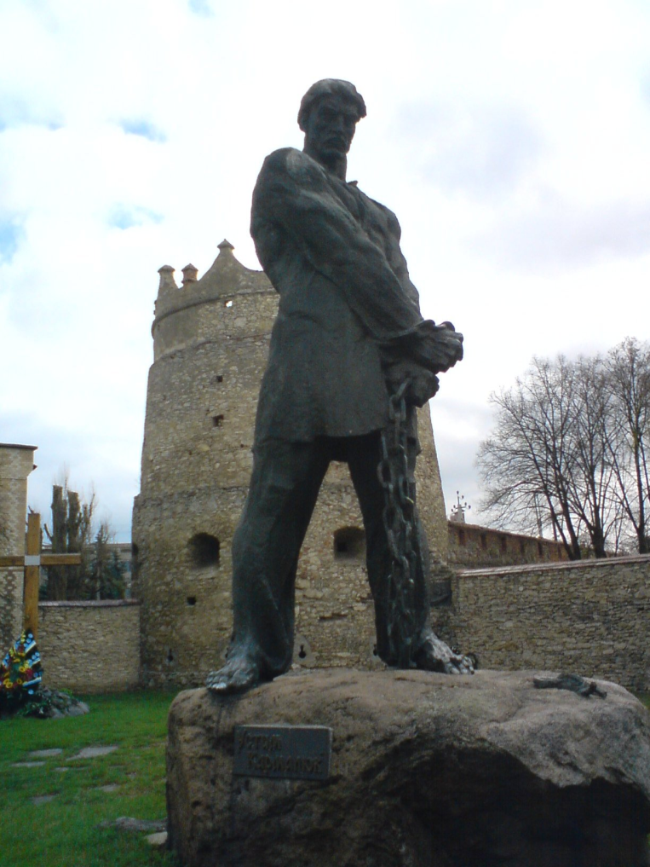
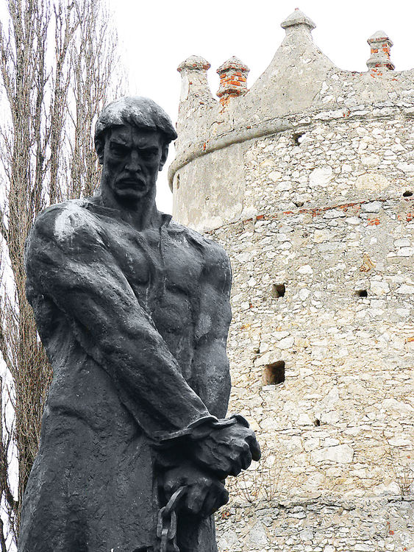
Monument to Ustim Karmelyuk

Slide 11



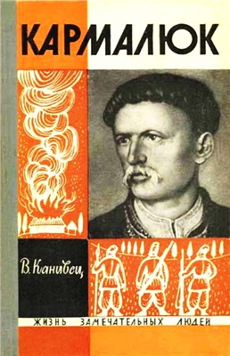
Karmalyuk is a subject of many art- and folk-songs. He is sometimes referred to as "the Houdini of Podilia", as no prison was able to hold him for very long. Affectionately, he is known as the last Haidamak of Ukraine.

