Slide 1
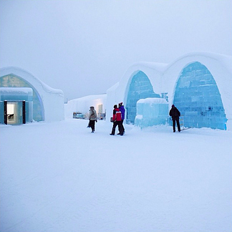
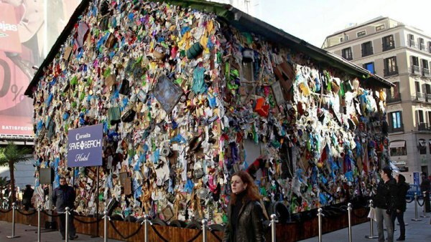
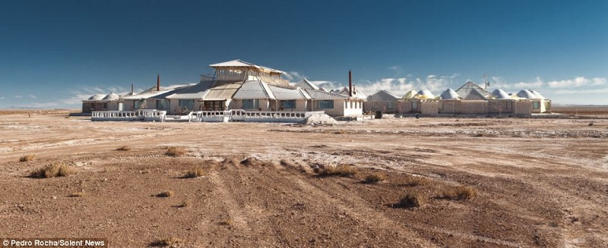
Unusual hotels that are built from the most unexpected materials
by Anastasia Meret’ska

Slide 2
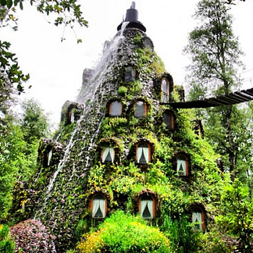
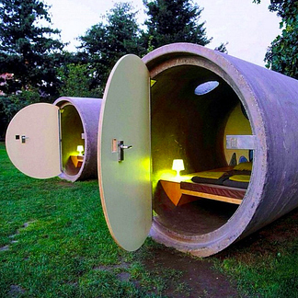
Quirky designs, unusual decor and strange building materials are a few of the traits of the world's most unusual hotels.
Some hotels are more than merely a place to sleep while visiting a destination.

Slide 3
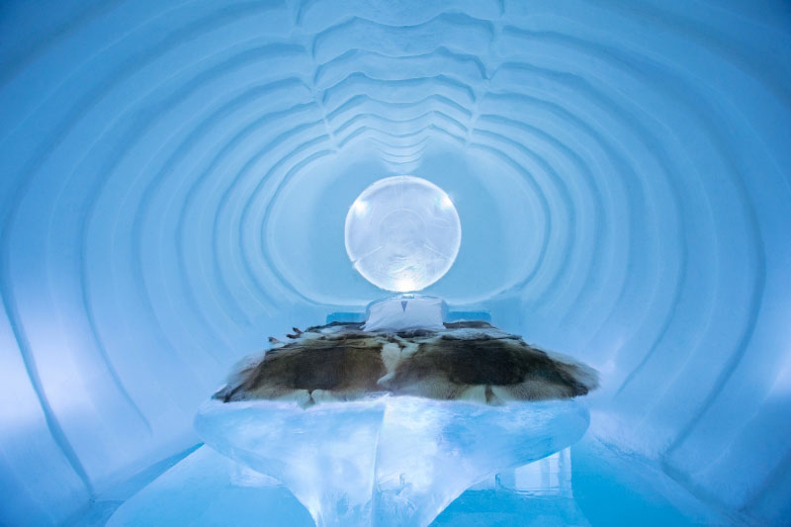
ICE HOTEL is the world’s first and largest hotel built of snow and ice.
It is situated in a small village in Northern Sweden.

Slide 4
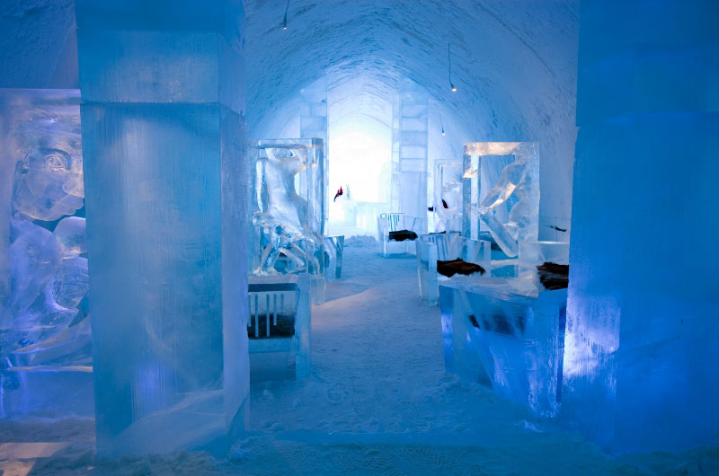
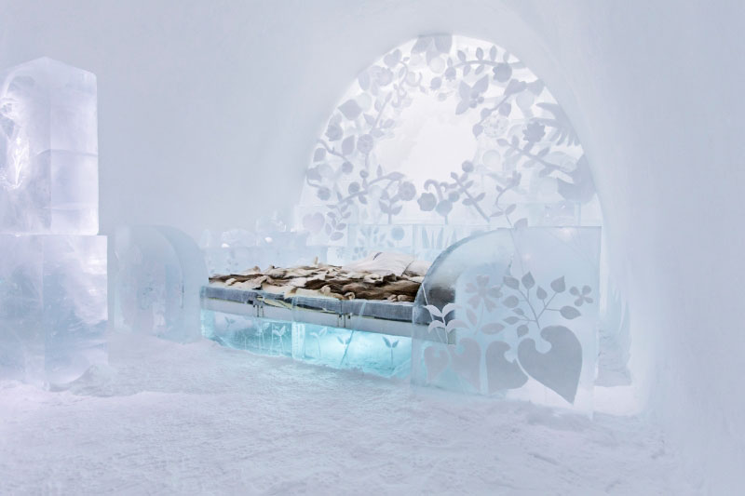
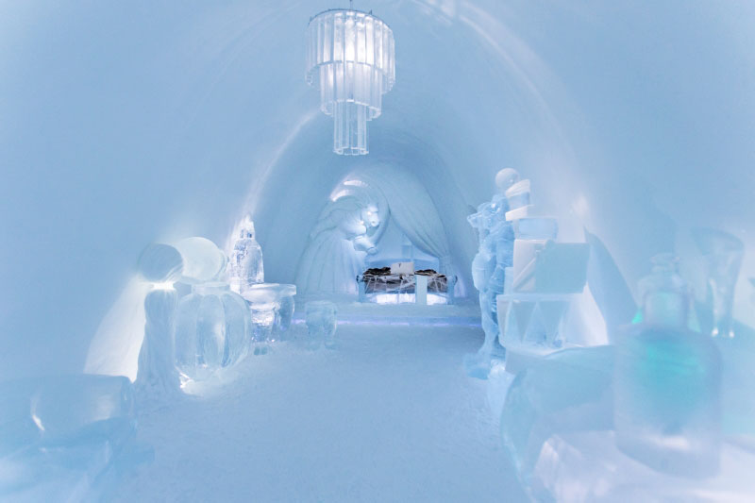
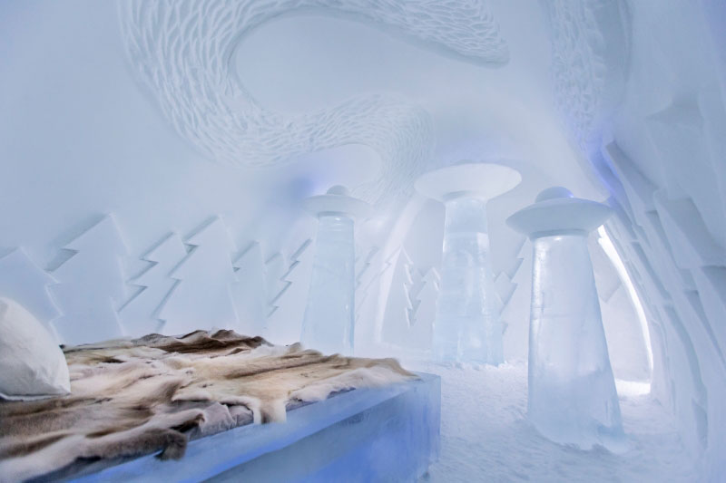
and is constructed each winter from 1,000 tons of Torne River ice
ICE HOTEL covers 5,500 square meters
and 30,000 tons of “snice”, a mixture of snow and ice.

Slide 5
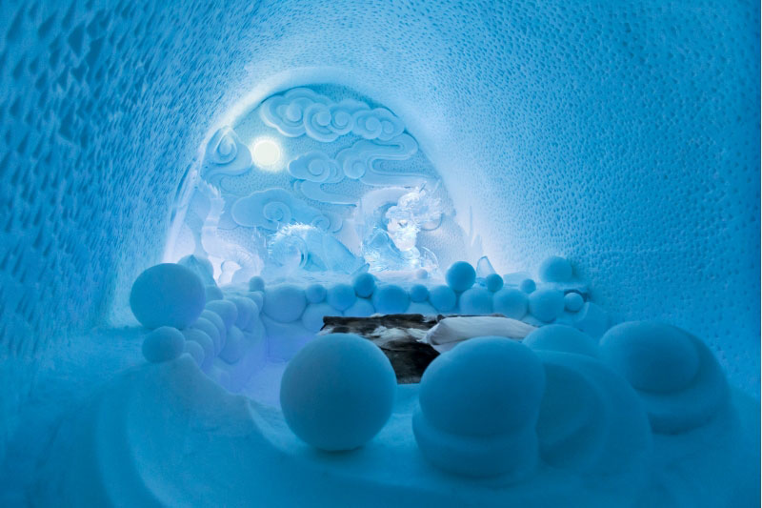
And each spring the hotel melts … to be reconstructed a new the following winter. As such, if you go each winter, year after year, you’ll never stay in the same building twice.

Slide 6
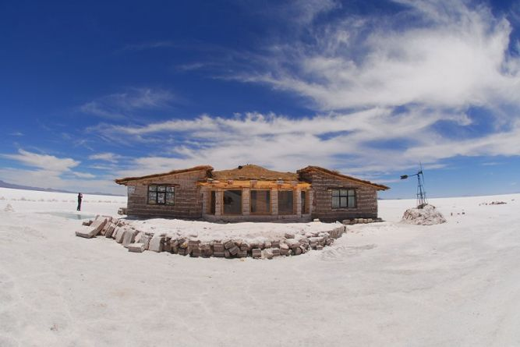
The Palacio de Sal (meaning Salt Palace) is located on the edge of Bolivia's Salar de Uyuni - the largest salt flat in the world.

Slide 7
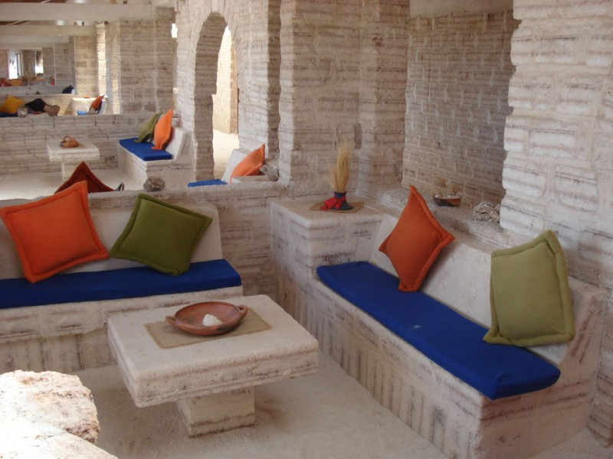
It is a hotel and spa where everything is made entirely of salt.
The walls, floors, ceilings, and even some of the furnishings such as chairs, tables, beds...

Slide 8
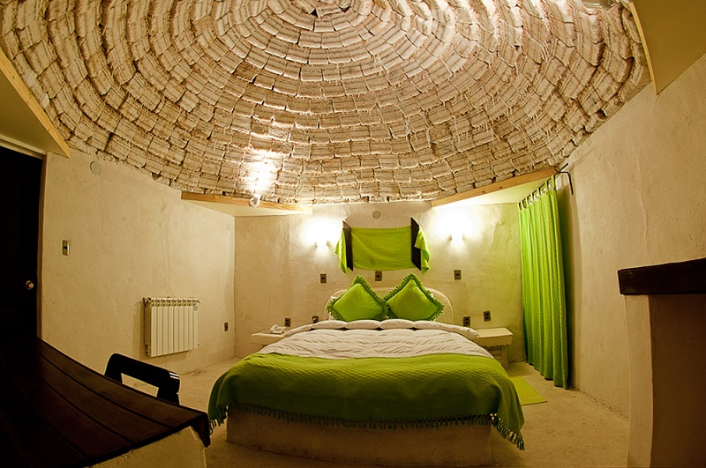
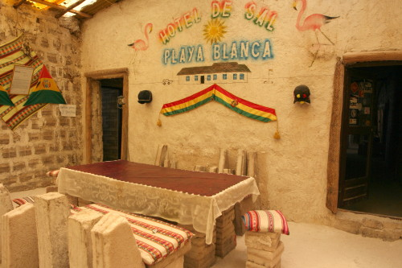
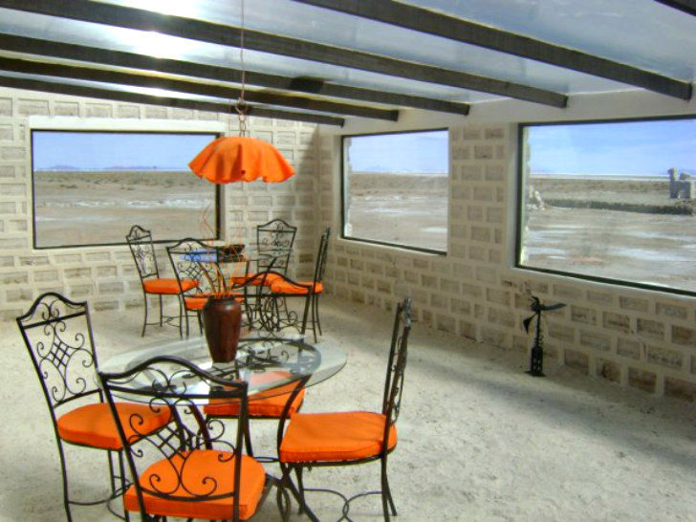
In order to maintain the integrity of the hotel’s structure, it is strictly forbidden to lick the walls.

Slide 9
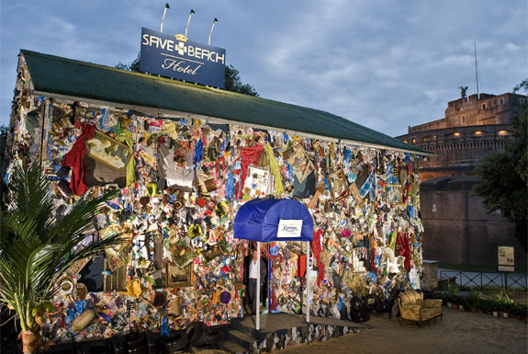
In 2010 was created the first hotel in the world created from garbage - the Beach Garbage Hotel.

Slide 10
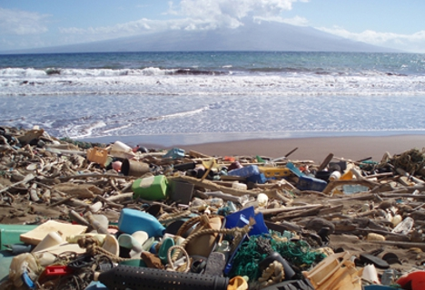
The aim is to raise awareness of the plight of beaches and seas around the world, which are increasingly plagued by garbage. The hotel opened its doors on World Environment Day.

Slide 11
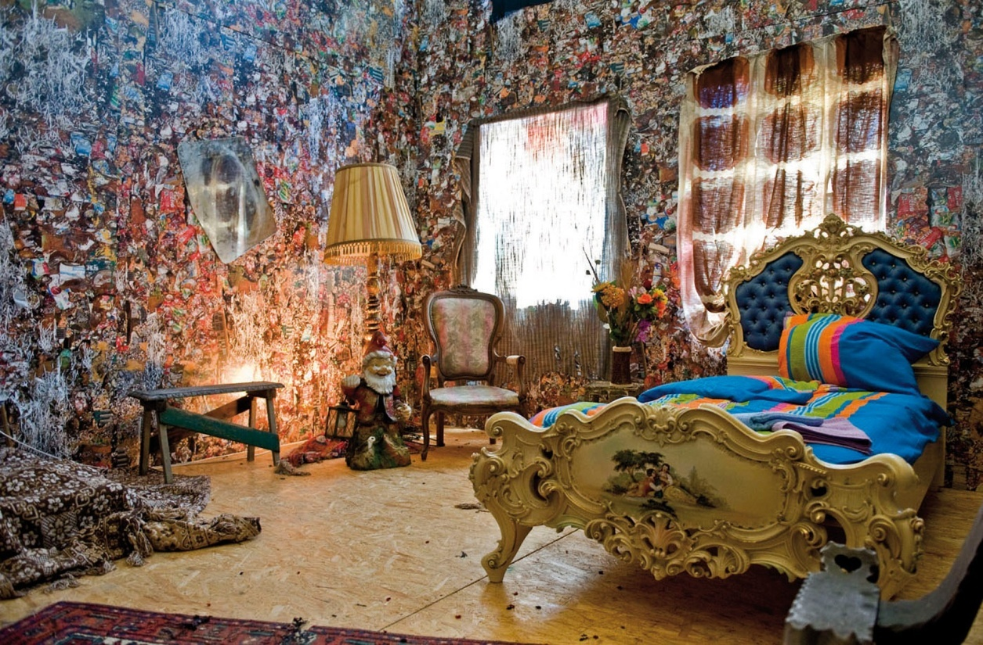
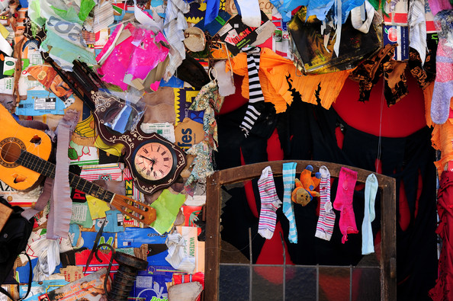

The walls of hotel made of materials found in landfills, the beaches and even flea markets.

