Slide 1
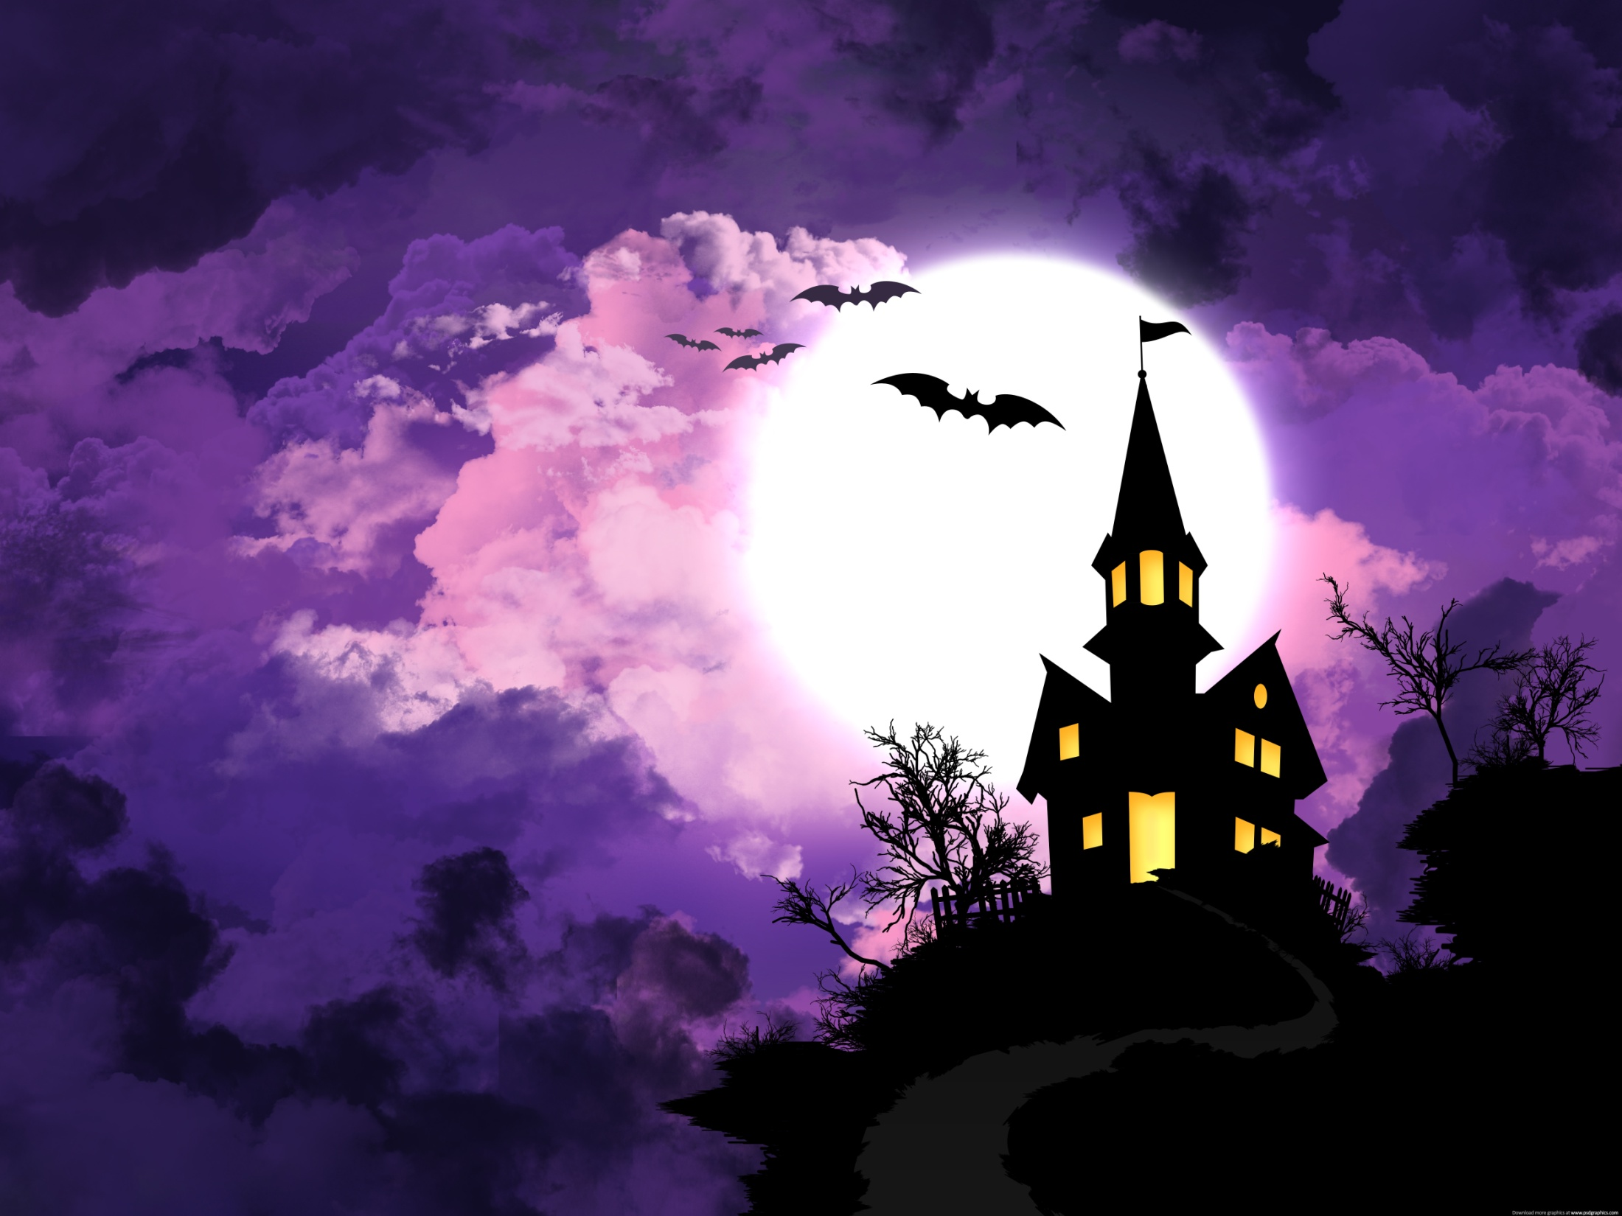

Halloween

Slide 2
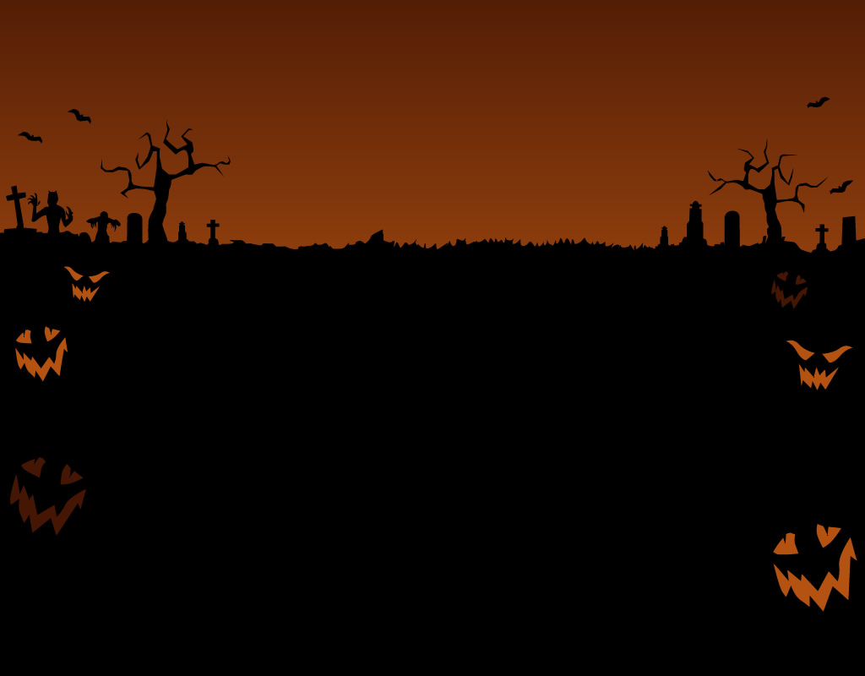
In the year 835 A. D. the Roman Catholic Church made November 1st a church holiday to honour all the saints. This day is called All Saint's Day. The Mass said on All Saints' Day was called Allhallowmass. The day before All Saints' Day was known all hallows' Eve or All Hallow e'en.
Since that time many years have passed. Some traditions are gone, new traditions appeared.
I am going to tell you about the most popular customs of Halloween. In the United States children wear costumes and masks and go trick-or-treating. Many of them carve jack-o'-lantens out of pumpkins. Fortunetelling and storytelling about ghosts and witches are popular activities

Slide 3
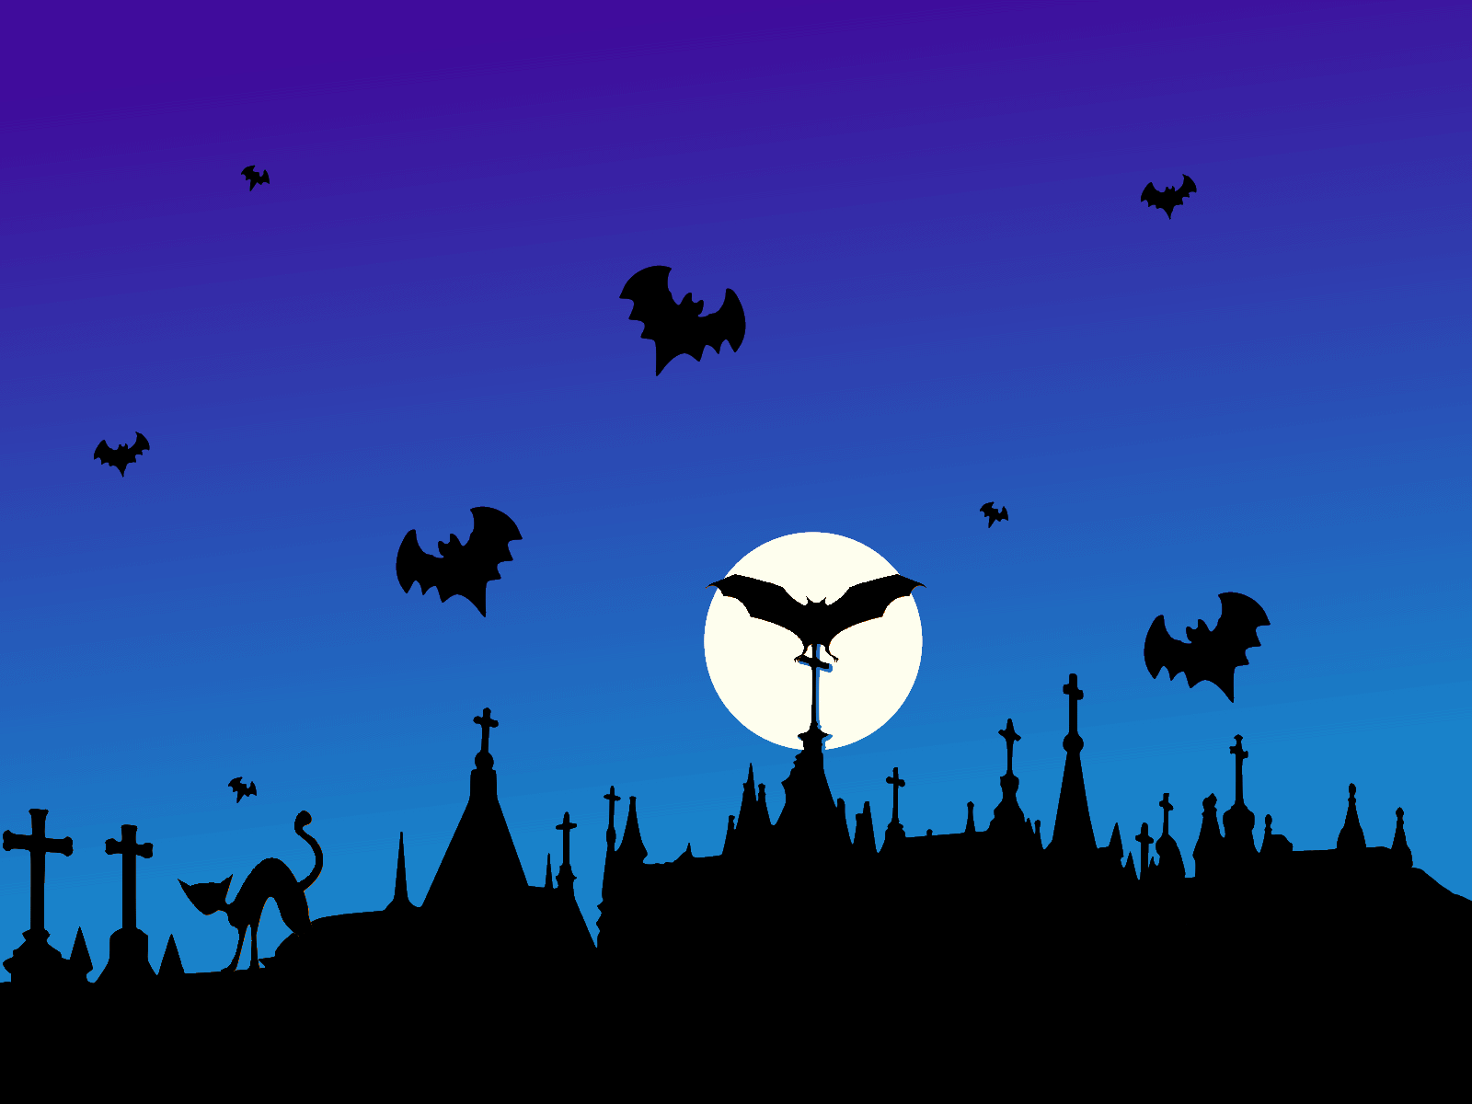
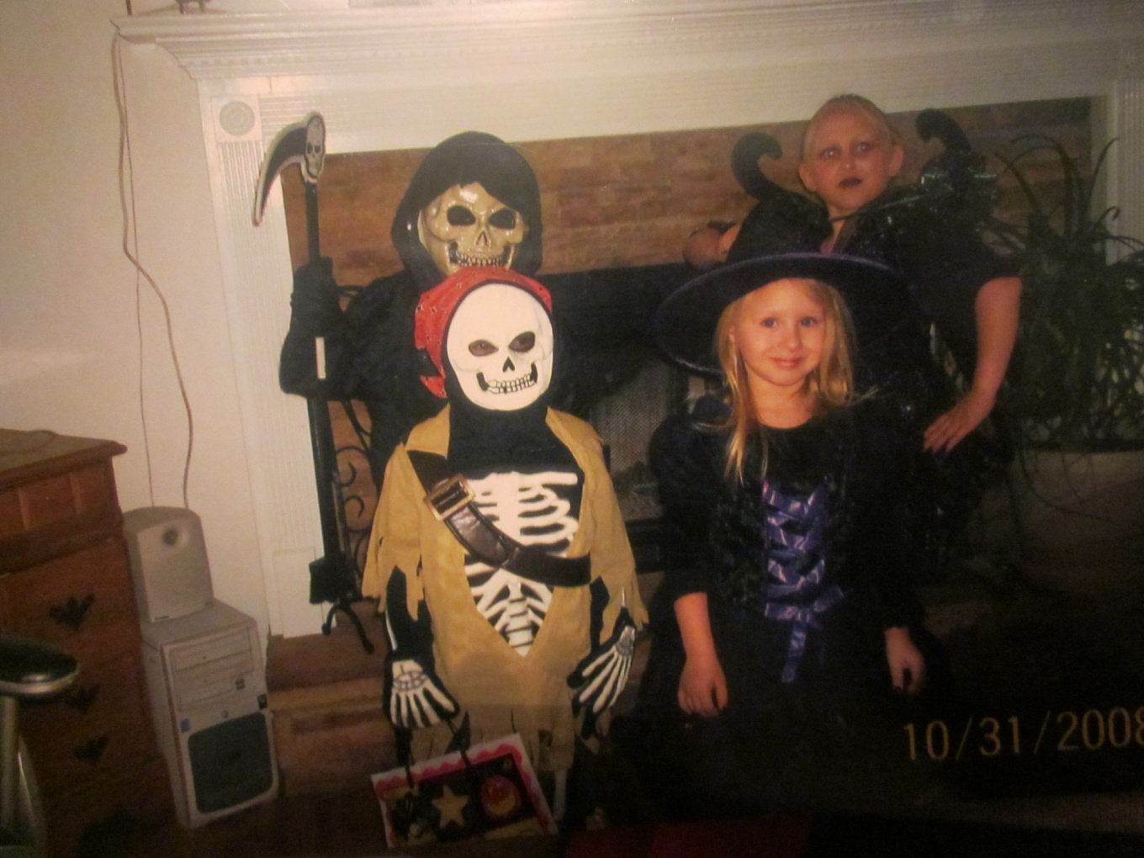
The tradition of dressing in costume for Halloween has both European and Celtic roots. Hundreds of years ago, winter was an uncertain and frightening time. Food supplies often ran low and, many people afraid of the dark, the short days of winter were full of constant worry.

Slide 4
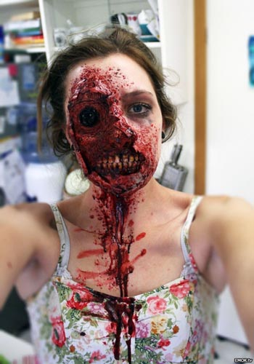
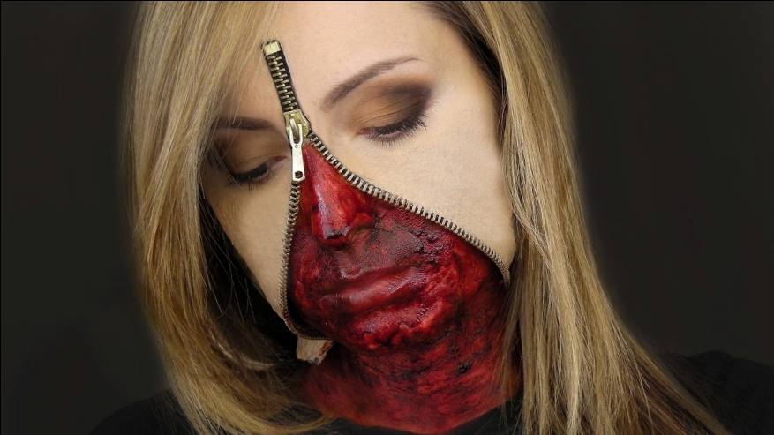
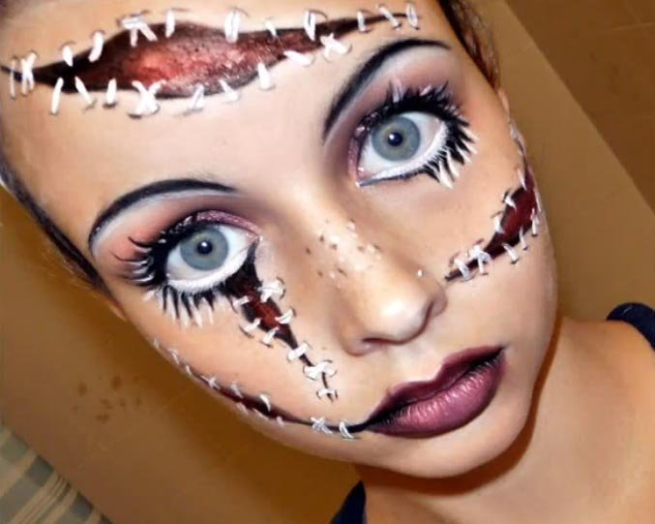
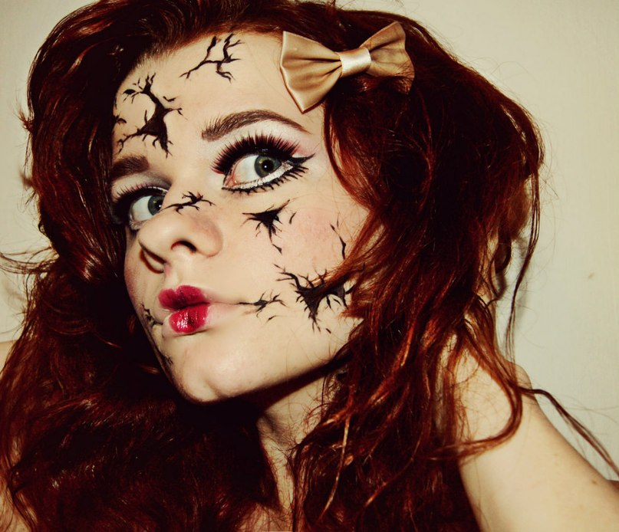
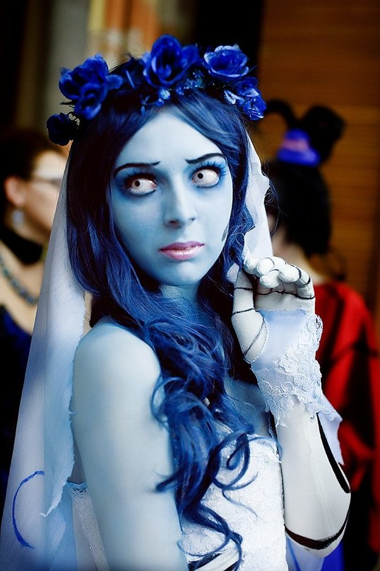
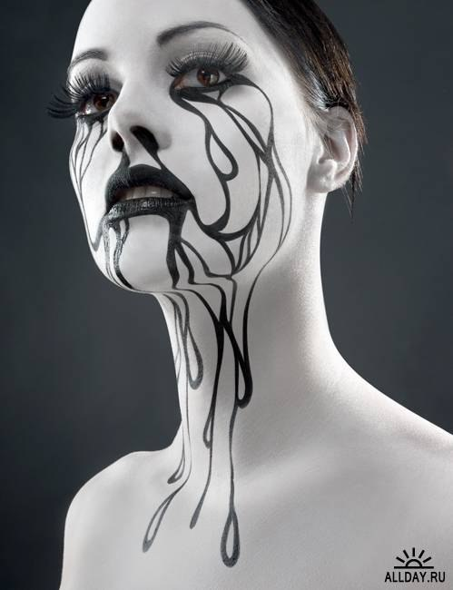
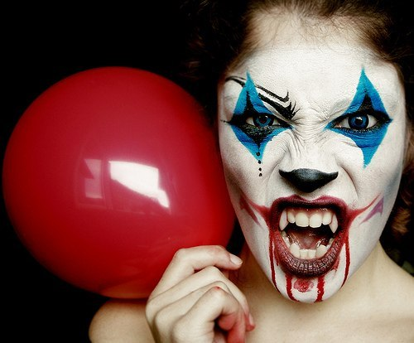
Examles of Halloween make-up and costumes

Slide 5
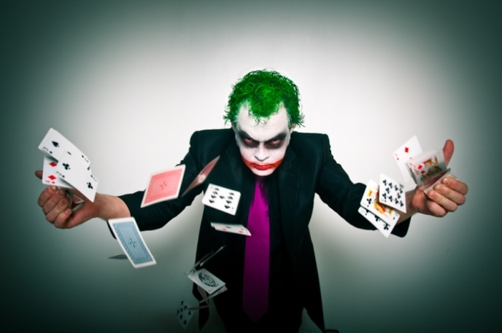
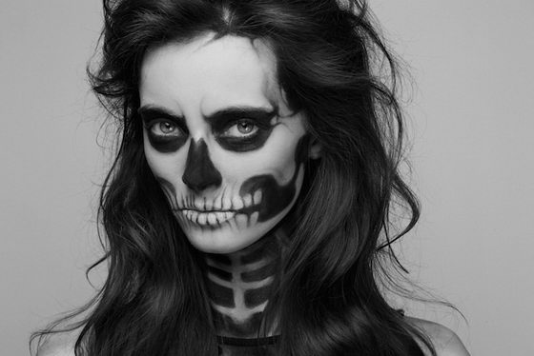
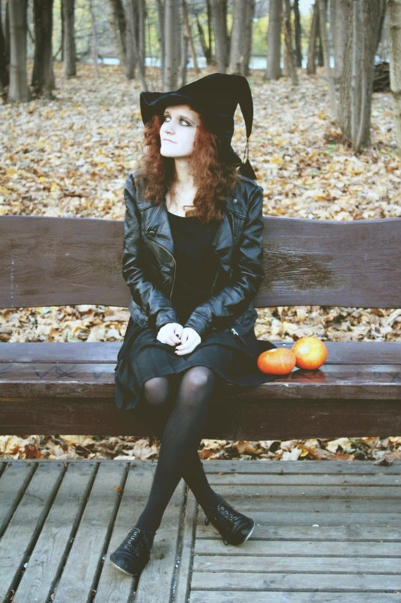
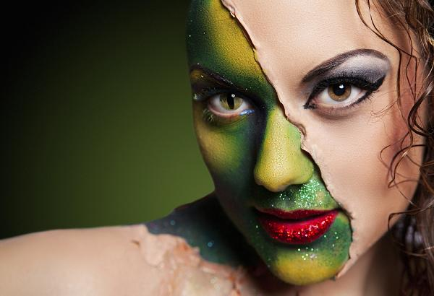
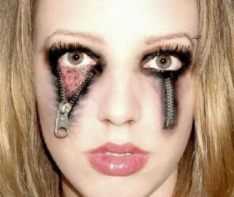
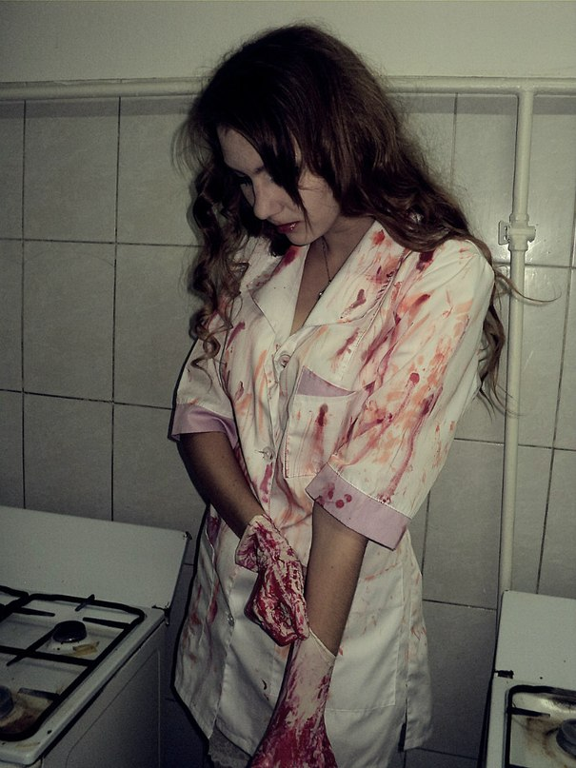
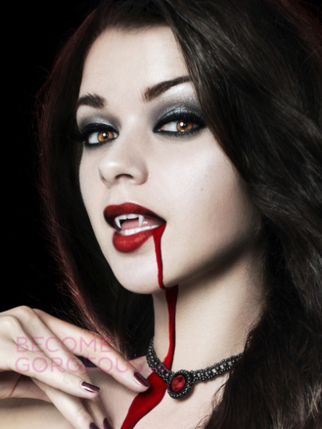
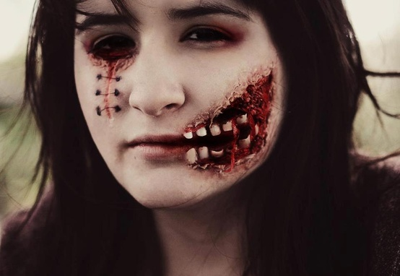

Slide 6
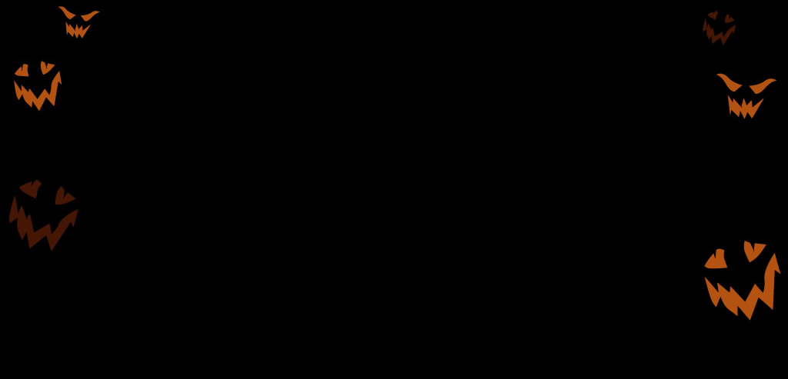
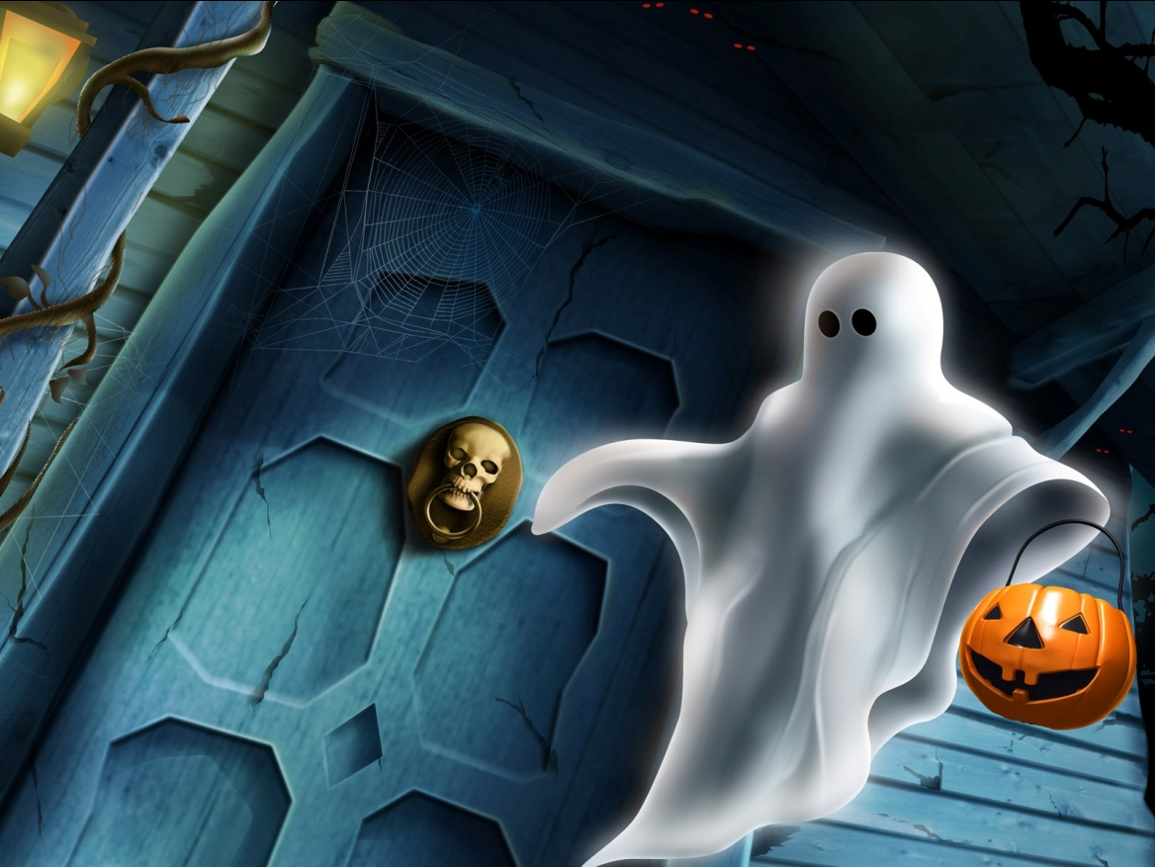
On Halloween, when it was believed that ghosts came back to the earthly world, people thought that they would encounter ghosts if they left their homes. To avoid being recognized by these ghosts, people would wear masks when they left their homes after dark so that the ghosts would mistake them for fellow spirits.
On Halloween, people placed bowls of food outside their homes to appease the ghosts and prevent them from attempting to enter their home.

Slide 7
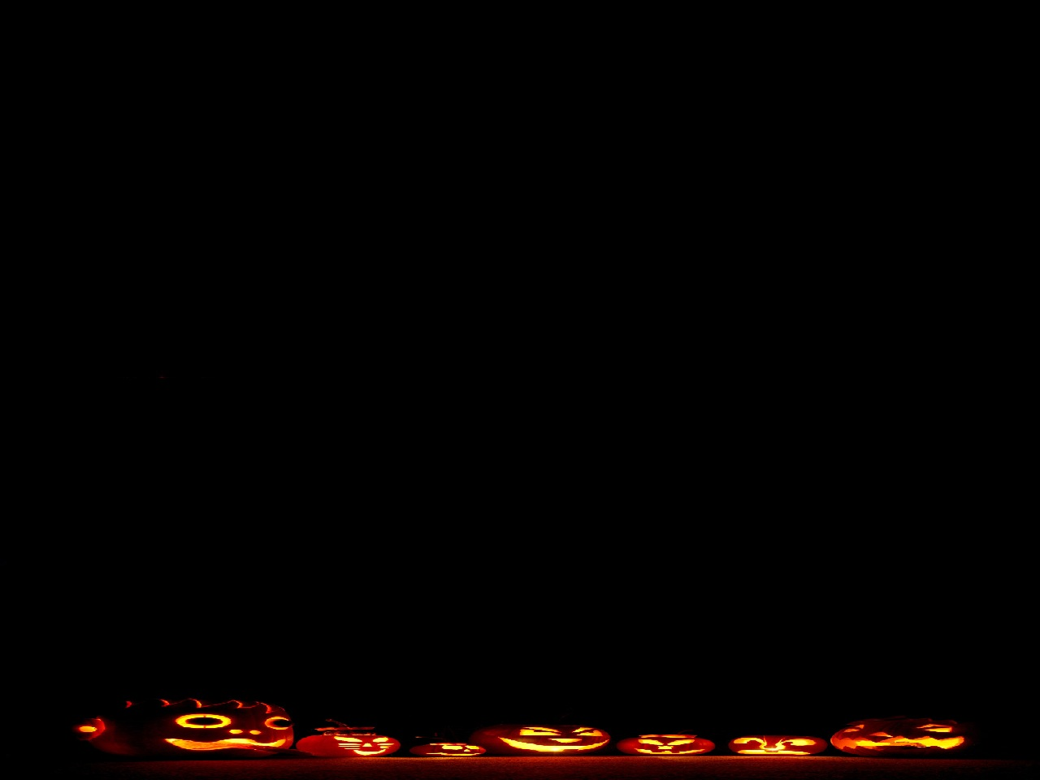
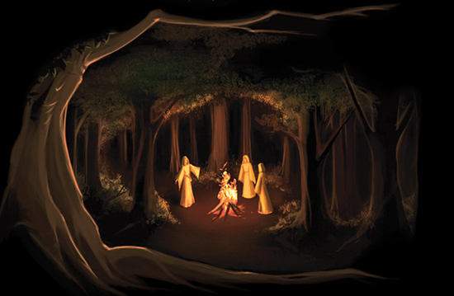
Fire was very important to the Celts as it was to all early people. In the old days people lit bonfires to ward away evil spirits and in some places they used to j ump over the fire to bring good luck. Today, we light candles in pumpkin and then put them outside our homes to ward of evil spirits.

Slide 8
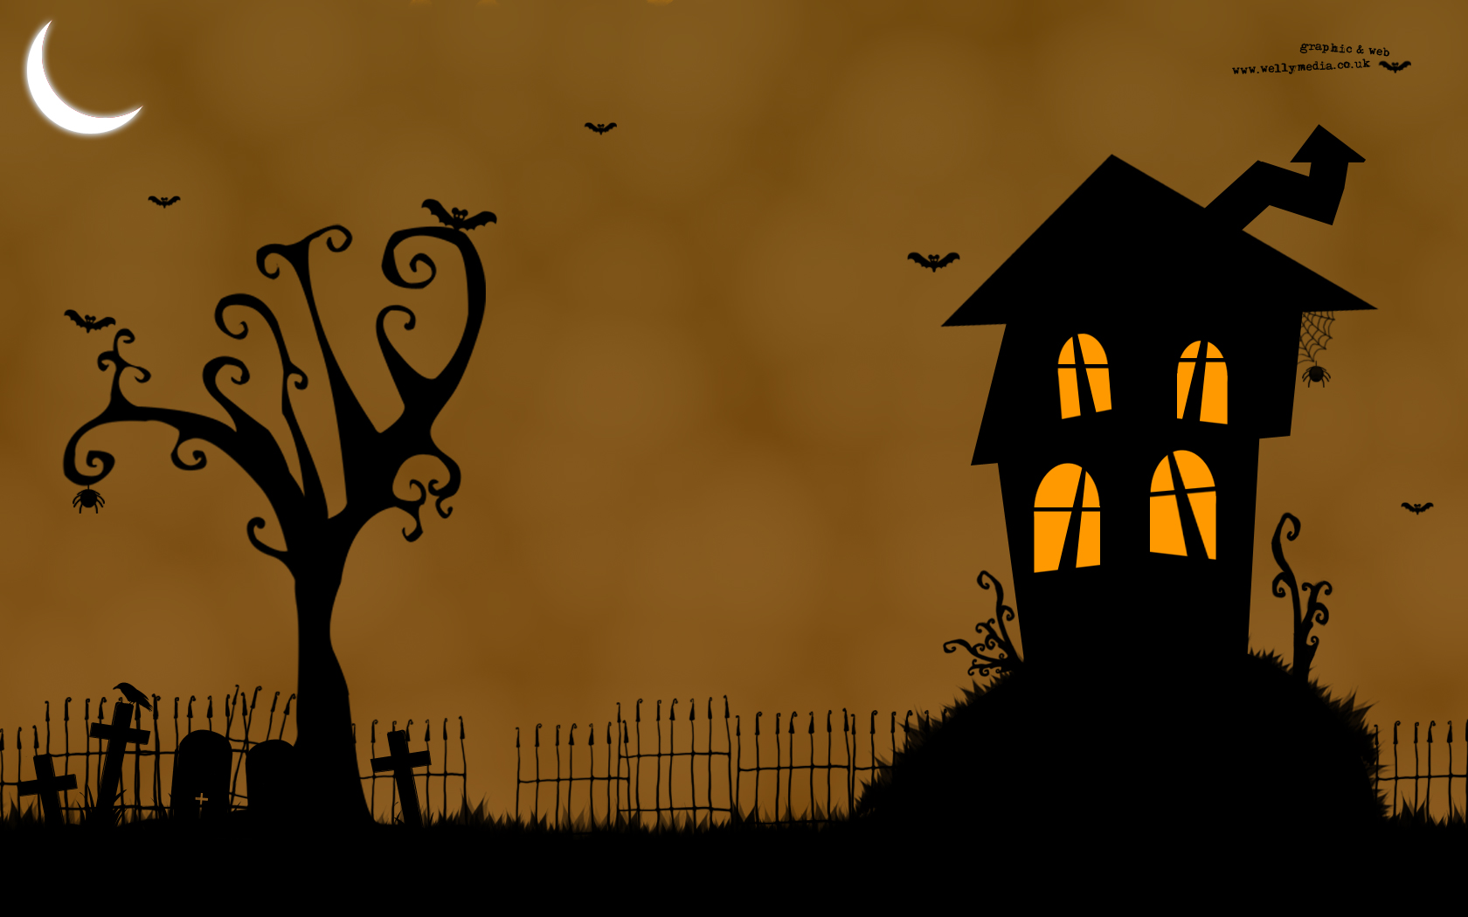
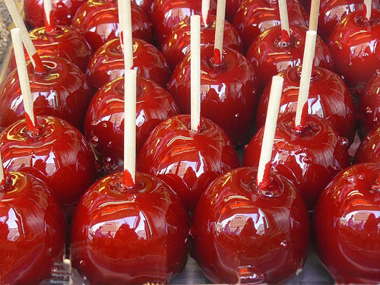
Another tradition is Apple Bobbing.
It has the roman origins. The Roman festival for remembering the dead was also in October. During this time, the Romans remembered their goddess, Pomona. She was the goddess of the trees and fruits, and when the Romans came to Britain, they began to hold these two festivals on the same day as Samhain. Apples probably became associated with Halloween because of this festival. Some people believe that, if you slice an apple through the equator (to reveal the five-pointed star within) and then eat it by candlelight before a-mirror, your future spouse will appear over your shoulder.

Slide 9
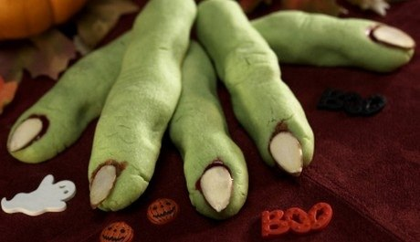
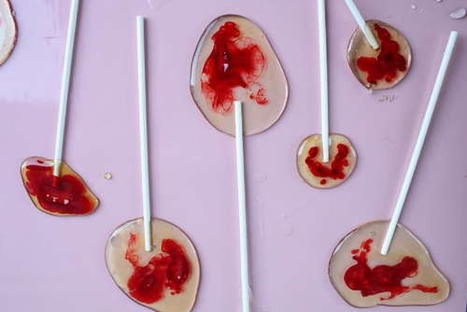
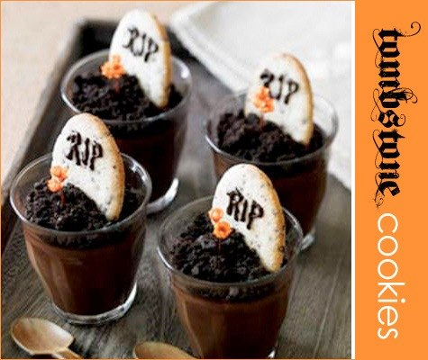
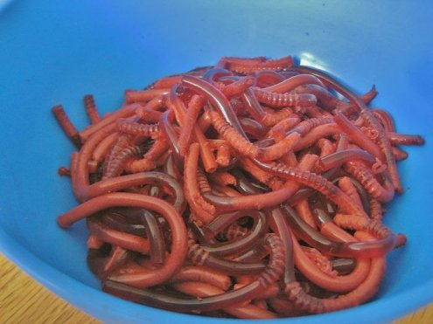
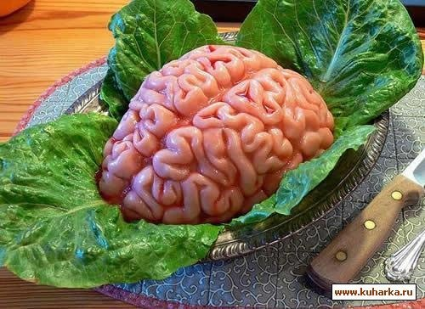
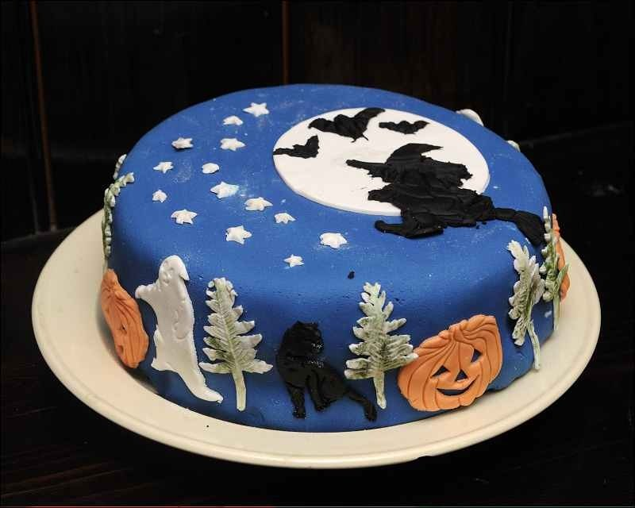
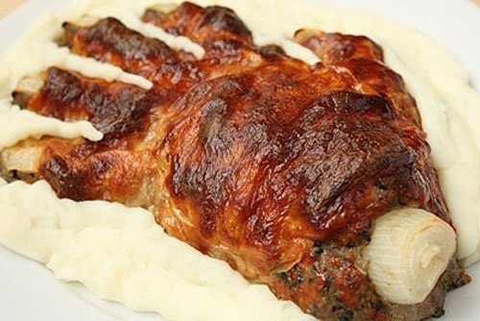
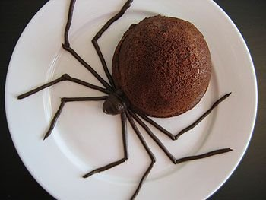
Examles of Halloween food

Slide 10
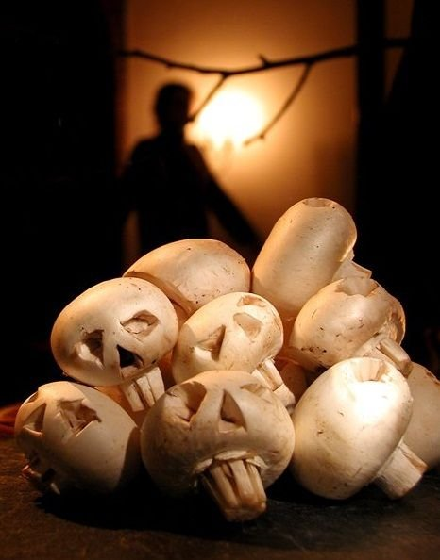
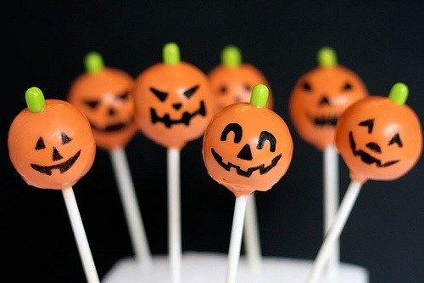
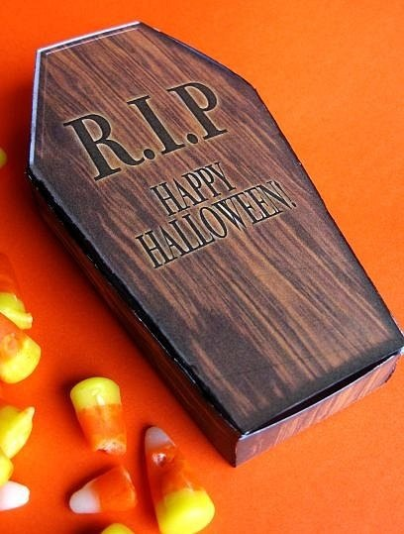
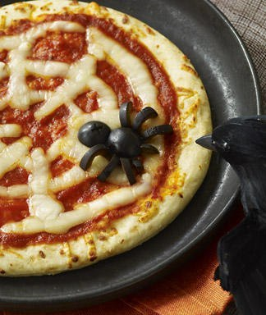
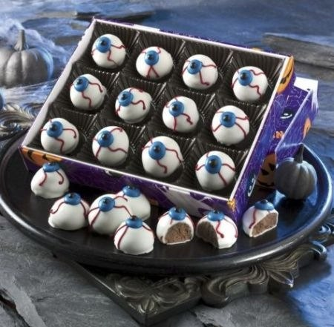
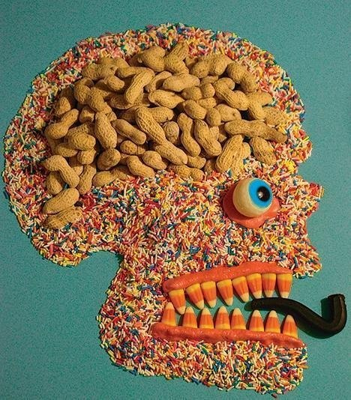
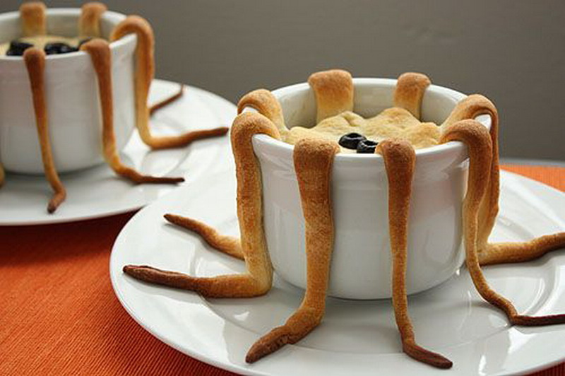
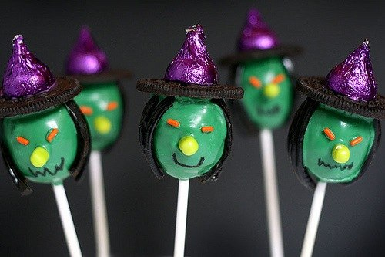
Examles of Halloween food

Slide 11
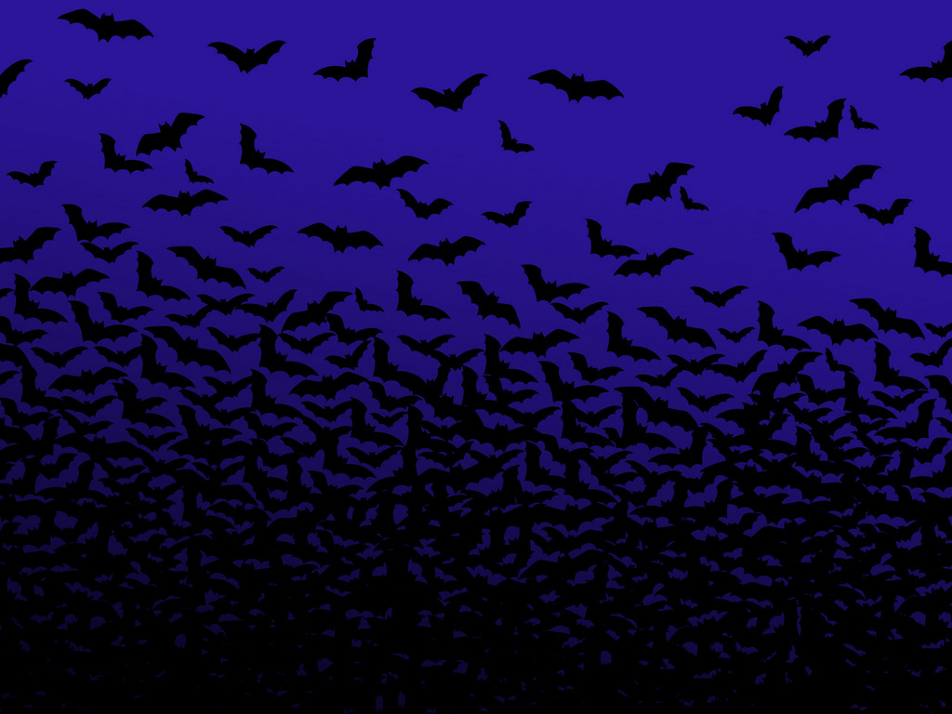
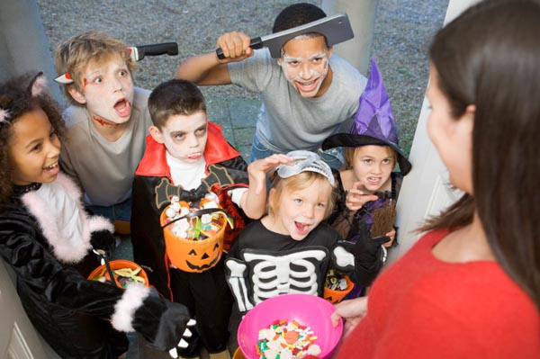
Trick or Treat was first known as Mischief Night. Halloween was a time for making mischief — many parts of England still recognize this date as Mischief Night Children dress in costumes and masks and go from door to door saying "trick or treat". The neighbours give children such treats as candy, fruit and pennies so that children do not play tricks on them.

Slide 12
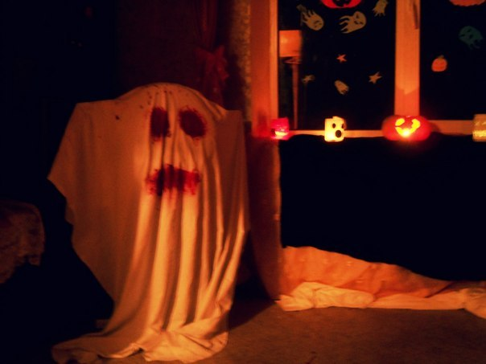
Jack-o'-lanterns are hallowed-out pumpkins with face carved into one side.
Most jack-o'-lanterns contain a candle inside. An Irish legend says that jack-o'-lanterns are named after the man called Jack.
He could not enter heaven because he was a miser, and he could not enter hell because he had played jokes on devil. As a result, Jack has to walk on the earth with his lantern until Judgment Day.

Slide 13
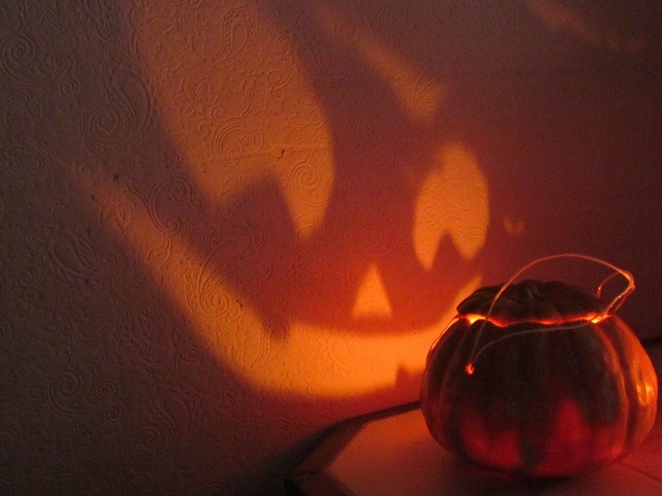
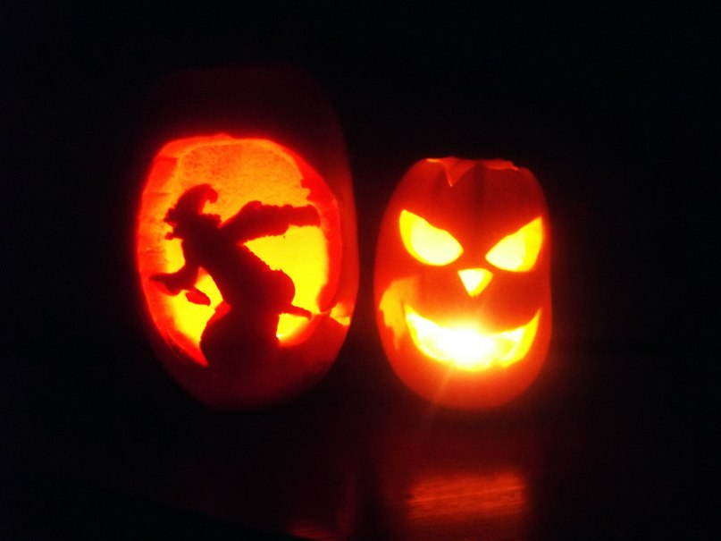
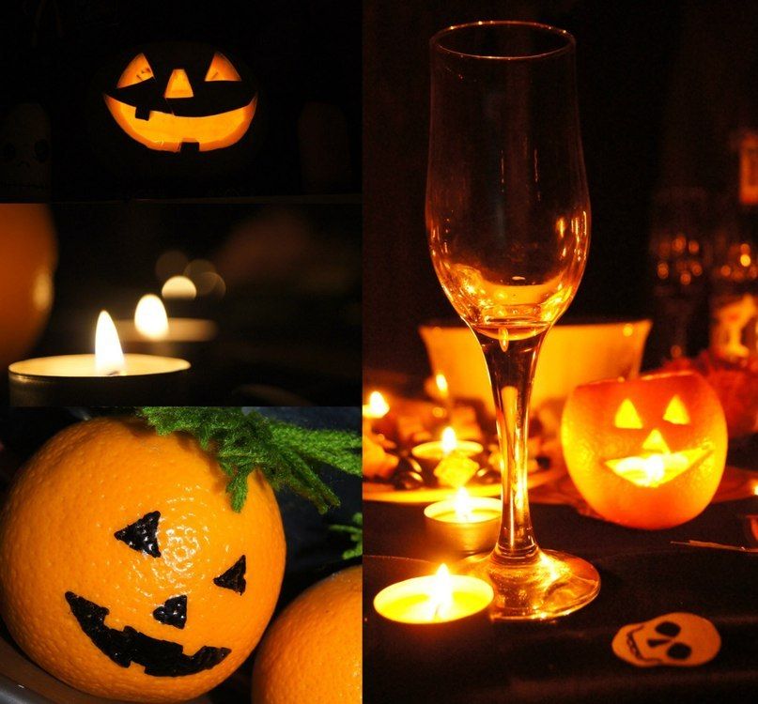
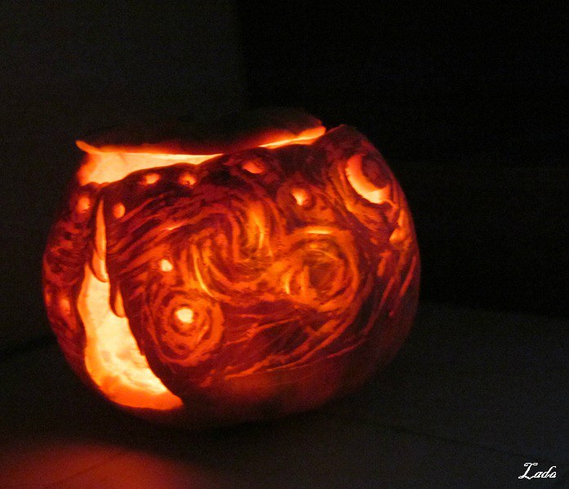
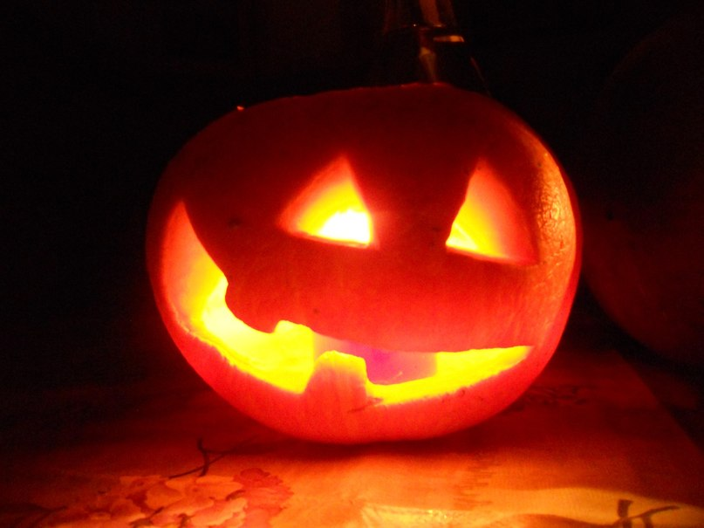
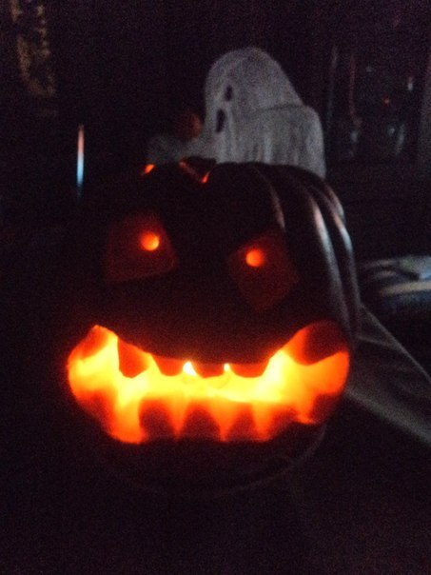



Slide 14




Slide 15

The End!

