Slide 1
The Images of Totemic Animals in the Artistic Plot Space of the Novel “A Game of Thrones“ by George R.R. Martin

Slide 2
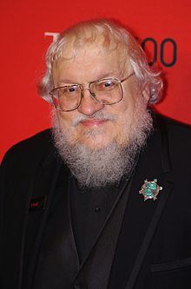
born September, 20 1948
an American author of fantasy, horror, and science fiction prose, as well as a screenwriter and television producer
George R.R. Martin

Slide 3
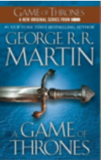




The Song of Ice and Fire
2011
1996
2000
1998
2005

Slide 4
Aim of the Investigation
Discover the notion “totemism”
Characterize totemic animals’ images, their features and functioning in the plot of the novel
Describe the totemic animals in the novel

Slide 5
The Main Tasks of the Investigation
To give the definition to the notion “totemism”;
to summarize the scientific views to this phenomenon;
to characterize the features and the functioning of the totemic animals images in the cultural and historical world space in general and on the territory of English-speaking countries in particular;
To characterize the types of totemic animals represented in the novel, analyze historical and mythological sources of their origin and determine their role and place in the novel, reveal their symbolic meaning;
Notes:
0

Slide 6
The Methodological Basis
Theoretical understanding of totemism and symbolism
Figurativeness in
the literature
Intertextuality
D. Haitun
V. Gening
C. Zaitseva
N. Kulagina
Z. Sokolova
O. Veselovsky
Y. Lotman
V. Hasilev
N. Nikolina
M. Bahtin
Y. Kristeva

Slide 7
The Research Methods
comparative
descriptive
contextual
intertextual

Slide 8
Totemism is a system of belief in which each human is thought to have a spiritual connection or a kinship with another physical being, such as an animal or plant, often called a "spirit-being" or "totem."

Slide 9
Classification of totems
depending on sex
trible
individual
Animals
Birds
Reptiles
Insects
Plants
inanimate objects

Slide 10
Main features of Martin’s totemism
Connection with mythology
Connection with the history of British Isles
Transformation of totemic animals into heraldic symbols

Slide 11
Functions of images of totemic animals
allusive
expressive
Character-making and character-revealing
estimative

Slide 12
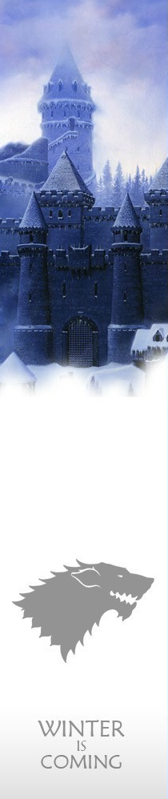
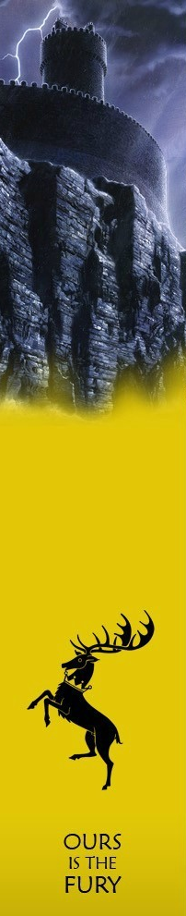
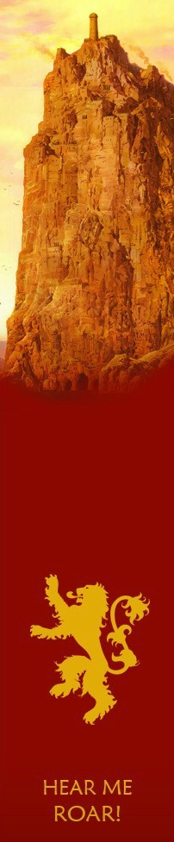
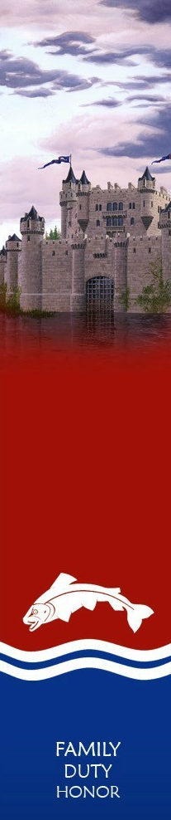
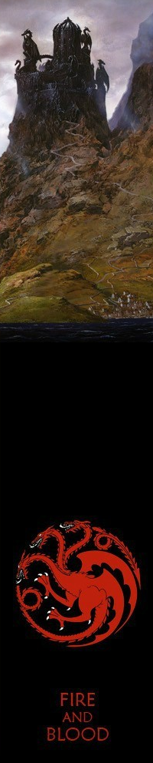
Seven Kingdoms
Main Aristocratic Houses
The Starks
The Baratheons
The Lannisters
The Tullys
The
Targaryens

Slide 13
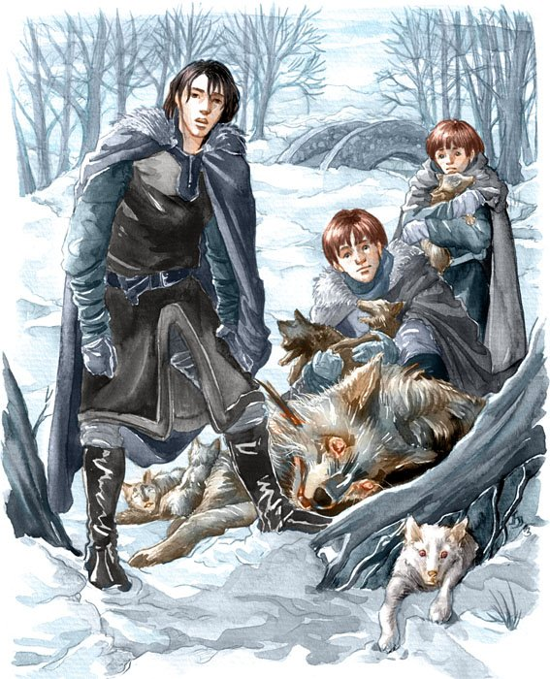
The Starks of Winterfell
“But it was the size of it that made him [Bran] gasp. It was bigger than his pony, twice the size of the largest hound in his father’s kennel…”
“That’s a direwolf. They grow larger than the other kind…”
“There’s not been a direwolf sighted south of the Wall in two hundred years.”

Slide 14
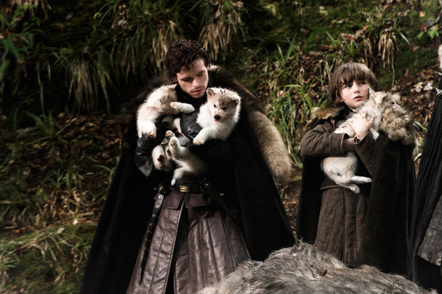
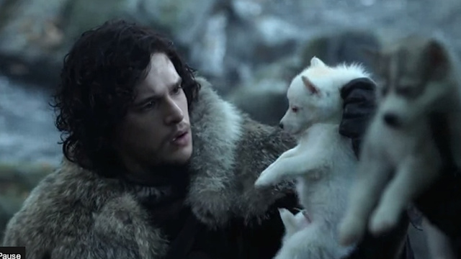
“There are five pups.
Three male and two female… You have five true born children. Three sons, two daughters. The direwolf is the sigil of your House. Your children were mean to have these pups, my lord.”

Slide 15
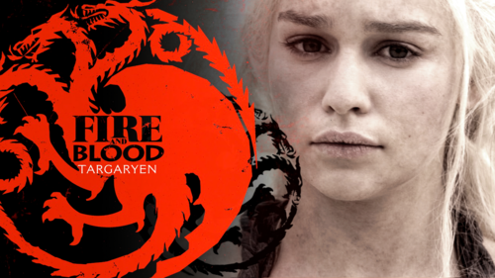
The Royal House of Targaryen
“The Targaryens are the blood of the dragon, descended from the high lords of the ancient Free hold of Valyria, their heritage proclaimed in a striking (some say inhuman) beauty, with lilac or indigo or violet eyes and hair of silver-gold or platinum white.”

Slide 16
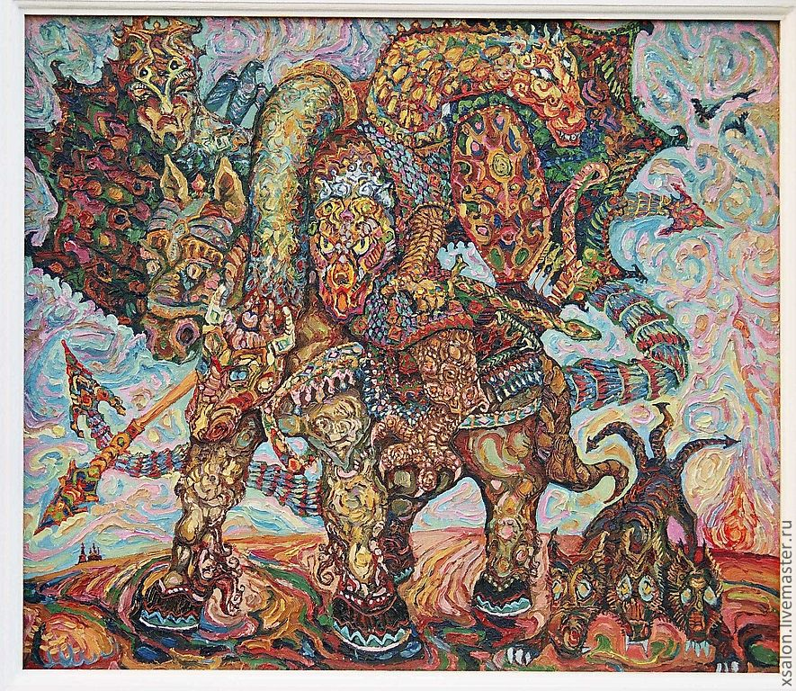
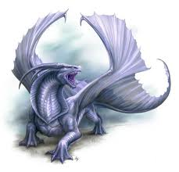
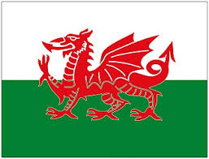
The Origin of Martin’s Dragon
Tugarin Zmej
The Old Welsh Dragon
The Red Dragon
of Wales

Slide 17
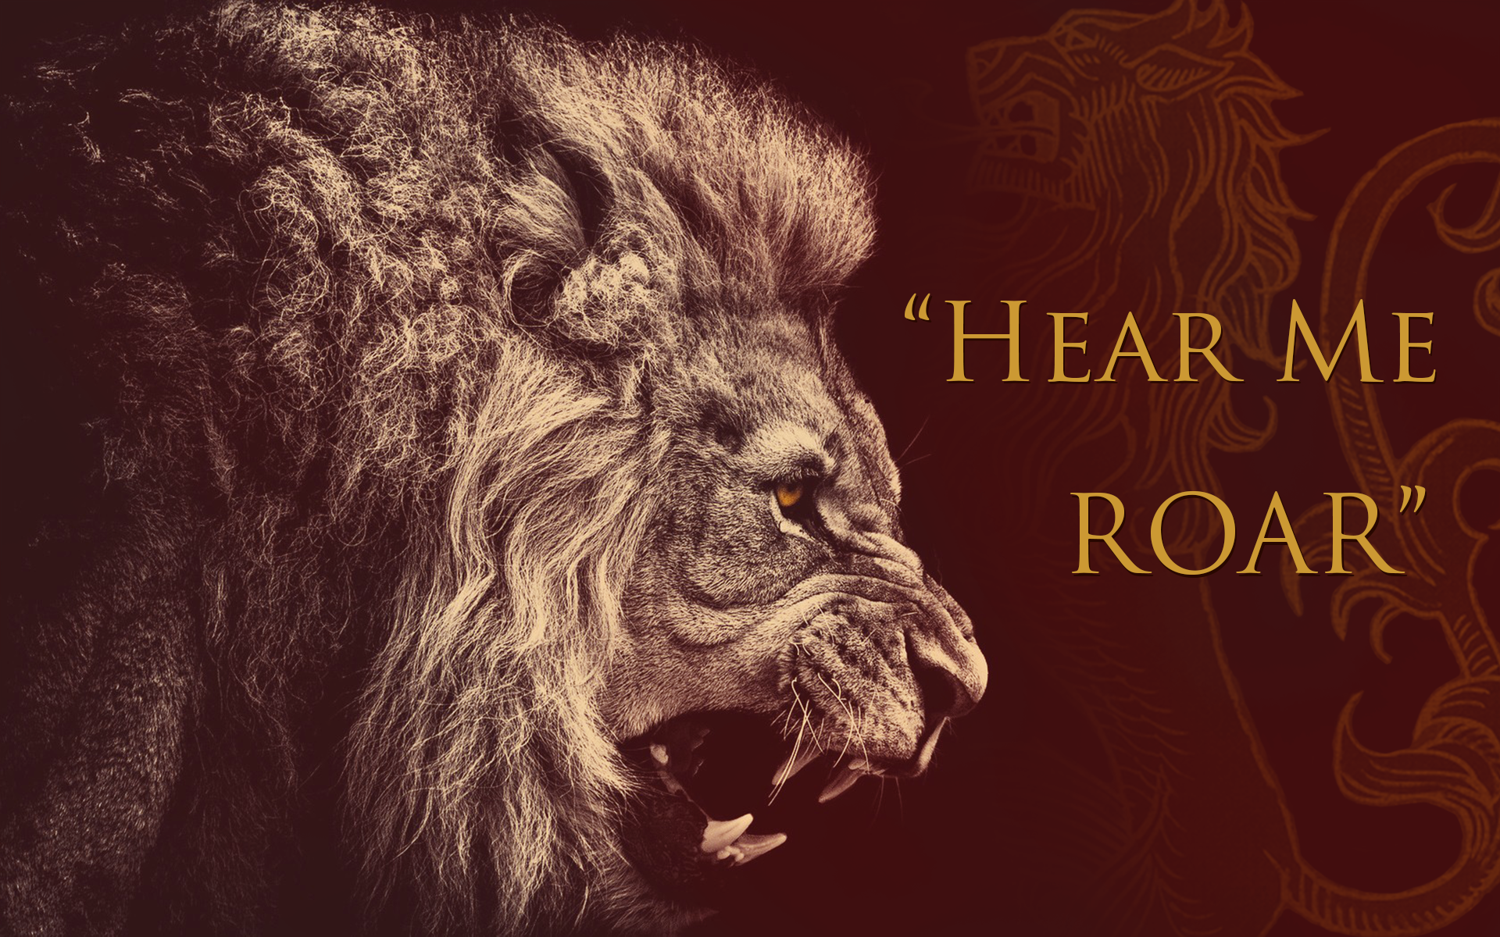

Slide 18
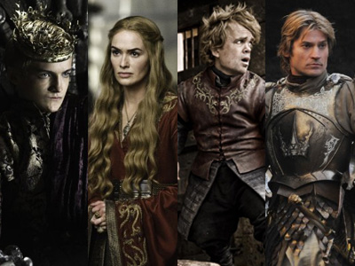
The House of Lannisters
“Sir Jaime Lannister was twin to Queen Cersei; tall and golden, with flashing green eyes and a smile that cut like a knife.”
“The gold of Casterly Rock and
the Golden Tooth has made them the wealthiest of the Great Houses.”

Slide 19
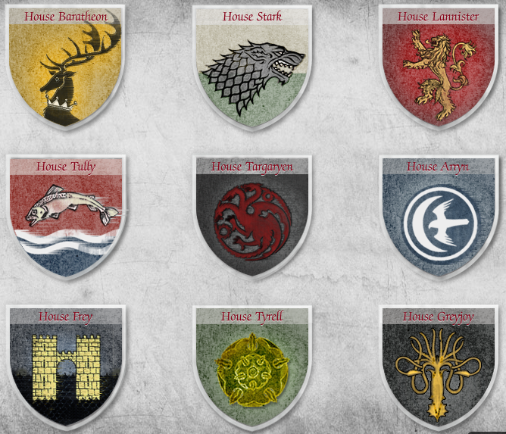
Heraldry of Seven Kingdoms by G. Martin

Slide 20
Thank you for your attention!

