Slide 1

Ukrainian Culture

Slide 2

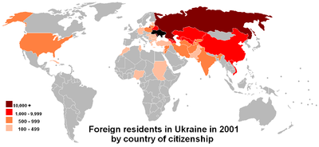
The Demographics of Ukraine
The population is 45,560,255 ;
The birth rate is 11.0 births/1,000 population ;
The death rate is 14.5 deaths/1,000 population ;
The life expectancy is 71.22 years

Slide 3

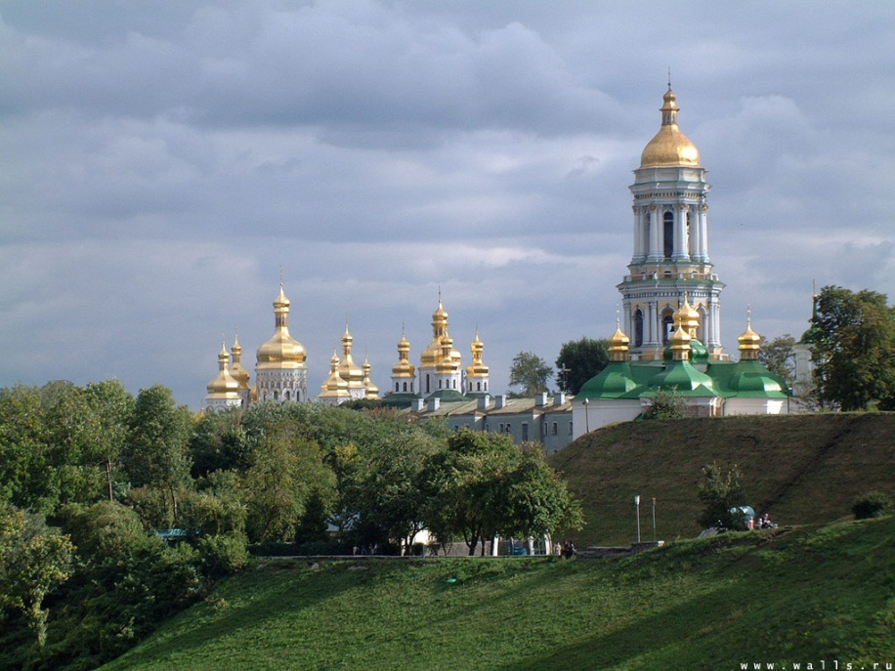
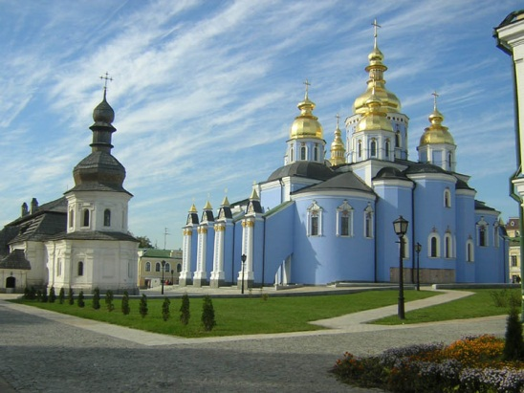
Religion of Ukraine
Eastern Orthodox (Ukrainian) (38.9%);
Greek Catholicism (14.7%);
Roman Catholicism (1.7%);
Judaism (0.2%)

