Slide 1
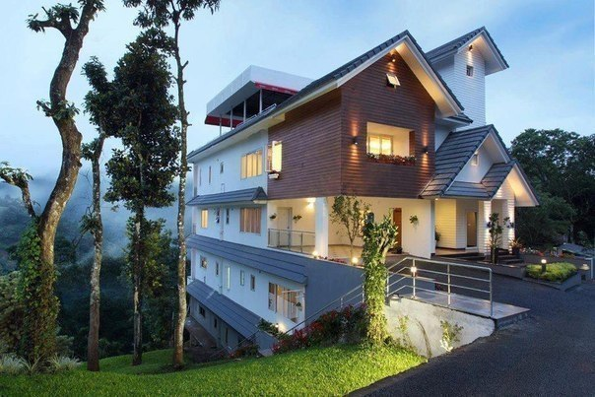
The house of my dream
by: Anna Manko
From 10

Slide 2
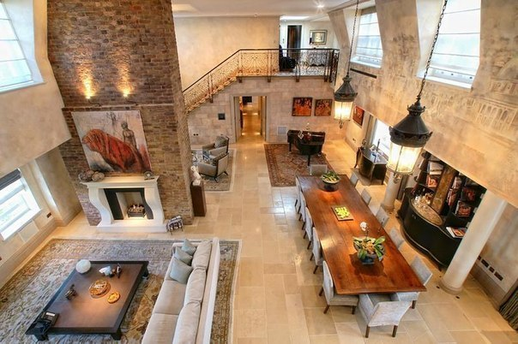
I would like to tell you about my dream house.

Slide 3
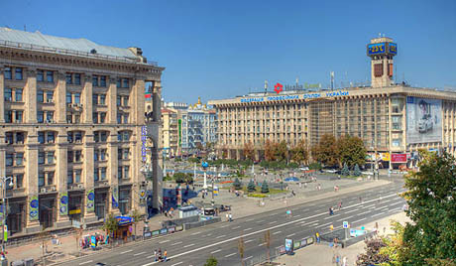
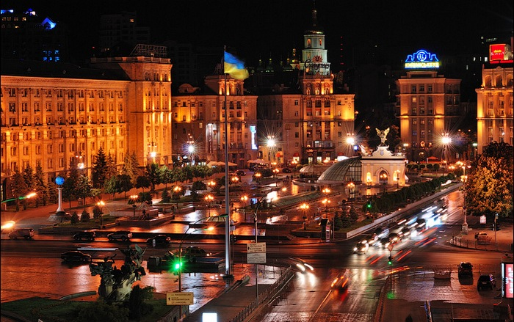
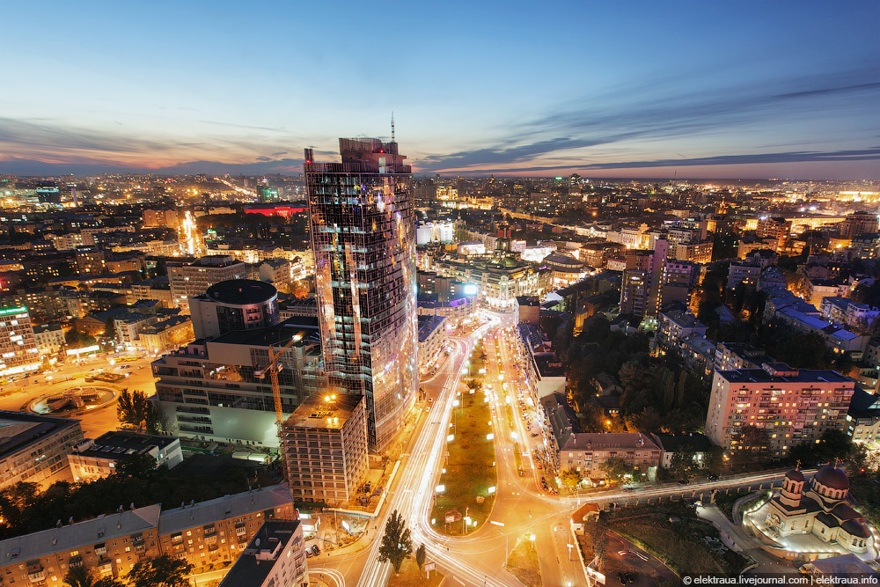
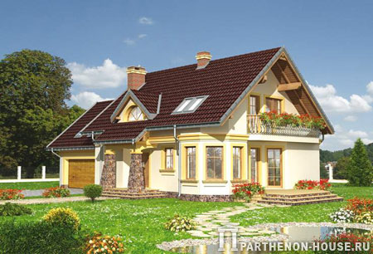
It would be located in Kiev.

Slide 4
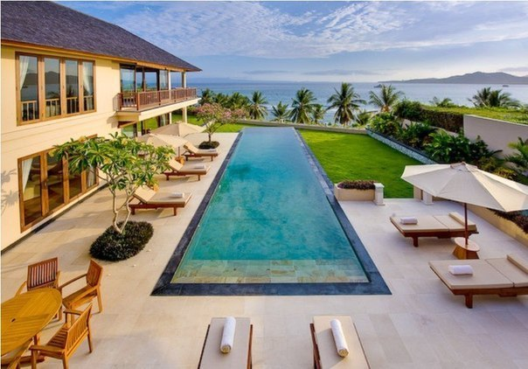
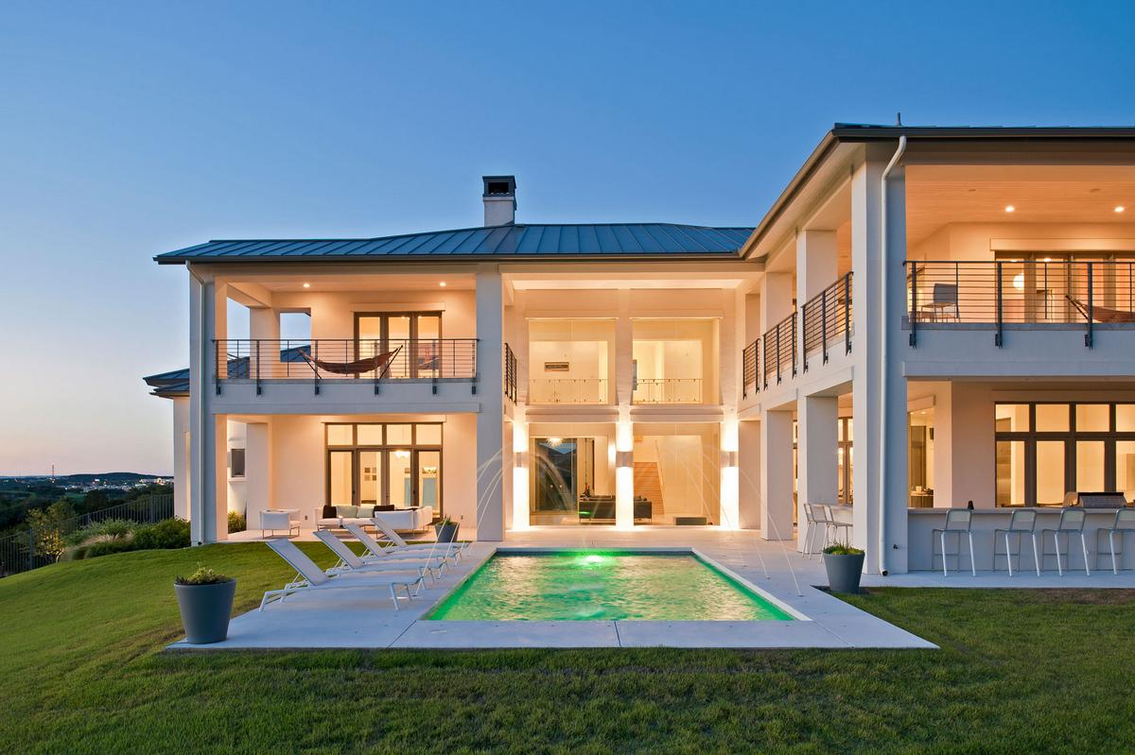
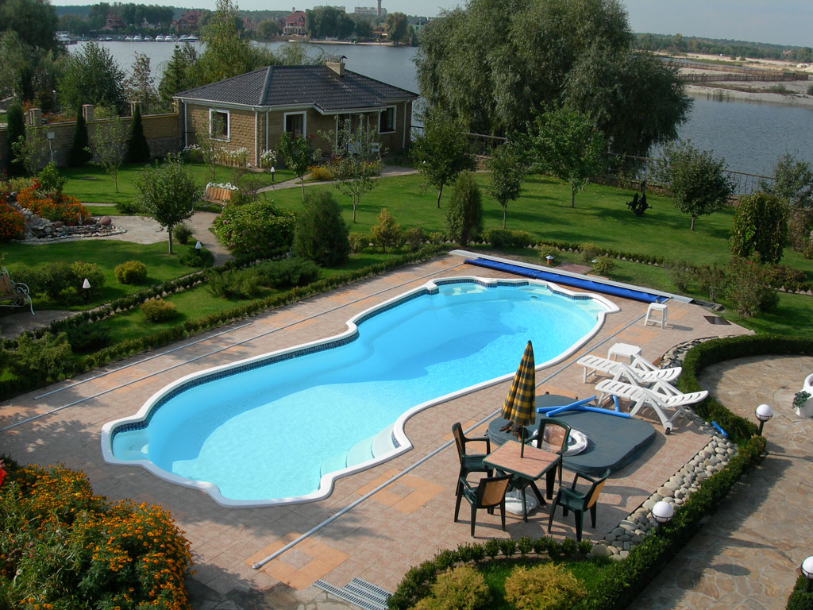
There it would be swimming – pool behind the house.

Slide 5
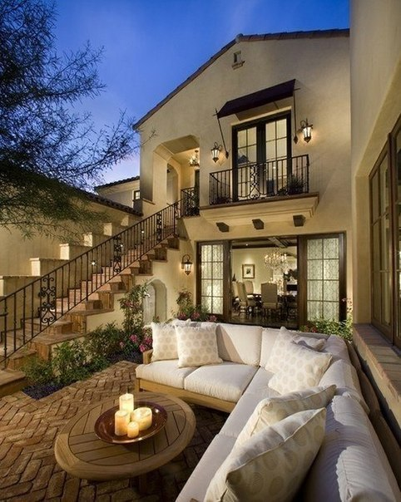
It would be a two - storey house with dark blue roof, and a chimney. It would be painted white.

Slide 6
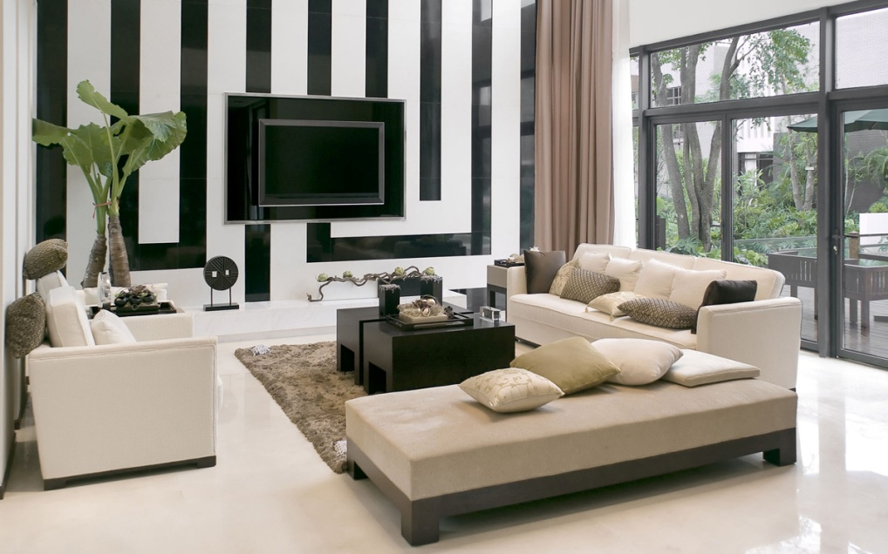
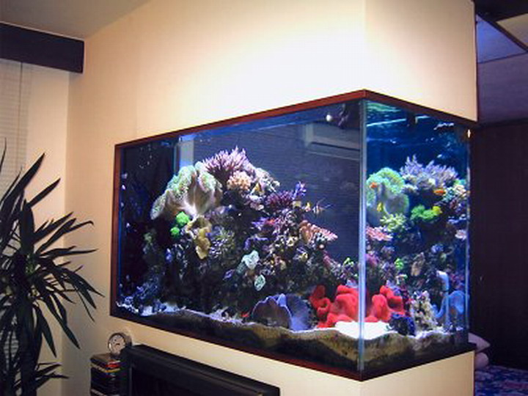
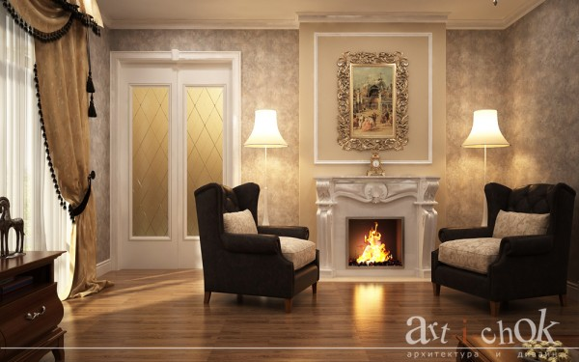
My living room would have a big TV on the wall, a fireplace and big aquarium.

Slide 7
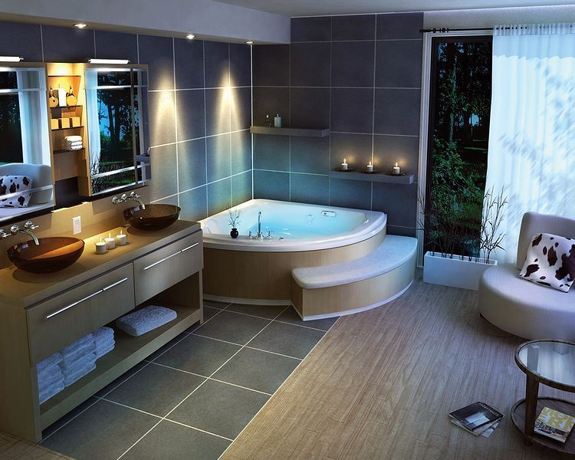
My bathroom would have wonderful Jacuzzi.

Slide 8
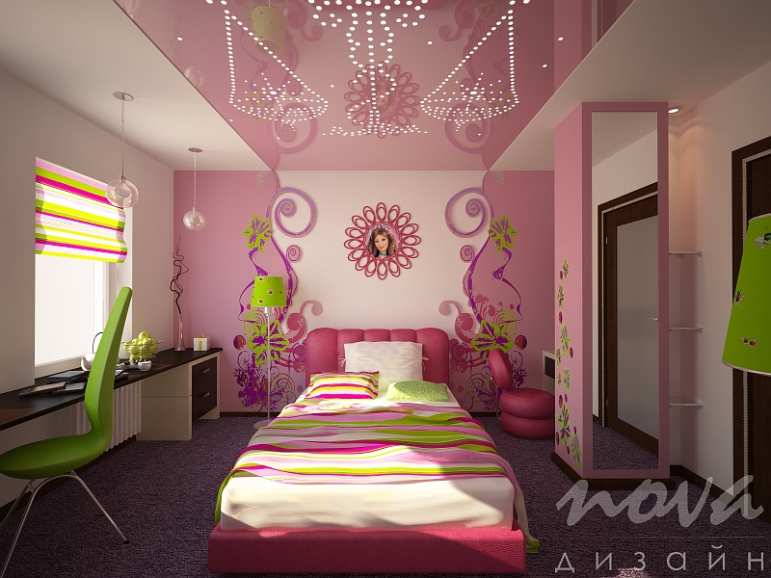
Nursery room for girl.

Slide 9
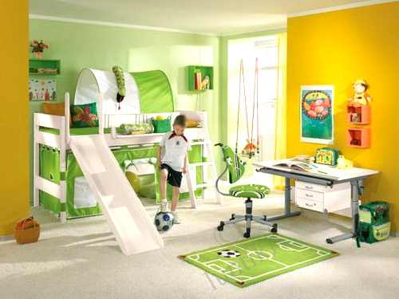
Nursery room for boy.

Slide 10
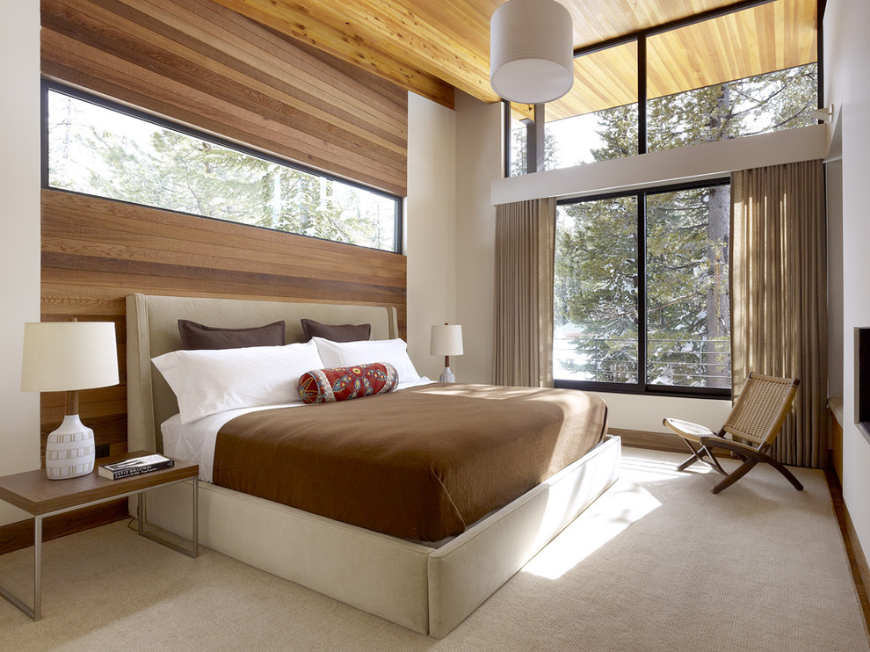
My bedroom would have a big bed, and window. There are comfortable.

Slide 11
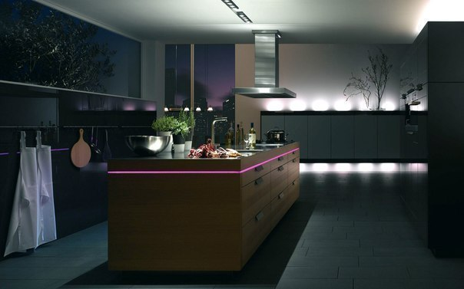
Kitchen would have a big table and beautiful lamp.

Slide 12
If i had such a nice house i would be an ideal place to spend time with my family.

