Slide 1
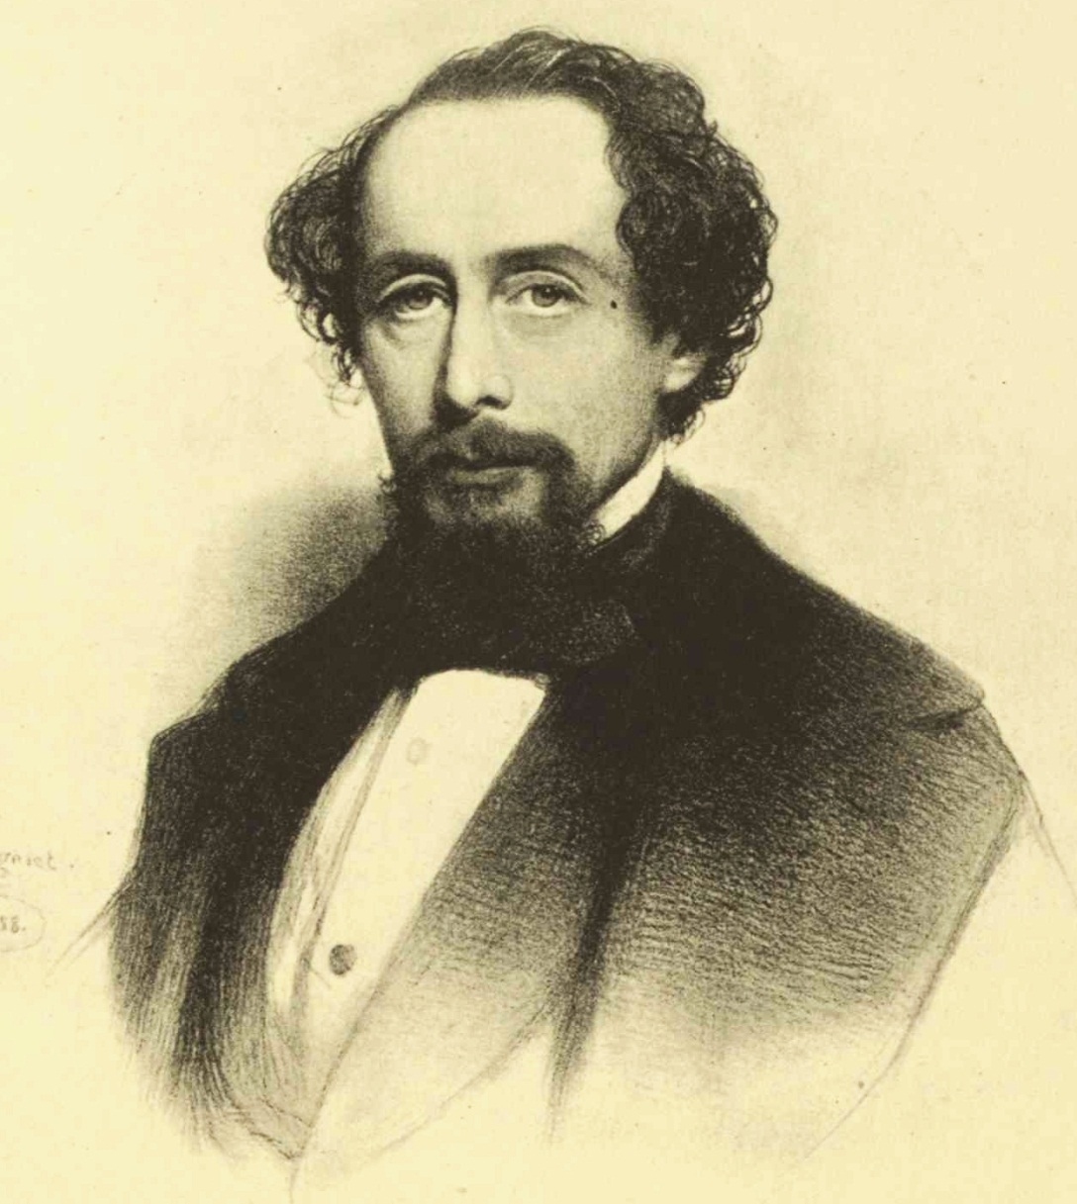
Charles Dickens
23 interesting facts about Charles Dickens

Slide 2
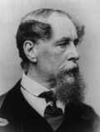
Charles John Huffam Dickens was an English writer and social critic. He created some of the world's most memorable fictional characters and is generally regarded as the greatest novelist of the Victorian period. During his life, his works enjoyed unprecedented fame, and by the twentieth century his literary genius was broadly acknowledged by critics and scholars. His novels and short stories continue to be widely popular.

Slide 3
Fact №1
Dickens had an obsessive compulsive disorder. He would comb his hair hundreds of times a day, constantly rearranged the furniture and was obsessed with looking in the mirror.

Slide 4
№2
He was obsessive about the position of his bed. It had to be aligned north to south because of his obsession with magnetic fields and the belief it improved his writing.

Slide 5
№3
He touched things 3 times for luck

Slide 6
№4
He was obsessed with tidiness and cleaned his friends home as well as his own.

Slide 7
№5
His pen name was Boz.

Slide 8
№6
Dickens had 10 children and gave them all nicknames.

Slide 9
№7
Dickens was epileptic and included epileptic characters in his books. Doctors are still astonished how accurate his descriptions of epilepsy are in his books.

Slide 10
№8
Dickens was the first superstar author, the J.K.Rowling of his day. In 1841 when the Old Curiosity Shop was serialized 6000 people descended on New York docks when the final installment arrived all shouting `does little Nell live`? to the sailors.

Slide 11
№9
He was a big fan of hypnotism and used it to try and cure his wife and children of any ailments.

Slide 12
№10
He was not very tolerant of his friends. When Hans Christian Anderson stayed with him he gave him a BIG hint that he had outstayed his welcome by attaching a note to his mirror which said `Hans Anderson slept in this room for 5 weeks which seemed to the family, like AGES`.

Slide 13
№11
In his study he had a secret door which was designed like a bookcase filled with fake books.

Slide 14
№12
Dickens had a big ego, referring to himself as `The sparkler of Albion` (Albion being an archaic name for England). It was a pun on Shakespeare's reference to himself as the Bard of Avon.

Slide 15
№13
Dickens father was at one time imprisoned in the Marshalsea debtors prison .

Slide 16
№14
He seemed to have a failure to grasp the basics of reproduction as he resented his wife for giving him 10 children and this resentment was a factor in their separation in1858.

Slide 17
№15
When he was 11 as a result of his father being in prison and to help provide for his family he was forced to leave school and Take his first job in a blacking (shoe polish) factory applying the labels to the bottles. Throughout his life he would never discuss this experience .

Slide 18
№16
In 1860 Dickens started an affair with a young actress named Ellen Ternan and this continued until his death. It was kept very secret and as a result there is little written literature on it.

Slide 19
№17
Dickens gave hundreds of paid readings to audiences which meant he could indulge his love of the stage and performing .

Slide 20
№18
Dickens books have never been out of print.

Slide 21
№19
His wife`s 17 year old sister, Mary who lived with them died in Dickens`s arms after a short illness. She would later be immortalized as Little Nell.

Slide 22
№20
Dickens was very interested in the paranormal and was an early member of The Ghost Club.

Slide 23
№21
On the 9th June 1865 he narrowly escaped death when the train he was traveling in with Ellen and her mother crashed in Staplehurst. He spent time after the crash helping tend to the dying and injured and although physically unharmed he mentally never recovered.

Slide 24
№22
Exactly 5 years to the day later Dickens died at his home from a massive stroke leaving his last work The Mystery of Edwin Drood unfinished. He was 58.

Slide 25
№23
Although David Copperfield is the most biographical book of his life, all of his books have characters and stories from his own past interwoven in them.

