Slide 1
William Shakespeare
26 April 1564 – 23 April 1616

Slide 2
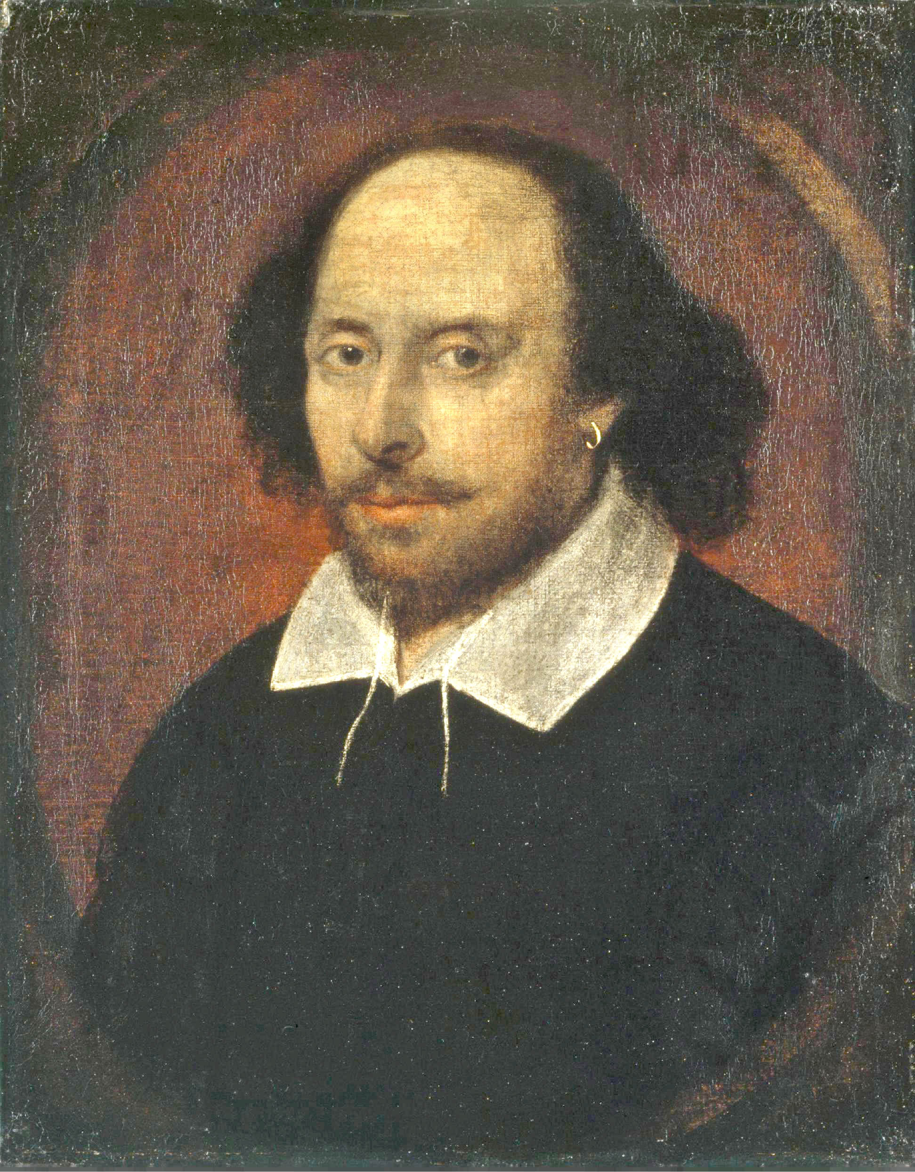
"All the world's a stage, and all the men and women merely players"
"To be, or not to be"
"Out, damned spot!"
"Romeo, Romeo! Wherefore art thou Romeo?"

Slide 3
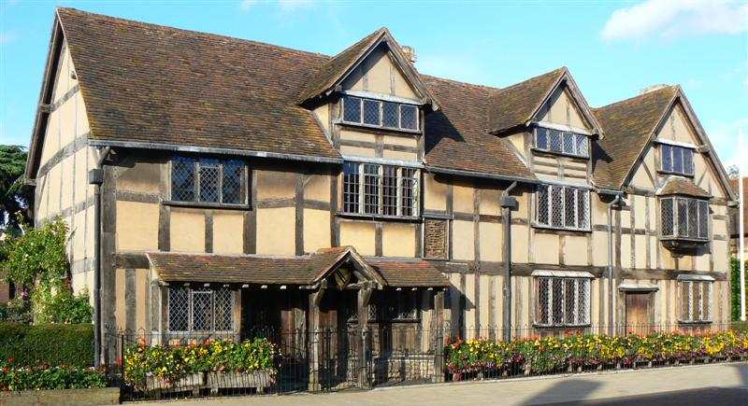
Shakespeare: Who was he?
Though William Shakespeare is recognized as one of literature’s greatest influences, very little is actually known about him. What we do know about his life comes from registrar records, court records, wills, marriage certificates and his tombstone. Anecdotes and criticisms by his rivals also speak of the famous playwright and suggest that he was indeed a playwright, poet and an actor.
John Shakespeare's house, believed to be Shakespeare's birthplace, in Stratford-upon-Avon.

Slide 4
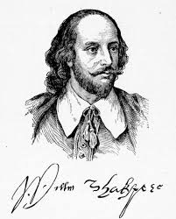
Date of Birth?
William was born in 1564. We know this from the earliest record we have of his life; his baptism which happened on Wednesday, April the 26th, 1564. We don’t actually know his birthday but from this record we assume he was born in 1564. Similarly by knowing the famous Bard's baptism date, we can guess that he was born three days earlier on St. George’s day, though we have no conclusive proof of this.
“Some are born great, some achieve greatness, and some have greatness thrust upon them”.

Slide 5
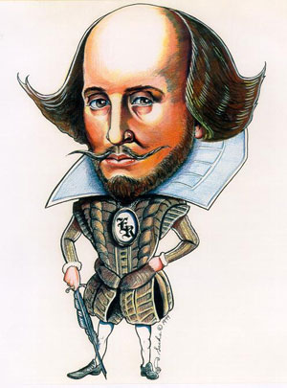
Brothers and Sisters
William was the third child of John and Mary Shakespeare. The first two were daughters and William was himself followed by Gilbert who died in 1612 and Richard who died in 1613. Edmund (1580-1607), sixth in the line was baptized on May the third, 1580 and William's oldest living sister was Joan who outlived her famous playwright brother. Of William’s seven siblings, only Judith and four of his brothers survived to adulthood.
“If music be the food of love, play on”.
“Hell is empty and all the devils are here”.
“Love all, trust a few, do wrong to none”.

Slide 6
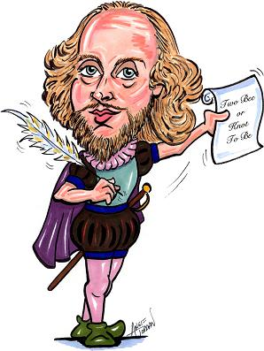
William's Father
From baptism records, we know William's father was a John Shakespeare, said to be a town official of Stratford and a local businessman who dabbled in tanning, leatherwork and whittawering which is working with white leather to make items like purses and gloves. John also dealt in grain and sometimes was described as a glover by trade.
John was also a prominent man in Stratford. By 1560, he was one of fourteen burgesses which formed the town council. Interestingly, William himself is often described as a keen businessman so we can assume he got his business acumen from his father. In the Bard's case, the apple didn’t fall far from the tree at all...

Slide 7

William's mother: Mary Arden
William's mother was Mary Arden who married John Shakespeare in 1557. The youngest daughter in her family, she inherited much of her father’s landowning and farming estate when he died.
“God has given you one face, and you make yourself another”.
The Bard's Education
Very little is known about literature’s most famous playwright. We know that the King’s New Grammar School taught boys basic reading and writing. We assume William attended this school since it existed to educate the sons of Stratford but we have no definite proof. Likewise a lack of evidence suggests that William, whose works are studied universally at Universities, never attended one himself!
Early Days on Henley Street
Since we know Stratford's famous Bard lived with his father, John Shakespeare, we can presume that he grew up in Henley Street, some one hundred miles northwest of London.
“It is not in the stars to hold our destiny but in ourselves”.

Slide 8
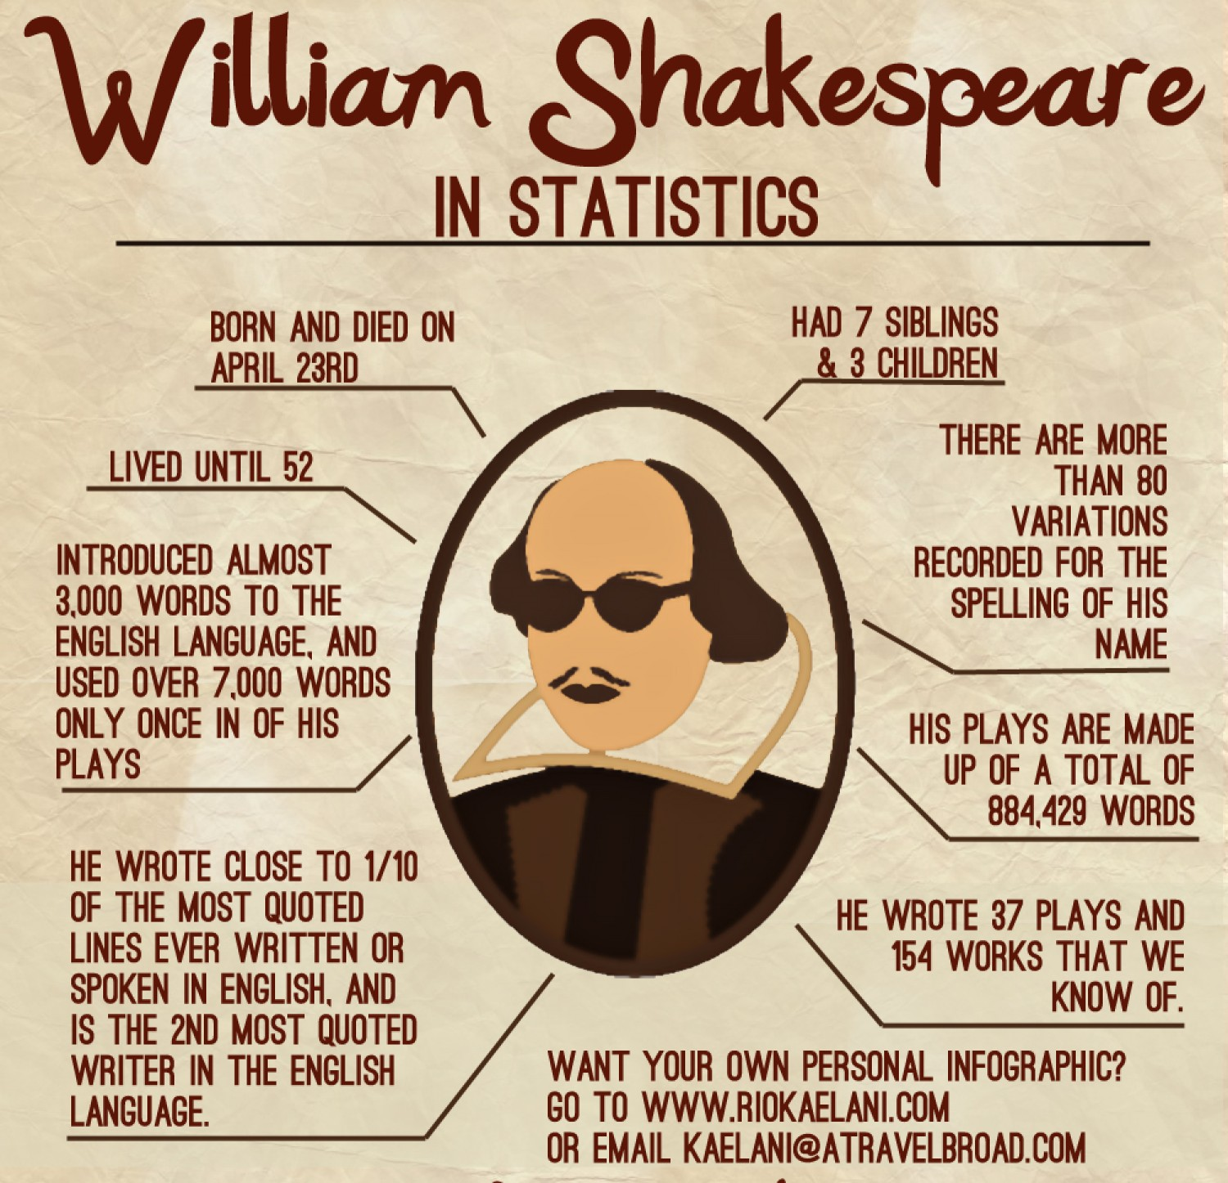
William marries an older woman. (1582)
A bond certificate dated November the 28th, 1582, reveals that an eighteen year old William married the twenty-six and pregnant Anne Hathaway. Barely seven months later, they had his first daughter, Susanna. Anne never left Stratford, living there her entire life.
The Bard's children. (1583 & 1592)
Baptism records show that William’s first child, Susanna was baptized in Stratford sometime in May, 1583. Baptism records again reveal that twins Hamnet and Judith were born in February 1592. Hamnet, William's only son died in 1596, just eleven years old. Hamnet and Judith were named after William’s close friends, Judith and Hamnet Sadler. William's family was unusually small in a time when families had many children to ensure parents were cared for in later years despite the very high mortality rates of children and also their life expectancy in the 1500s.

Slide 9
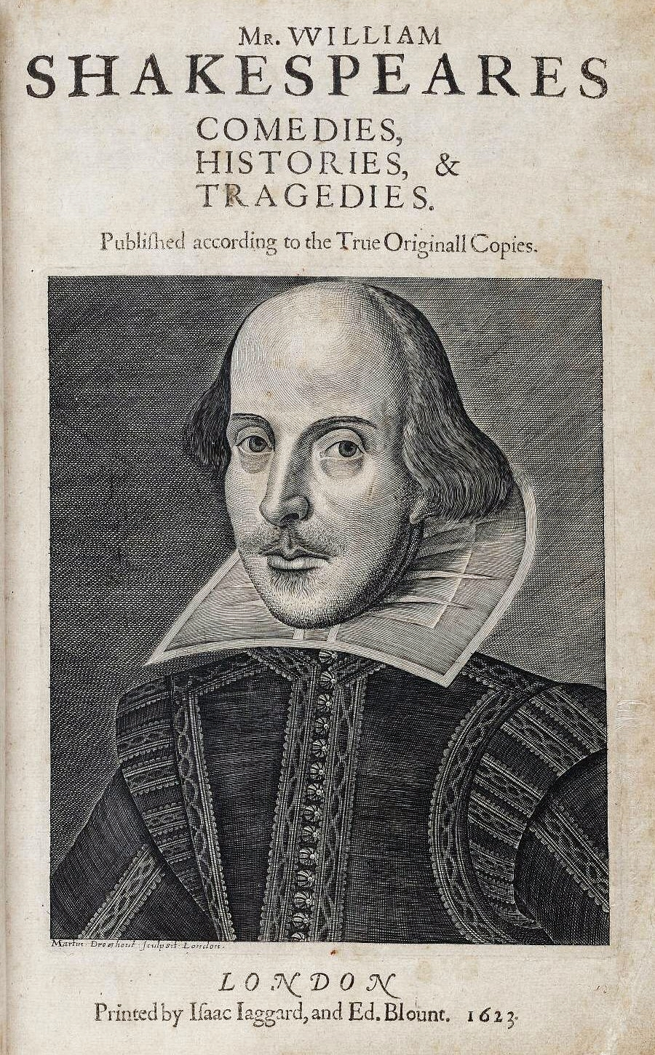
The Bard as a poet
Evidence that the great Bard was also a poet comes from his entering his first poem Venus and Adonis in the Stationers’ Registrar on the 18th of April, 1593. The playwright registered his second poem The Rape of Lucrece by name on the 9th of May, 1594.
The Bard suffers breech of copyright. (1609)
In 1609, the Bard's sonnets were published without the Bard’s permission. It is considered unlikely that William wanted many of his deeply personal poems to be revealed to the outside world. It was not however the first time; in 1599, in a collection entitled "The Passionate Pilgrim" , two of his poems had been printed without William’s permission.

Slide 10
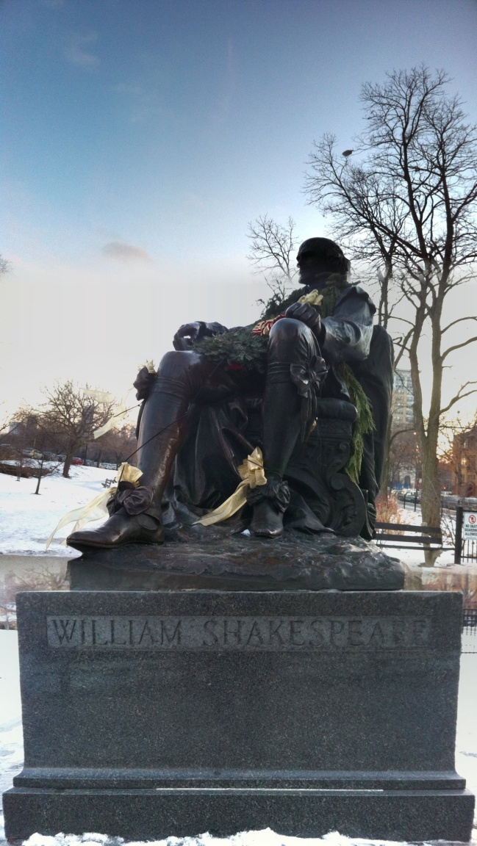
The Bard's will and death
Records reveal that the great Bard revised his will on March the 25th, 1616. Less than a month later, he died on April the 23rd, 1616. Literature's famous Bard is buried at the Holy Trinity Church in Stratford. He infamously left his second-best bed to his wife Anne Hathaway and little else, giving most of his estate to his eldest daughter Susanna who has married a prominent and distinguished physician named John Hall in June 1607. This was not as callous as it seems; the Bard's best bed was for guests; his second-best bed was his marriage bed... His will also named actors Richard Burbage, Henry Condell and John Hemminges, providing proof to academics today that William was involved in theatre. The Bard's direct line of descendants ended some 54 years later until Susanna’s daughter Elizabeth died in 1670.
A recently garlanded statue of William Shakespeare in Lincoln Park, Chicago, typical of many created in the 19th and early 20th century.

Slide 11
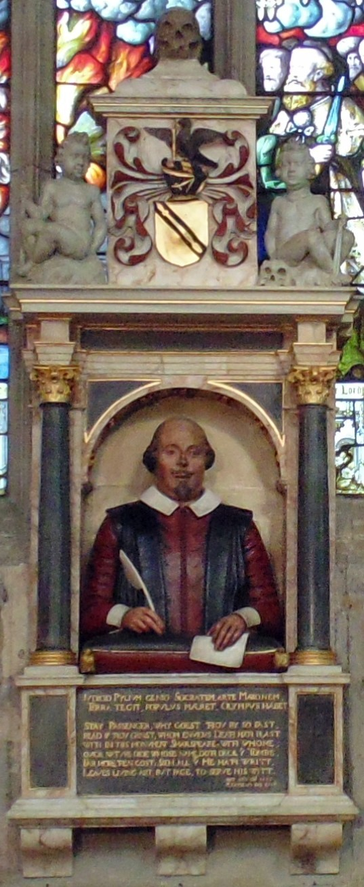
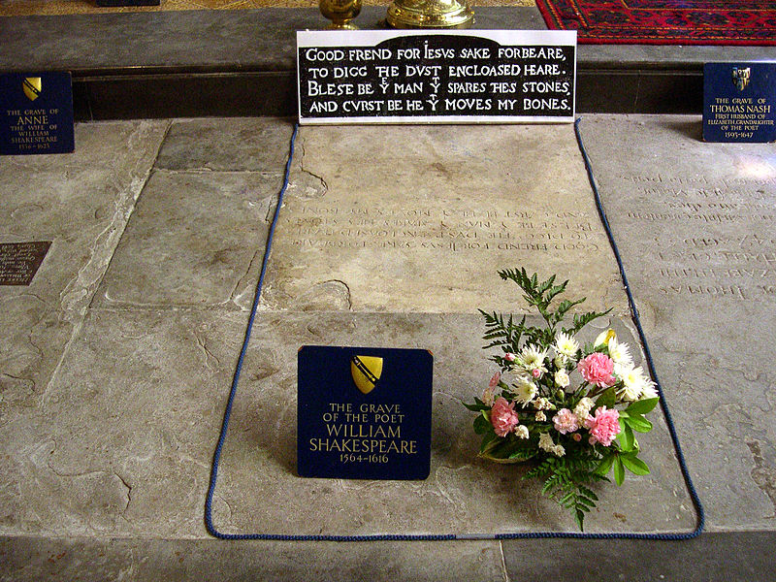
The Bard's last words...
Written upon William Shakespeare’s tombstone is an appeal that he be left
to rest in peace with a curse on those who would move his bones...
Good friend, for Jesus´ sake forbeare
To digg the dust enclosed here!
Blest be ye man that spares thes stones
And curst be he that moues my bones.
Translated this reads as:
Good friend, for Jesus’ sake, forbear
To dig the dust enclosed here;
Blest be the man that spares these stones
And curst he that moves my bones.

Slide 12
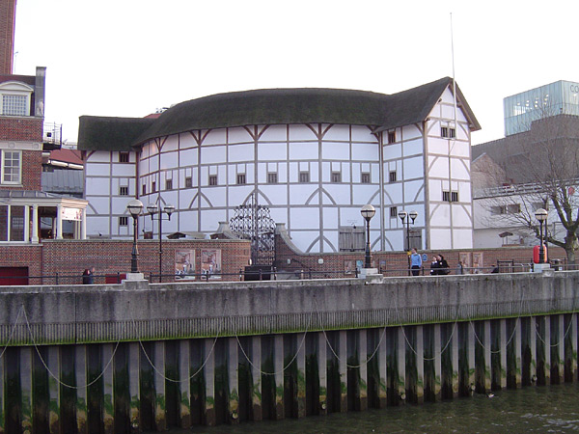
Did Shakespeare write the 37 plays and 154 sonnets credited to him?
The evidence above proves William existed but not that he was a playwright nor an actor nor a poet. In fact recently some academics who call themselves the Oxfords argue that Stratford's celebrated playwright did not write any of the plays attributed to him. They suggest that he was merely a businessman and propose several contenders for authorship, namely an Edward de Vere.
The reconstructed Globe Theatre, London.

