Slide 1
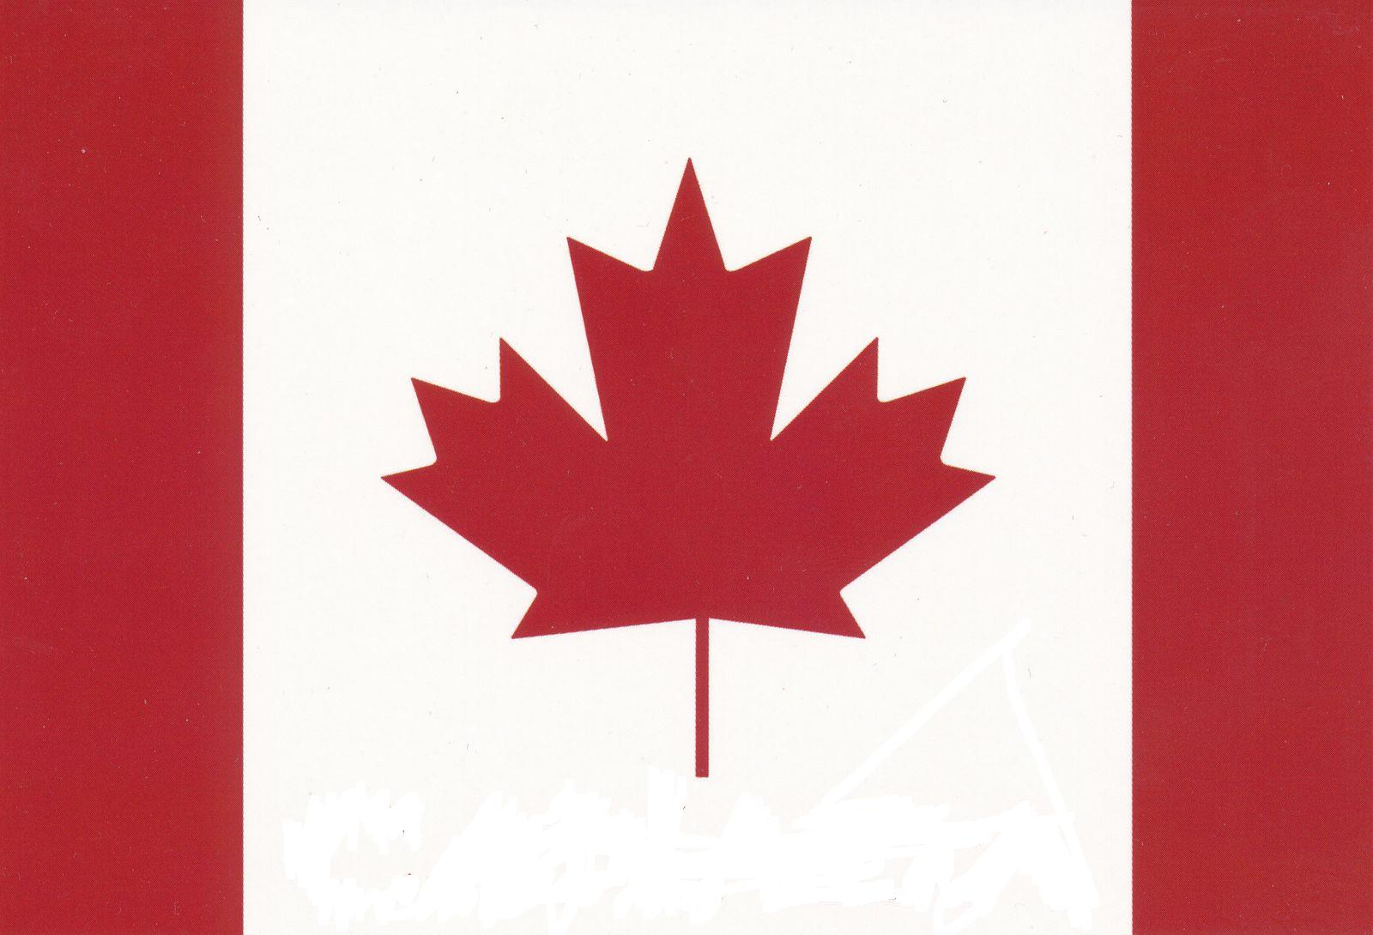
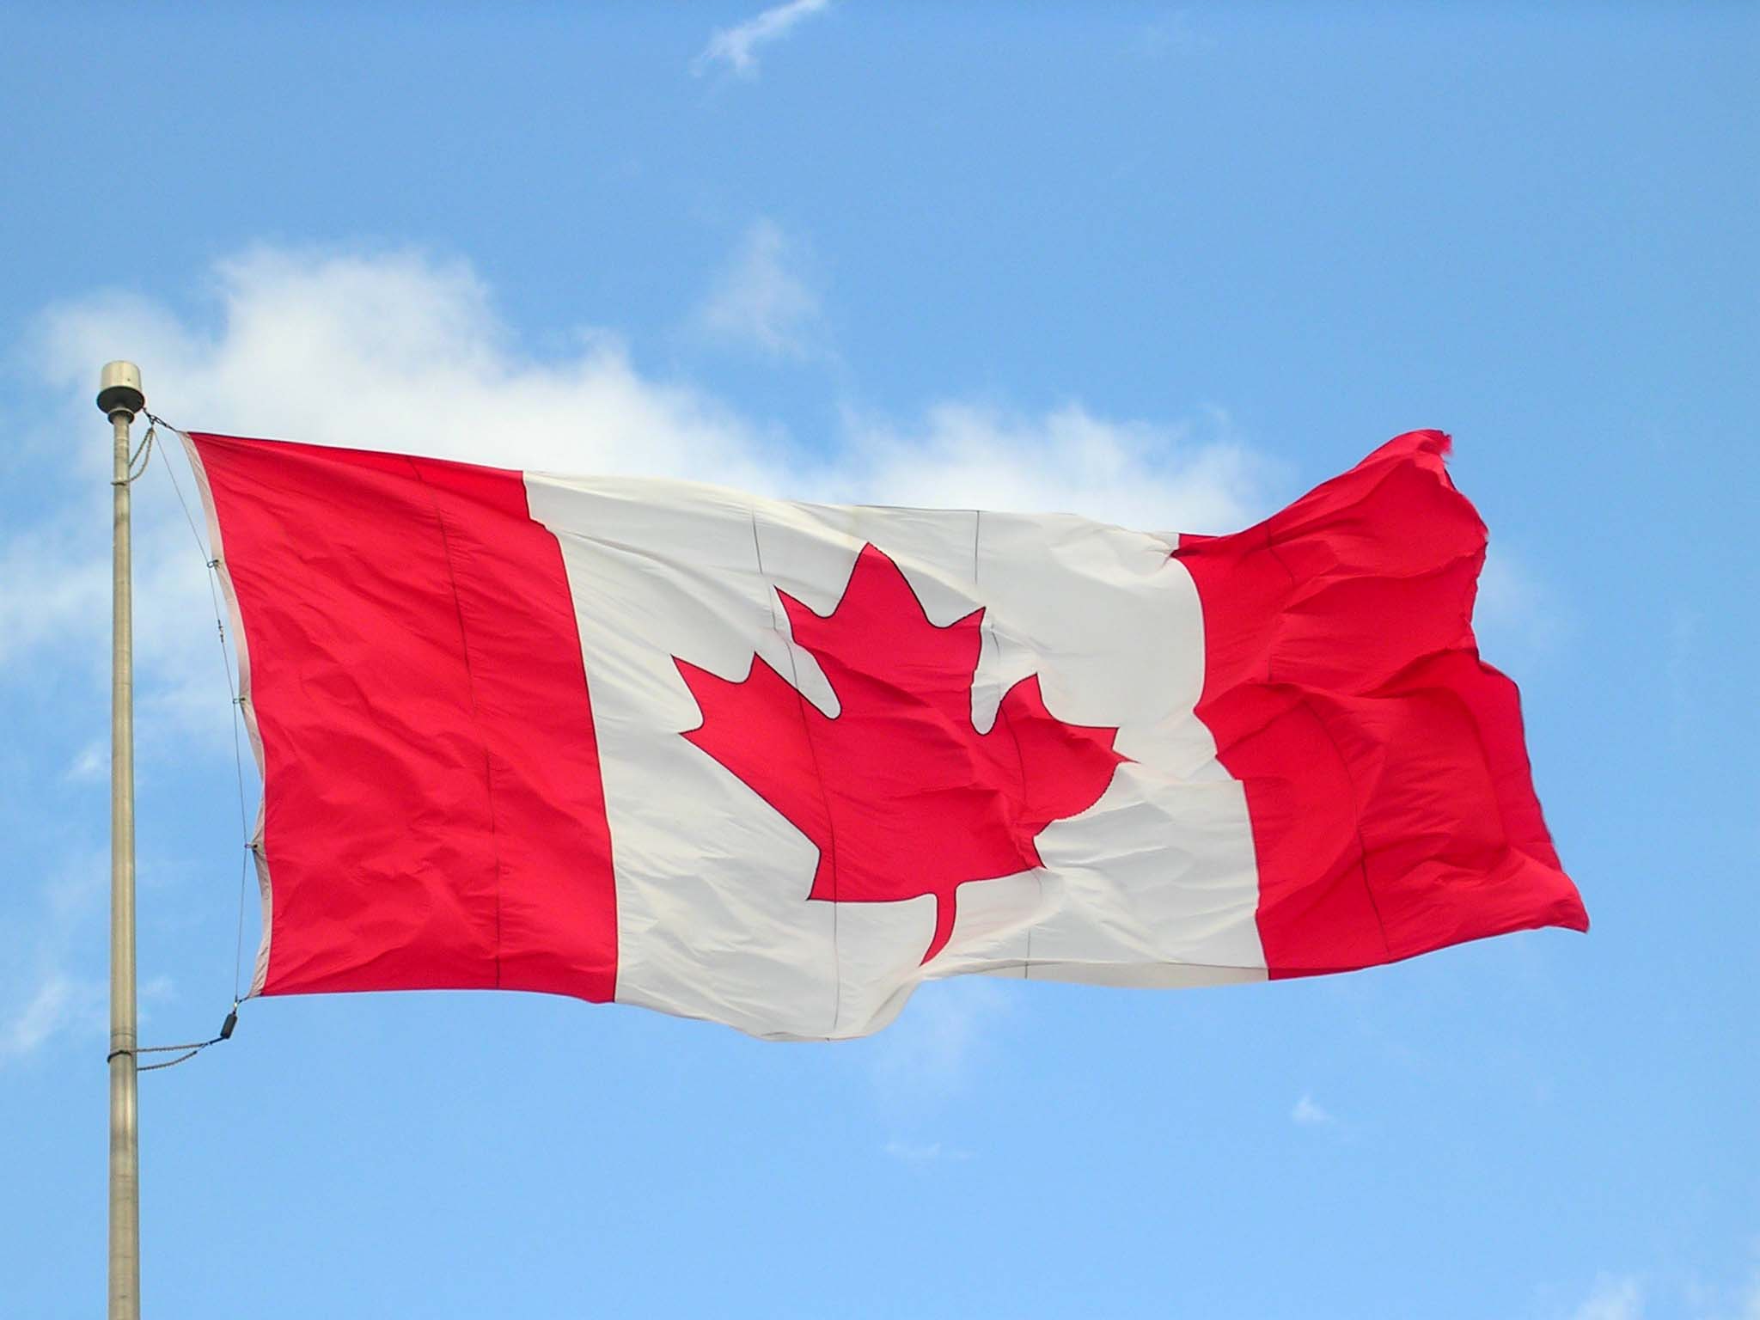
СANADA
Yulia Kryvych 10-B

Slide 2
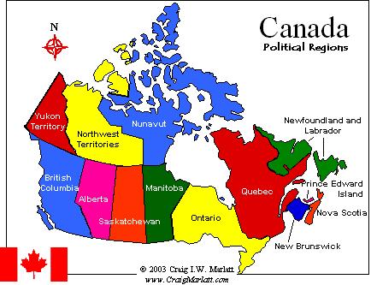
Canada is a North American country consisting of ten provinces and three territories. Located in the northern part of the continent, it extends from the Atlantic to the Pacific and northward into the Arctic Ocean. Canada is the world's second-largest country by total area, and its common border with the United States is the world's longest land border shared by the same two countries.

Slide 3
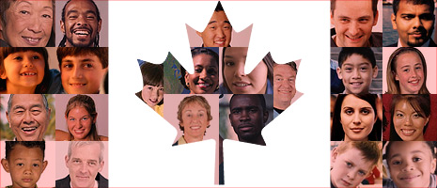
Canada is a federal state governed as a parliamentary democracy and a constitutional monarchy, with Queen Elizabeth II as its head of state. The country is officially bilingual and multicultural at the federal level, with a population of approximately 35 million.

Slide 4
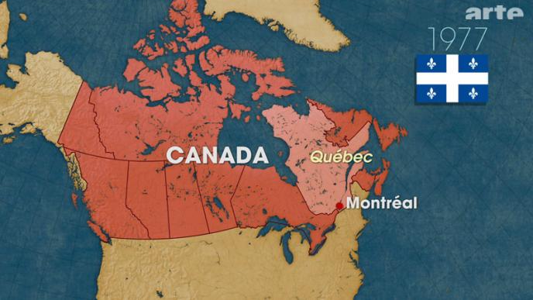
The name Canada comes from the St. Lawrence Iroquoian word Kanata, meaning "village" or "settlement". The area was later split into two British colonies, Upper Canada and Lower Canada. They were reunified as the Province of Canada in 1841.

Slide 5
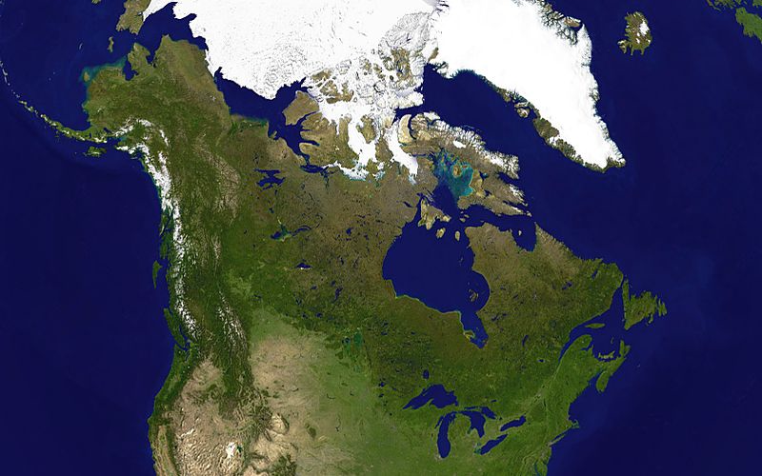
Geography
Canada stretches from the Atlantic Ocean in the east to the Pacific Ocean in the west; to the north lies the Arctic Ocean. By total area Canada is the second-largest country in the world, after Russia.

Slide 6
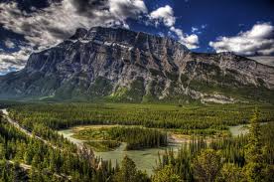
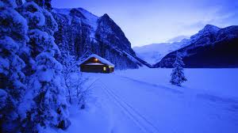
Average winter and summer high temperatures across Canada vary from region to region. Winters can be harsh in many parts of the country, particularly in the interior and Prairie provinces, which experience a continental climate, where daily average temperatures are near −15 °C, but can drop below −40 °C with severe wind chills.

Slide 7
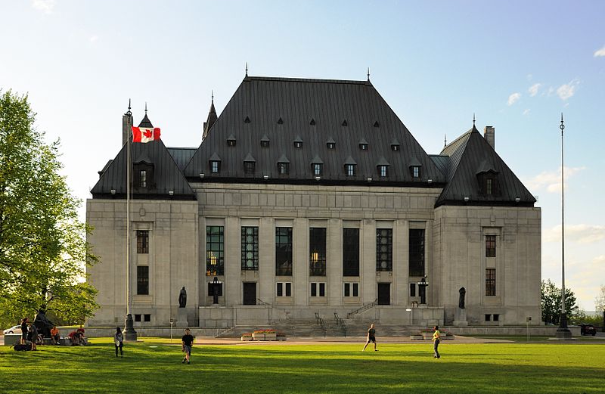
Law of Canada
The Supreme Court of Canada is the highest court and final arbiter and has been led since 2000 by the Chief Justice Beverley McLachlan (the first female Chief Justice).
The Supreme Court of Canada in Ottawa, west of Parliament Hill

Slide 8
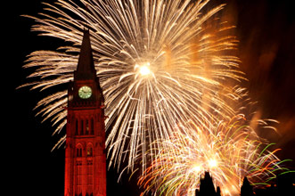
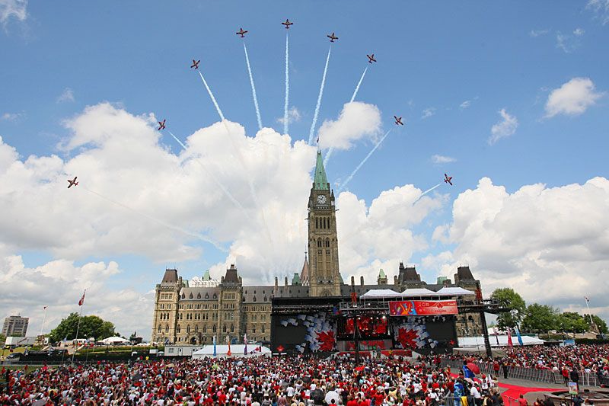
Canada Day
Canada Day is the national day of Canada, a federal statutory holiday celebrating the anniversary of the July 1, 1867, enactment of the British North America Act, 1867, which united three colonies into a single country called Canada within the British Empire. Originally called Dominion Day, the holiday was renamed in 1982, the year the Canada Act was passed.

Slide 9
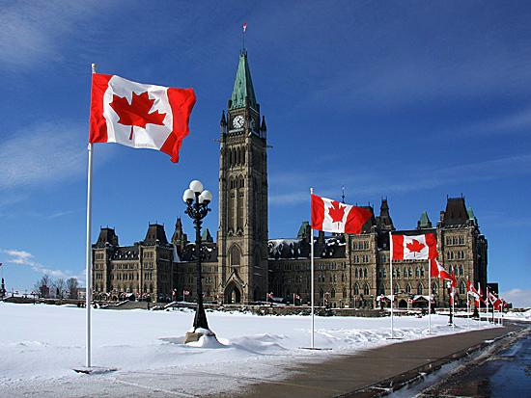
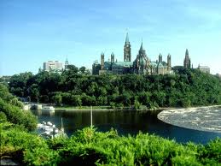
Ottawa
Ottawa is the capital of Canada, and the fourth largest city in the country. The city is located on the south bank of the Ottawa River in the eastern portion of Southern Ontario. The name "Ottawa" is derived from the Algonquin word adawe, meaning "to trade".

Slide 10
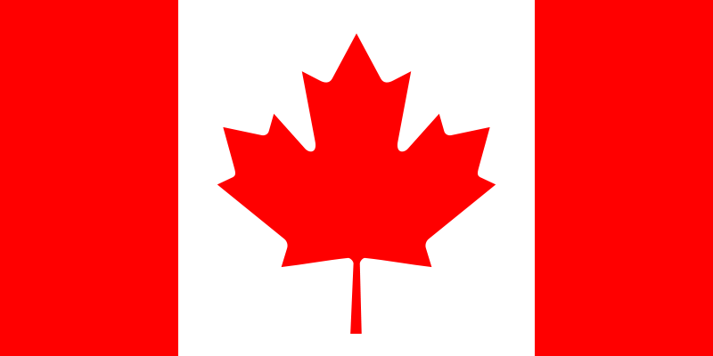
Flag of Canada
Coat of arms of Canada

