Slide 1
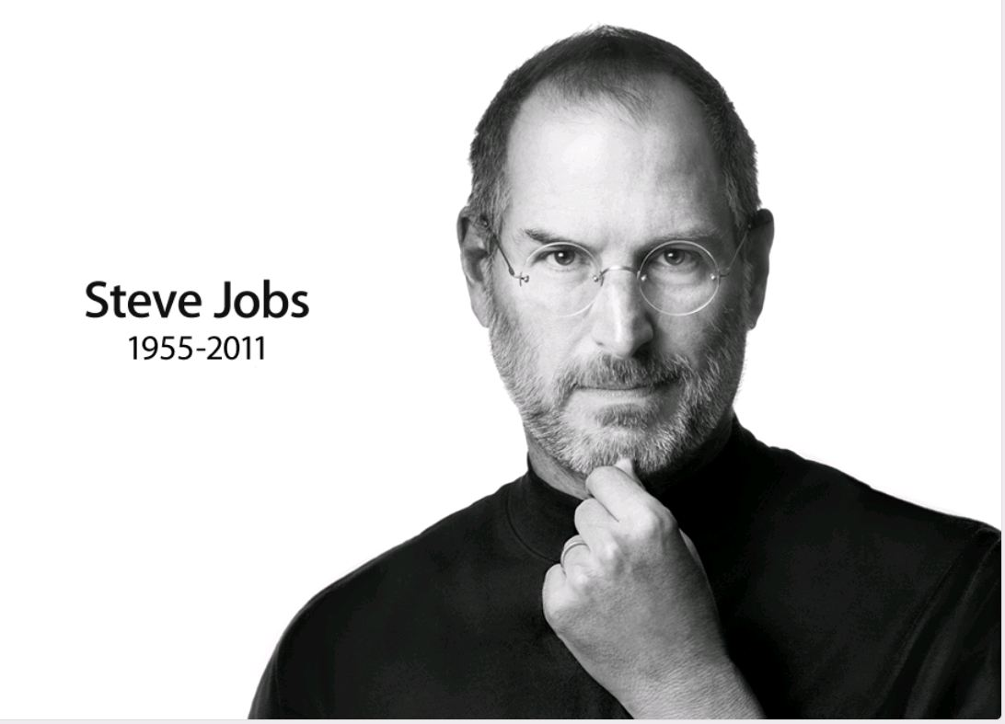

Slide 2
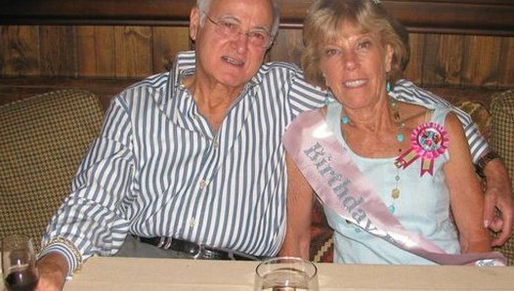
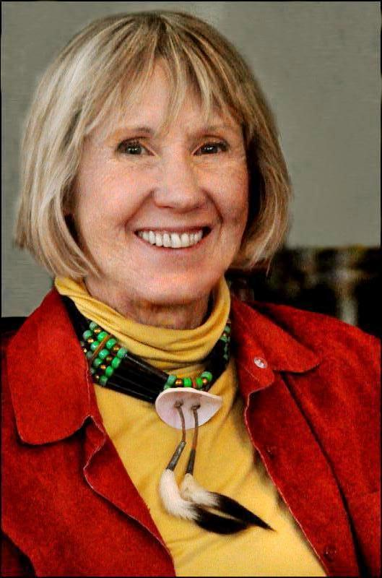
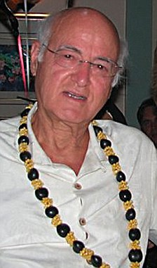
Steven Paul Jobs was born in San Francisco on February 24, 1955 to two university students, Joanne Carole Schieble and Syrian-born John Jandali who were both unmarried at the time. Jandali, who was teaching in Wisconsin when Steve was born, said he had no choice but to put the baby up for adoption because his girlfriend's family objected to their relationship.

Slide 3
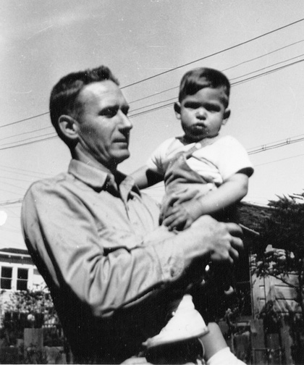
The baby was adopted at birth by Paul Reinhold Jobs and Clara Jobs. The Jobs family moved from San Francisco to Mountain View, California when Steve was five years old.

Slide 4
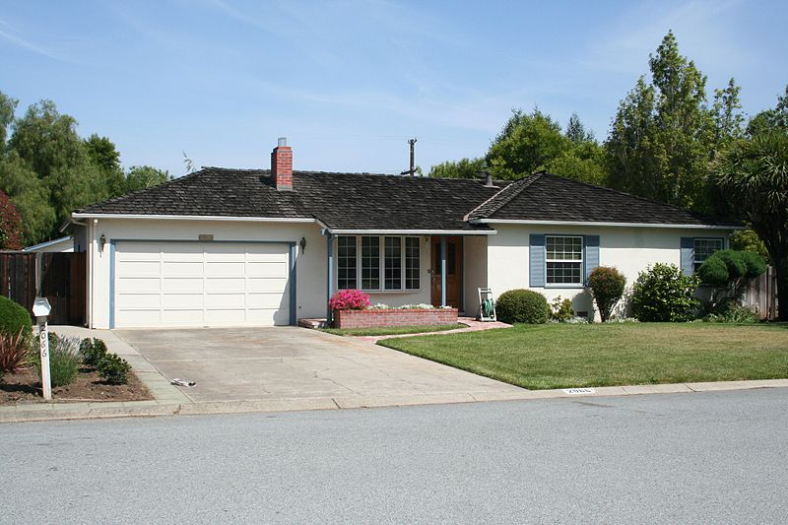
Home of Paul and Clara Jobs at Crist Drive in Los Altos. Here, Steve Jobs, Steve Wozniak and Ronald Wayne in 1976 founded the Apple Computer
Schoolwork disappointed Steve but he still remained a good student. He is passed his exams well and the school principal offered to transfer him out of the fourth grade right in the seventh.

Slide 5
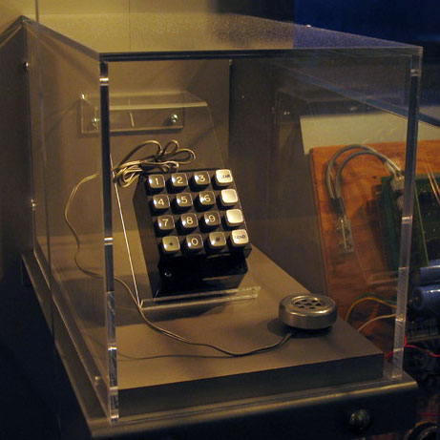
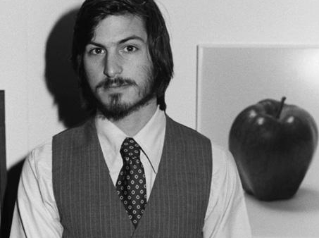
The first real business project Jobs realized when he was at school.
It is called the “BlueBox”

Slide 6
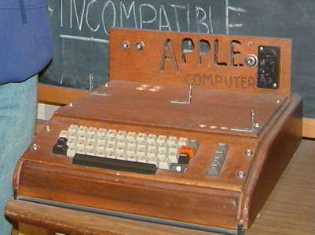
FIRST APPLE COMPUTER

Slide 7
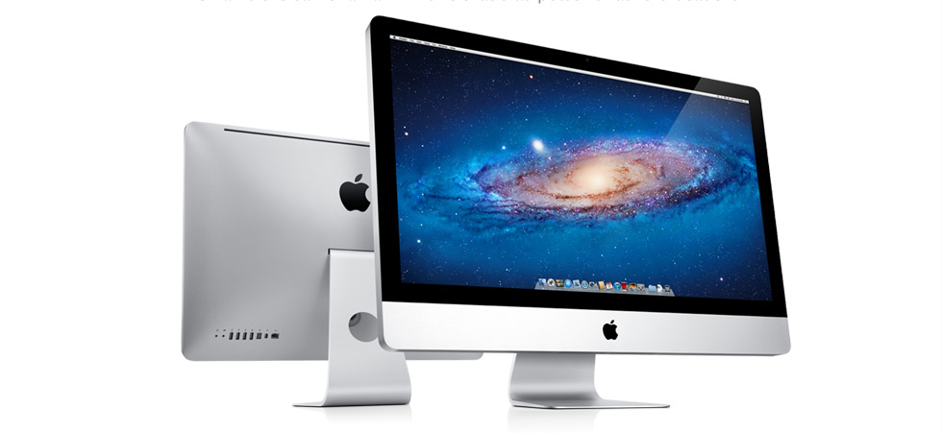
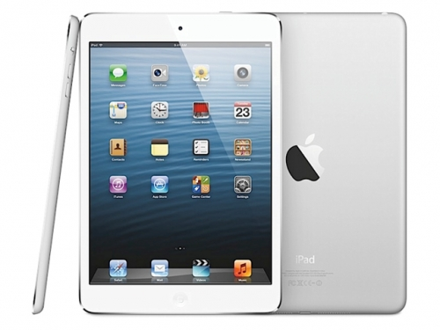
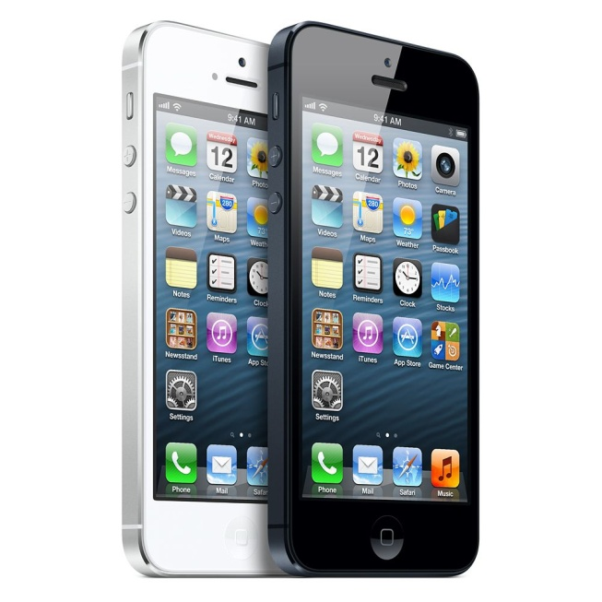
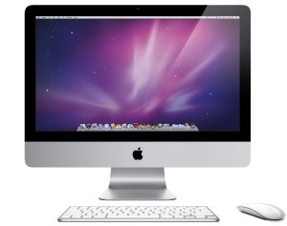
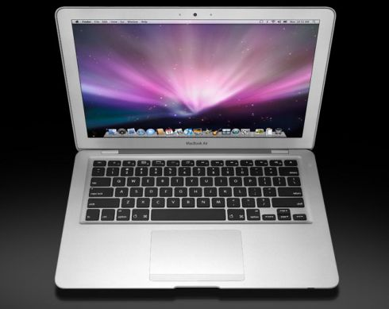
APPLE PRODUCTION NOW

Slide 8
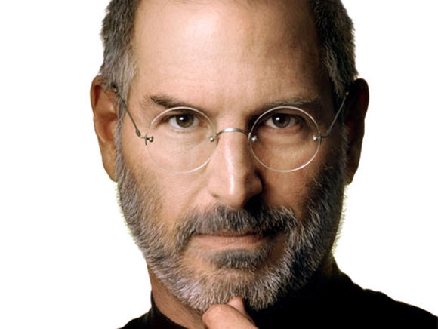
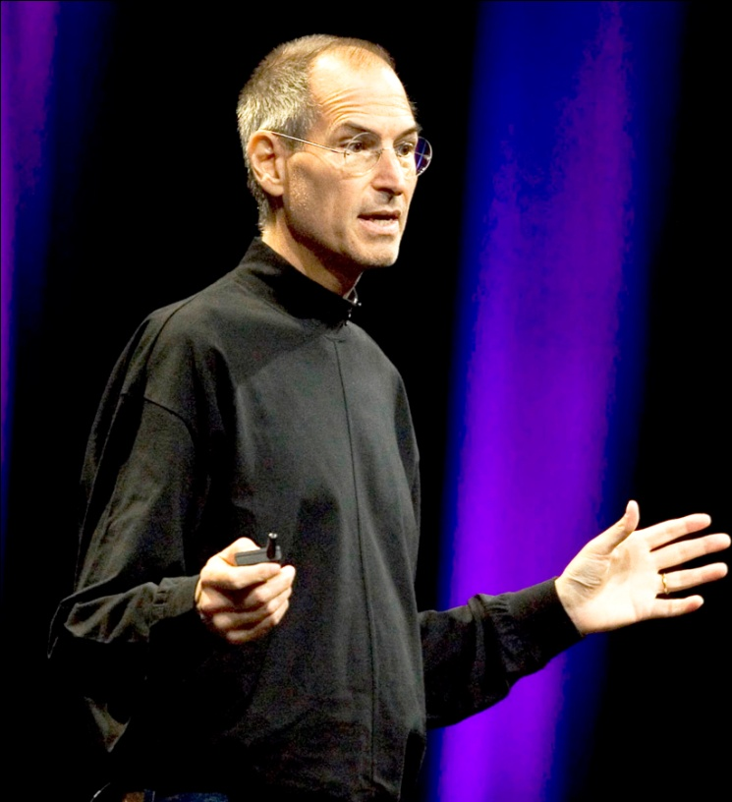
In 1985, Steve Jobs resigned from the APPLE company. December 20, 1990 Jobs returned to the company he founded and in his speech to the graduates of Stanford University in 2005, Jobs said that getting fired from Apple was the best thing that could have happened to him at that moment: The burden of being successful was replaced by the lightness beginner again, less sure about everything. It freed me to enter one of the most creative periods of my life. <...> I'm pretty sure none of this would have happened if I had not been fired from Apple. Was awful tasting medicine, but the patient needed it.

Slide 9
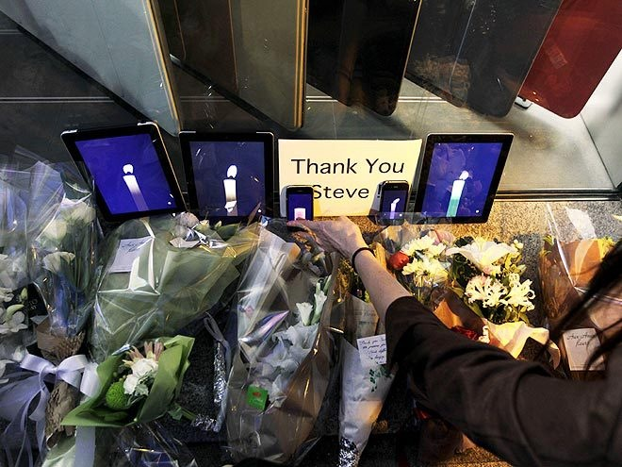
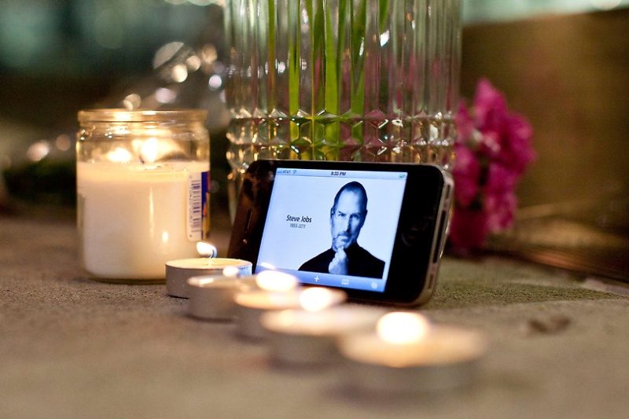
Steve Jobs died at around 3 pm October 5, 2011 at his home in California due to complications that led to respiratory stoppage.

Slide 10
