Slide 1

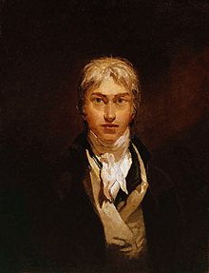
William Turner (23 April 1775 – 19 December 1851)
He was one of the most famous landscape painters of 19 century. He was an English Romantic landscape painter

Slide 2


We need to consider and understand his work. He painted waves and storms, clouds and mists with a great skills.

Slide 3


WELCOME to personal gallery William Turner!

Slide 4

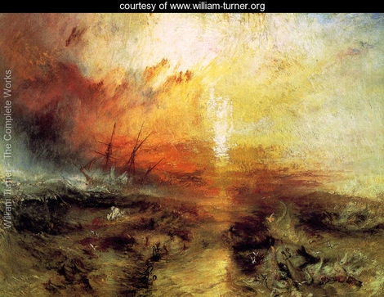
Title:The Slave Ship
Location:Museum Of Fine Arts, Boston, USA
Year:1840
Orientation:Landscape

Slide 5

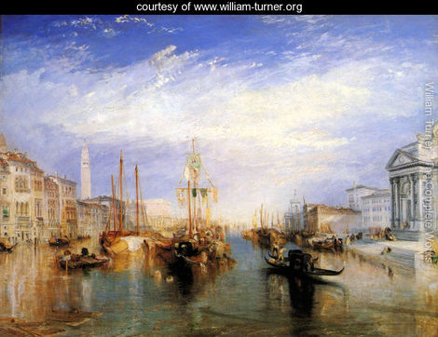
Title:The Grand Canal, Venice
Location:Metropolitan Museum Of Art,, New York, Year:1835
Orientation:Landscape

Slide 6
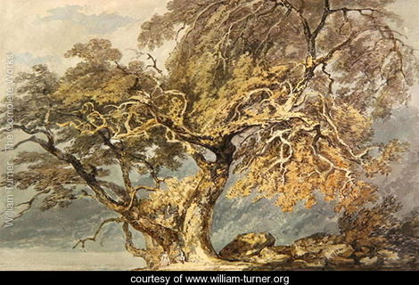
Title:A Great Tree
Location:Yale Centre For British Art, Hartford, Connecticut
Year:1796
Orientation:Landscape

Slide 7
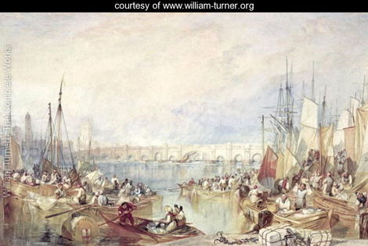
Title:The Port of London
Location:Victoria And Albert Museum, London, England
Orientation:Landscape

Slide 8
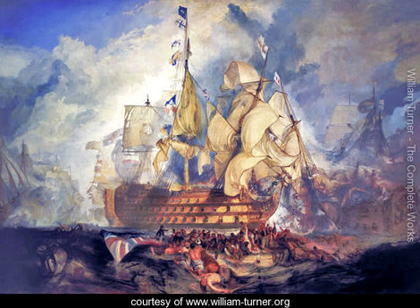
Title:The Battle of Trafalgar
Orientation:Landscape

Slide 9
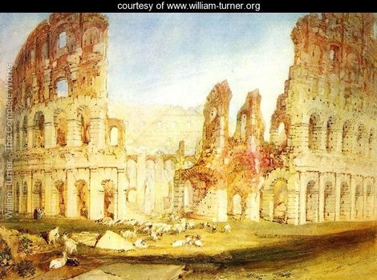
Title:Rome
The Location:British Museum, London, England
Orientation:Landscape

Slide 10
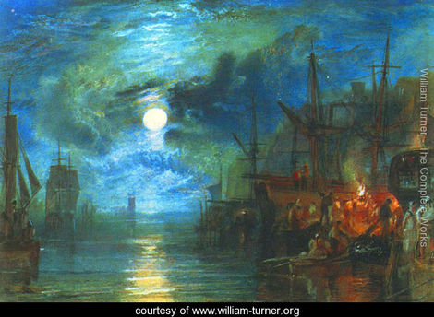
Title:Moon on the River
Location:Tate Gallery, London, England
Orientation:Landscape

Slide 11
Exit

Slide 12
Thank you for your attention!

