Slide 1
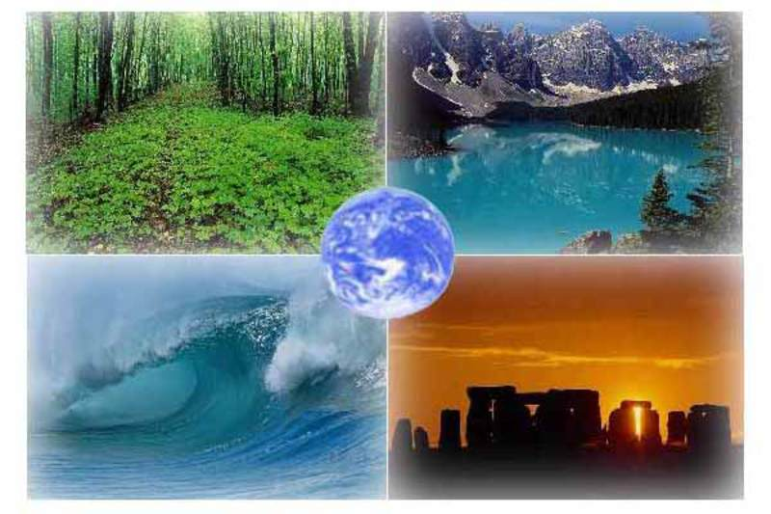
Ecological Problems. Natural disasters

Slide 2
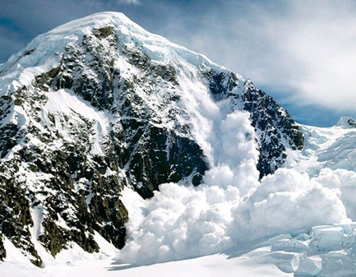
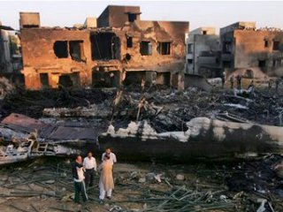
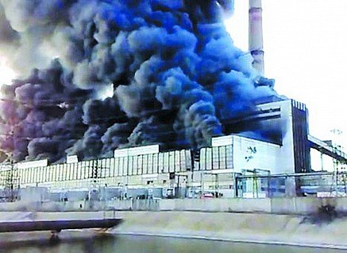
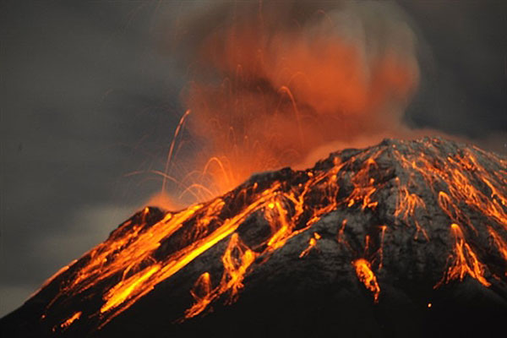
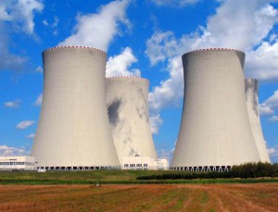
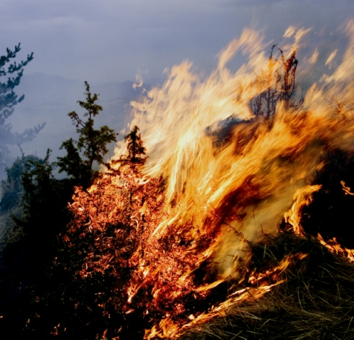
Natural disasters

Slide 3
What does it mean “Eco”?
“Eco” means “home" in Latin language. It’s a science about our mutual home – about nature.
Science, which teachers us to treat very carefully to our homeland.

Slide 4
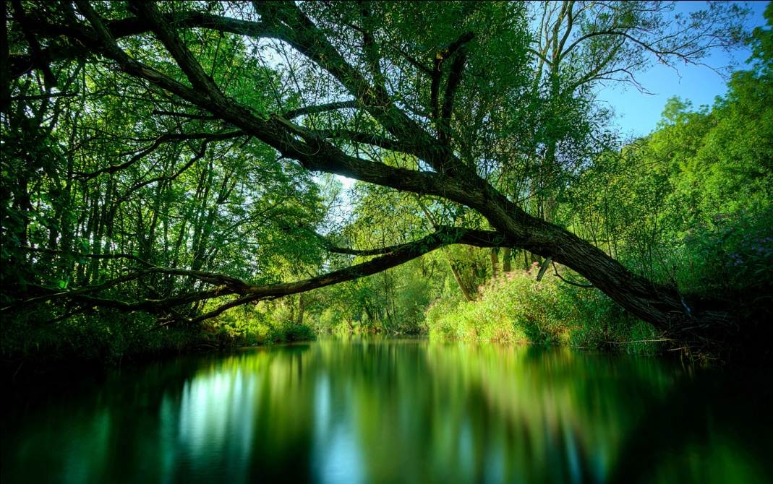
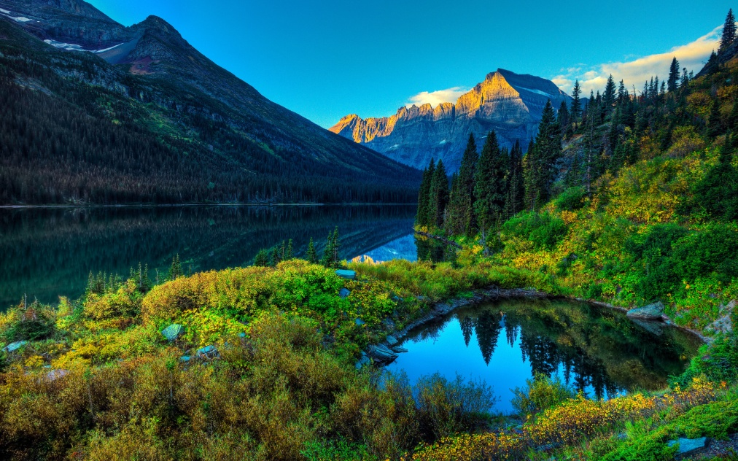
Environment – is surroundings we live in.

Slide 5
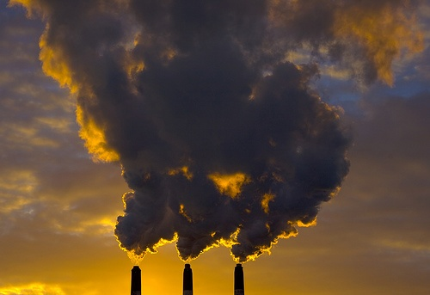
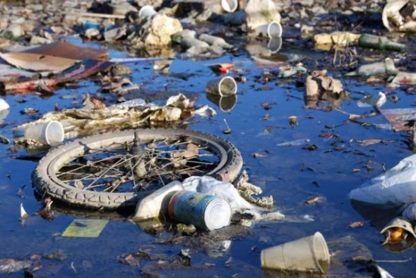
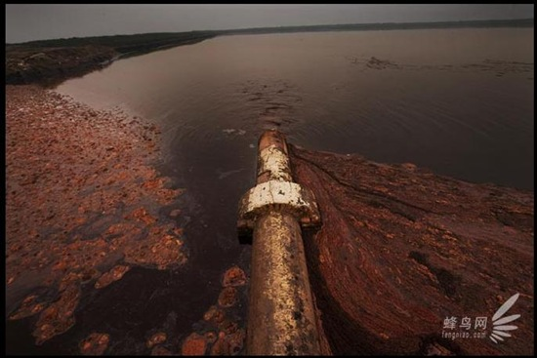
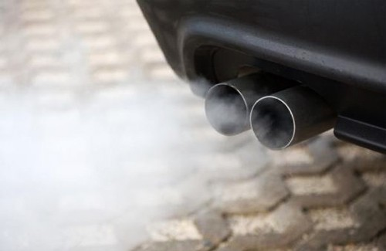
Ecological problems
Air pollution
Water pollution

Slide 6
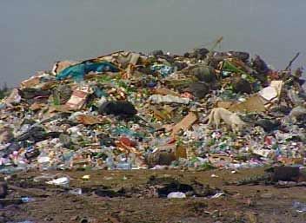
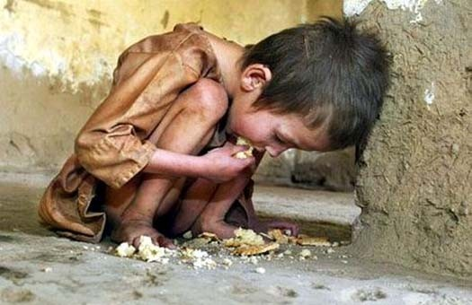
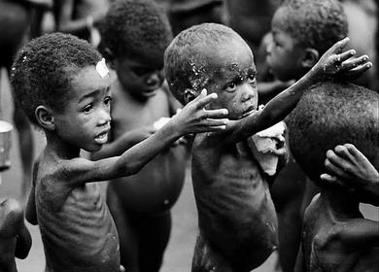
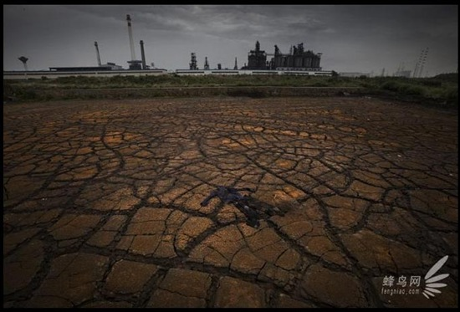
Ecological problems
Famine
Soil pollution

Slide 7
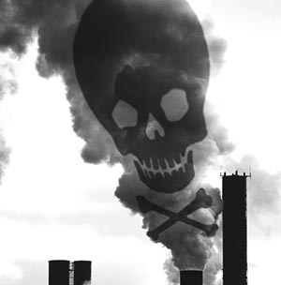
Air pollution is a very serious problem, because polluted air can cause illness and even death. Every year world industry pollutes the atmosphere with about 1500 million tons of dust and other harmful substances. Many cities suffer from smog, the oxygen balance upsets. Cars are polluting the air by exhaust gases and other dangerous chemicals.
Air pollution

Slide 8
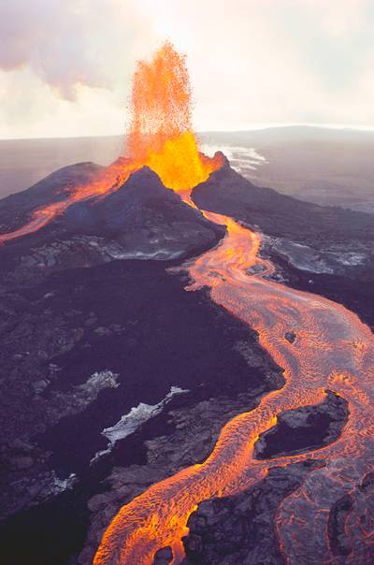
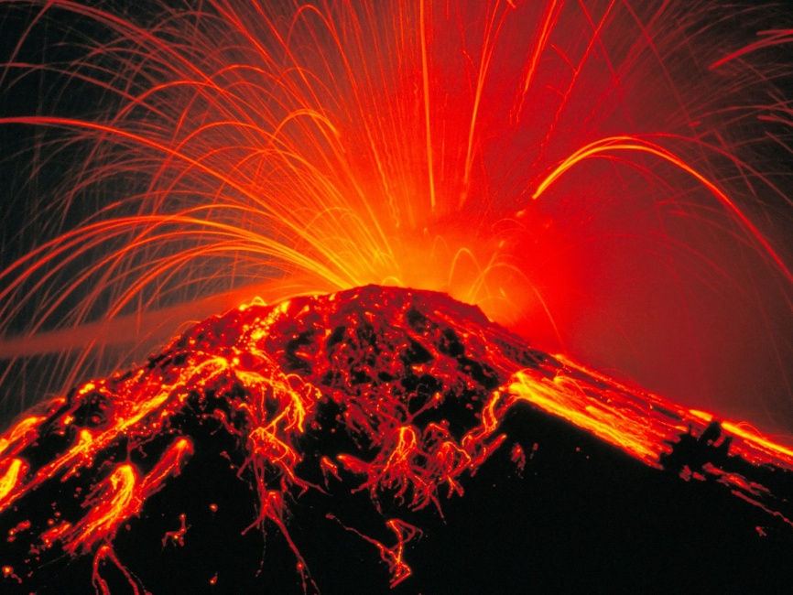
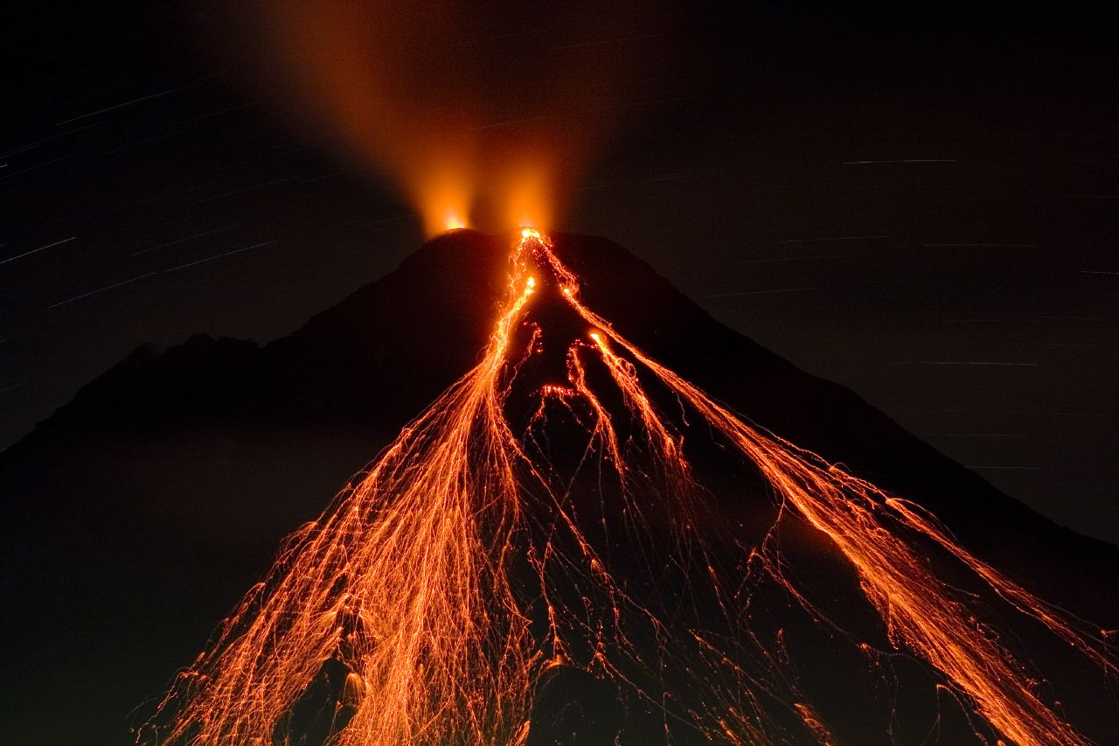
Virtually not only human beings pollute the air but nature itself can cause damage,for example volcanic eruptions.
But the consequences after volcanic eruptions aren’t so harmful as human beings , in contrast to human activities, these processes are always reversible – thought after a while the atmosphere will recover in former structure.

Slide 9
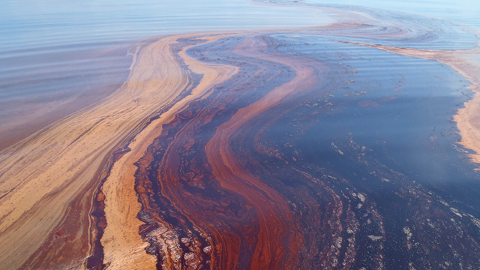
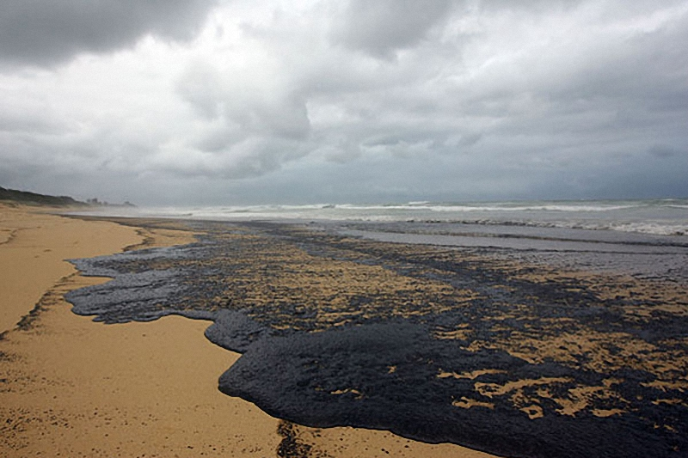
Water pollution
Water recourses is one of the main factor of existing life in our planet.
People use fresh water for their needs. It is more than 2% of hydrosphere volume.
First of all water pollution is the result of industrial, agricultural and everyday necessities discharge of wastes into rivers, lakes and seas.
The main part of water pollution plays a large number of oil industry wastes.

Slide 10
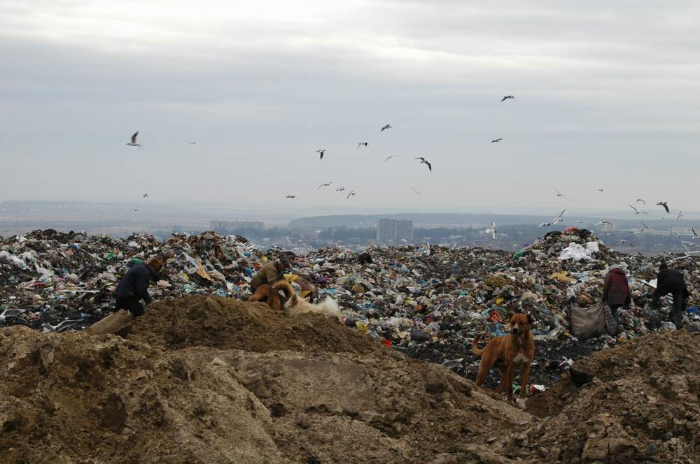
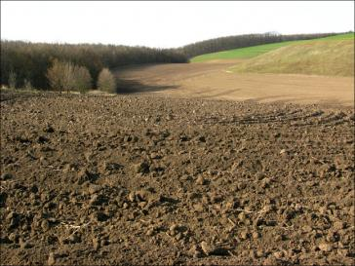
The main component of the Earth biosphere represents topsoil.
Soil is polluted by: litter, wastes, heavy metals, pesticides, radioactive elements.
Sinking aerosol may contain heavy poisonous metals and it may lead to plants’ ruin.
Soil pollution

Slide 11
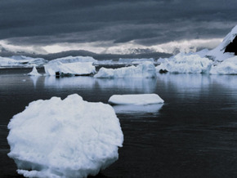
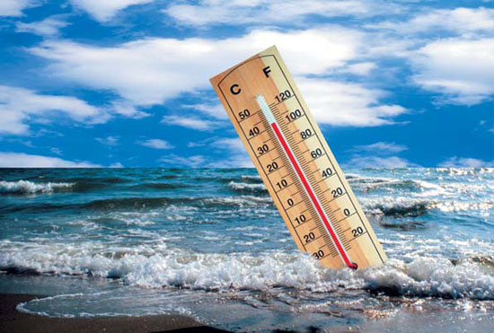
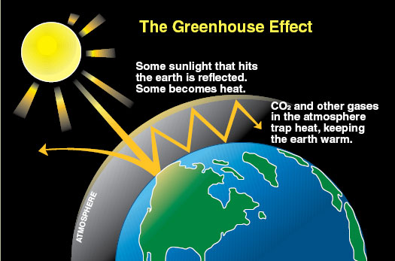
Modern ecological problems
Greenhouse effect

Slide 12
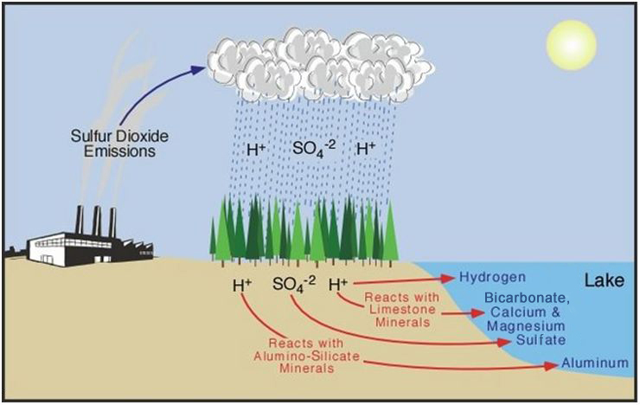
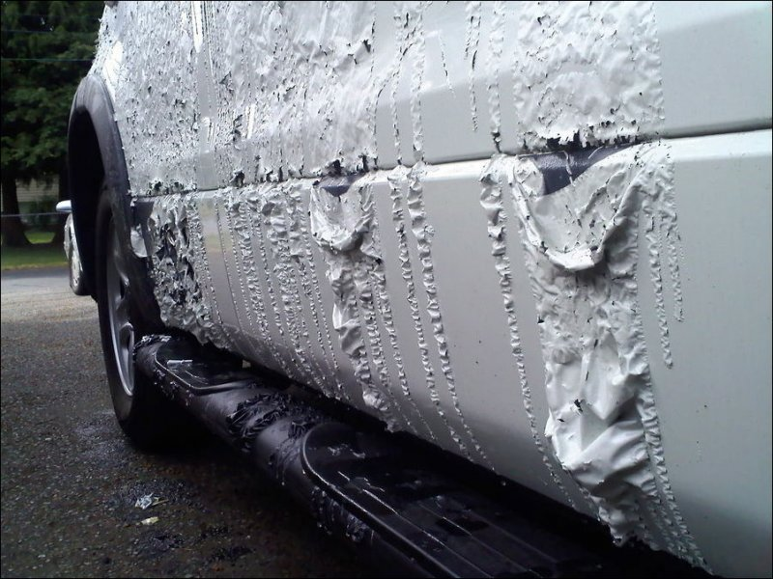
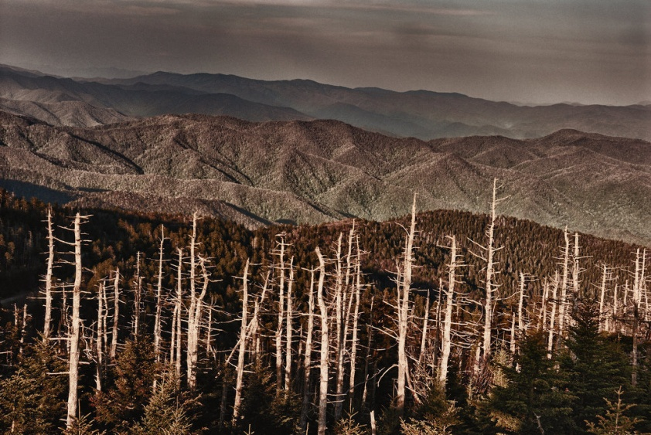
Acid rains

Slide 13
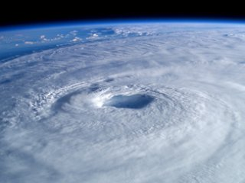
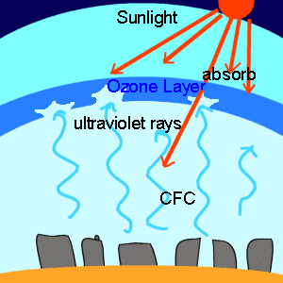
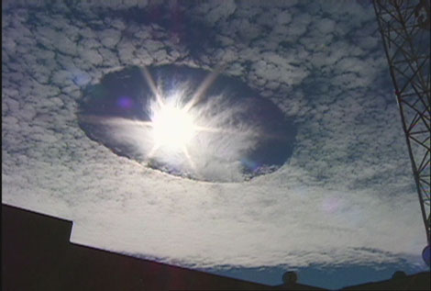
Ozon layer

Slide 14
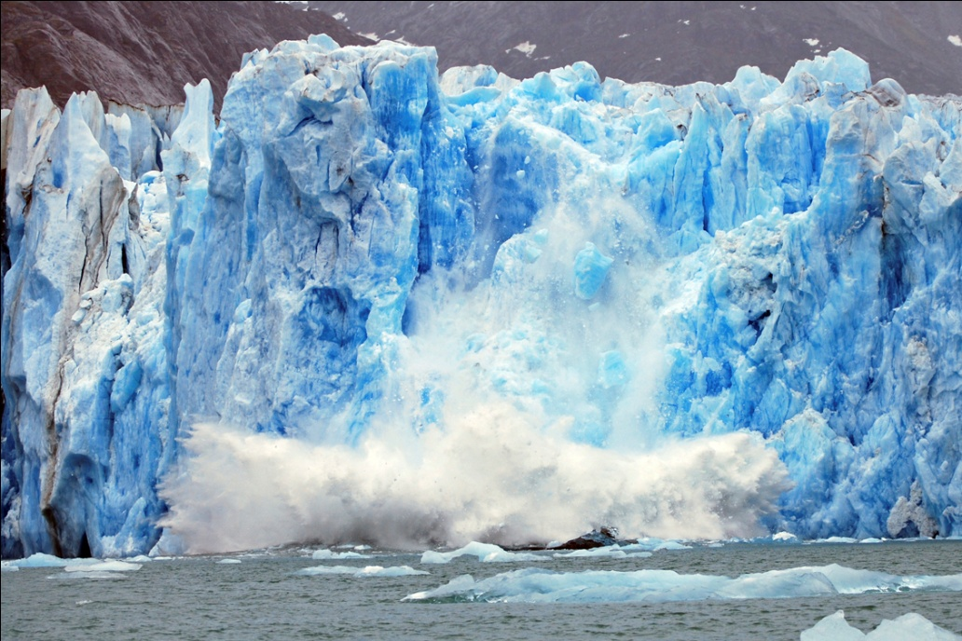
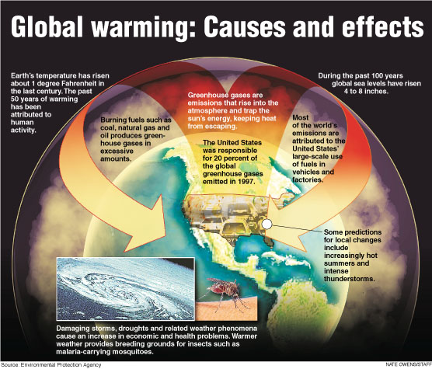
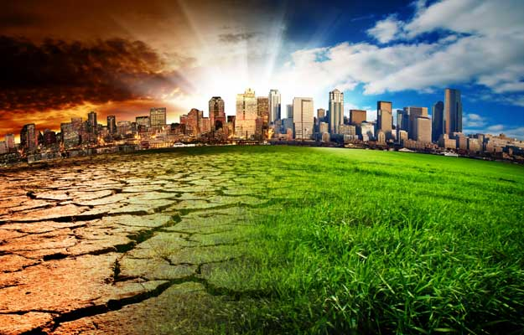
Global warming

Slide 15

Ways of solving ecological problems
Creation of different kinds of purification plants;
Recycling.

Slide 16
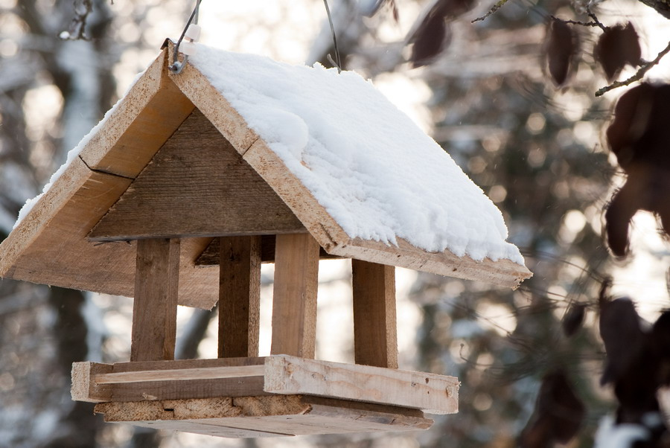
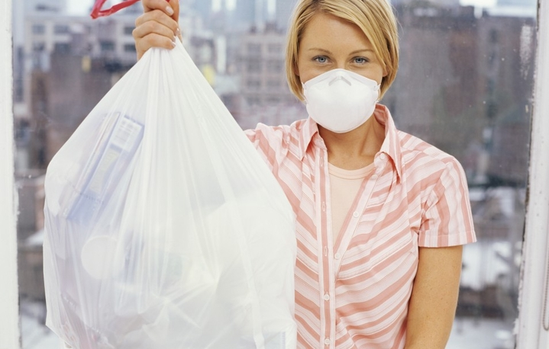
III. Using of conservation technologies and rational distribution of industry.
Creation of purification territorial systems.

Slide 17
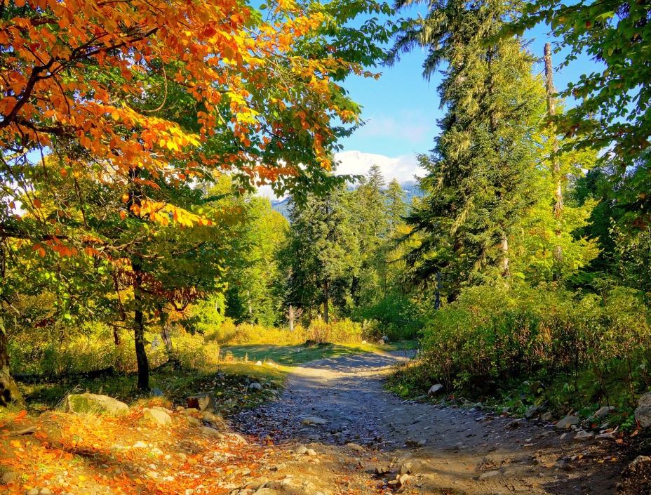
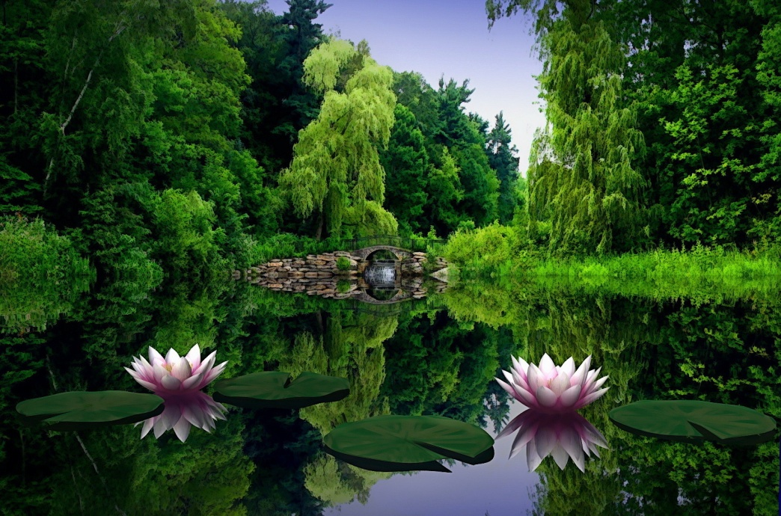
Look how beautiful our planet can be!

Slide 18
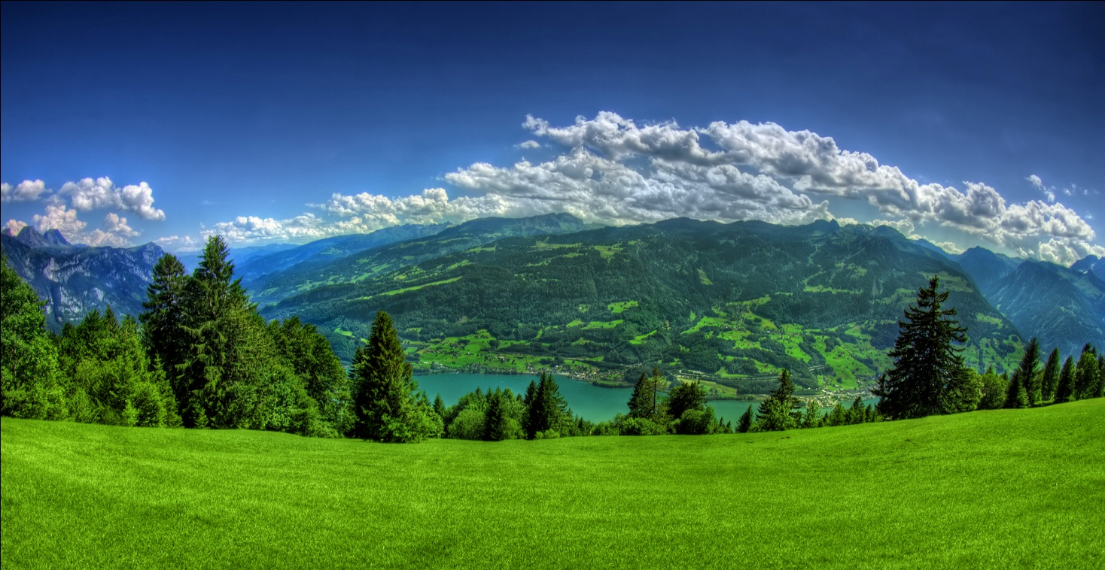
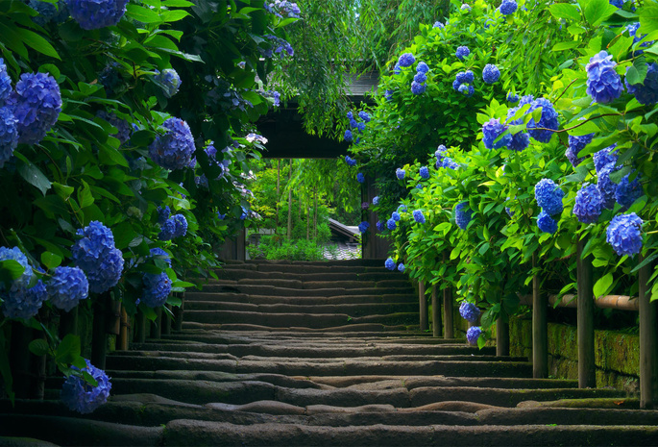

Slide 19
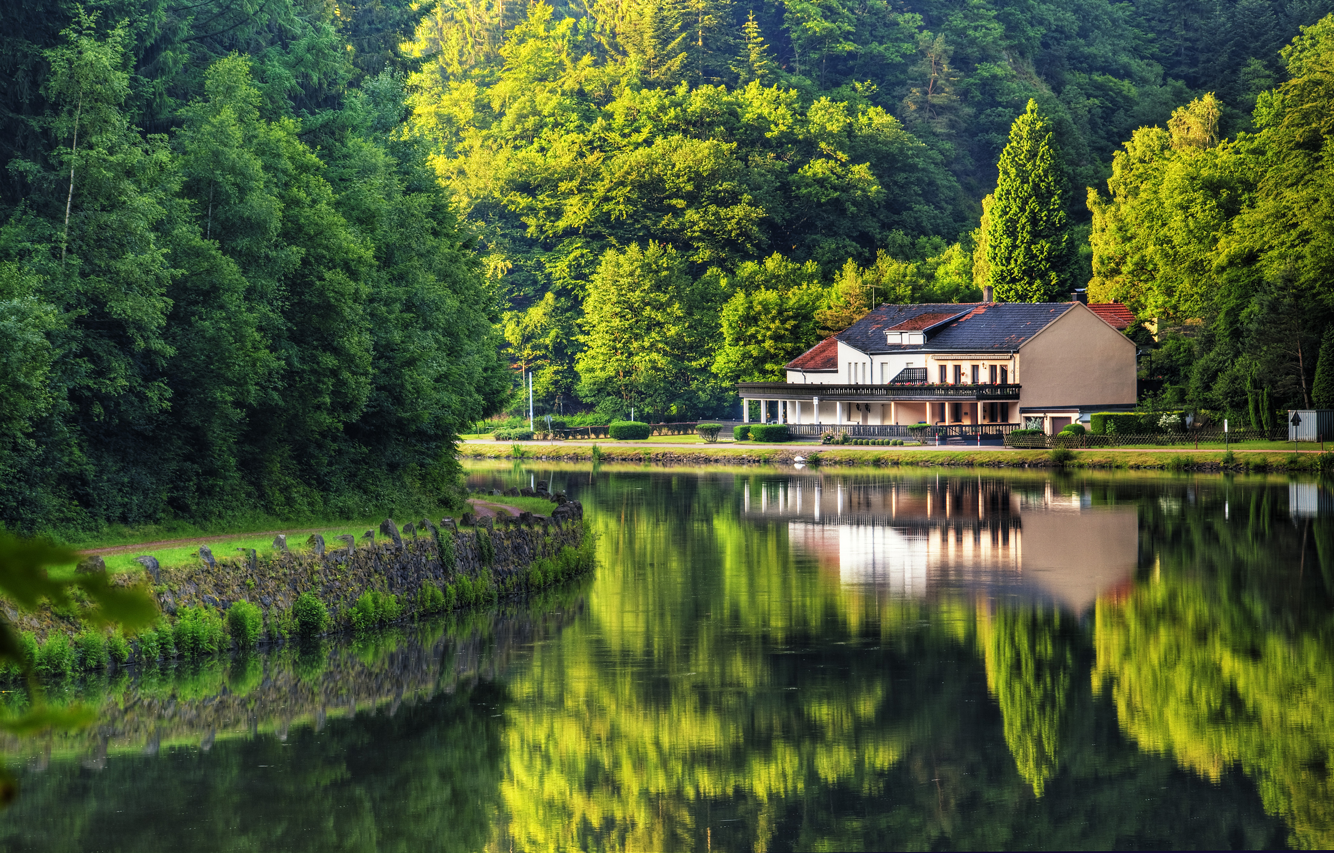
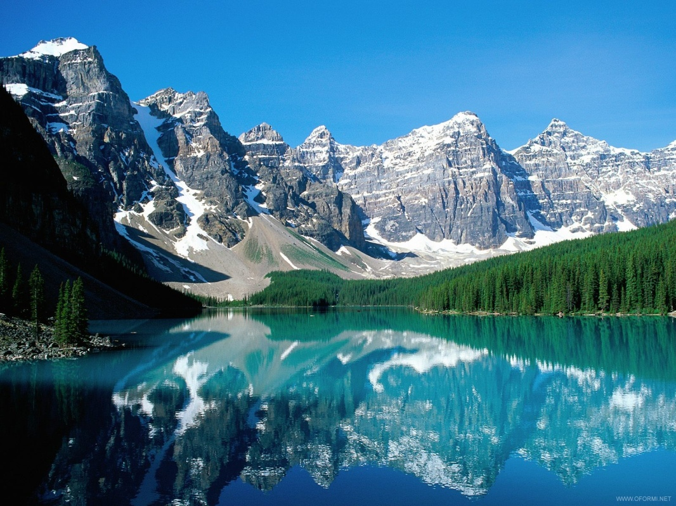
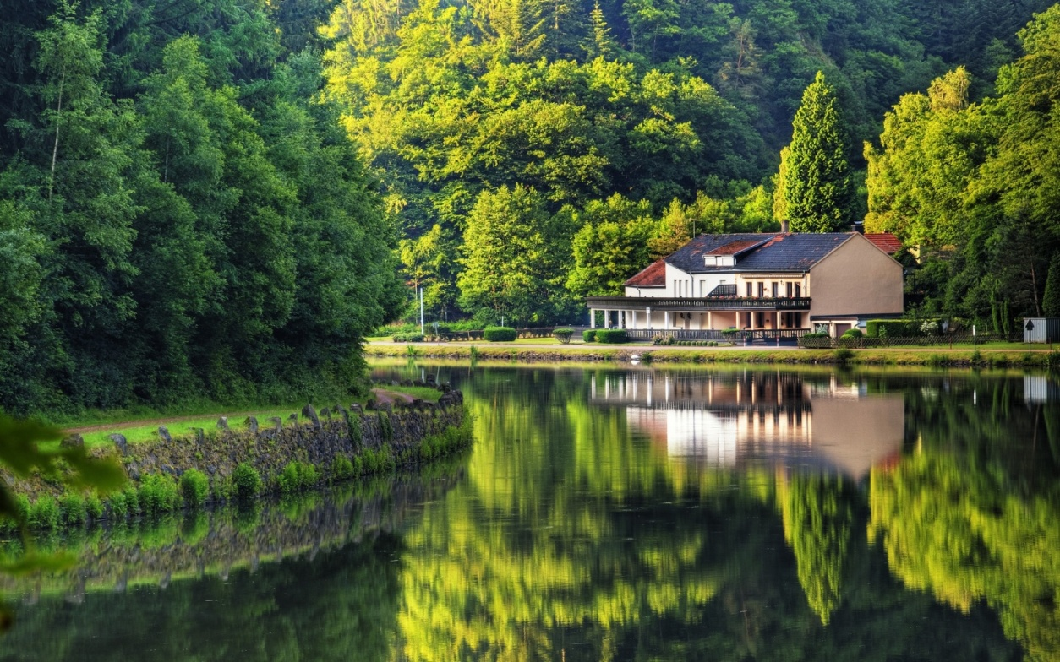

Slide 20
Prepared
Pupil 10-A class
Sarny Lyceum "Leader“
Zhuchenya Kateryna

