Slide 1
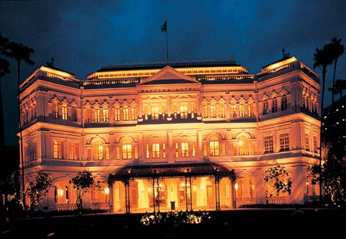
Raffles hotel Singapore

Slide 2
Raffles Hotel is a colonial-style hotel in Singapore. It was established by two Armenian brothers from Persia—Martin and Tigran Sarkies—in 1887. In later years they were joined by younger brothers Aviet and Arshak and kinsman Martyrose Arathoon. With their innovative cuisine and extensive modernisations, the firm built the hotel into Singapore's best known icon. It was named after Stamford Raffles, the founder of modern Singapore, whose statue had been unveiled in 1887. The hotel is currently managed by Fairmont Raffles Hotels International and houses a tropical garden courtyard, museum, and Victorian-style theatre.

Slide 3
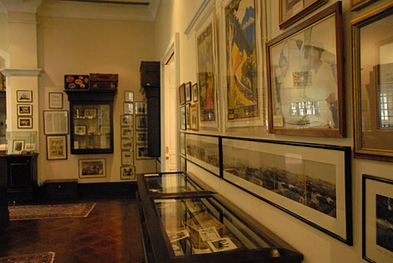
Raffles Hotel Museum The hotel houses the Raffles Hotel Museum, which displays the rich history of the hotel. The museum was created after a well-orchestrated heritage search by a public relations consultant. People from all over the world returned items and memorabilia of their stay at the 'grand lady of the Far East'; photographs, silver and china items, postcards and menus as well as old and rare editions of the works of the famous writers who stayed there. These items are displayed in the museum along with photographs of its famous guests and visitors.

Slide 4
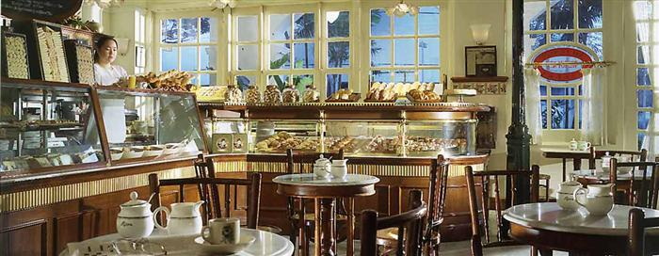
Food and beverage outlets Interior view of Raffles Hotel Ah Teng's Bakery Bar and Billard Room & Martini Bar Empire Cafe Long Bar, birthplace of the Singapore Sling Long Bar Steakhouse Raffles Courtyard & Gazebo Bar Raffles Creamery Raffles Grill Tiffin Room, Singapore's oldest restaurant Writer's Bar Royal China at Raffles (branch of the famous Royal China in London) Shinji by Kanesaka

Slide 5
Trivia View of the courtyard and some of the hotel rooms Raffles Hotel is reputedly where the sole surviving wild tiger in Singapore was shot and made extinct. Some stories place this event in the Long Bar. The hotel management claims the tiger escaped from enclosure at a nearby "native show" and was chased underneath the hotel's Bar & Billiard Room (a raised structure) and shot to death there on 13 August 1902.

Slide 6
Raffles Hotel has a shopping arcade housing boutique brands such as Louis Vuitton, Surrender, and Tiffany & Co.. The arcade houses most of the hotel's restaurants. It also has shops such as the custom tailor, CYC The Custom Shop,^{[9]} which makes shirts for Singapore's first prime minister, Lee Kuan Yew, and the third and current prime minister, Lee Hsien Loong. The third floor of the arcade houses the Raffles Hotel Museum and Jubilee Hall.

