Slide 1
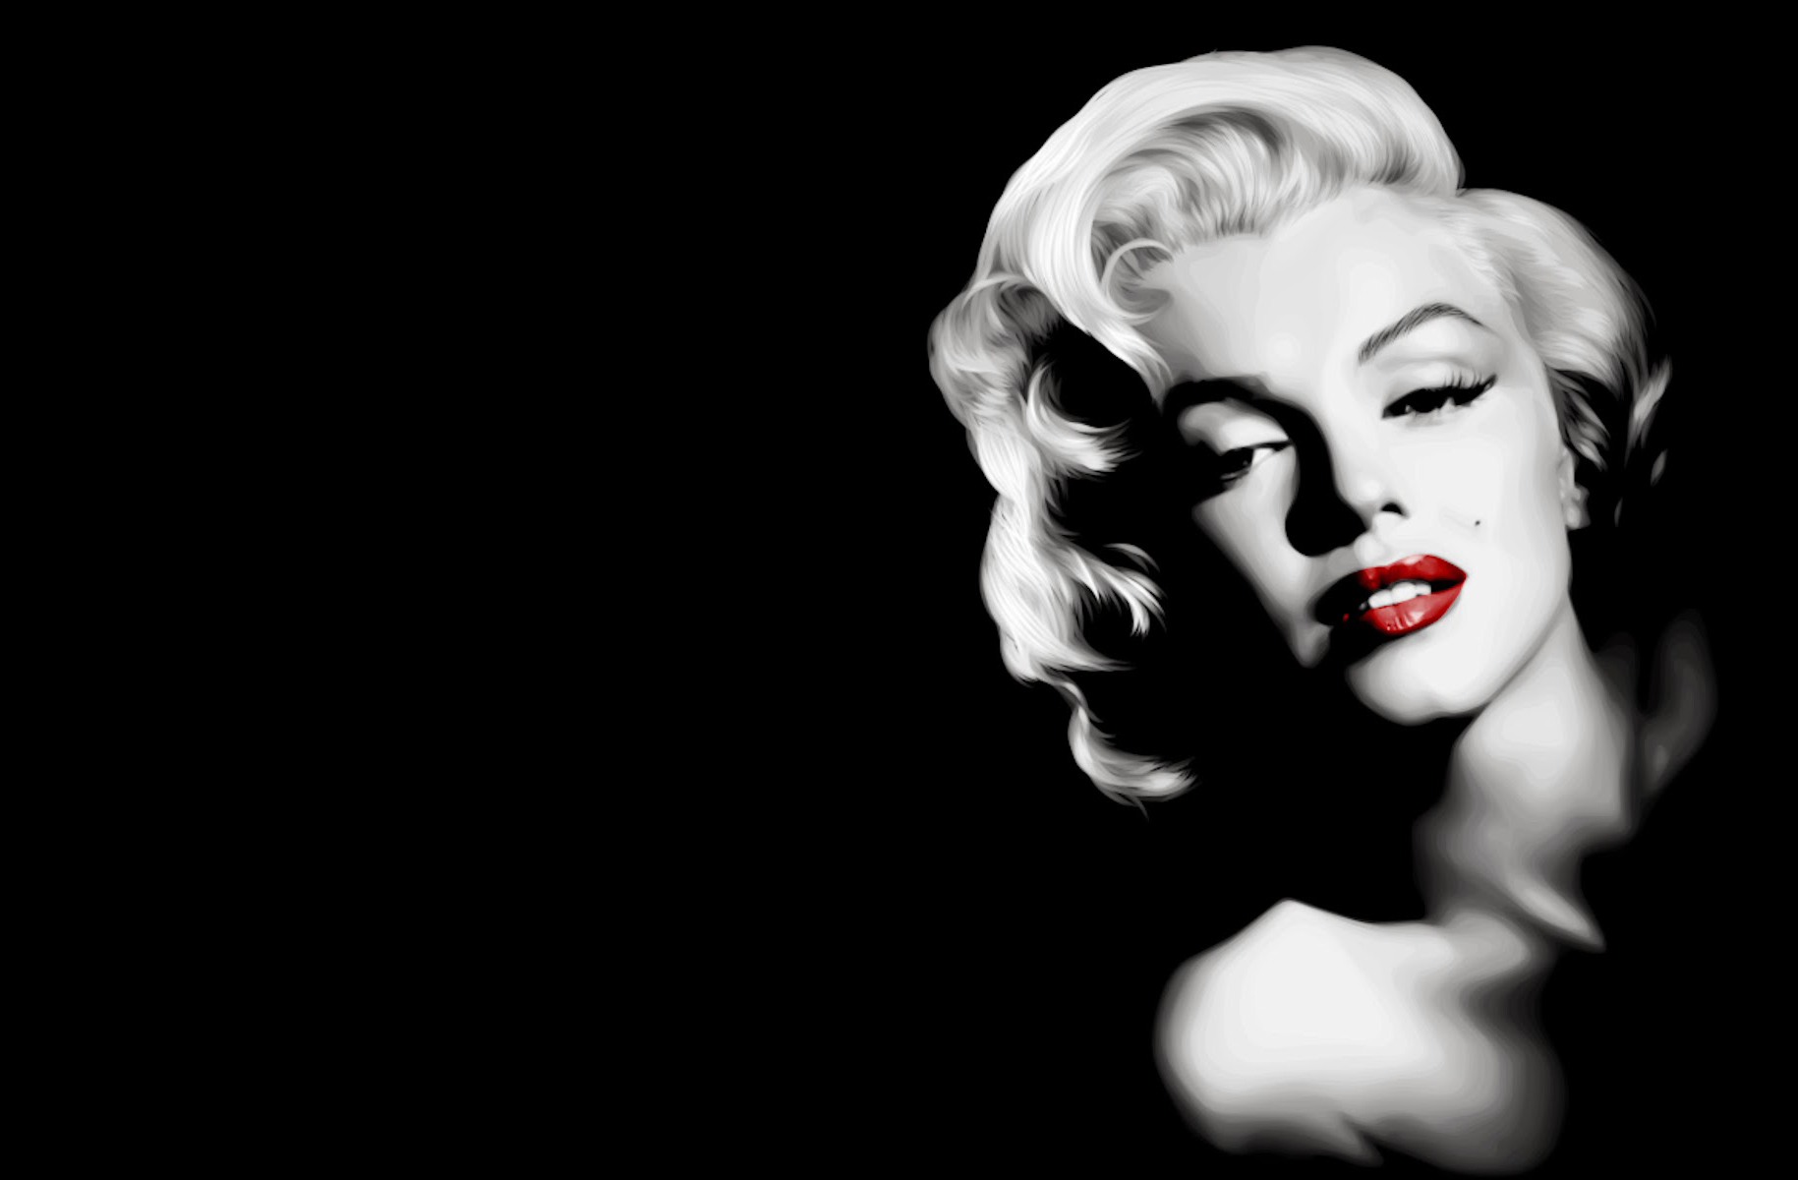
Marilyn Monroe
… the woman, which was loved by millions

Slide 2
Marilyn Monroe
Marilyn Monroe was a legendary American actress, model, and singer, starring in a number of commercially successful motion pictures during the 1950s and early 1960s.

Slide 3
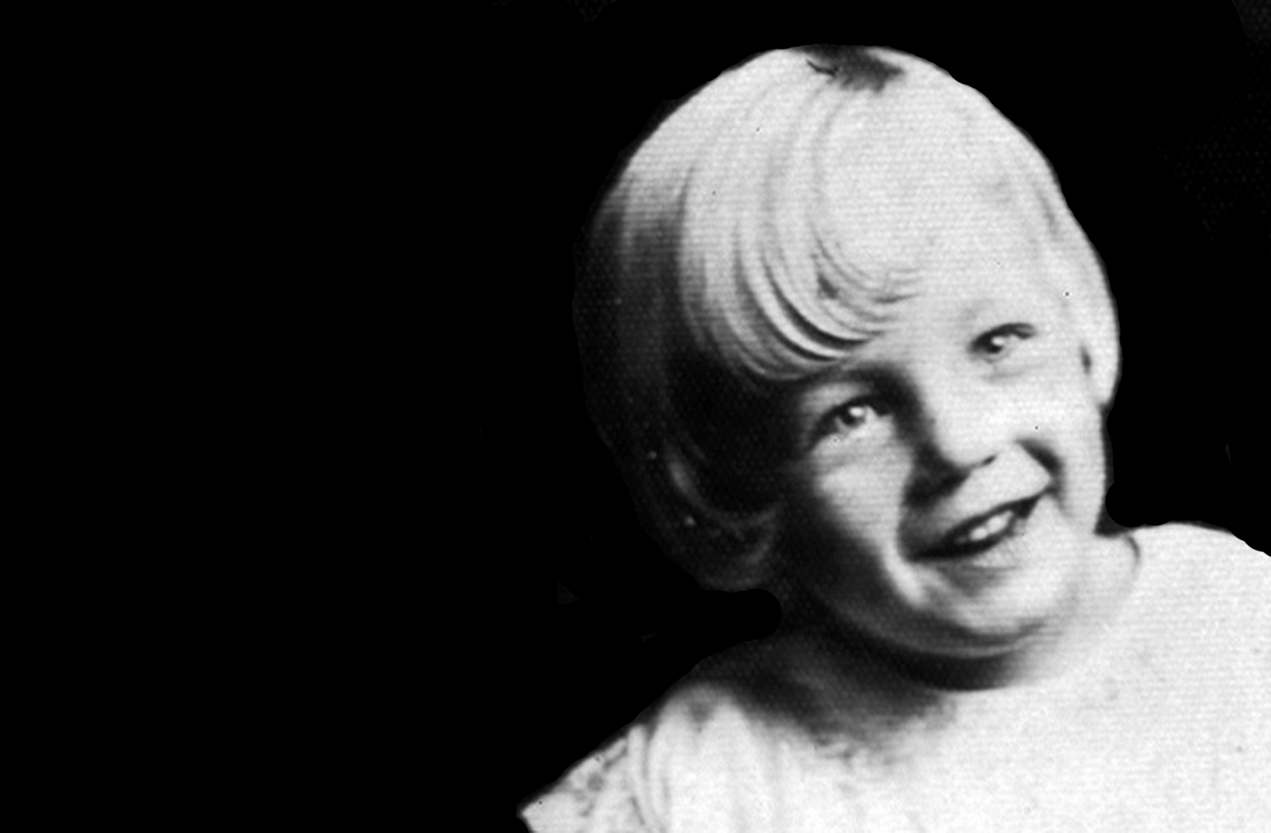
In early years
She was born on 1 June 1926 in the Los Angeles County Hospital. She lived with a number of foster parents, as her mother was mentally unstable, until her mum's best friend Grace Mckee became her guardian.
Mckee was inspired by Jean Harlow and allowed the nine-year-old Norma to wear makeup and curl her hair until McKee married and sent Norma to an orphanage.

Slide 4
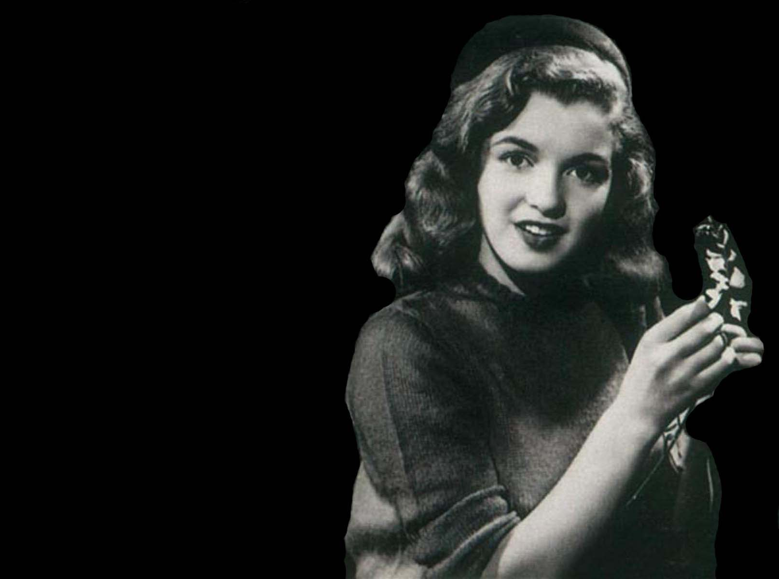
Growing up
After Norma's sixteenth birthday, her foster parents had to move from California. To avoid an orphanage or a new foster home, Norma chose to get married. On June 19, 1942, Norma married James Dougherty, but the marriage would all but end when he joined the U.S. Merchant Marines in 1943.
Her difficult childhood and early failed marriage would make Norma Jean a strong and resilient woman,

Slide 5
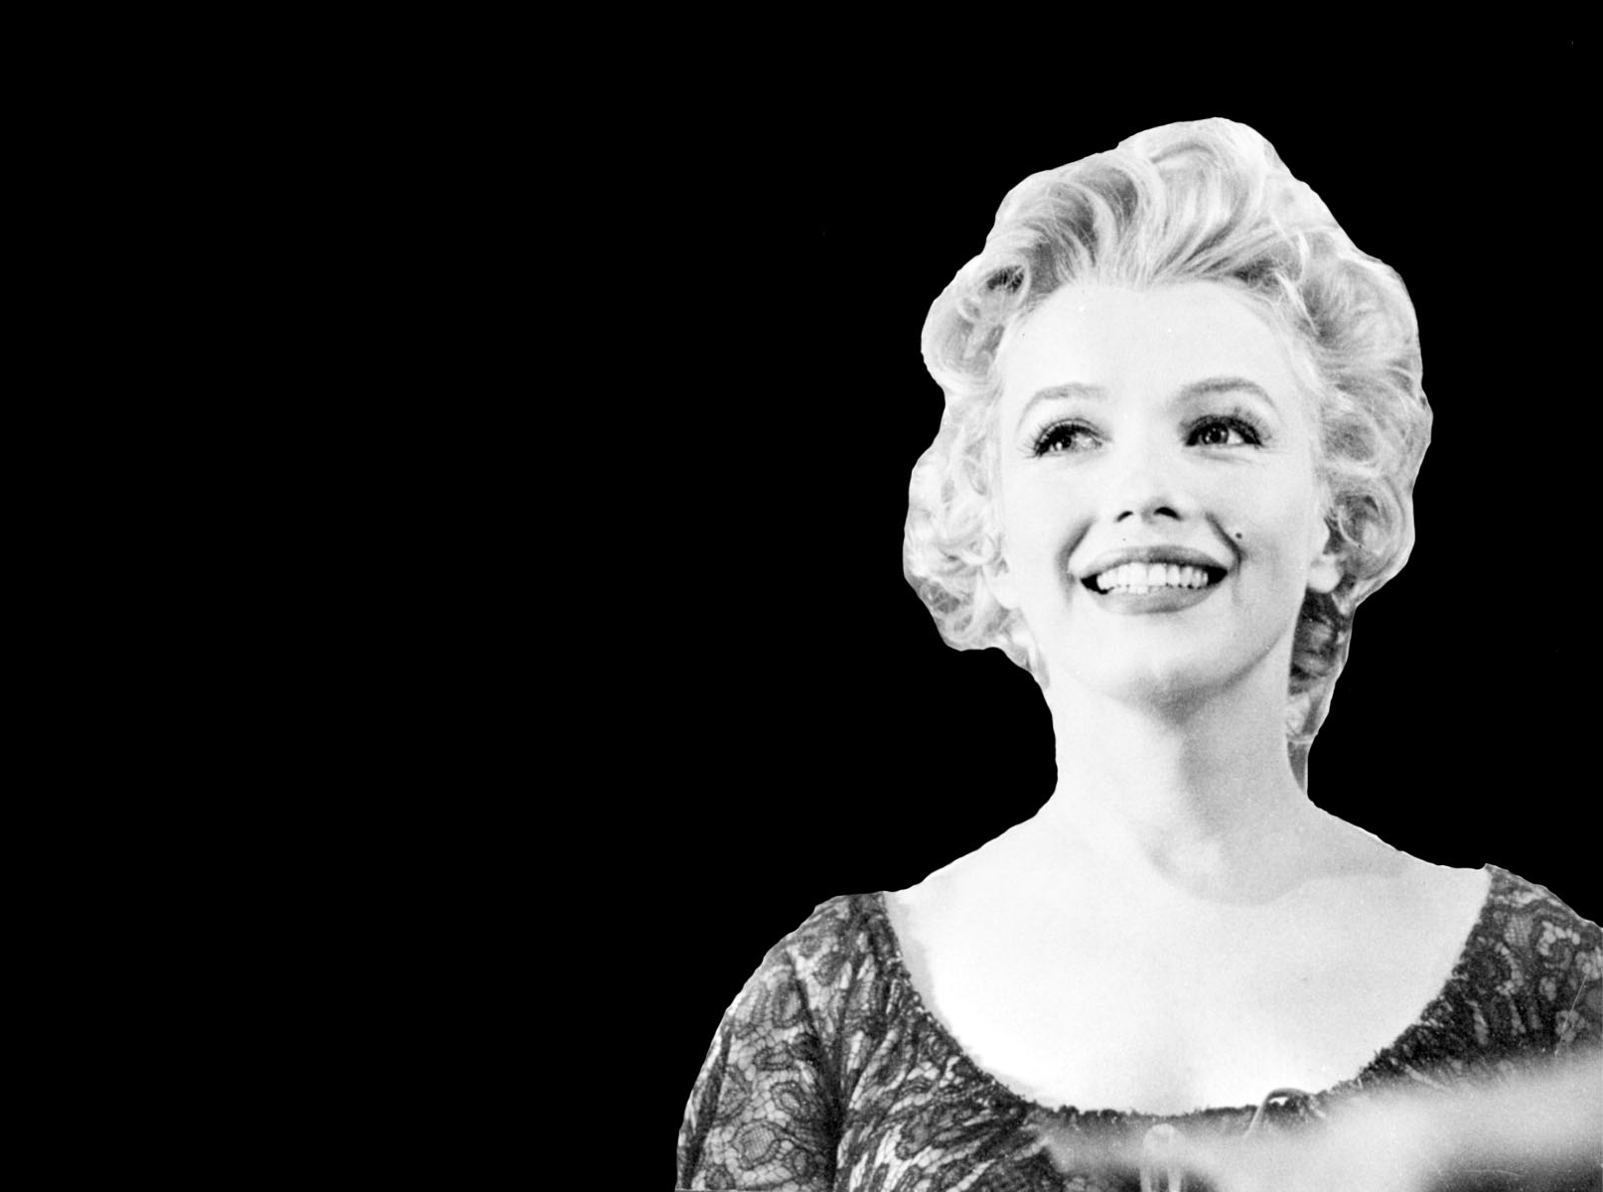
Becoming Marilyn
During World War II (1939–45), Norma Jean worked at the Radio Plane Company in Van Nuys, California, but she was soon discovered by photographers. She enrolled in a three-month modeling course, and in 1946, aware of her considerable charm and the potential it had for a career in films. She then headed for Hollywood, where Ben Lyon, head of casting at Marilyn Monroe.
Twentieth Century Fox, arranged a screen test. On August 26, 1946, she signed a one hundred twenty-five dollar a week, one-year contract with the studio. Ben Lyon was the one who suggested a new name for the young actress—Marilyn Monroe.
In 1952, after an extensive publicity campaign, Monroe appeared in Don't Bother to Knock, Full House, Clash by Night, We're Not Married, Niagara, and Monkey Business. The magazine Photoplay termed her the "most promising actress," and she was earning top dollars for Twentieth Century Fox.

Slide 6
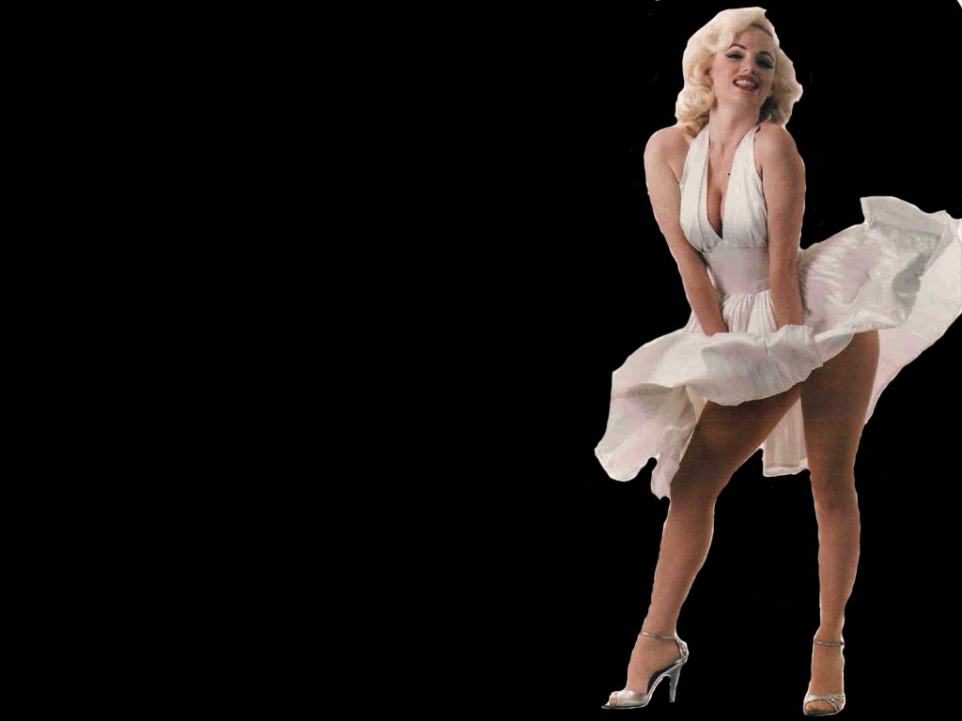
Popularity and personal failures
On January 14, 1954, Monroe married Yankee baseball player Joe Di Maggio (1919–1999). But the pressures created by her billing as a screen sex symbol caused the marriage to fall apart, and the couple divorced on October 27, 1954.
In 1955 Monroe formed her own studio, Marilyn Monroe Productions, and renegotiated a contract with Twentieth Century Fox.
She appeared in Bus Stop in 1956 and married playwright Arthur Miller on July 1, 1956. In 1961 she starred in The Misfits, for which her husband Miller wrote the screenplay.
Sept. 15 marks the anniversary of the day Marilyn Monroe shot the famous "Seven Year Itch" scene that had her wearing an iconic white dress and standing over a New York City subway grate.

Slide 7
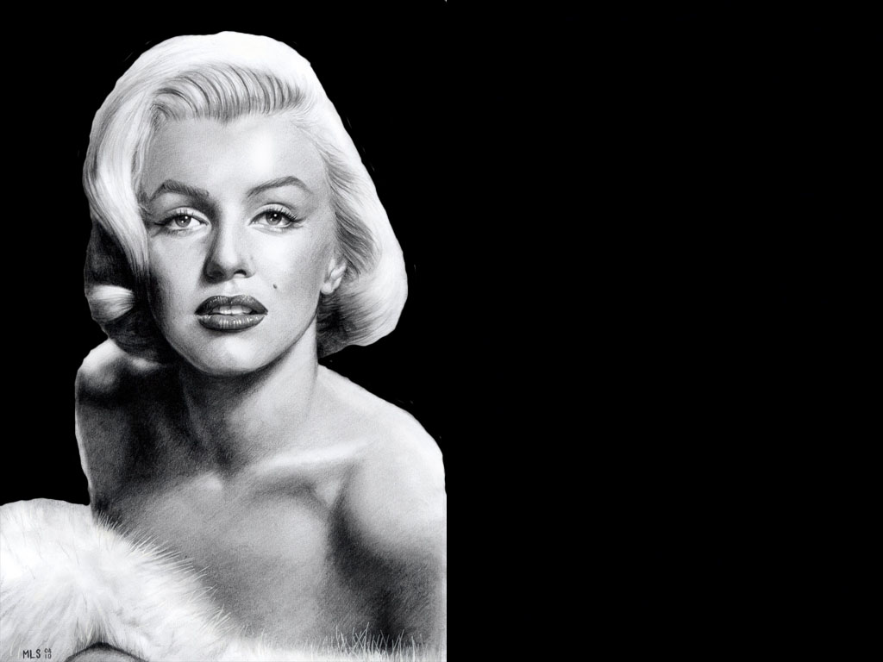
End of a star
The couple was divorced on January 24, 1961, and later that year Monroe entered a New York psychiatric clinic. After her brief hospitalization there she returned to the Fox studio to work on a film, but her erratic (unsteady and irregular) behavior betrayed severe emotional disturbance, and the studio fired her in June 1962.
Marilyn Monroe was found dead in her Los Angeles bungalow on August 5, 1962, an empty bottle of sleeping pills by her side. The exact events surrounding her death are not totally known and have been the subject of many rumors and books over the years. Monroe's image is one of the most lasting and widely seen of any star in the twentieth century—and today. As a subject of biographies, more than twenty books have been written about her short and tragic life.

Slide 8


Slide 9
The End

