Slide 1
Better sleep mean better health
Підготувала
Учениця 10-Б класу
Дулюк Світлана

Slide 2
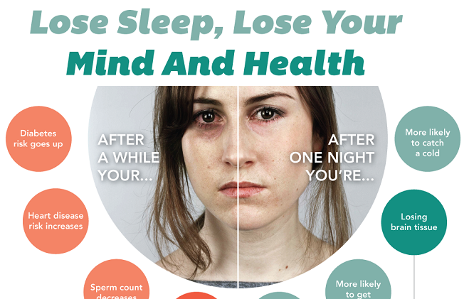

Slide 3

Sleep makes you feel better, but its importance goes way beyond just boosting your mood or banishing under-eye circles.
Adequate sleep is a key part of a healthy lifestyle, and can benefit your heart, weight, mind, and more.

Slide 4
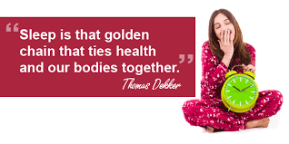
"Sleep used to be kind of ignored, like parking our car in a garage and picking it up in the morning," says David Rapoport, director of the NYU Sleep Disorders Program.

Slide 5

Better health
Getting a good night's sleep won't grant you immunity from disease. But study after study has found a link between insufficient sleep and some serious health problems, such as heart disease, heart attacks, diabetes, and obesity.
In most cases, the health risks from sleep loss only become serious after years.

Slide 6
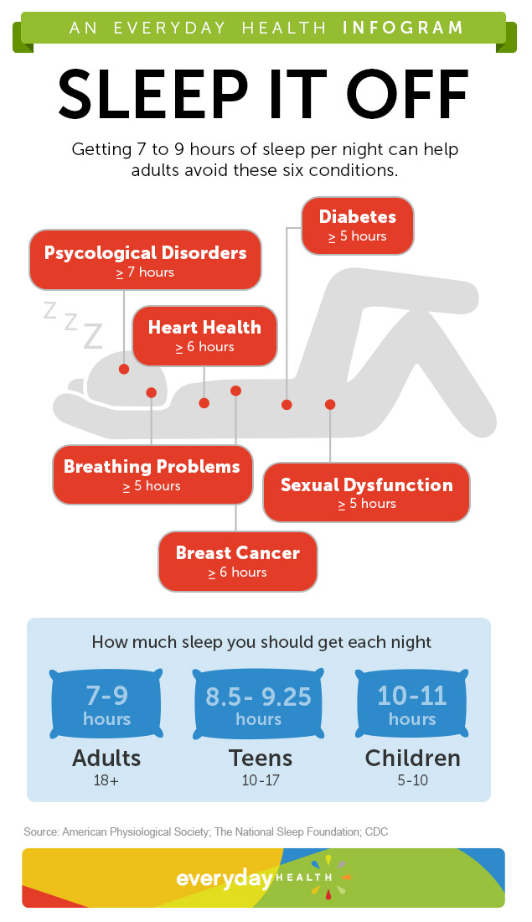
Sleep helps your brain work properly. While you're sleeping, your brain is preparing for the next day. It's forming new pathways to help you learn and remember information.
Studies show that a good night's sleep improves learning. Sleep also helps you pay attention, make decisions, and be creative.

Slide 7
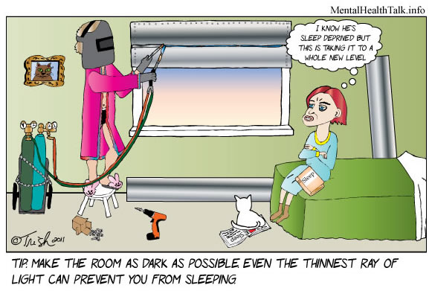
Sleep plays an important role in your physical health. For example, sleep is involved in healing and repair of your heart and blood vessels. Ongoing sleep deficiency is linked to an increased risk of heart disease, kidney disease, high blood pressure, diabetes, and stroke.
Sleep deficiency also increases the risk of obesity. For example, one study of teenagers showed that with each hour of sleep lost, the odds of becoming obese went up. Sleep deficiency increases the risk of obesity in other age groups as well.

Slide 8
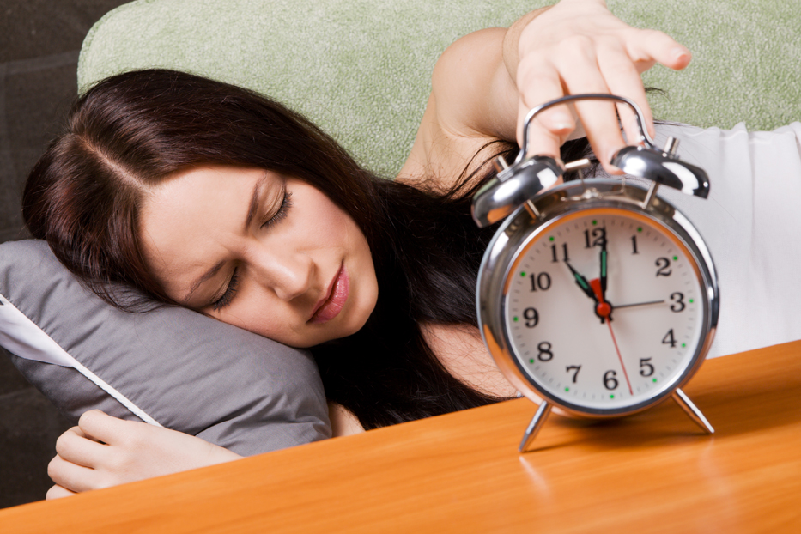
Sleep plays a vital role in good health and well-being throughout your life. Getting enough quality sleep at the right times can help protect your mental health, physical health, quality of life, and safety.
The way you feel while you're awake depends in part on what happens while you're sleeping. During sleep, your body is working to support healthy brain function and maintain your physical health.

