Slide 1
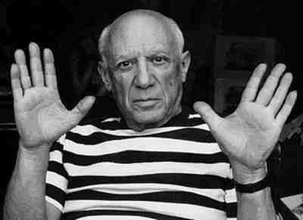
Pablo Picasso
(1881 – 1973)
Painter, Sculptor
By Karin Ocheretyana

Slide 2
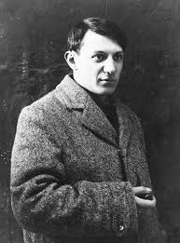
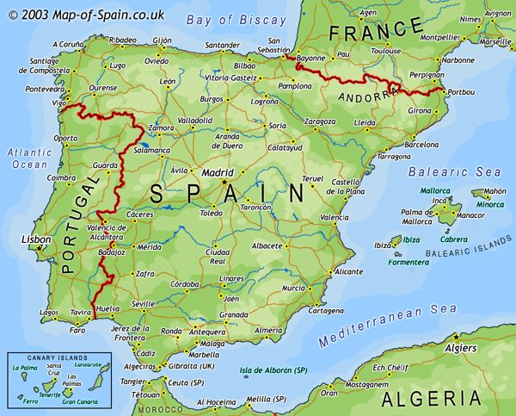
Pablo Diego José Francisco de Paula Juan Nepomuceno María de los Remedios Cipriano de la Santísima Trinidad Ruiz y Picasso a.k.a. Pablo Picasso
Picasso was born October 25, 1881 in Málaga, Spain. His father was a painter and art professor. Pablo showed artistic talent from a very early age – his first word was the spanish for “pencil”. At age 13, his father convinced the school of fine arts to take him on as a student and rented him a room so that he could have somewhere he could be alone to paint.

Slide 3
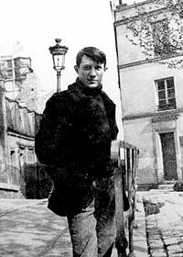
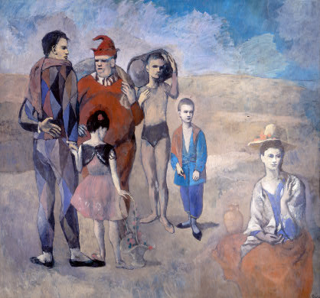
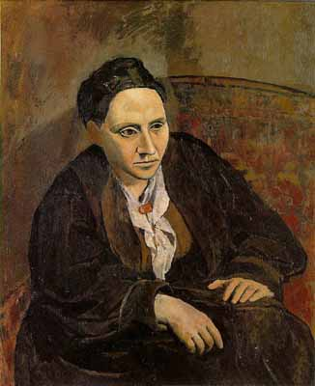
Portrait of Gertrude Stein (1906)
Family of Saltibanques (1905)

Slide 4
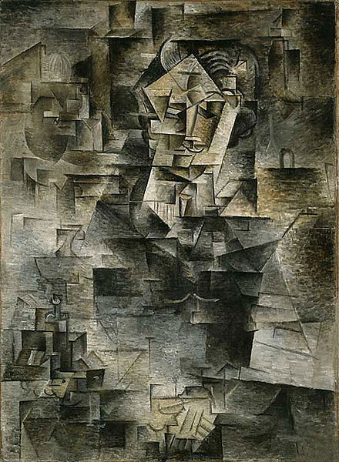
Portrait of Daniel-Henry Kahnweiler (1910) kahnweiler was an art dealer who was an early believer in Picasso’s talent
Picasso lived through World War I, the Spanish Civil War, and World War II, refusing to fight for any side or country. In 1944, he joined the communist party, although he had some differences with them and was never an ardent communist.
Picasso had many relationships over his lifetime with different women. He married twice and had four children with three different women.

Slide 5
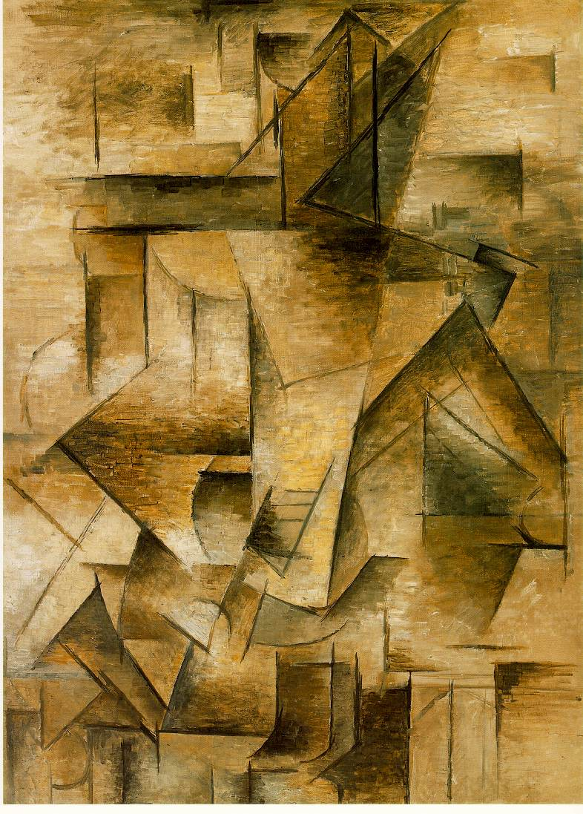
Along with fellow painter George Braque, Picasso pioneered a new style of painting called “Cubism”. The artists analyzed subjects and broke them down into the shapes that composed them. Sometimes they cut up pieces of newspaper or wallpaper and glued them onto the paintings. This was the first time collage was used in fine art.
The Guitar painter (1910)

Slide 6
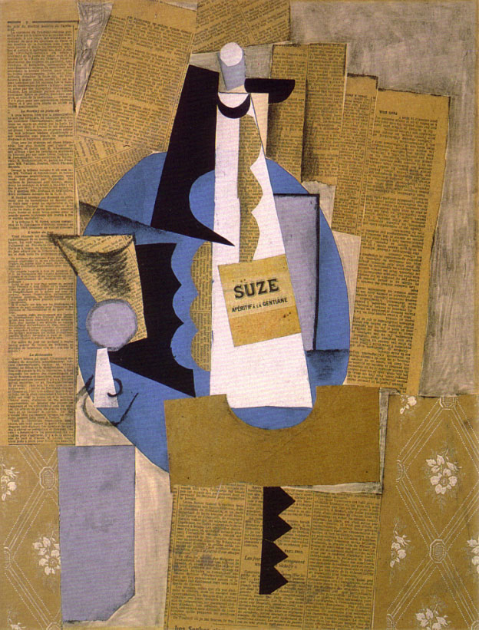
Glass and bottle of Suze (1912)

Slide 7
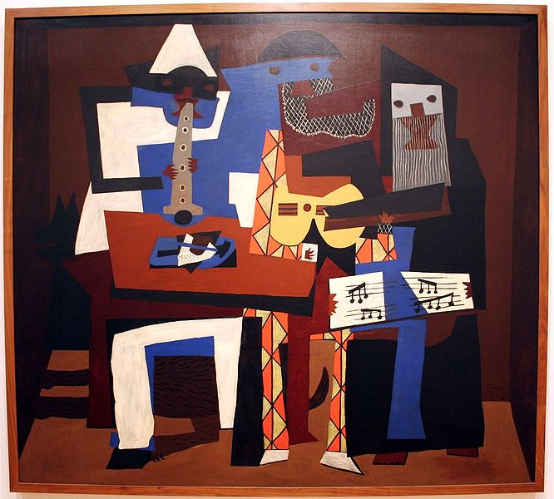
Three musicians (1921)

Slide 8
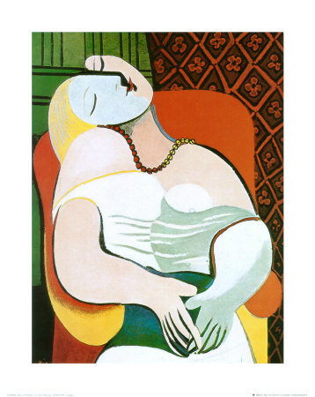
The Dream (1932)

Slide 9
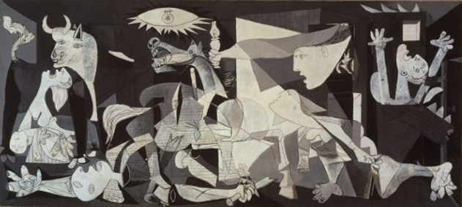
Guernica (1937)
One of Picasso’s most famous paintings, this one represents the German bombing of Guernica during the Spanish Civil War. It was a statement about the brutality and hopelessness of war.

Slide 10
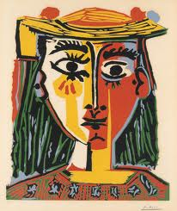
Woman in a Hat with Pompoms and a Printed Blouse, 1962

Slide 11
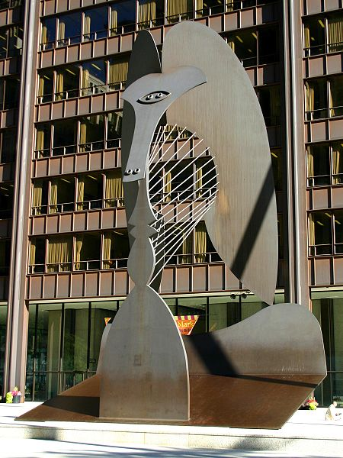
Picasso was also a sculptor. In the mid 1960s, he was hired to create a huge (50 foot high) public sculpture
to be built in Chicago.
He was excited about the project, designing something very ambiguous and controversial. What it is meant to represent, no one really knows, is it a bird, a horse, a woman, or something abstract? Picasso refused the $100,000 fee he was offered, instead donating the sculpture to the people of Chicago.
Chicago Picasso (1967)

Slide 12
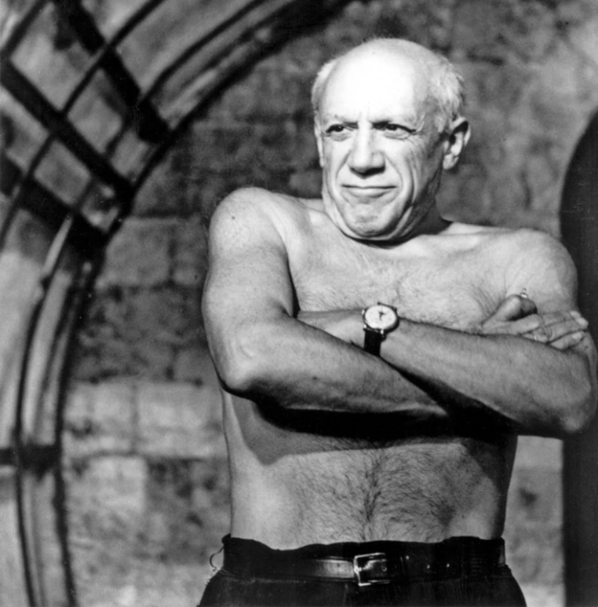
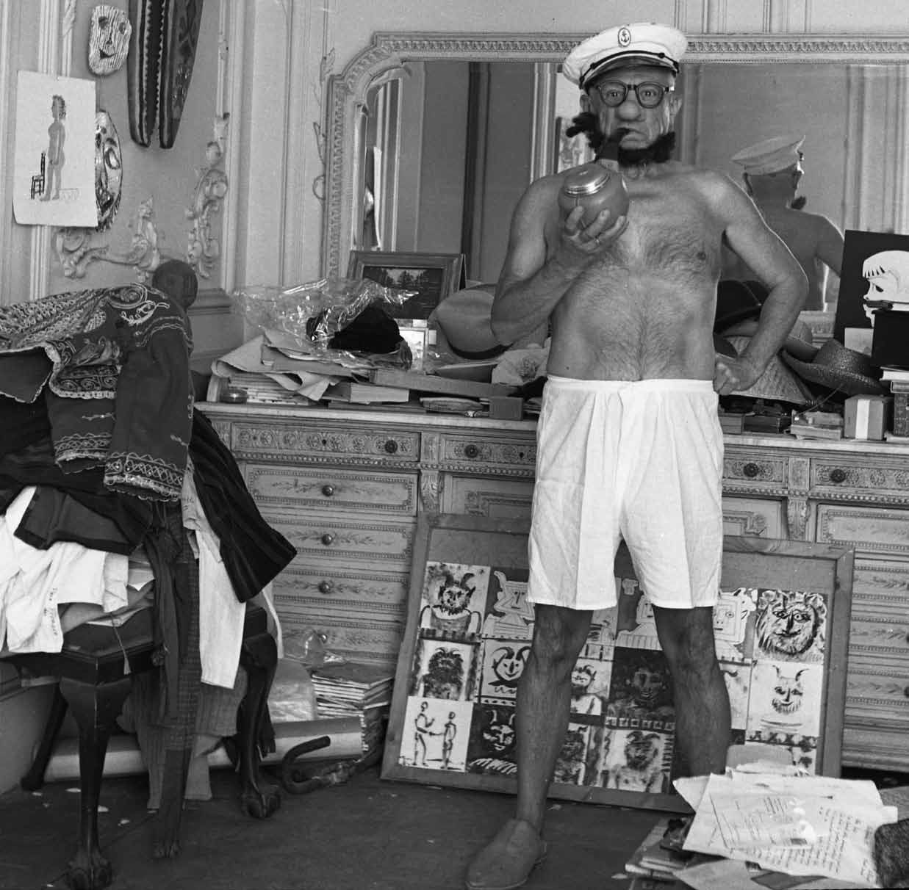
Picasso was hugely successful during his long career, earning enough money to live very well and being a celebrity. In addition to his enormous body of work he also had a film career, appearing in several films. He always played himself.
Pablo Picasso died on April 8, 1973 in Mougins, France while he and his wife were having a dinner party. His last words were “Drink to me, drink to my health, you know I can’t drink any more.” He was buried in France on a piece of private property he and his wife owned.

Slide 13
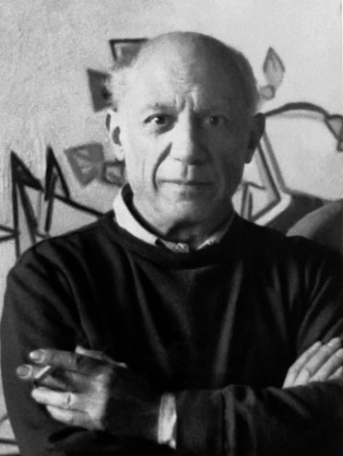
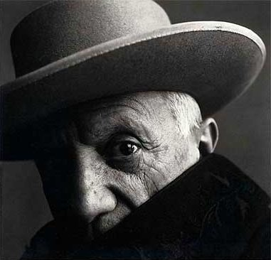
“There are painters who transform the sun to a yellow spot, but there are others who with the help of their art and their intelligence, transform a yellow spot into the sun”
– Pablo Picasso

Slide 14
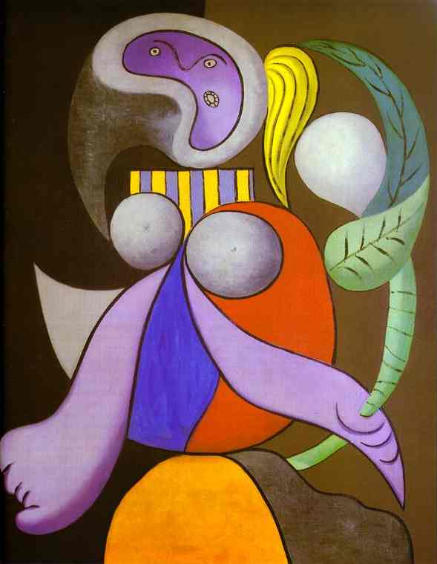
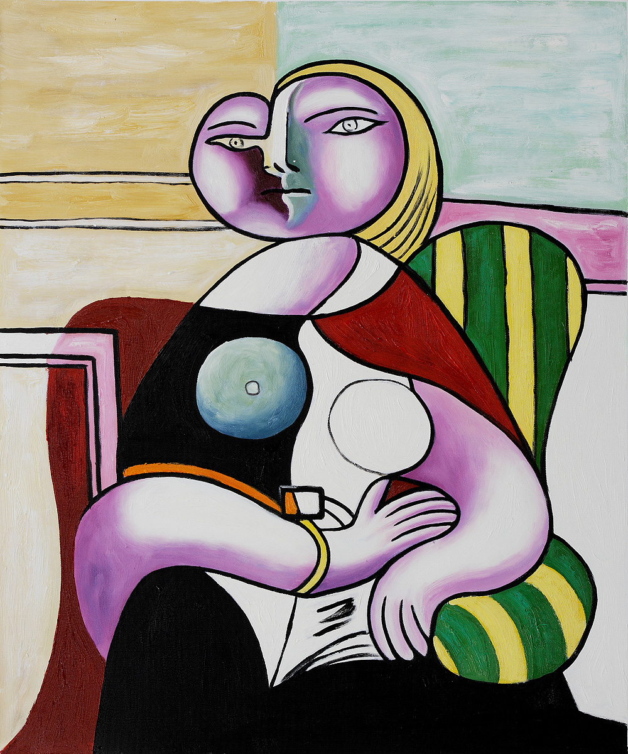

Slide 15
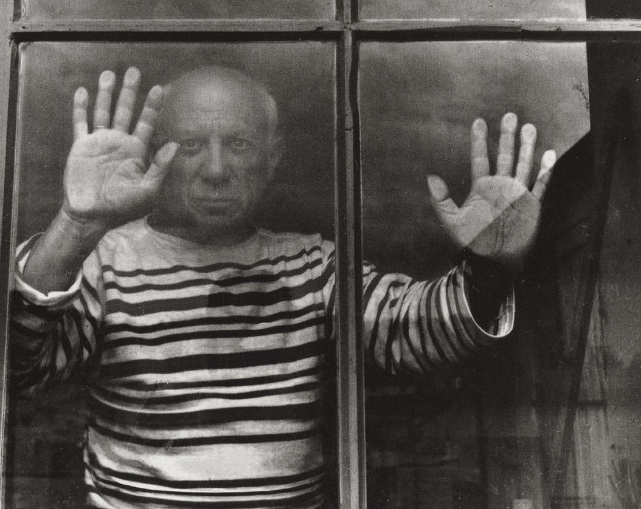

Slide 16
THE END

