Slide 1
How I imagine my school leaving exams
By Daria Posokhova

Slide 2
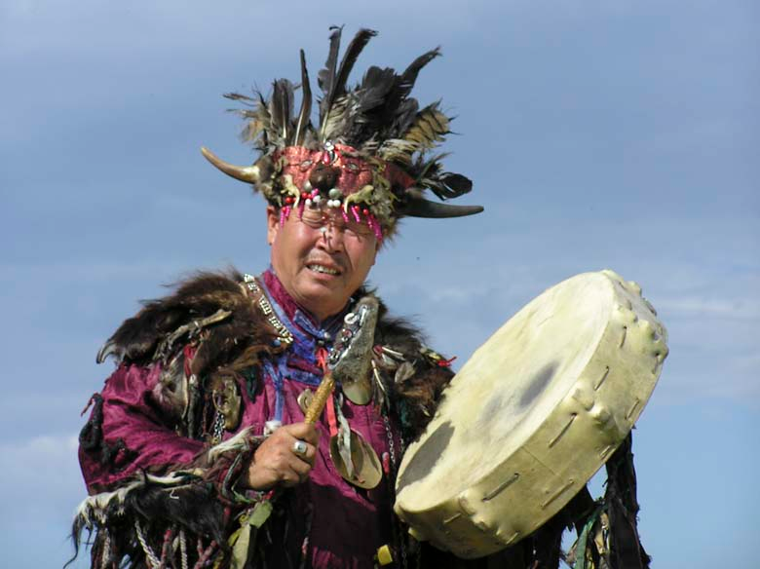
Preparing for the exams

Slide 3
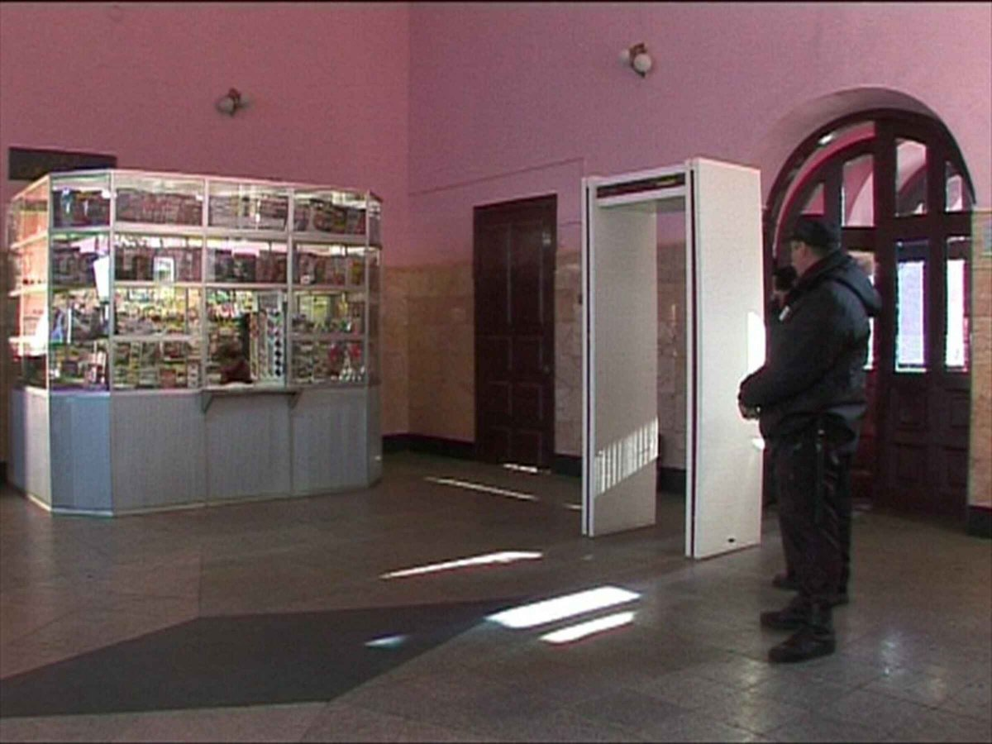
Before the exam

Slide 4
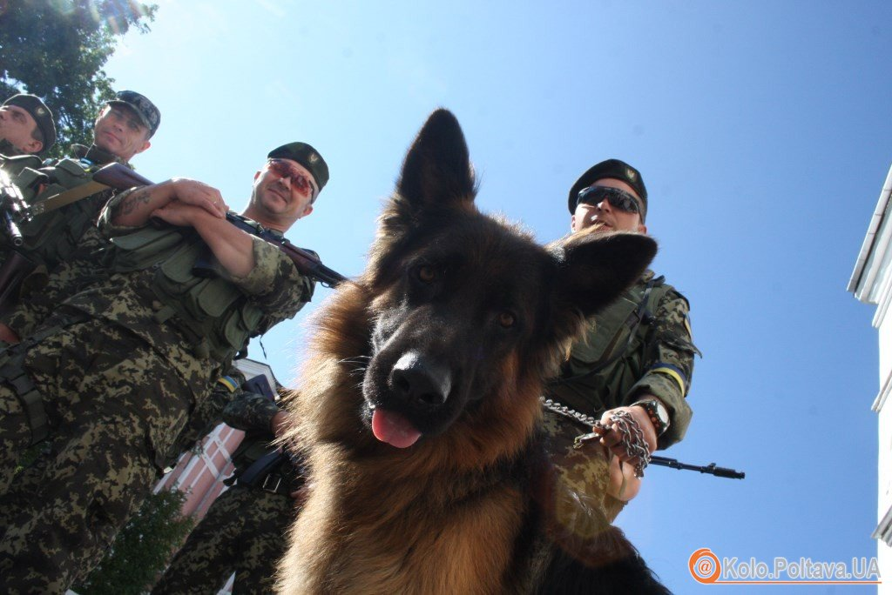
Teachers during the exam

Slide 5
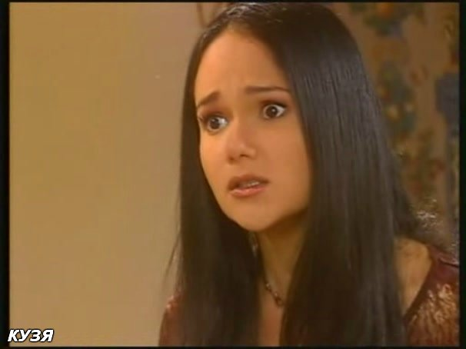
Me, when I look through tasks

Slide 6

Me after I know about the results

Slide 7
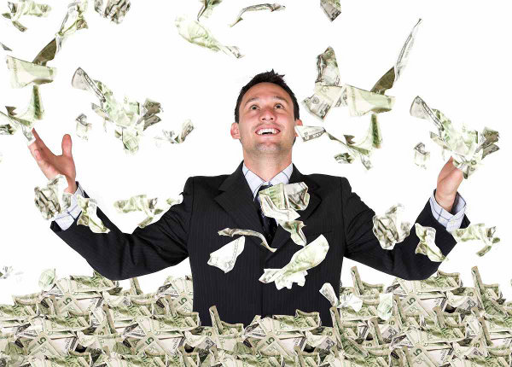
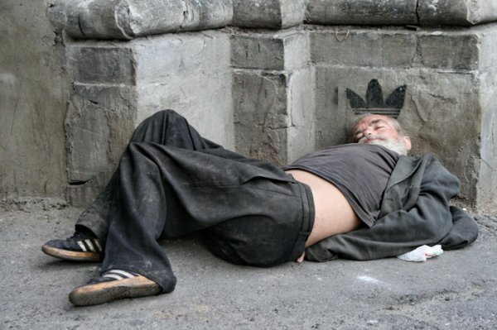
Happy end

