Slide 1
Landscape paintings

Slide 2
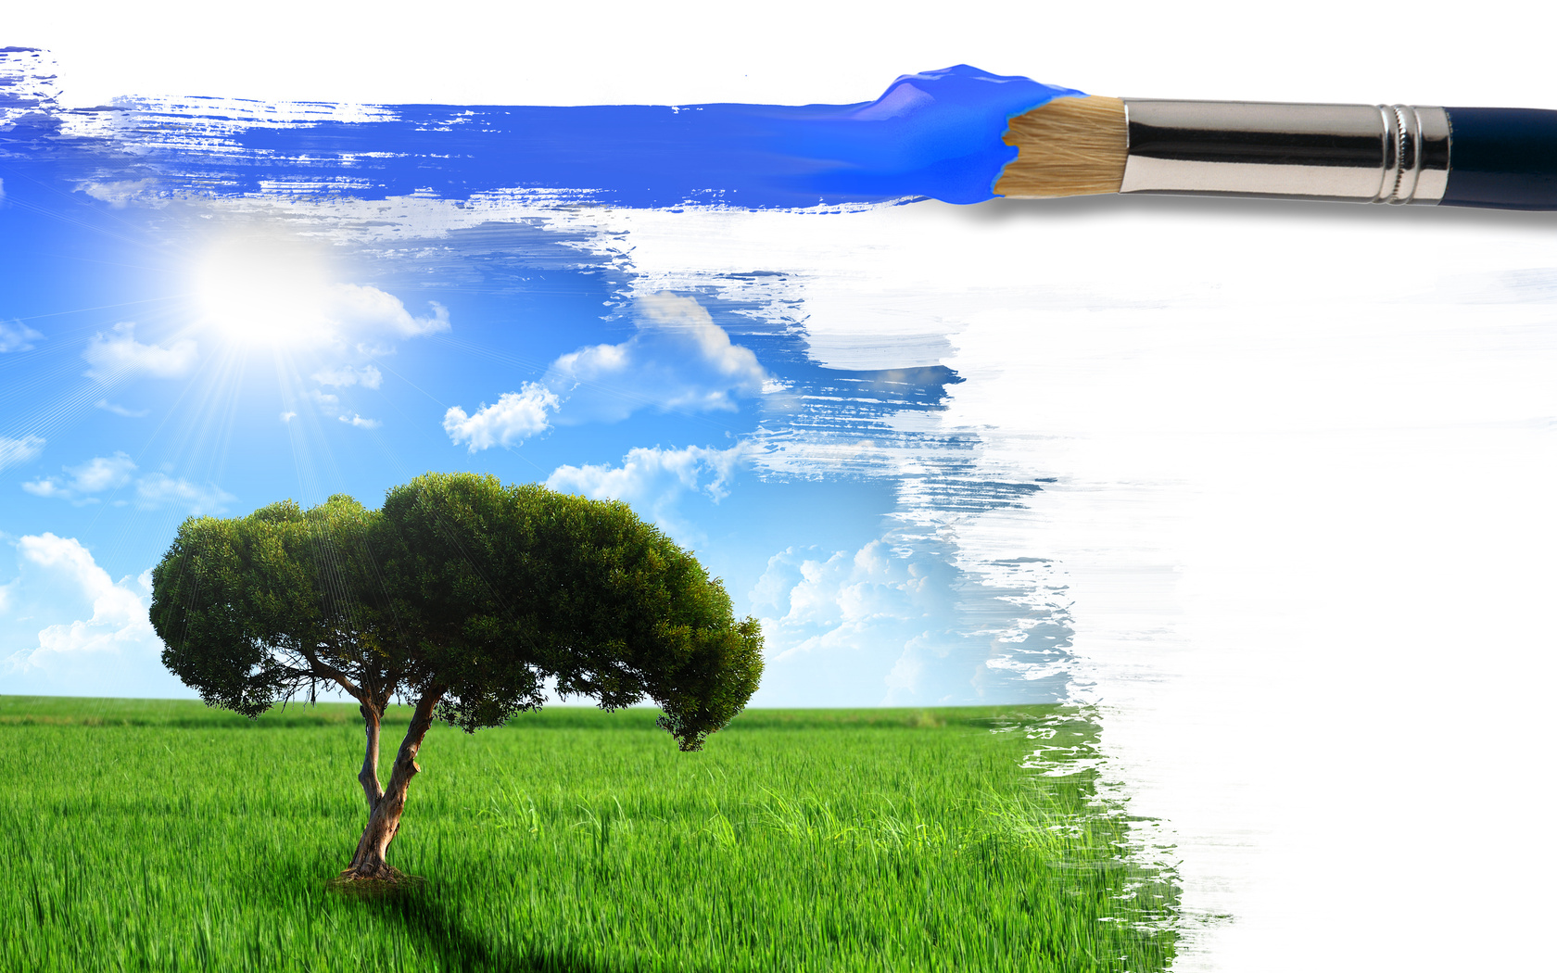
Our life seems to be impossible without art. It really occupies an important part in our daily life. Also it makes our life brighter, richer and more intellectual. So, art units different people, influences the development of personality, makes our world richer, feels our soul with different feelings.

Slide 3
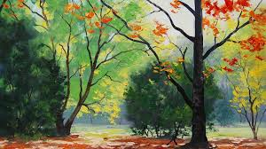
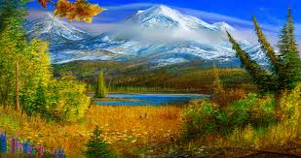
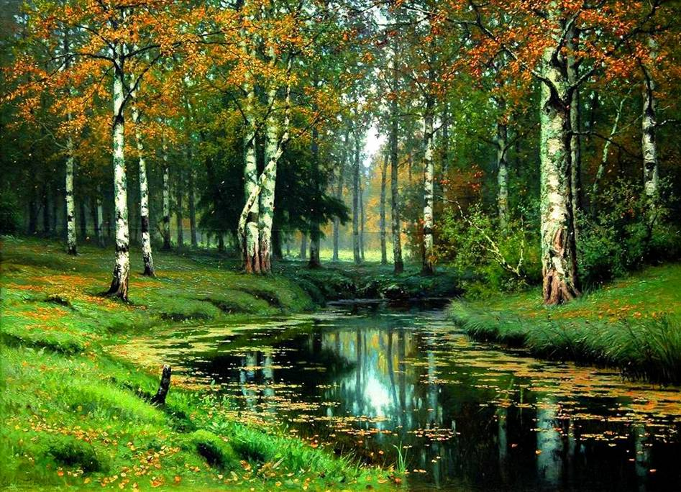
Landscape art is the depiction in art of landscapes, natural scenery such as mountains, valleys, trees, rivers, and forests.

Slide 4
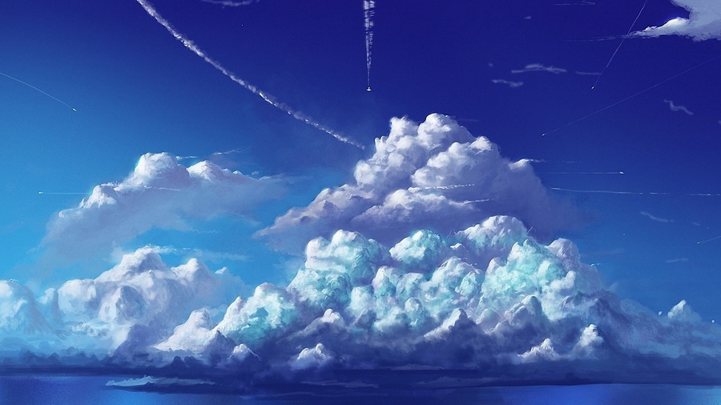
Sky is almost always included in the view, and weather is often an element of the composition.

Slide 5
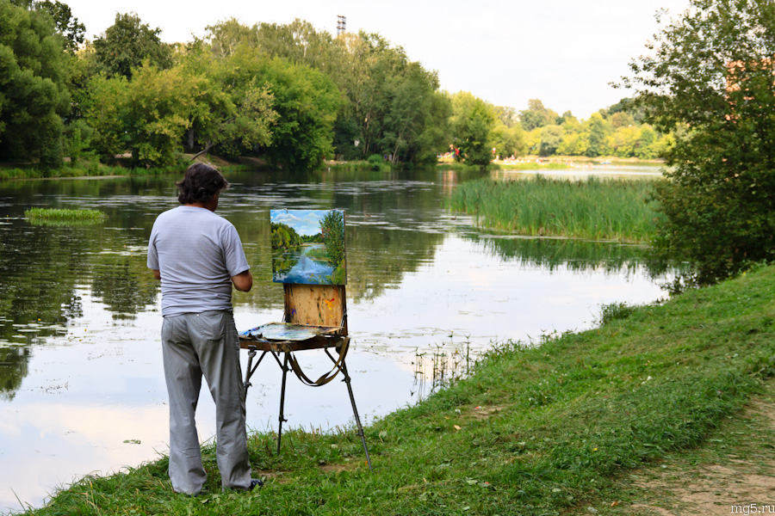
Painters depict a real or an idealized scene.Many painters focus their attention on the atmospheric effects ,dissolved into a haze of colour and light, to express their feelings for nature’s grandeur and immensities.

Slide 6
Famous landscape painters

Slide 7
16th century

Slide 8
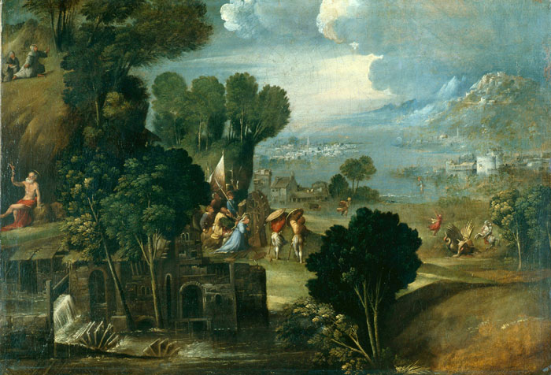
Dosso Dossi (Italy)
“Landscape with scenes from the life of the Holy”

Slide 9
17th Century

Slide 10
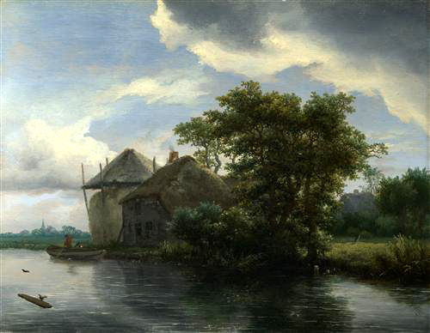
Jacob van Ruisdael
“A Bleaching Ground in a Hollow by a Cottage”

Slide 11
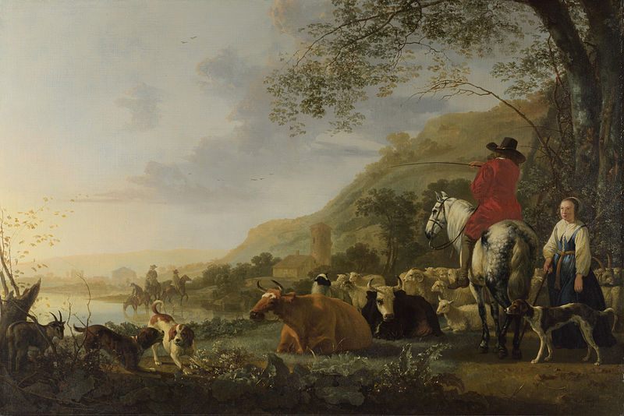
Albert Jacobs Cape
“A Hilly Landscape with Figure”

Slide 12
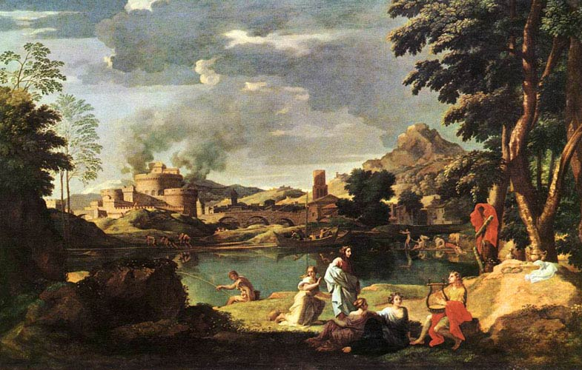
Nicolas Poussin
“Landscape with Orpheus and Eurydice”

Slide 13
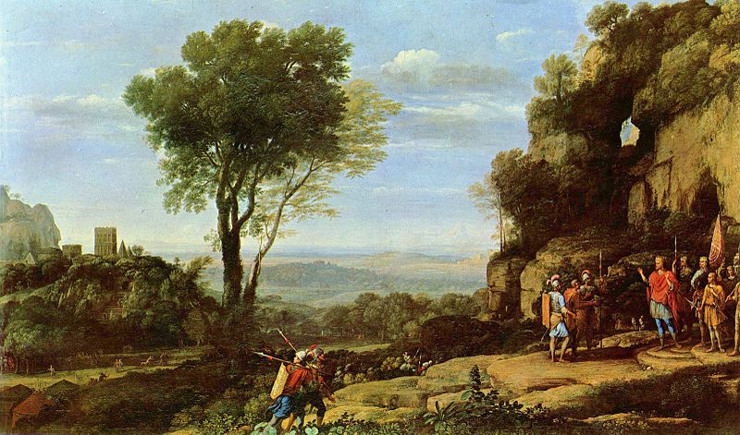
Claude Lorrain
“Landscape with David at the Cave of Adullam”

Slide 14
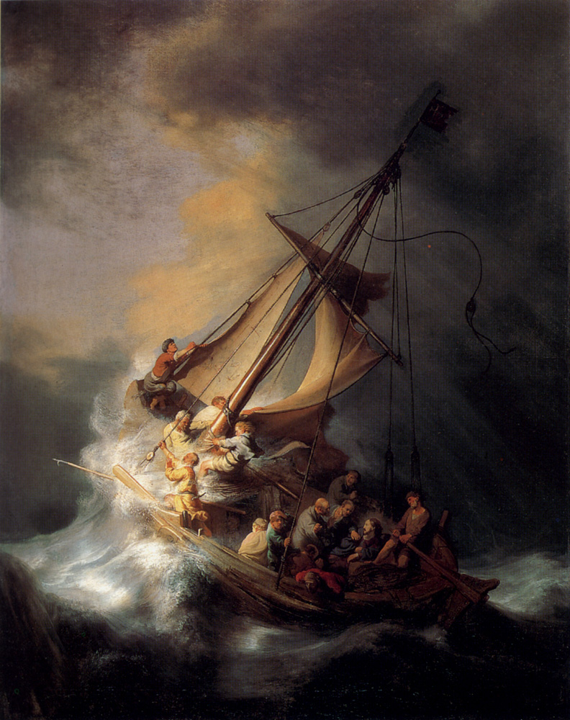
Rembrandt
"Christ in the storm on the Sea of ​​Galilee"

Slide 15
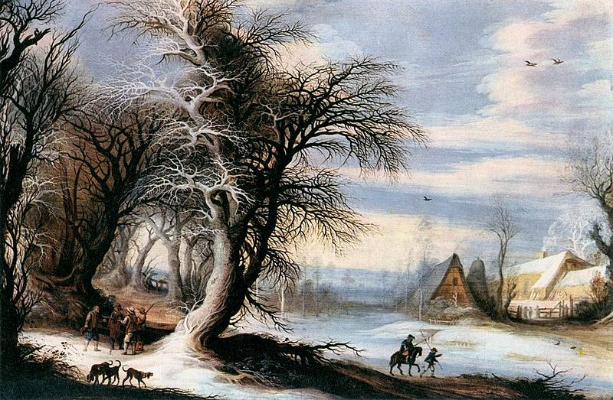
Heysbreht Leytens
“Winter Landscape”

Slide 16
18th century

Slide 17
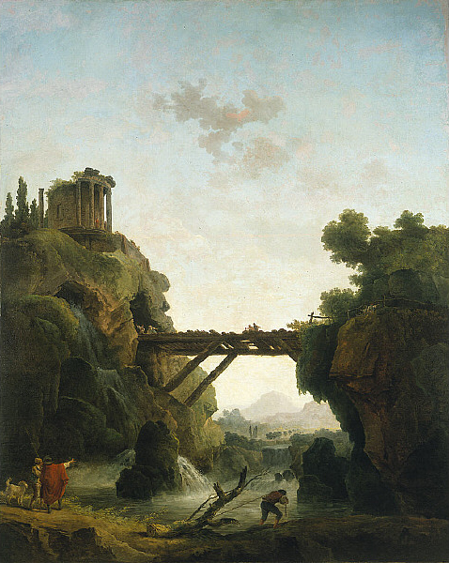
Hubert Robert
“Fantastic View of Tivoli”

Slide 18
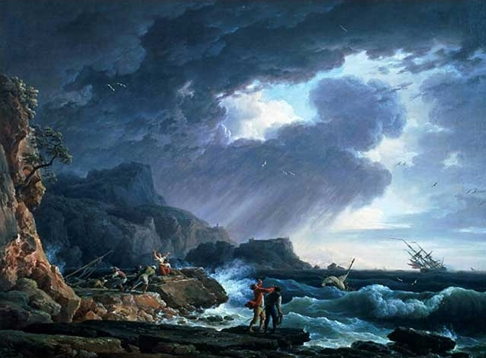
Claude Vernet
“A Seastorm”

Slide 19
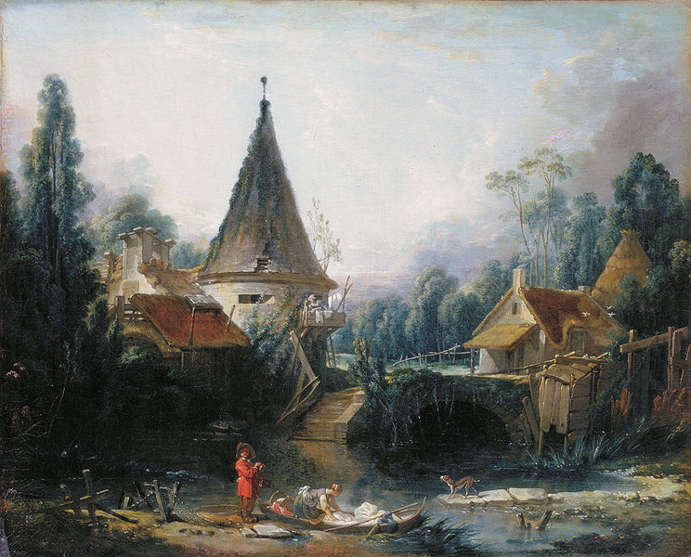
Francois Boucher
“Landscape near Beauvais”

Slide 20
19th century

Slide 21
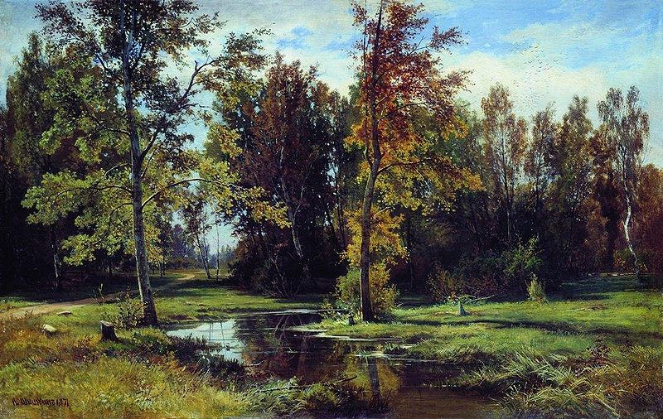
Ivan Shishkin
“Birch Forest”

Slide 22
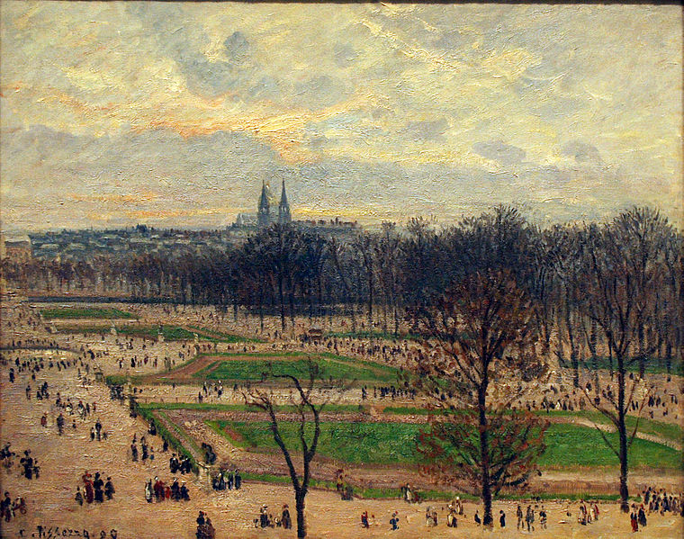
Camille Pissarro
“The Garden of the Tuileries on a Winter Afternoon”

Slide 23
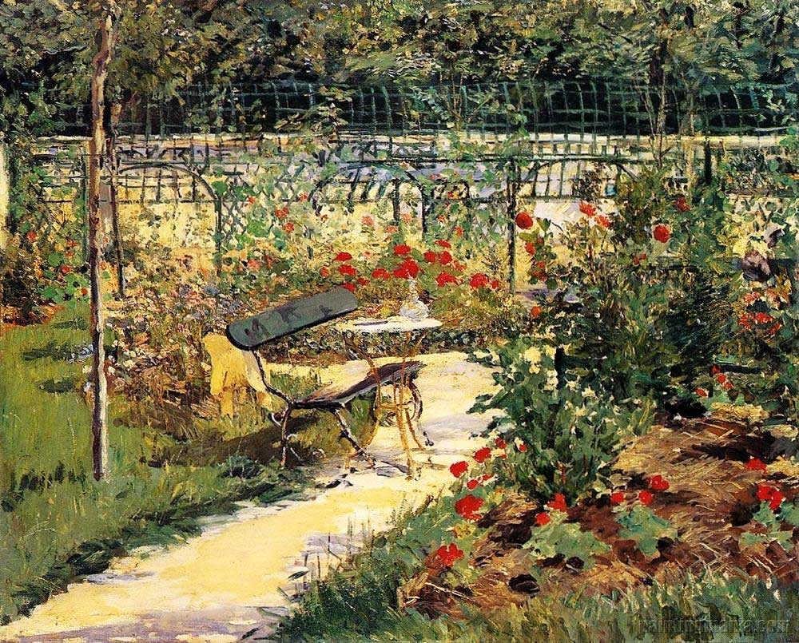
Édouard Manet
“My Garden”

Slide 24
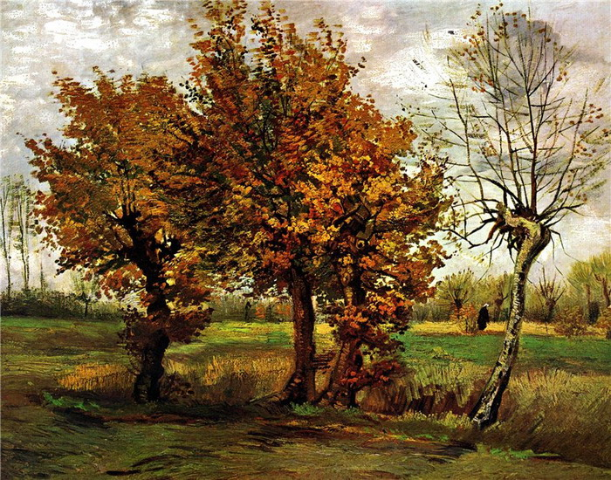
Van Gogh
“Autumn Landscape with Four Trees “

Slide 25
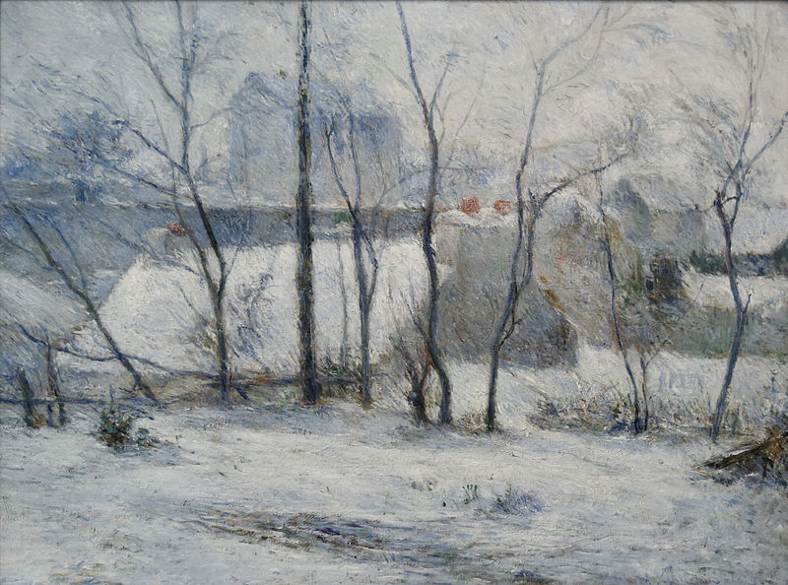
Paul Gauguin
“Winter Landscape”

Slide 26
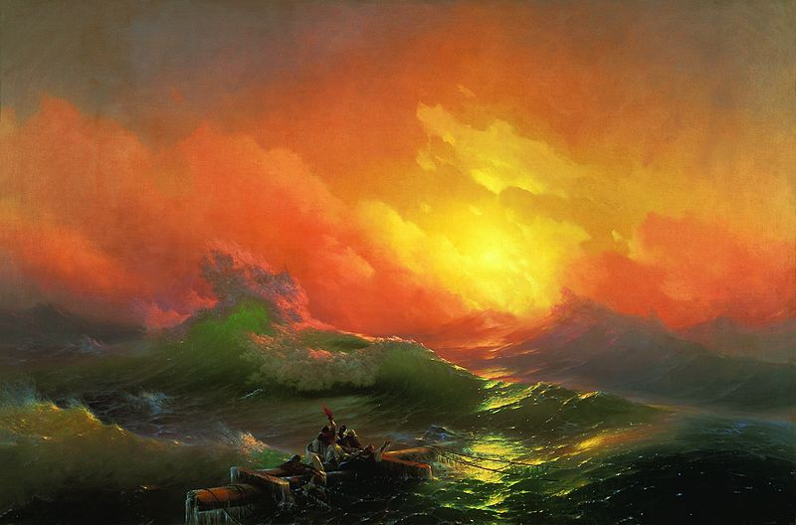
Ivan Aivazovsky
“The Ninth Wave”

Slide 27
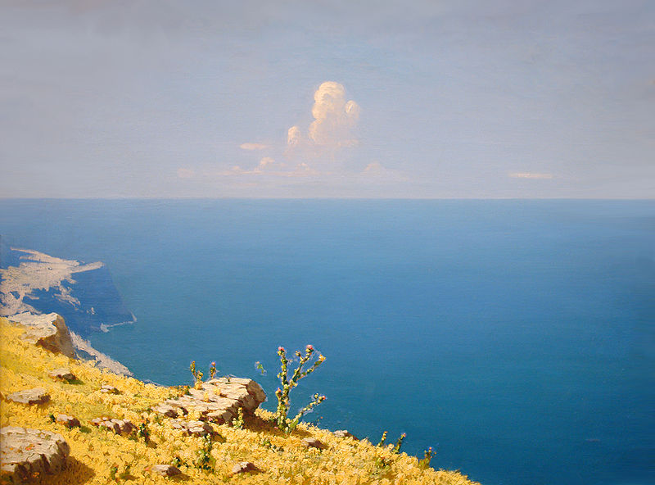
Arkhyp Kuindzhi
Sea. Crimea.

Slide 28
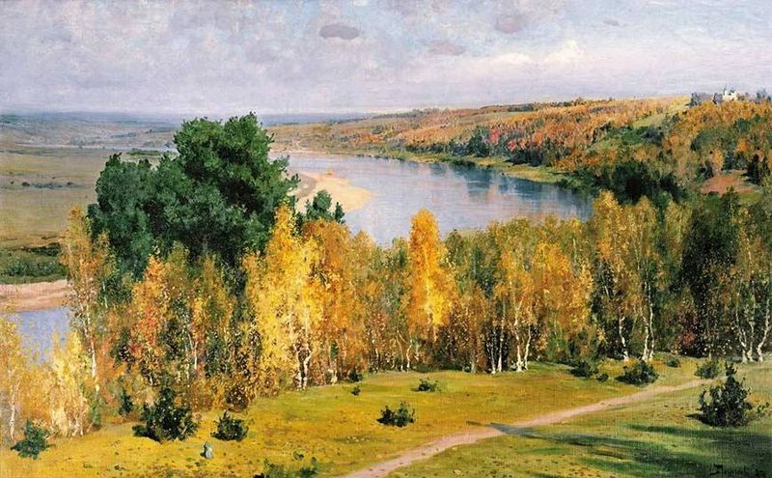
Vasily Polenov
"Indian summer"

Slide 29
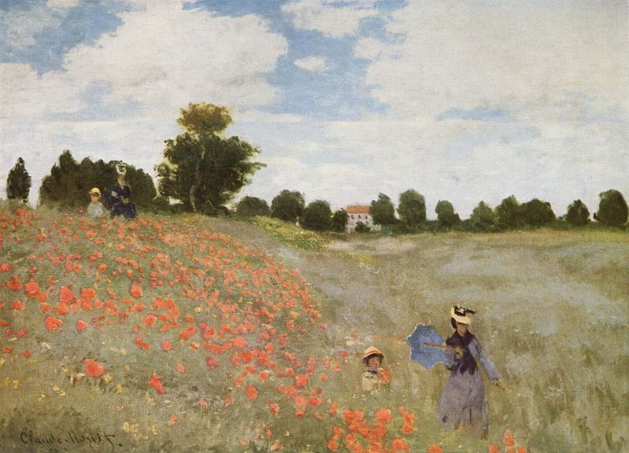
Claude Monet
“Poppies”

Slide 30
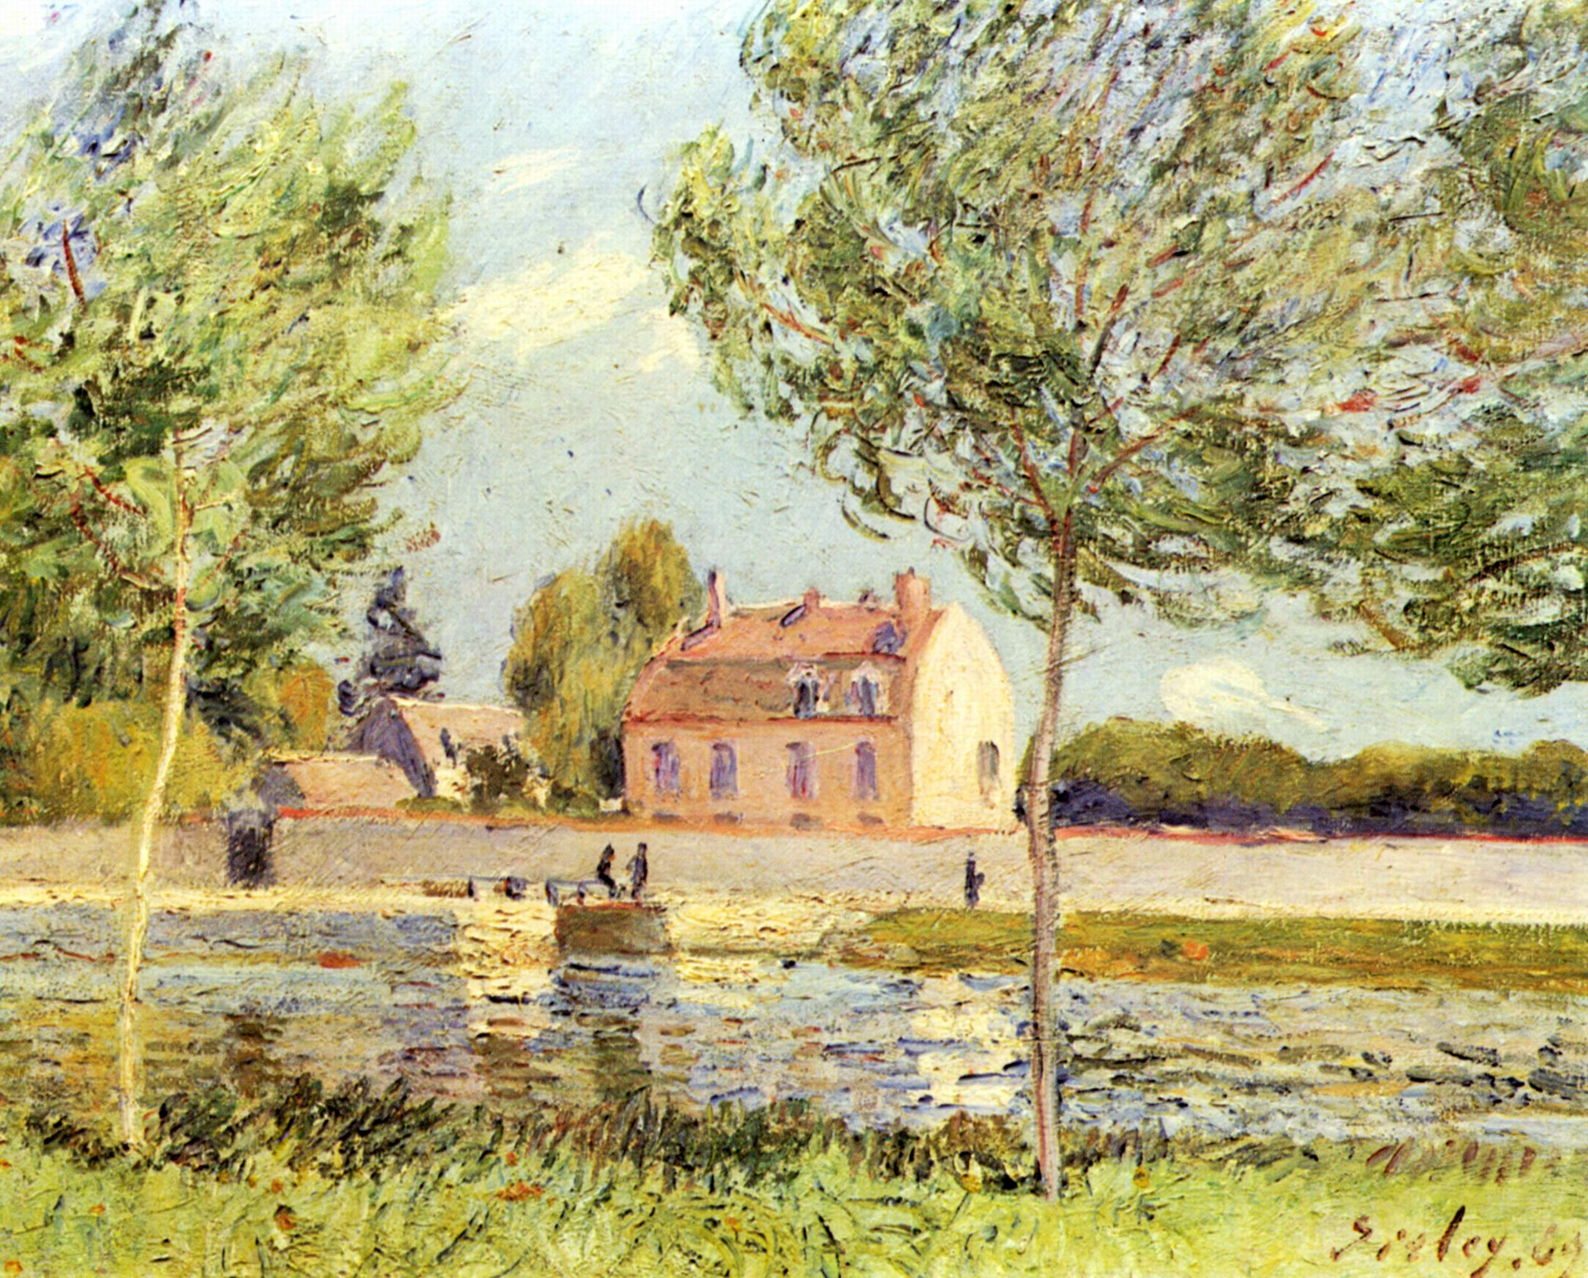
Alfred Sisley
“Houses on the banks of the Loing”

Slide 31
20th century

Slide 32
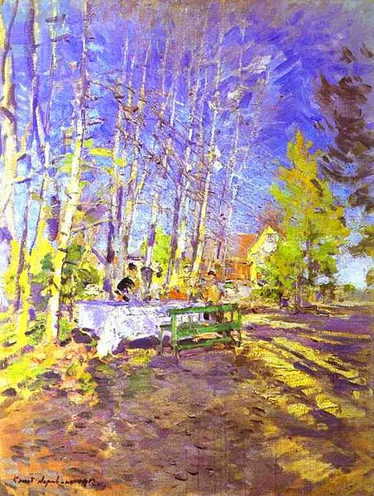
Konstantin Korovin
“Spring”

Slide 33
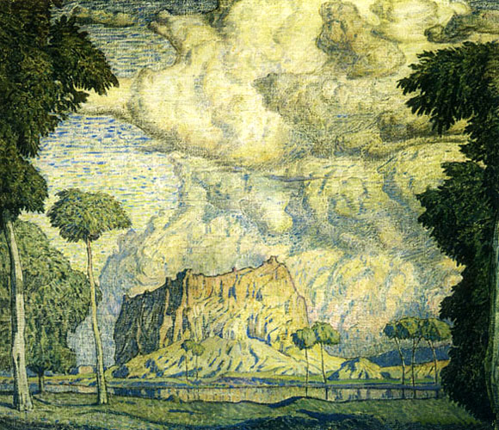
Konstantin Bohaievsky
“Tropical Landscape”

Slide 34
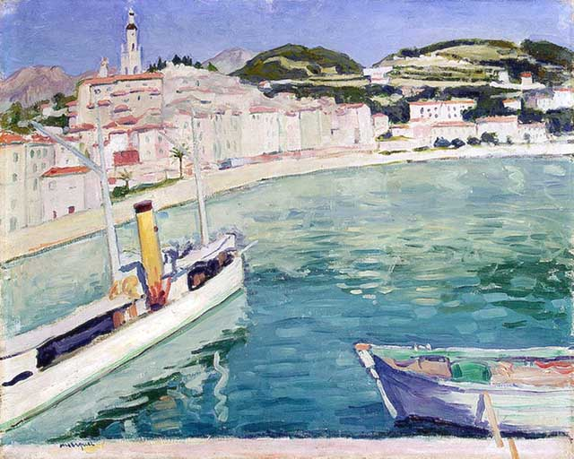
Albert Marquet
“Harbor in Menton”

Slide 35
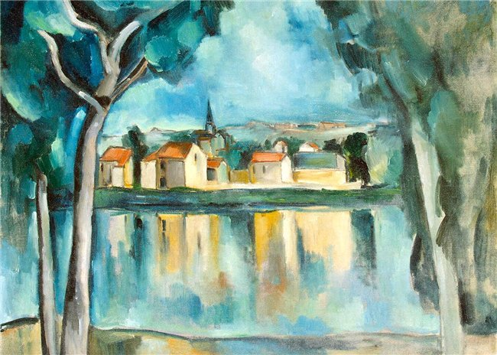
Maurice Vlaminck
“Over Water”

Slide 36
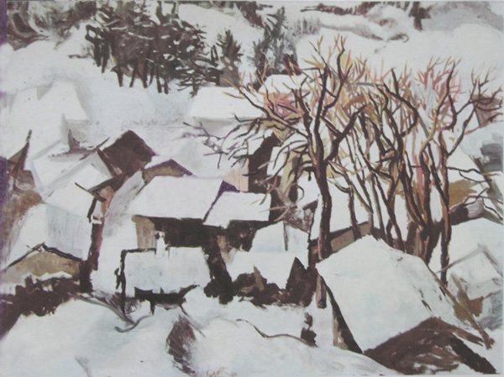
Renato Guttuso
“Winter Landscape in Lombardy”

Slide 37
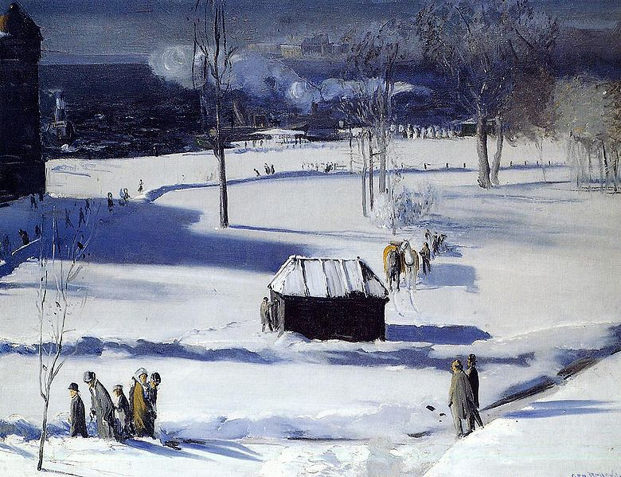
George Bellows
“Blue Snow”

Slide 38
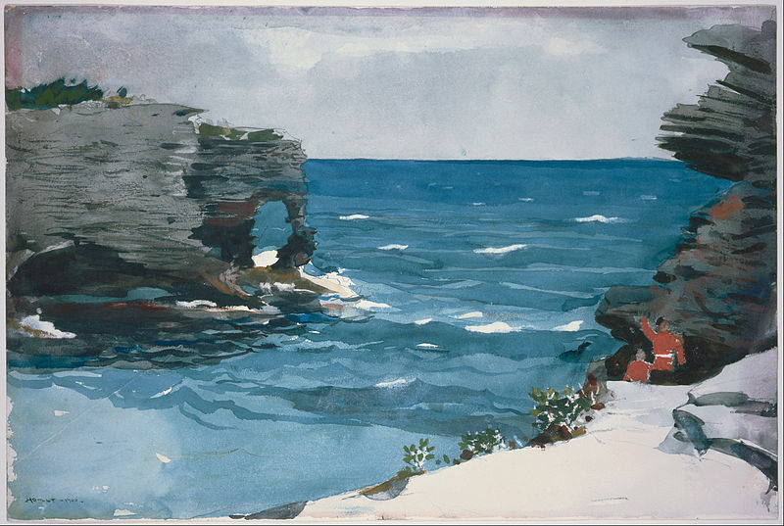
Winslow Homer
“Rocky Shore”

Slide 39
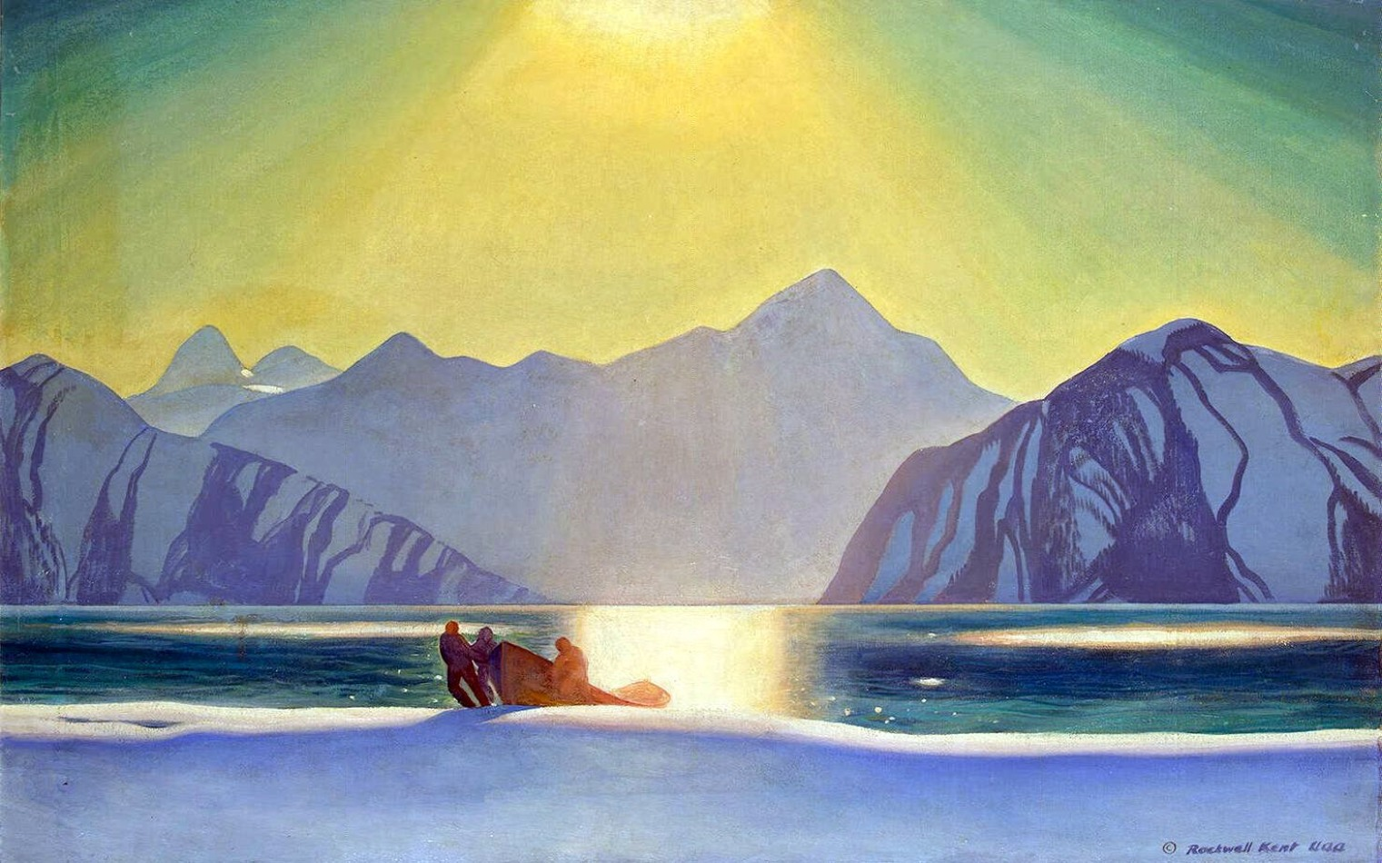
Rockwell Kent
“Sunny Shine”

