Slide 1
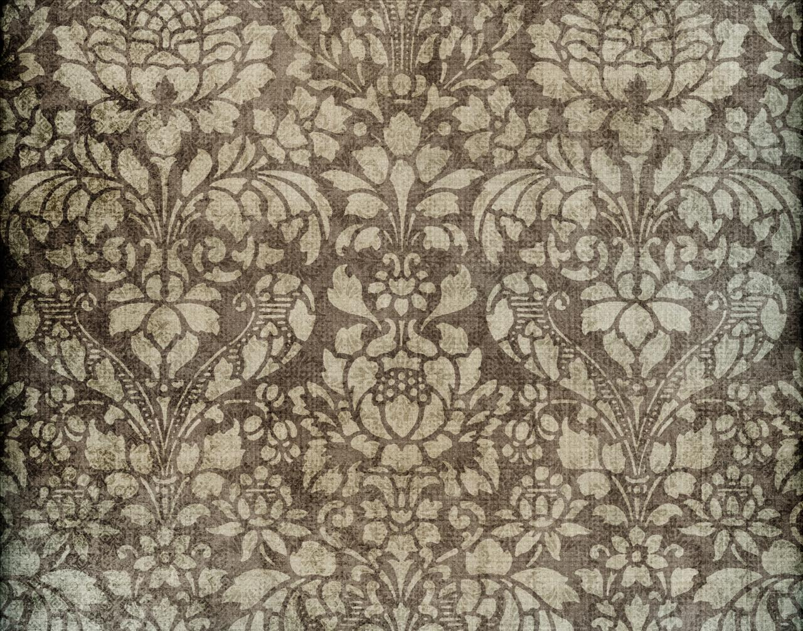

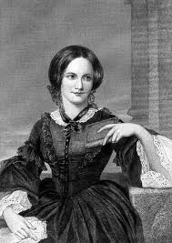
Charlotte Bronte

Slide 2

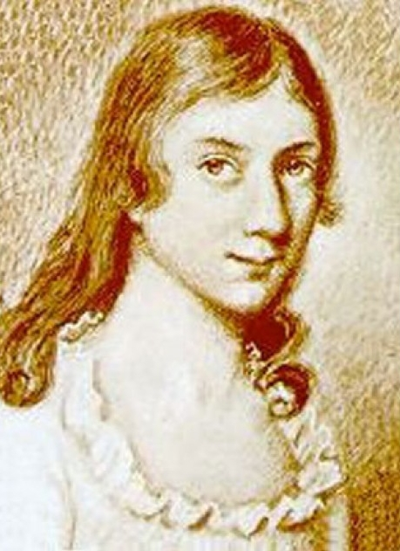
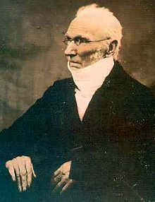
Charlotte was born in Thornton, Yorkshire in 1816, the third of six children, to Maria (née Branwell) and Patrick Brontë , an Irish Anglican clergyman. In 1820 her family moved a few miles to the village of Haworth, where her father had been appointed Perpetual curate of St Michael and All Angels Church.

Slide 3
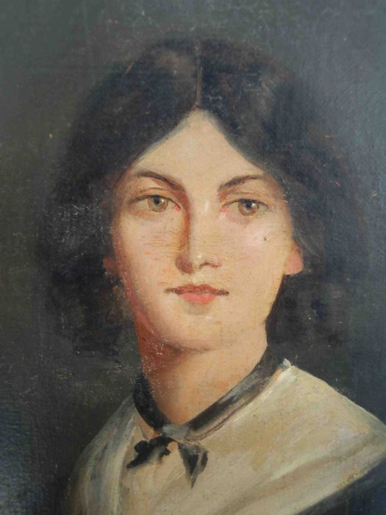
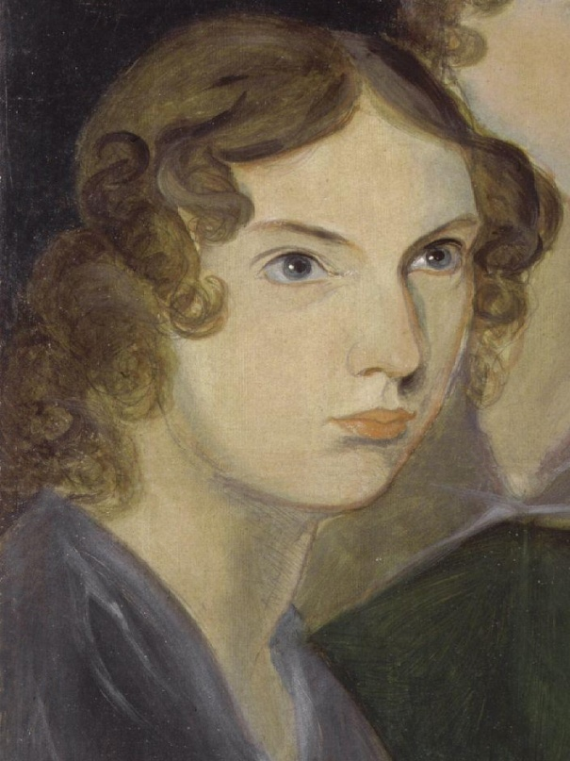
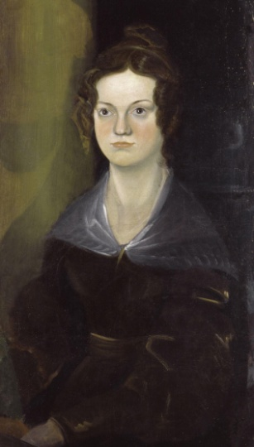
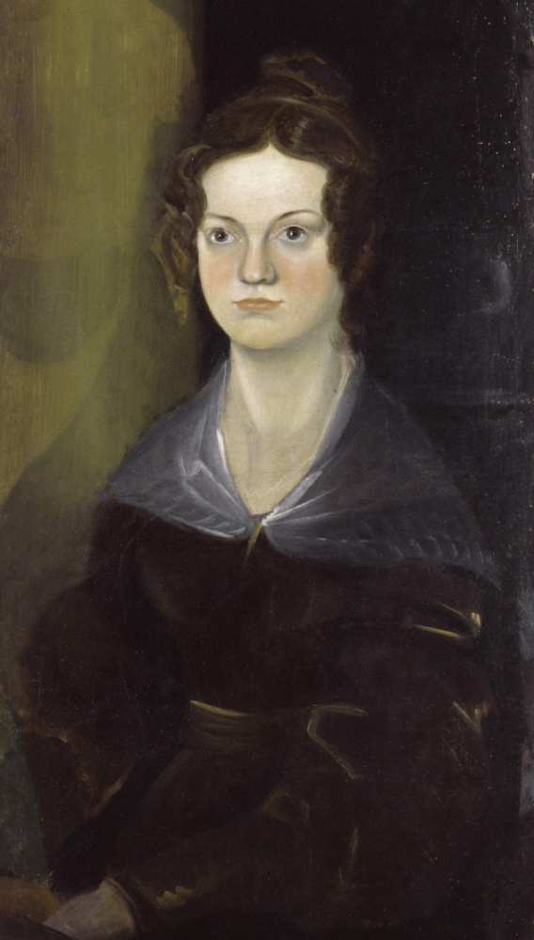
Emily Bronte
Ann Bronte
Charlotte Bronte

Slide 4
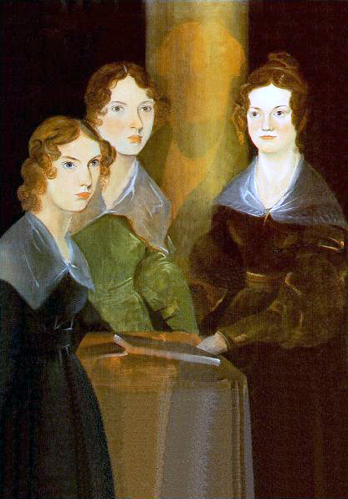
Their mother died of cancer on 15 September 1821, leaving five daughters, Maria, Elizabeth, Charlotte, Emily, Anne and a son Branwell to be taken care of by her sister, Elizabeth Branwell.
In August 1824, Patrick Brontë sent Charlotte, Emily, Maria and Elizabeth to the Clergy Daughters' School at Cowan Bridge in Lancashire.

Slide 5
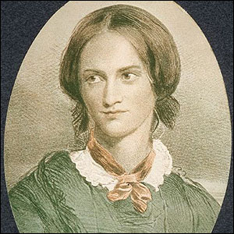
In 1824 the 4 oldest girls were sent to boarding school. Maria and Elizabeth died of tuberculosis and Charlotte and Emily were removed. For next six years they pursued their education at home. Charlotte returned to school in 1831.

Slide 6
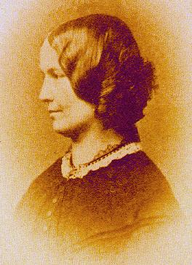
In 1839 she spent some months as governess in private families

Slide 7
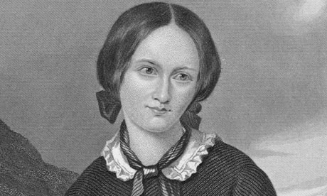
Her sister Emily died in 1849 leaving Charlotte alone with her father. Charlotte died in childbirth in 1855.

Slide 8
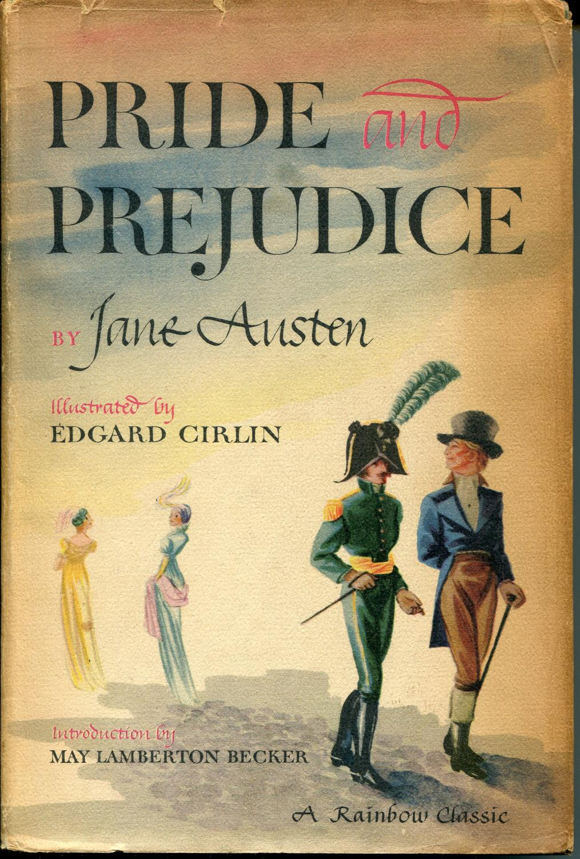
Pride and Prejudice is a novel of manners by Jane Austen, first published in 1813. The story follows the main character Elizabeth Bennet as she deals with issues of manners, upbringing, morality, education, and marriage in the society of the landed gentry of early 19th-century England.

Slide 9
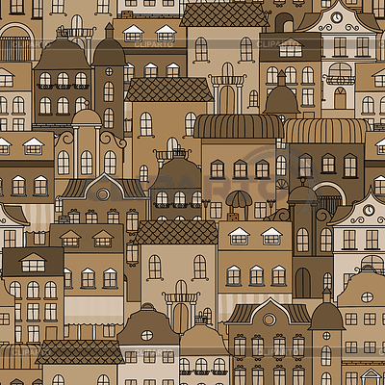
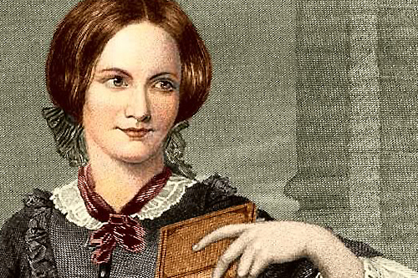
Charlotte Bronte

