Slide 1

Lady Gaga

Slide 2
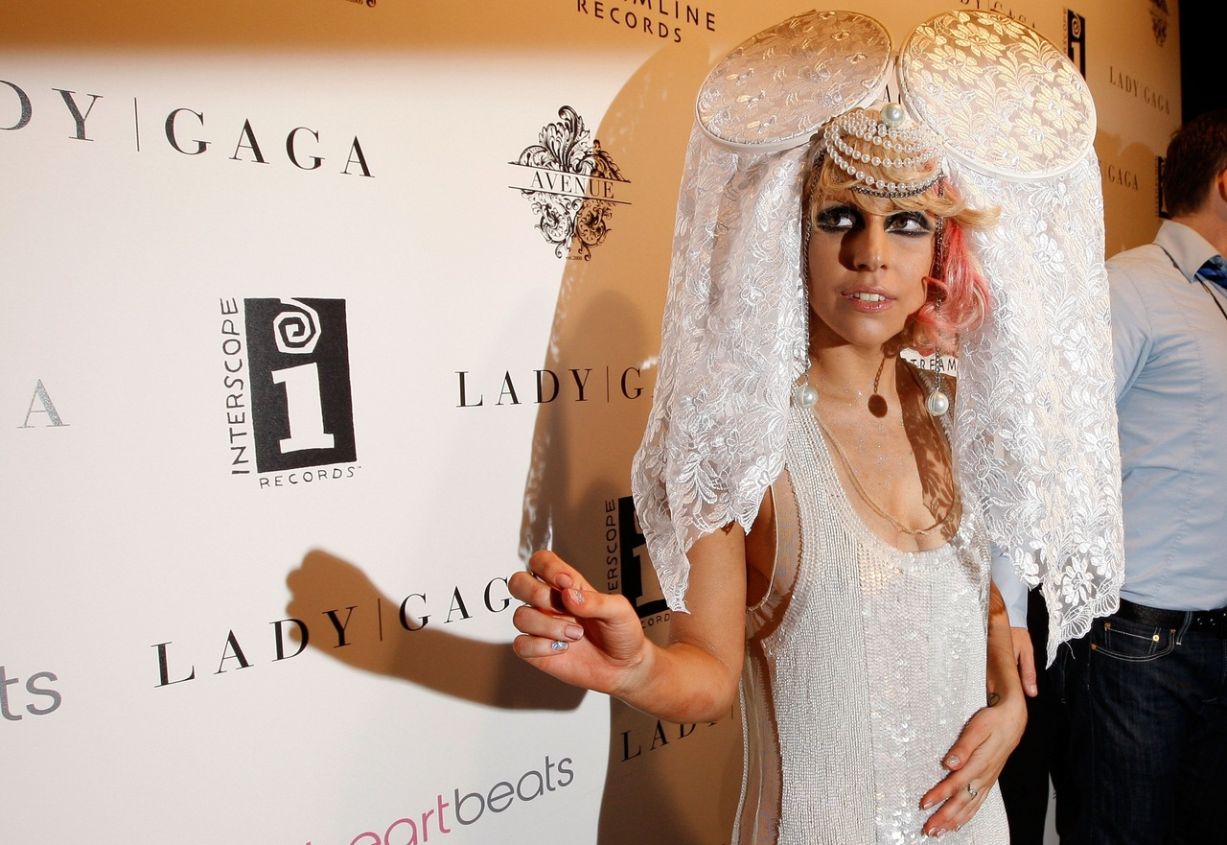
Lady Gaga may be considered the most controversial singer of our time because of the style of her clothes. Rate it most shocking sight costumes.

Slide 3
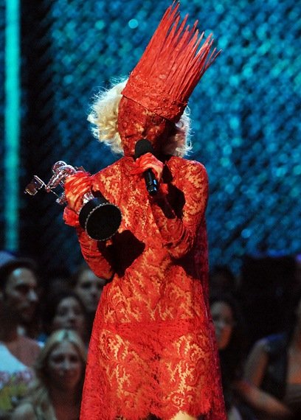

Slide 4
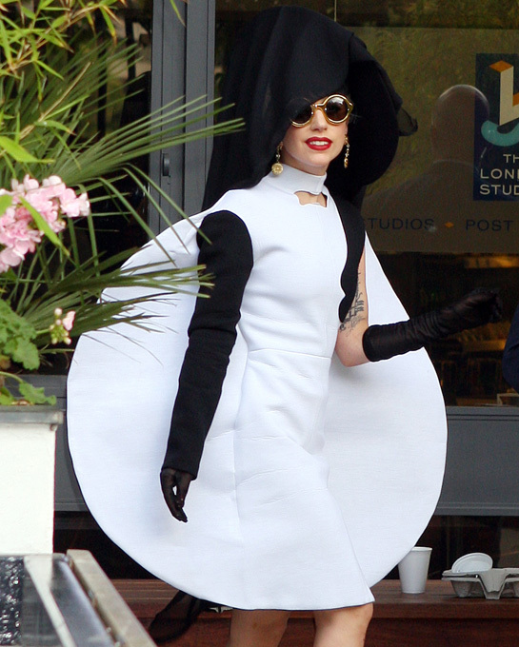
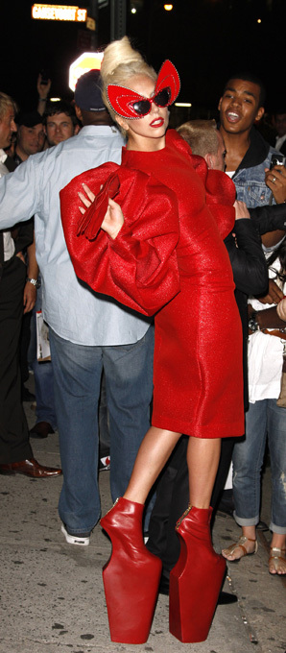

Slide 5
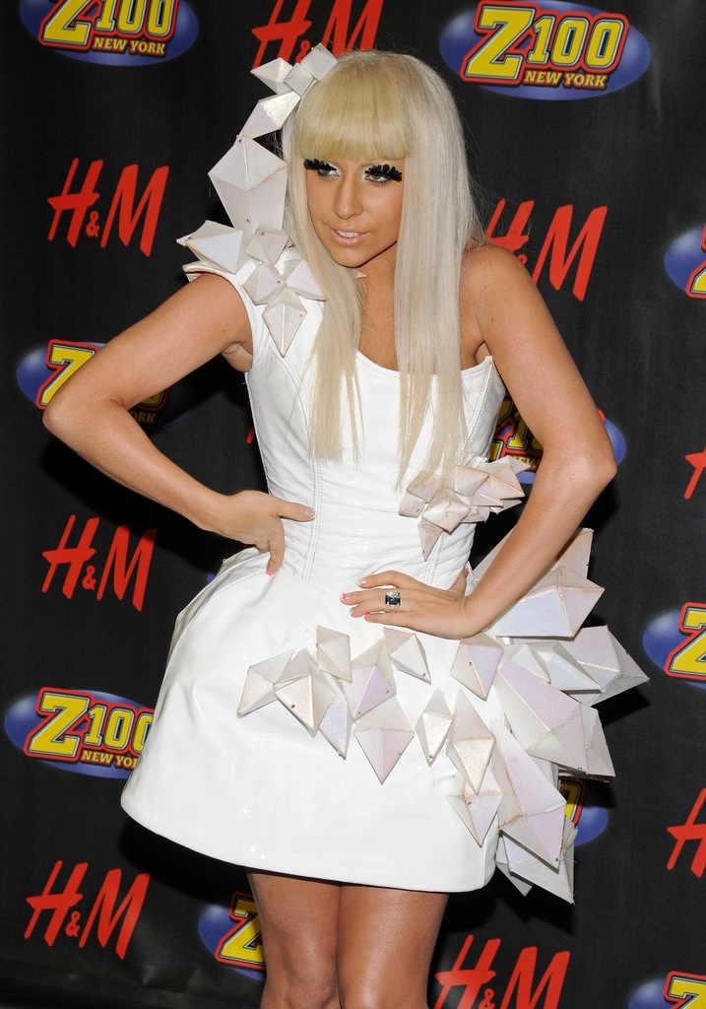
At the moment, Lady Gaga is the most popular of celebrities. It is full of unique and extravagant about anything to do with her music career.

Slide 6
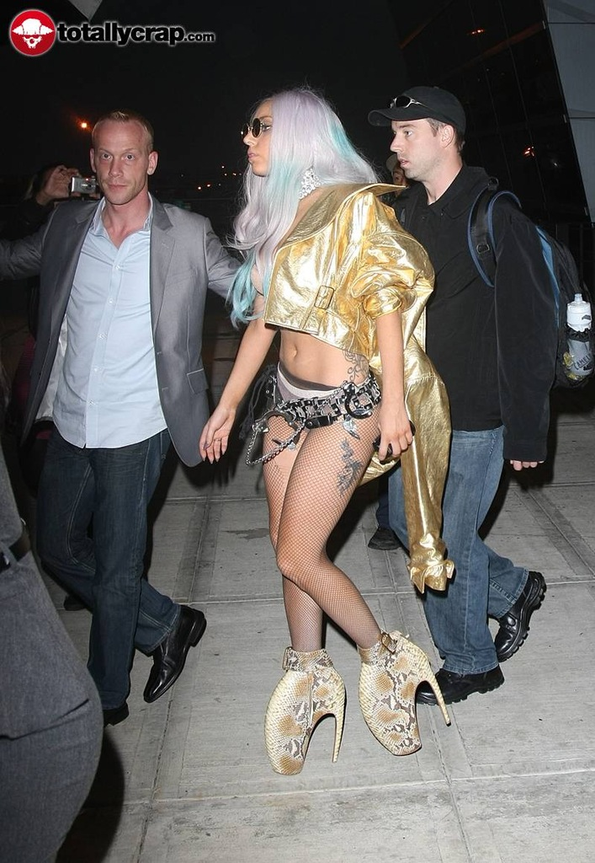
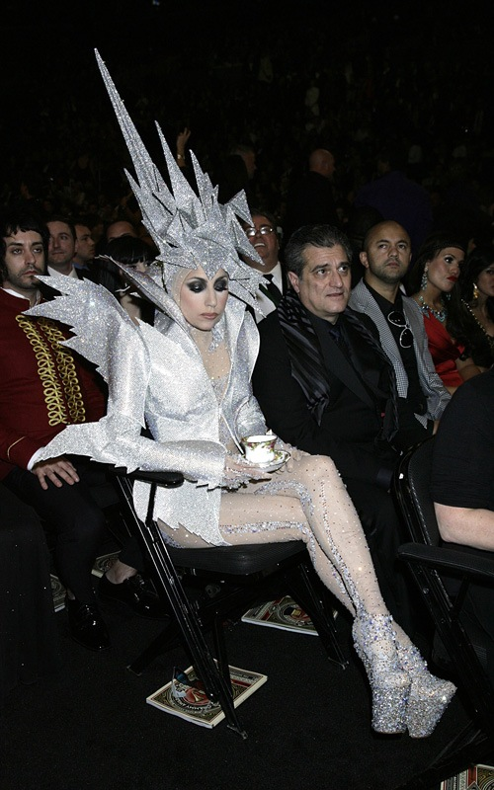

Slide 7
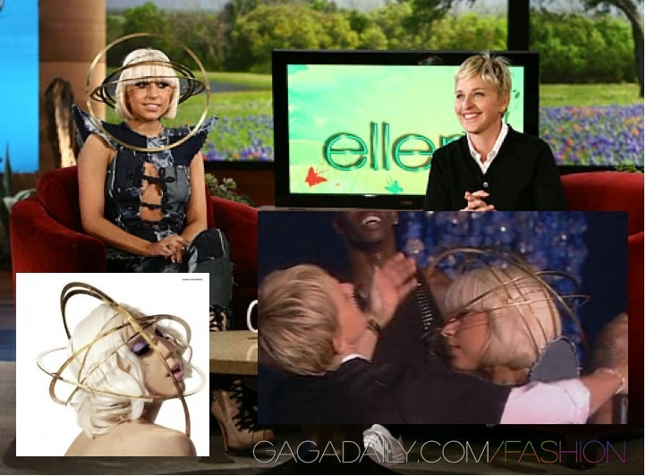

Slide 8
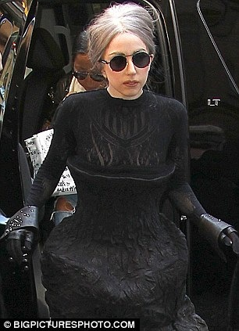
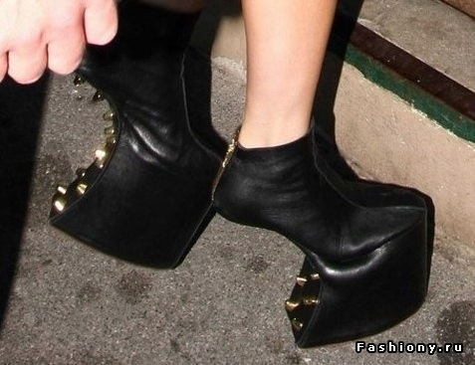
Lady Gaga has shocked people with her fashion choices, but for many it has become a fashion icon, a woman who likes to emphasize their individuality and challenging the society their clothes.

Slide 9
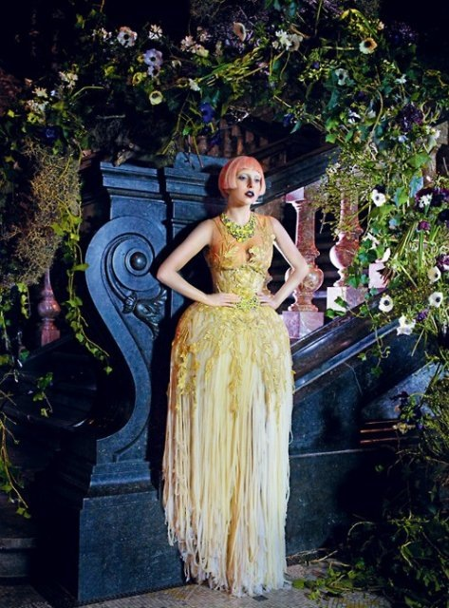

Slide 10
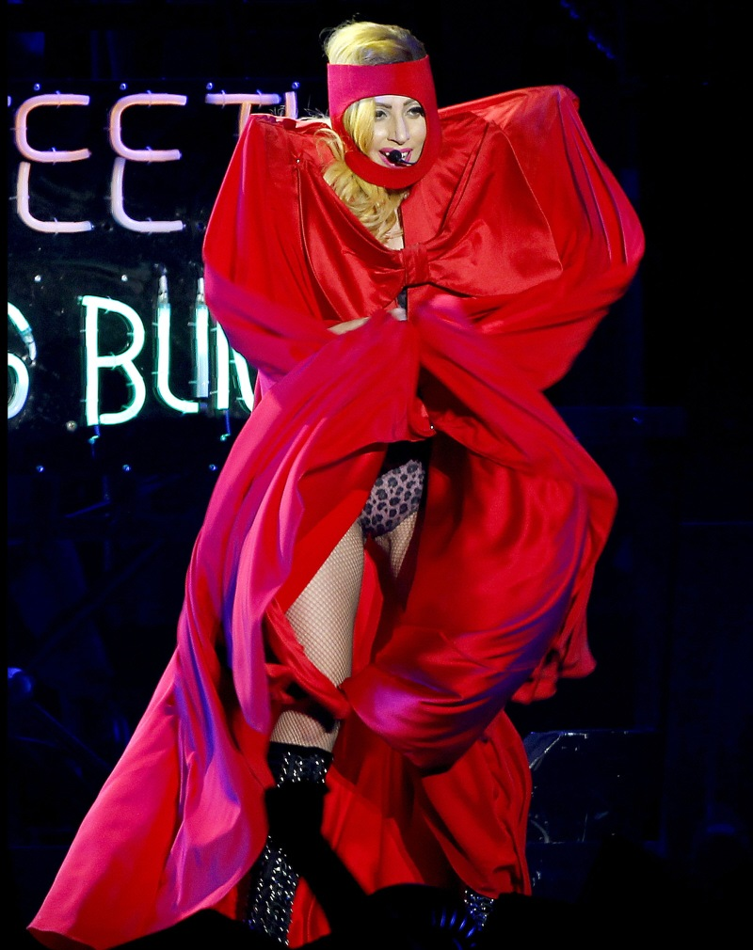

Slide 11
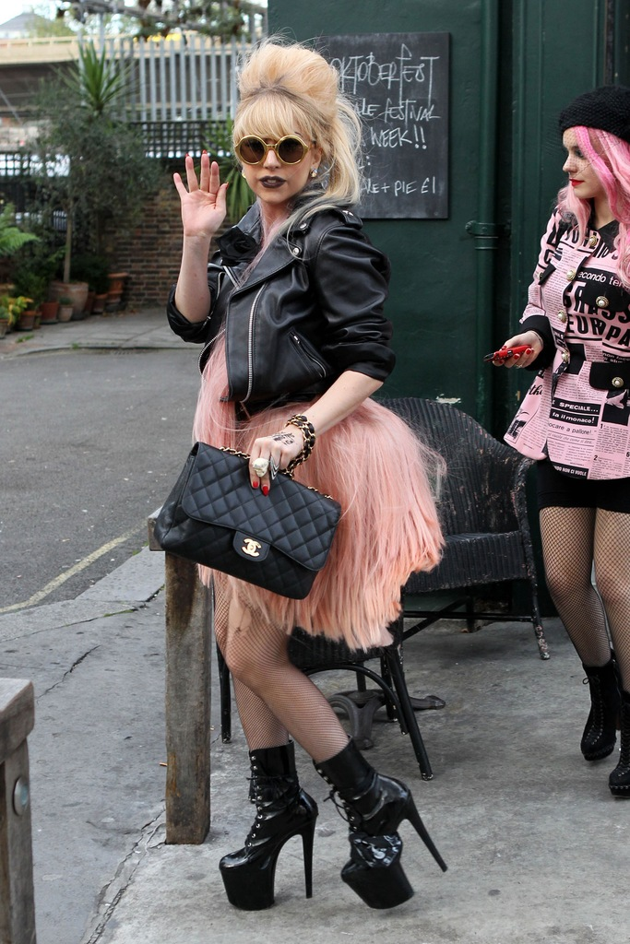
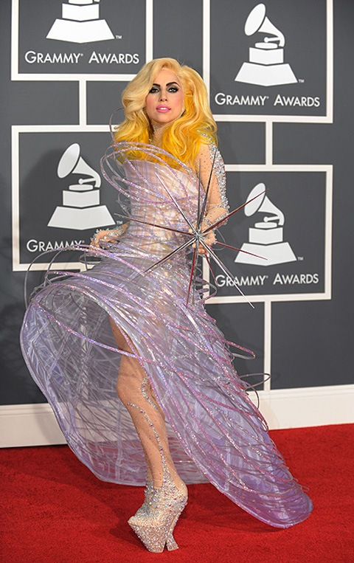
How many designers create clothing for the supernatural Lady Gaga!

Slide 12
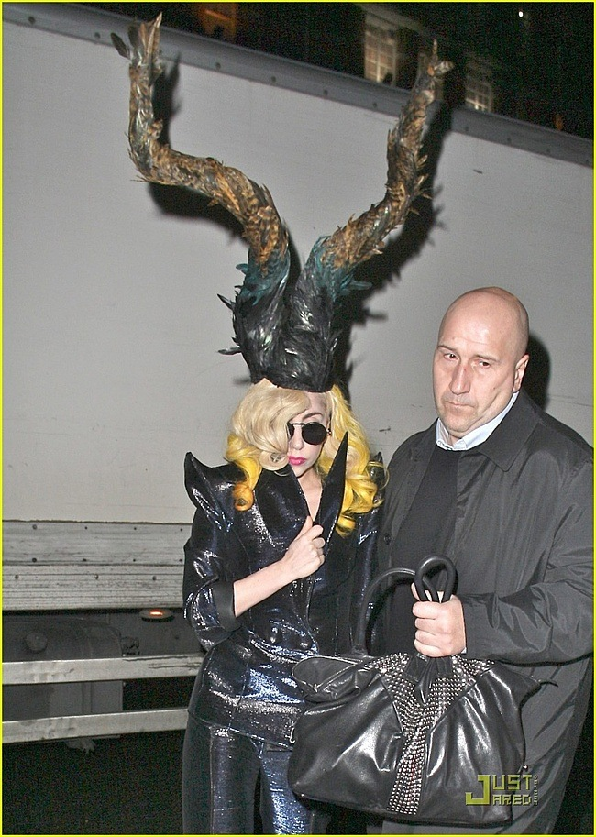

Slide 13
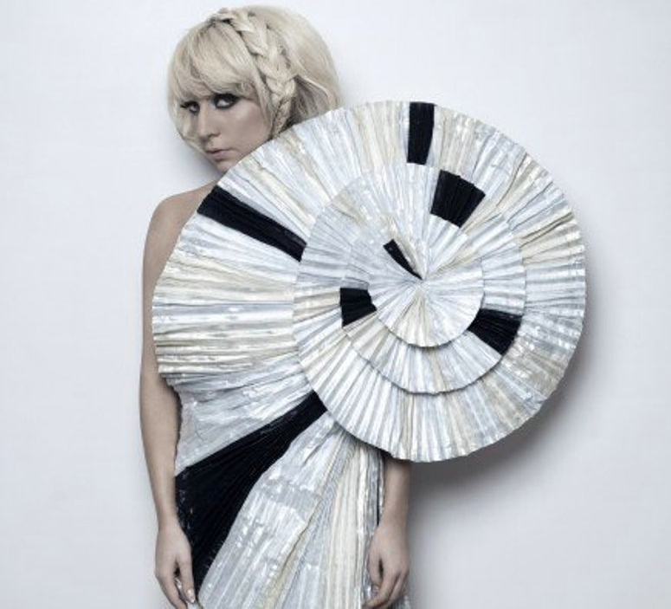
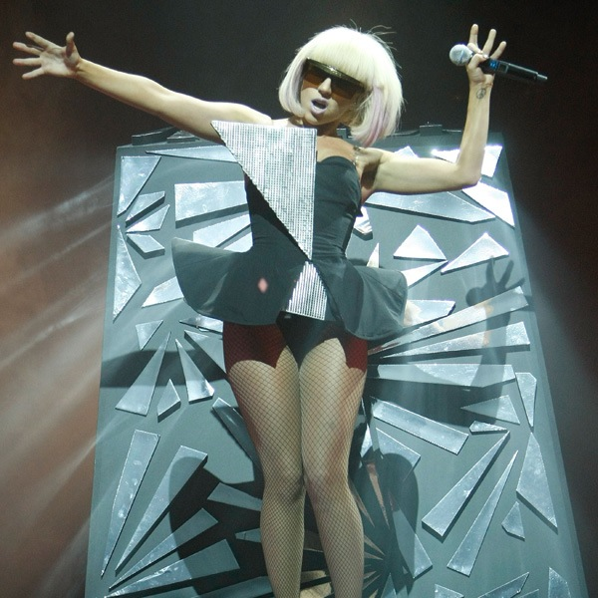
Since Lady Gaga is always shocking, even when everyone is convinced that there is nothing more striking, we made a "collection" the most unusual outfits Lady Gaga.

Slide 14
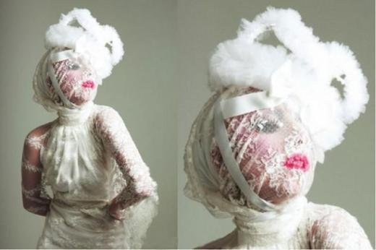

Slide 15
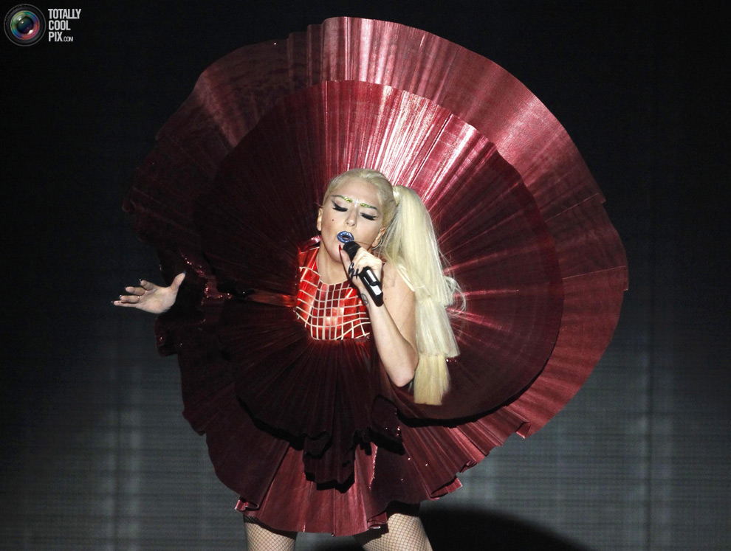

Slide 16
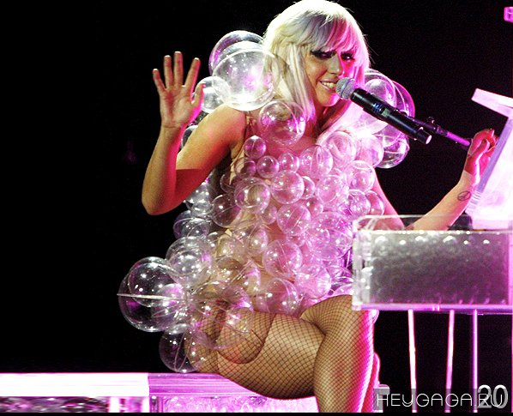

Slide 17
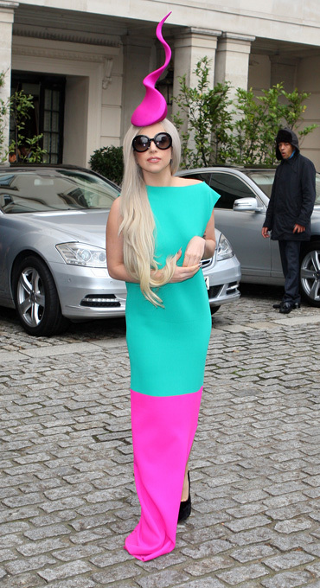

Slide 18
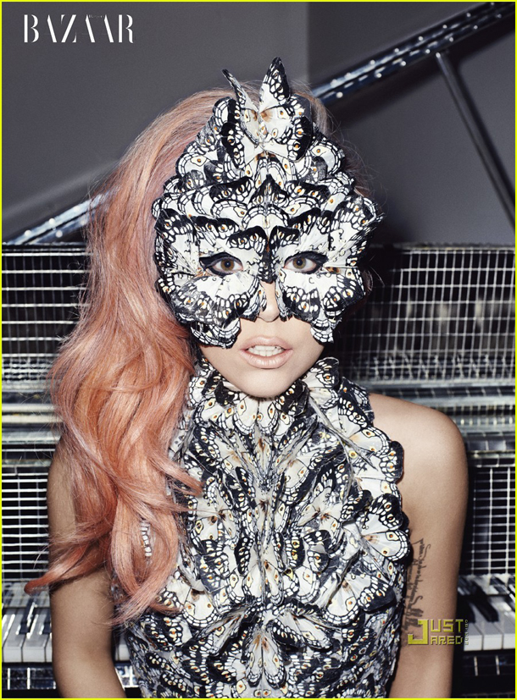

Slide 19
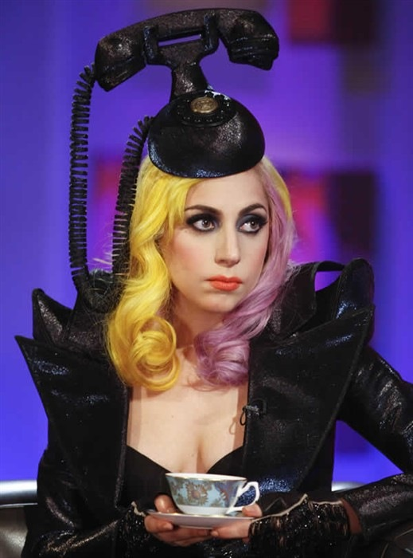

Slide 20
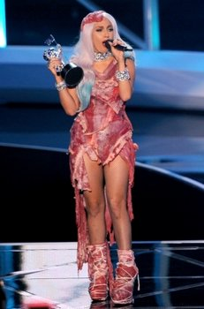
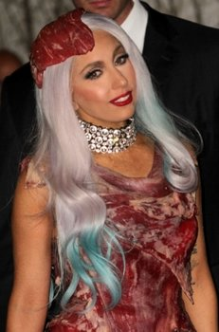
Lady Gaga costume for the MTV Video Music Awards 2010 again shocked the audience.

Slide 21
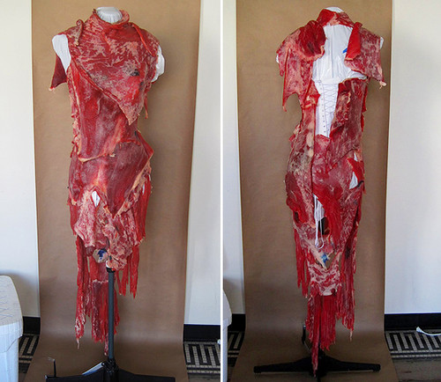
"Meat" dress Lady Gaga threw all by surprise! Shoes and dress look really incredible, because they were made of cloth, accurately simulating the pieces of raw meat.

Slide 22
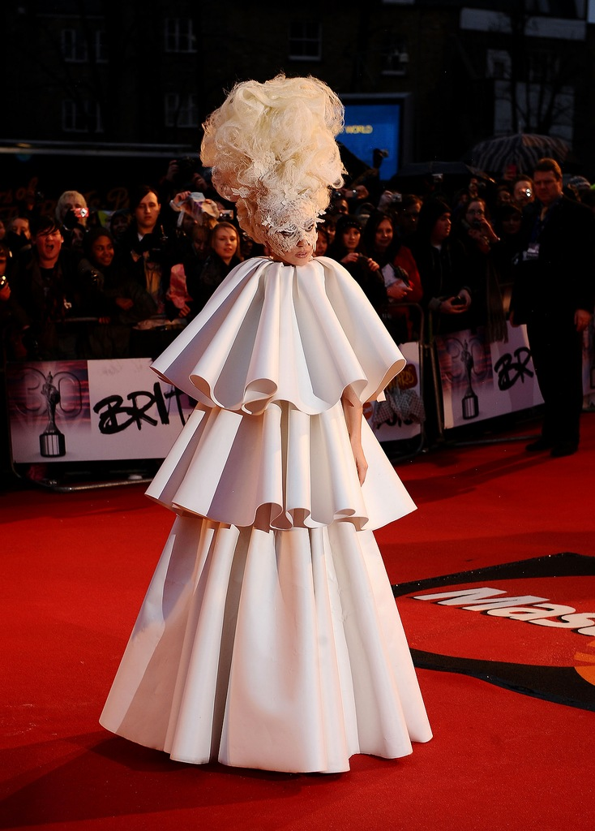
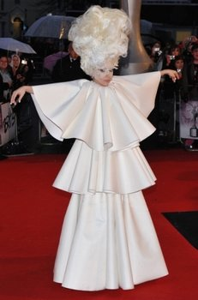
Another odd choice, but at the Award Ceremony British Awards 2010 - white dress, trench coat, which looked just awkward.

