Slide 1
Project entitled: ,,favorite book’’
Prepared:
Troyanovskaya tamila

Slide 2
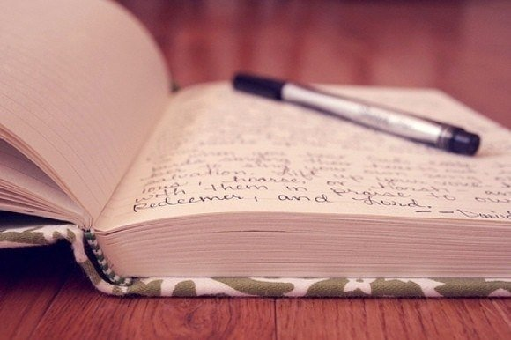
Books-a very nice treasure. The book teaches how to live in the world. The book can be read many interesting things. People read books from childhood. Book - source of knowledge.

Slide 3
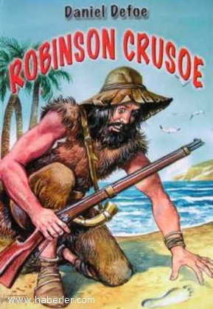
My favourite book is "Robinson Crusoe" by Daniel Defoe. D. Defoe (1660—1731) was a great master of realistic detail.

Slide 4
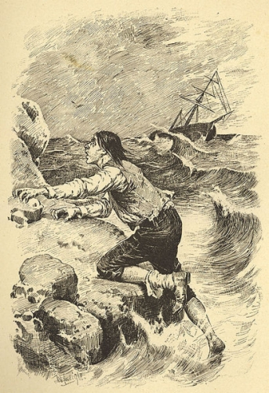
The novel "Robinson Crusoe" was written in 1719. The novel is praise to human labour and the triumph of man over nature.

Slide 5
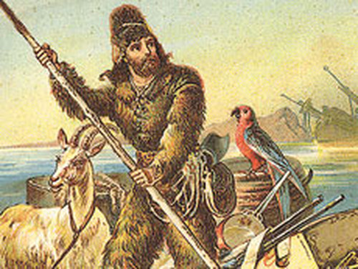
Defoe shows the development of his hero. At the beginning of the story we see an inexperienced youth, a rather frivolous boy, who then becomes a strong-willed man.
Robinson Crusoe's most characteristic trait is his optimism. His guiding principle in life become "never say die" and "in trouble to be troubled is to have your troubles doubled".
He had confidence in himself and in man. He believed it was within the power of man to overcome all difficulties. Crusoe was an enthusiastic worker and always hoped for the best.

Slide 6
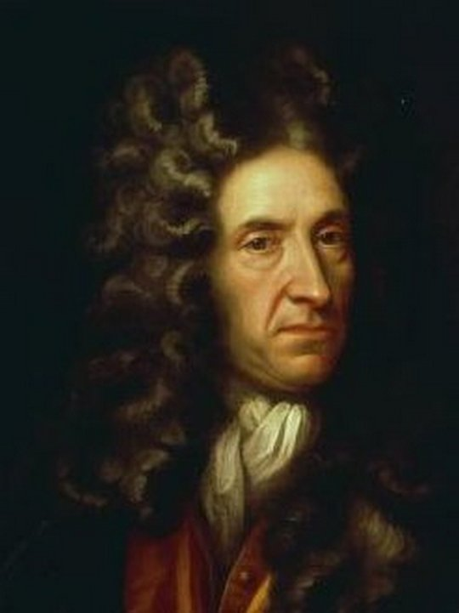
Defoe is a writer of the Enlightenment. He teaches people how to live, he tries to teach what's good and what's bad. His novel "Robinson Crusoe" is not only a work of fiction, an account of adventures, a biography and an educational pamphlet.

Slide 7
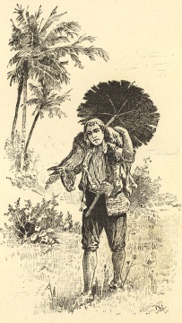
It is a study of man, a great work showing man in relation to nature and civilization as well as in relation to labour and private property.

Slide 8
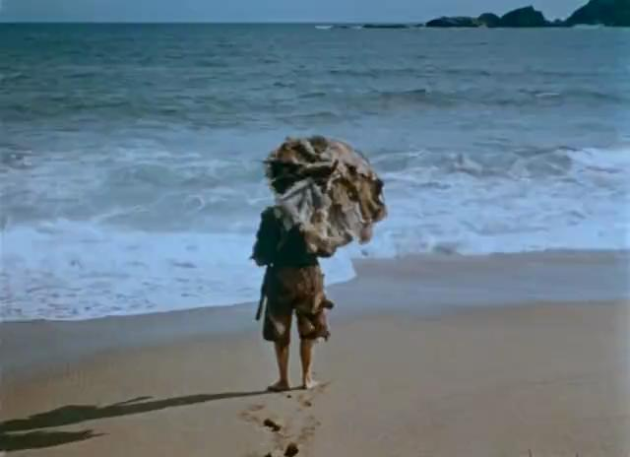
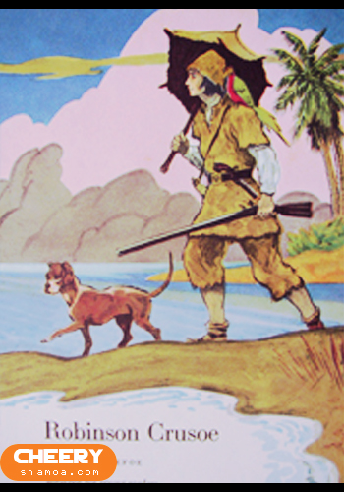
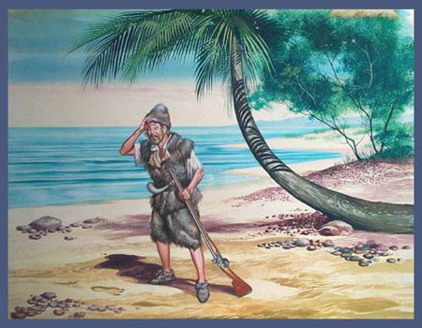

Slide 9
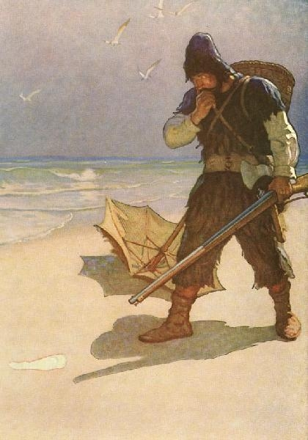
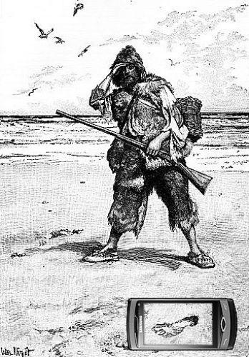

Slide 10
Thank you for attention!!!

