Slide 1
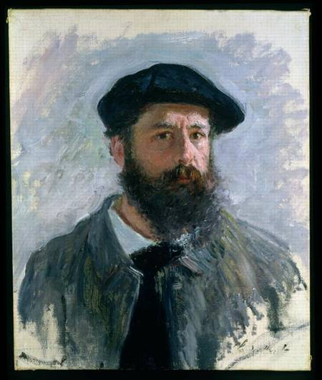
Claude Monet
Prepared
Pupil form10
Kolpakchi Yana

Slide 2
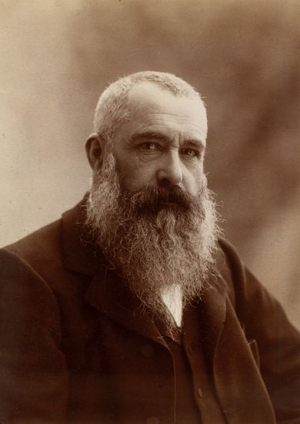
Oscar-Claude Monet (14.11.1840 – 5.121926) was a founder of French Impressionist painting and the most famous continuer of this direction.

Slide 3
From the late 1860s impressionists were met with rejection
At their first exhibition, held in April 1874, Monet exhibited his work, that were to give impressionist their good name.
"Impression, Sunrise". This picture was painted in 1872. the art critic Louis Leroy coined the term "Impressionism",as disparagement, but the Impressionists appropriated the term for themselves.

Slide 4
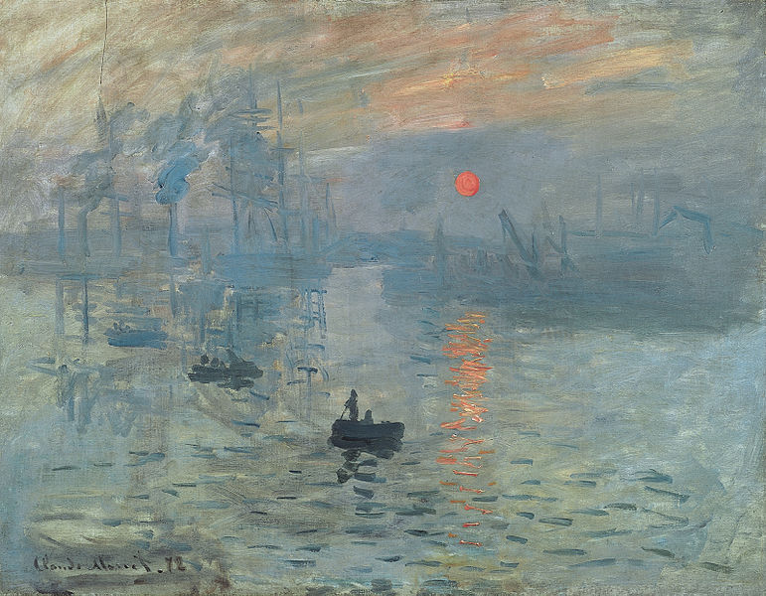
"Impression, Sunrise".

Slide 5
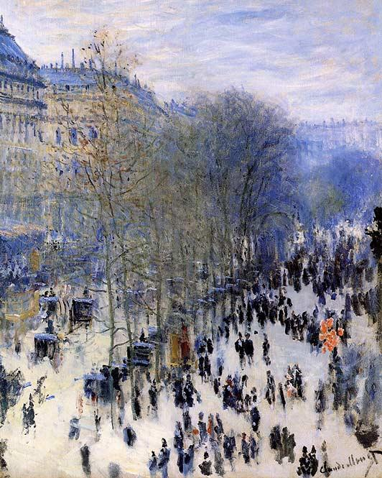
Claude Monet fought all his life for the right of existence of impressionism
The first Impressionist exhibition was held in 1874 at 35 boulevard des Capucines, Paris, from 15 April to 15 May. The primary purpose of the participants was promote a new style and free themselves from the constraints
Boulevard des Capucines

Slide 6
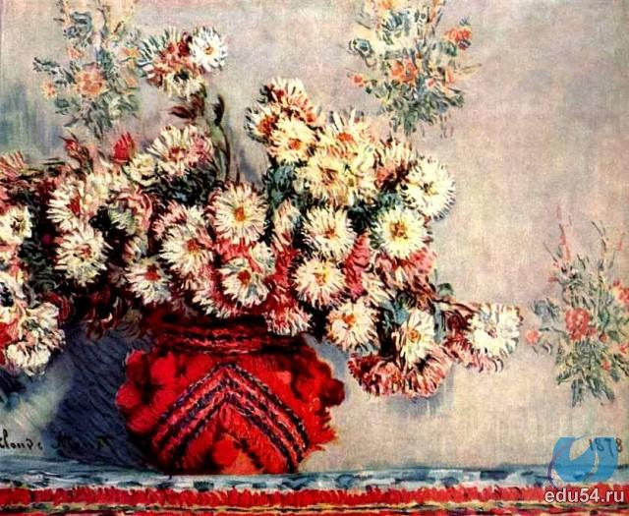
Claude Monet. Chrysanthemums

Slide 7
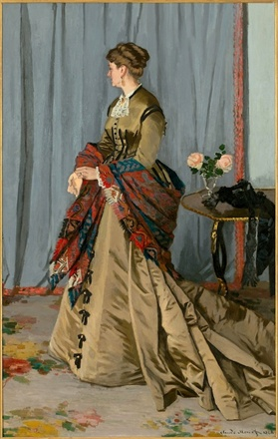
Claude Monet - Portrait of Mrs. Gaudibert

Slide 8
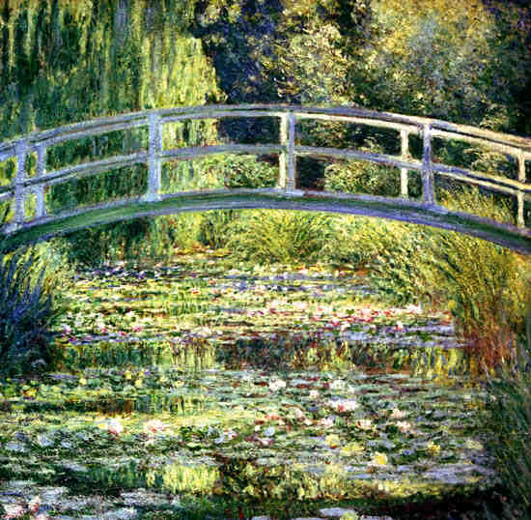
Claude Monet. Water Lily Pond.

Slide 9
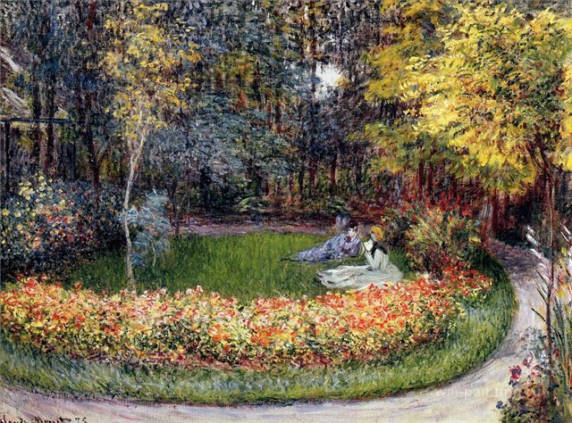
In the Garden by Claude Monet.

Slide 10
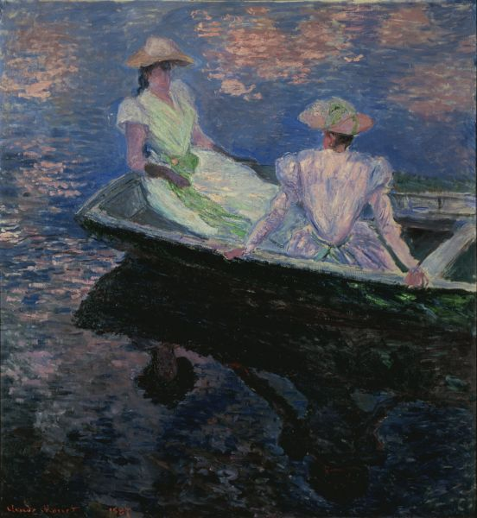
Young Girls in the Rowing Boat .Claude Monet.

Slide 11
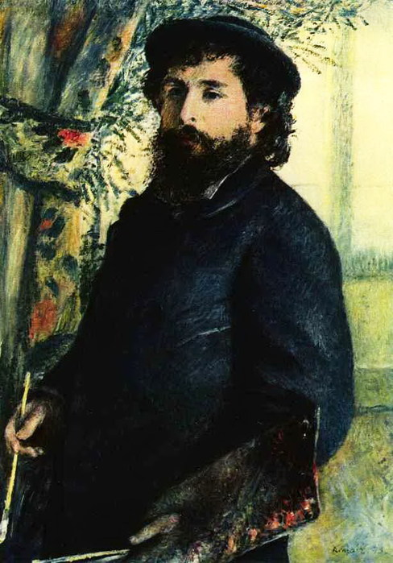
Claude Monet was a great artist, a fighter for the style that he created. I am confident that we will admire his paintings more than one century.
Pierre Auguste Renoir . Claud Monet

